Slide 1
VM CONSOLIDATION ALGORITHM FOR ENERGY EFFICIENCY AND QUALITY OF SERVICE
PANIMALAR ENGINEERING COLLEGE
DEPARTMENT OF INFORMATIONTECHNOLOGY
S.MANIKANDAN
M.S.V. GUNASEELAN
J. HARSHAN
ANU SHERLY

Slide 2
ABSTRACT
In this research paper, we propose a standard priority seek set of rules for assignment execution and an evaluation with FCFS and spherical-robin scheduling.
The proposed version is based totally on queuing fashions. Directing incoming requests into a minimal workload reduced workload, reaction time, and common queue duration. These consequences display that our version can growth the use of the worldwide agenda and reduce the latency.
We advocate a heterogeneous useful resource allocation technique called Skewness avoidance multi-resource allocation (SAMR) to allocate assets primarily based on specific necessities for exclusive styles of assets.
We will exhibit the pretty low complexity of our version approach for practical and correct evaluation paintings. Extensive simulation effects show SAMR's effectiveness and overall performance blessings over peers.

Slide 3
INTRODUCTION
Cloud computing is a vital part of advanced computing systems. The concepts of computing, generation and structure have evolved and consolidated in current decades.
Many systems are concern to technological development and revolution. Cloud computing is a computing era this is unexpectedly gaining ground as the subsequent step in growing and deploying more than one disbursed applications. To get the most price out of cloud computing, developers must increase equipment that optimize the use of architectures and deployment paradigms. .
Cloud computing structure has 3 levels for software that calls for on-call for services over the Internet. The principal purpose is to schedule tasks for digital machines in a timely manner, which includes determining the appropriate collection wherein tasks can be accomplished, given the limits of the transaction account. Planning for cloud computing is a complicated commercial enterprise.
To solve this problem, we will proposed some green scheduling algorithms.

Slide 4
EXISTING SYSTEM
This paper focuses on the design and implementation of several online algorithms to optimize the VM scheduling in such a queuing cloud system, aiming at minimizing the delay performance of all jobs over time. The main contributions of the paper are as follows.
We formulate the delay-optimal scheduling of VMs as a decision-making process by using a feasible VM configuration to present the physical resource requirements.
A low-complexity online scheme is proposed to determine the solutions by buffering arriving jobs with the shortest-job-first (SJF) policy and scheduling them with the min-min best fit (MMBF) algorithm.
To avoid the potential of job starvation in the first scheme, another scheme that combines the SJF buffering and reinforcement learning (RL)-based scheduling algorithms is further proposed.
Simulations are carried out to validate the efficiency of the proposals.

Slide 5
DISADVANTAGES OF EXISTING SYSTEM:
Low complexity.
In existing system, It will take more time for execution.

Slide 6
PROPOSED SYSTEM:
In this research paper we presented a Generalized Priority algorithm for efficient execution of task and comparison with FCFS and Round Robin Scheduling.
we mainly discuss three algorithm we developed a new generalized priority based algorithm with limited task, future we will take more task and try to reduce the execution time as presented and we develop this algorithm to grid environment and will observe the difference of time in cloud an grid.
We propose a heterogeneous resource allocation approach, called skewness-avoidance multi-resource allocation (SAMR), to allocate resource according to diversified requirements on different types of resources. Our solution includes a VM allocation algorithm to ensure heterogeneous workloads are allocated appropriately to avoid skewed resource utilization in PMs, and a model-based approach to estimate the appropriate number of active PMs to operate SAMR.

Slide 7
ADVANTAGES OF PROPOSED SYSTEM:
The main advantage of job scheduling algorithm is to achieve a high performance computing and the best system throughput.
In proposed system, It will take less time for execution.

Slide 8
LITERATURE SURVEY
S.NO | TITLE | AUTHOR | TECHNIQUE | RESULT | LIMITATION
1 | Better never than late: Meeting deadlines in datacenter networks | C.Wilson, H.Balani, T.Karagianis, A.Rowton | From a technical perspective, we have strived to restrict the state maintained and the processing done by a D3 router to a bare minimum. | It explicitly deals with the challenges of the datacenter environment- small RTTs and a bursty, diverse traffic mix with widely varying deadlines. | These problems have placed artificial limitations on application design, with designers resorting to modifying application workflow to address the problem.
2 | The Benefits of a Disaggregated Data Centre: A Resource Allocation Approach | A. D. Papaioannou, R. Nejabati, and D. Simeonidou | Researchers have also focused on the network requirements in order to support disaggregated data centres [1] [2], and have indicated the need for a unified resource management software in order to take advantage of disaggregation. | The results suggest that MCRVMP placements improve the data centre scalability and support time-varying traffic demands. | In a real data centre scenario, the pattern of incoming VM requests and their requirements are not known, and the scheduling software should be able to adapt and take the best possible decision in real-time.

Slide 9
S.NO | TITLE | AUTHOR | TECHNIQUE | RESULT | LIMITATIONS
3 | Towards understanding uncertainty in cloud computing resource provisioning | A. Tchernykh, U. Schwiegelsohn, V. Alexandrov, and E. ghazali Talbi | Their analysis quantifies the effect of input random variables on model outputs. It is an integral part of reliabilitybased and robust design. The efficiency and accuracy of probabilistic uncertainty analysis is a tradeoff issue. | The main results on the problems with random processing times, due dates machine breakdownsconsidering different objective functions both regular, which are non decreasing functions of job completion time, and nonregular such as expected weighted earliness tardiness. | It has many drawbacks, especially in the areas of security, reliability, performance of both computing and communication, to list just a few. They are strengthened by the uncertainty, which accompanies all of these shortcoming

Slide 10
S.NO | TITLE | AUTHOR | TECHNIQUE | RESULT | LIMITATIONS
4 | A scheduling strategy on load balancing of virtual machine resources in cloud computing environment | J. Hu, J. Gu, G. Sun, and T. Zhao | The current virtual machine(VM) resources scheduling in cloud computing environment mainly considers the current state of the system but seldom considers system variation and historical data, which always leads to load imbalance of the system. In view of the load balancing problem in VM resources scheduling | that after using the algorithm, the loads of every node basically tend to be balanced and the system load variation is smaller than . Therefore we can conclude that the algorithm has fairly good global astringency and can converge to the best solution in a very short time. | Complexity Cost Can be Skewed Lack of Flexibility

Slide 11
S.NO | TITLE | AUTHOR | TECHNIQUE | RESULT | LIMITATION
4 | A hybrid metaheuristic algorithm for vm scheduling with load balancing in cloud computing | K.-M. Cho, P.-W. Tsai, C.-W. Tsai, and C.-S. Yang | Techniques like Min-Min, Round Robin and FCFS for load balancing. He proposed an intelligent method for load balancing. Proposed novel model improve cloud computing performance by balancing data distribution in dataintensive applications, like distributed data mining. | The results given by the proposed work is much better than the other methods used previously. Performance analysis performed only by using limited number of jobs and resources. | A general disadvantage of all static schemes is th selection of a host for process allocation is made when the process is created and cannot be changed during process execution to make changes in the system load.

Slide 12
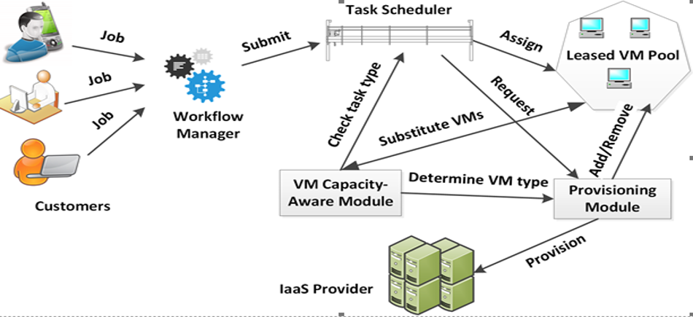
SYSTEM ARCHITECTURE

Slide 13
MODULES
Service and VM scheduling
Analysis
Results

Slide 14
SERVICE AND VM SCHEDULING
A scheduling framework can be implemented by using different parameters. Good scheduling framework should include the following specifications. It must focus on:
Load balancing and energy efficiency of the data centers and virtual machines.
Quality of service parameters calculated by the user which contain execution time, cost and so on.
It should satisfy the security features.
Fairness resource allocation places a vital role in scheduling.
ANALYSIS:
In this module, we mainly discuss SAMR algorithm we developed a new generalized priority based algorithm with limited task, future we will take more task and try to reduce the execution time as presented and we develop this algorithm to grid environment and will observe the difference of time in cloud an grid.
RESULTS
In this module, result indicate that our model increase utilization of global scheduler and decrease waiting time. And also indicated that model decrease waiting time at global scheduler in cloud architecture.

Slide 15
CONCLUSION
Design of a resource management system for cloud computing services, implementation and it presented and evaluated. Based on the changing demands of adaptively multiplexing physical resources, a system of virtual us.
As appropriate to the capacity of the server is fully utilized, this are using a Skewness metric that combines the VM resources and different characteristics. The algorithm has been achieved both of green computing for a system with multi-resource constraints and avoid overload.

Slide 16
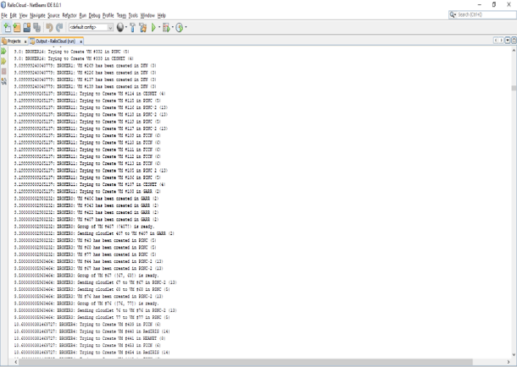
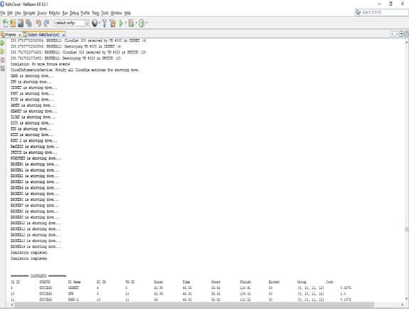
SCREENSHOTS:

Slide 17
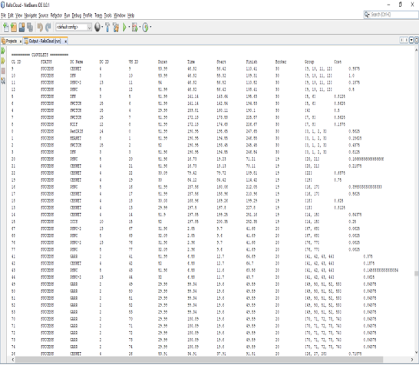
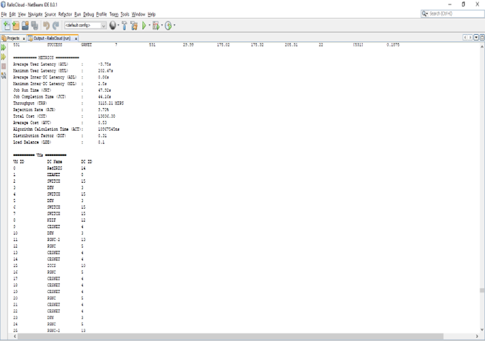

Slide 18
REFERENCES:
[1] C. Wilson, H. Ballani, T. Karagiannis, and A. Rowtron, “Better never than late: Meeting deadlines in datacenter networks,” SIGCOMM Comput. Commun. Rev., vol. 41, no. 4, pp. 50–61, 2011.
[2] A. D. Papaioannou, R. Nejabati, and D. Simeonidou, “The benefits of a disaggregated data centre: A resource allocation approach,” in Proc. IEEE GLOBECOM, pp. 1–7, Dec 2016.
[3] A. Tchernykh, U. Schwiegelsohn, V. Alexandrov, and E. ghazali Talbi, “Towards understanding uncertainty in cloud computing resource provisioning,” in Proc. ICCS, pp. 1772–1781, 2015.
[4] J. Hu, J. Gu, G. Sun, and T. Zhao, “A scheduling strategy on load balancing of virtual machine resources in cloud computing environment,” in Proc. PAAP, pp. 89–96, 2010.
[5] K.-M. Cho, P.-W. Tsai, C.-W. Tsai, and C.-S. Yang, “A hybrid metaheuristic algorithm for vm scheduling with load balancing in cloud computing,” Neural Comput. Appl., vol. 26, no. 6, pp. 1297– 1309, 2015.
[6] S. Rampersaud and D. Grosu, “Sharing-aware online virtual machine packing in heterogeneous resource clouds,” IEEE Transactions on Parallel and Distributed Systems, vol. 28, pp. 2046–2059, July 2017.
[7] S. S. Rajput and V. S. Kushwah, “A genetic based improved load balanced min-min task scheduling algorithm for load balancing in cloud computing,” in 2016 8th International Conference on Computational Intelligence and Communication Networks (CICN), pp. 677–681, 2016.

