Slide 1

PANIMALAR ENGINEERING COLLEGE AN AUTONOMOUS INSTITUTION DEPARTMENT OF INFORMATION TECHNOLOGY
IT8611 Mini Project Project Review
III year/VI sem
WAREHOUSE AUTOMATION SYSTEM
Team members
TERESA MARY DELICIA.M(211420205167)
YESHWANTHI.G(211420205183)
YUVASRI.R.J(211420205187)

Slide 2
Abstract
To help e-commerce websites and wholesale distributers manage warehouse operations and processes associated with it .
The system automates everything like resource utilization, supply chain management and automatic object (goods) detection or recognition using Artificial Intelligence.
Setting up and renting temporary and local rooftop warehouses to reduce the transportation cost, and to minimize transportation time, Setting up local warehouses will ensure fastest delivery of goods (Pharmaceuticals or Groceries).
In some locations the warehouse can act as both storage unit and retail stores for developing Business opportunities.
System improves forecasting and demand planning, to reduce stockouts and overstocking by updating sales records on daily basis and report productivity
Enterprise applications like Payment,Goods ordering are embedded inside the project

Slide 3
Existing System
The existing system lacks operational efficiency, it does not have inventory visibility and require manual object detection, it also requires additional hardware utilities. The existing system has a central warehouse and not local warehouses which leads to service time delay. Thus the existing system lacks effective time management.
The existing systems does not benefit the local retail units as there is no link between the E-commerce sites and local Retail shops.
The existing system lack enough storage facilities as it mainly depends only on the central Warehouse

Slide 4
PROPOSED SYSTEM
For fast and efficient management of warehouse operations, we are building a software application integrated with AI for object detection and product recognition. This application allows e-commerce website to rent locally available storage areas and this application automates daily warehouse operations like supply chain management.

Slide 5
Proposed System
Automatic object detection can be used to identify and track goods, and to improve the accuracy of inventory management. It involves the use of Yolo algorithm and Java programs to automatically detect objects or materials of interest in an image or video.
Warehouses in Retail Units are a type of storage space that is located within a Retail store. This system allows Retail units to rent their free space to E-commerce sites which offer businesses a unique opportunity to sell their products directly to customers through the software in a large and retailers get paid for their storage facility and E-commerce sited get benefitted by fastest delivery.
Rooftop warehouses are rented in urban areas where land is scarce and expensive, and where businesses need additional storage space.

Slide 6
LITERATURE SURVEY
1.Chen Chen 1., Warehousing is the top priority in logistics. Intelligent logistics is an important link linking customer, supply chain and manufacturing industry. Warehousing management balances all aspects of logistics operation imbalance, which integrates the whole process of logistics operation. It is the design goal of the warehouse management system (WMS) to find the best solution to solve all kinds of contradictions in the warehouse under certain hard conditions.(Design of automated warehouse system-2018).
2.Kamali-(design of a reference architecture for developing a smart warehouse in industry 4.0-2020) Their focus was not the design of a reference architecture, but the development of an IoT-based system. They implemented a smart warehouse management system that uses optimization algorithms and artificial intelligence techniques. Stock planning, product placement, transferring to pick zones, order picking, transport, and tracking features were realized in this system. Barcodes were attached to the racks, and vehicles were tracked using the GPS module.

Slide 7
3.Design of Warehouse Control System For Automated Warehouse Environment(2016 5th IIAI International Congress on Advanced Applied Informatics).Dong Woo Son-Warehouse Control System-A number of material handling equipment can be integrated with WCS through an integrated interface. Equipment in the warehouse can be managed and controlled with it.
4.Yao et al. (2014) designed an intelligent warehouse control system that has the following components: event-handling system, wireless sensor network system, and intelligent control system. Zigbee technology was used in the wireless sensor network system. The temperature and humidity of the warehouse were monitored and controlled based on this system. He then proposed a web-oriented architecture for communication of objects in the warehouse, and the REST framework was used as the basis of communication between objects. Also most of companies do not provide flexible user interface (UI), good visibility on the warehouse, and functionality for lifecycle management of equipment. It is considered that maintenance system should provide such capabilities with generic capabilities.

Slide 8
5.A Multiple Object Tracking Algorithm Based on YOLO Detection (2021)
Xu Dong-2018 11th International Congress on Image and Signal Processing, Bio Medical Engineering and Informatics -Computer vision and related fields, such as smart monitoring, human-computer interaction, and virtual reality, require multi-target tracking. By locating and finding the most similar candidate target areas, multiple targets can be tracked efficiently in an image sequence.
6.Md. Bahar UllahA Real Time Object Detection .Algorithm(2020 IEEE Region 10 Symposium (TENSYMP), 5-7 June 2020, Dhaka, Bangladesh) -An early detection of an object in real time can be helpful in determining the cause, detecting vehicles, traffic control, CCTV monitoring, etc. The ability to give vision to a computer therefore depends on day-to-day progress in technology. So, low-cost technology and learning tools are in high demand

Slide 9
Requirements of the Project
Software Requirement:
Windows 10
HTML,CSS
Java ,JSP
MYSQL,Eclipse
Open CV
Hardware Requirement
Processor: Minimum 1 GHz
Memory (RAM): 4 GB
Hard Drive: 32 GB
Internet Connection

Slide 10
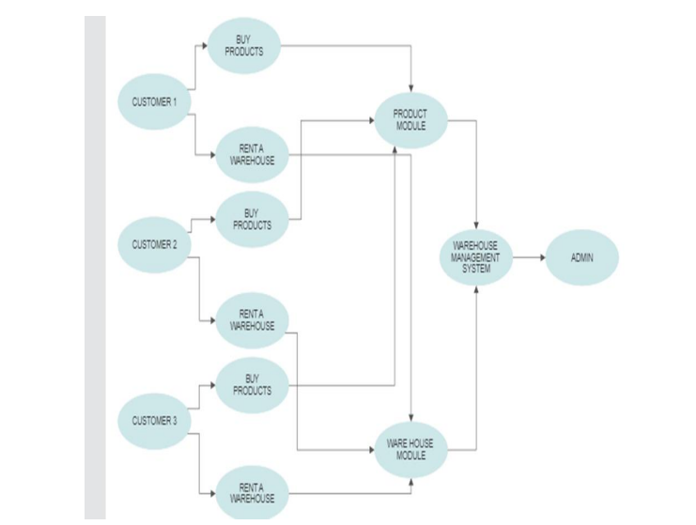
Architecture Design

Slide 11
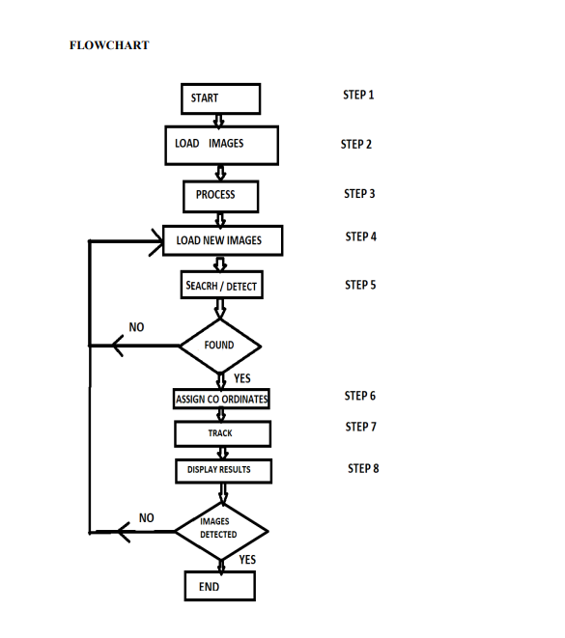

Slide 12
Modules of the Project
Rent warehouse module:
The customer will we able to rent out the their warehouse by selecting the type of warehouse, by entering the address of warehouse and selecting the renting period of the warehouse. Selecting the capacity of the Warehouse.
• Select type of warehouse
• Select address of warehouse
Object Detection module:
The Object detection Module Can be used by the customer/Retailer to detect products and Add products to his warehouse.
• Detect products
• Add products to Warehouse
My cart module:
User also can add any products to his cart in warehouse By adding items to Cart ,Remove items from the cart, He can also increase and decrease the Quantity in the cart
Add items to cart
Remove items from cart
Increase/decrease quantity

Slide 13
Admin Modules:
Send Goods module:
The Admin will be able to send Products to Warehouses and make payment to the warehouses to the customers
Send Products to warehouse.
Make payment.
All warehouses module:
Admin will be able to view all the warehouses and view details of the warehouse
View all warehouses available.
View details of warehouses.
Make Payment Module:
Admin will be able to send payment to the retail owners
Selecting the Payment Gateway.
Pay depending on the capacity

Slide 14
Result discussion
Better integration of warehouse management systems with other systems, such as enterprise resource planning (ERP) systems, to ensure a seamless flow of information between different systems. Warehouse automation systems are computer-controlled systems that automate various processes in a warehouse to improve efficiency, accuracy, and productivity. The main goal of a warehouse automation system is to streamline the flow of goods and information throughout the warehouse, from receiving to shipping.

Slide 15



SOURCE INPUT IMAGE
OBJECT TO BE DETECTED
OUTPUT

Slide 16
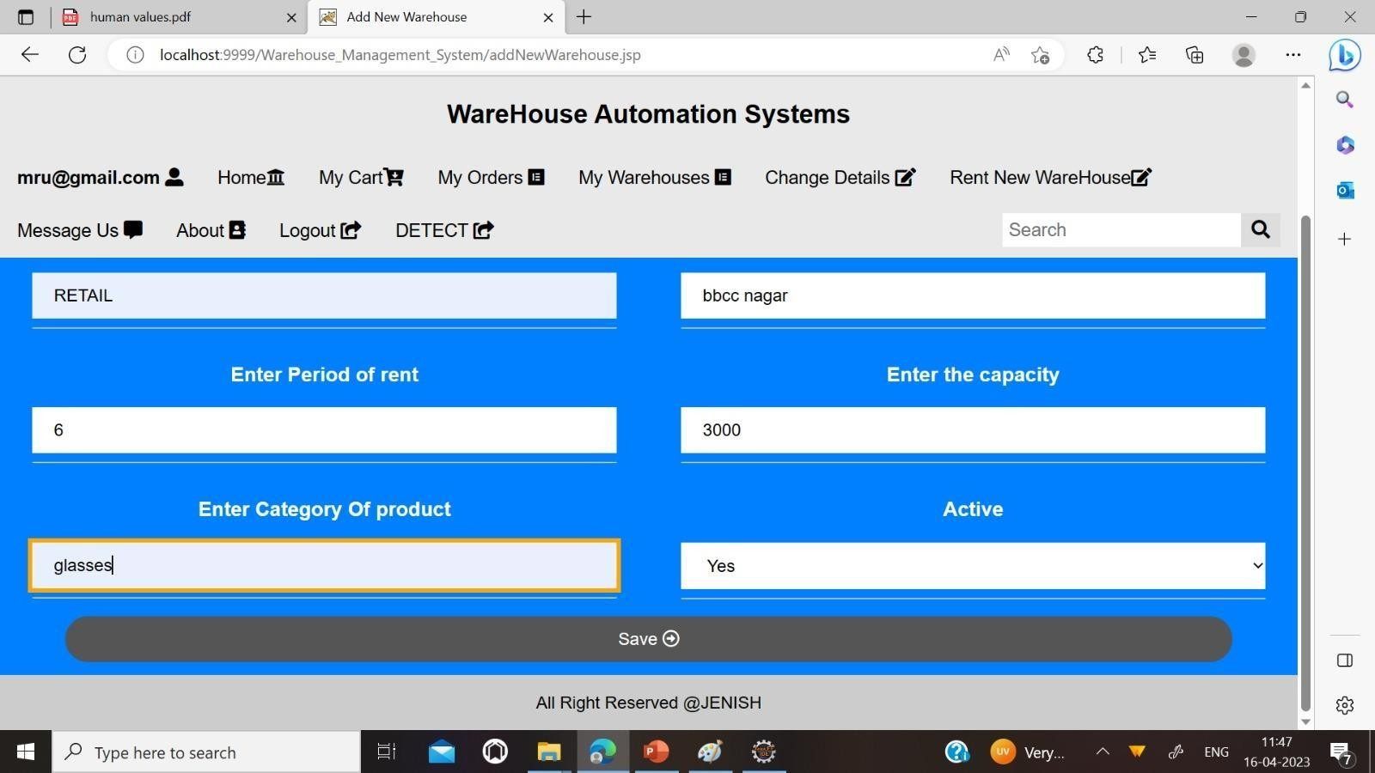
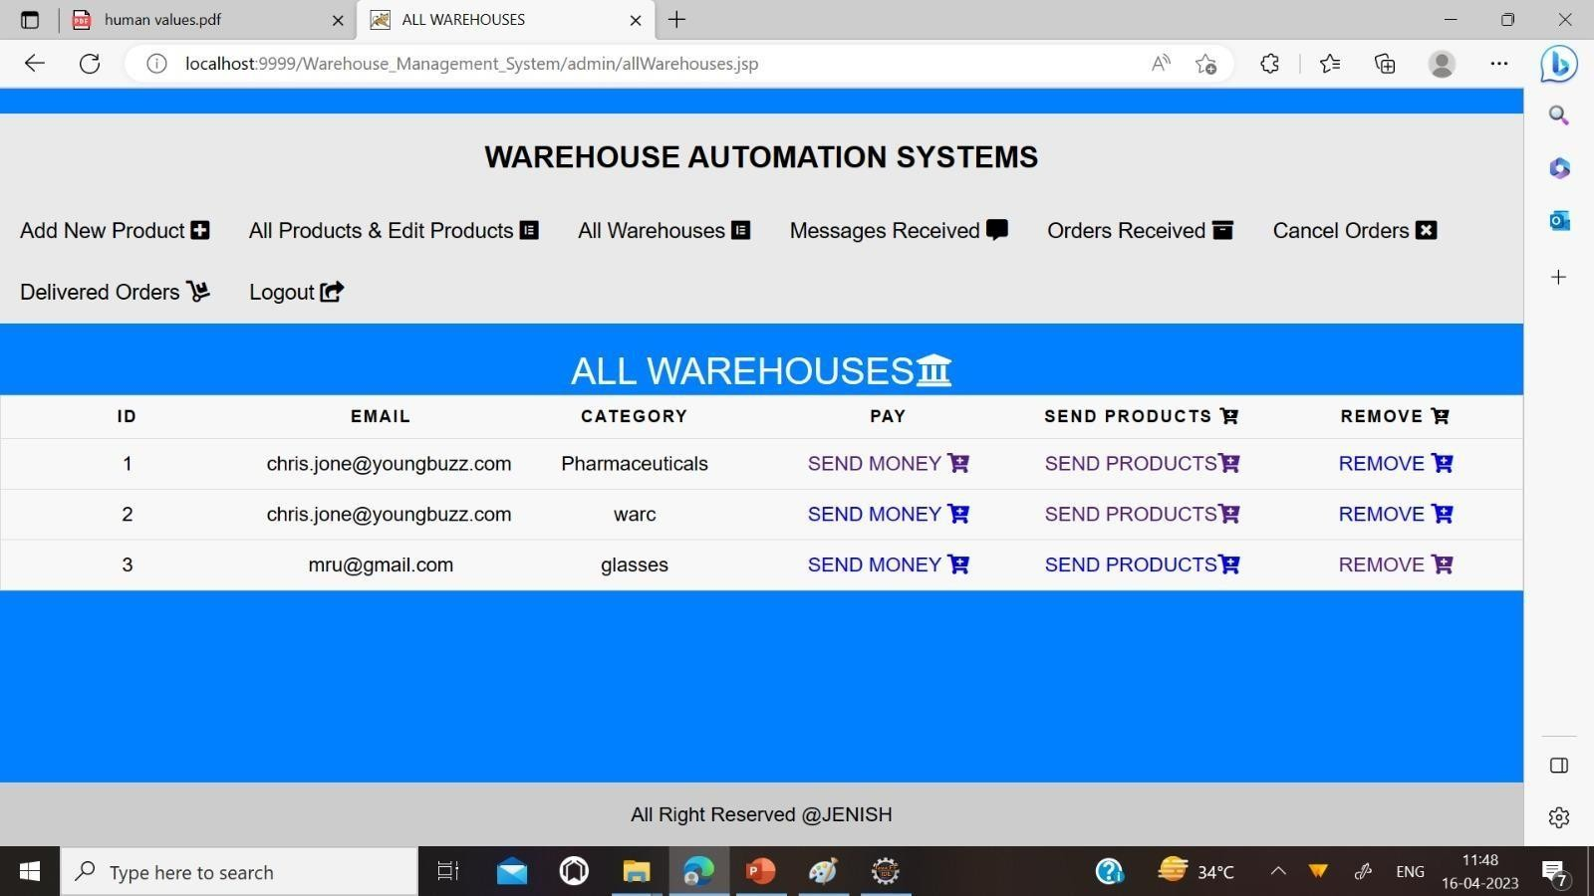
RENT WAREHOUSE PAGE
ALL WAREHOUSES PAGE

Slide 17
References
1.)Guy Scher and Hadas kress-Gazit,”Warehouse Automation in a Day:From Model to Implementation with Provable Guarantees”August 20-21 2020.
Md. Bahar Ullah “ CPU Based YOLO : A Real Time Object Detection Algorithm” (TENSYMP),5-7 June 2020.
2.)Yong Li,Can Lv SS-YOLO : “An Object Detection Algorithm based on YOLOv3 and ShuffleNet” ITNEC 2020.
3.)DC VELOCITY, “Driverless forklifts are now a thing,” 2020. [Online]. Available: https://www.dcvelocity.com/articles/ 44254-driverless- forklifts-are-now-a-thing.
4.)S. L. Beckwith, “Supply chain automation surges: supply chain automation is gaining ground, particularly in warehousing and middleand last-mile logistics,” Inbound Logistics, 2019.
5.)ANSI/ITSDF Safety Standard for Guided Industrial Vehicles, “B56.5- 2019,” 2019. [Online]. Available: https://webstore.ansi.org/Standards/ ANSI/ANSIITSDFB562019-2388609

