Slide 1



Dashboard
View in Power BI
Last data refresh:
8/1/2024 8:29:23 AM UTC
Downloaded at:
8/1/2024 8:38:56 AM UTC

Slide 2
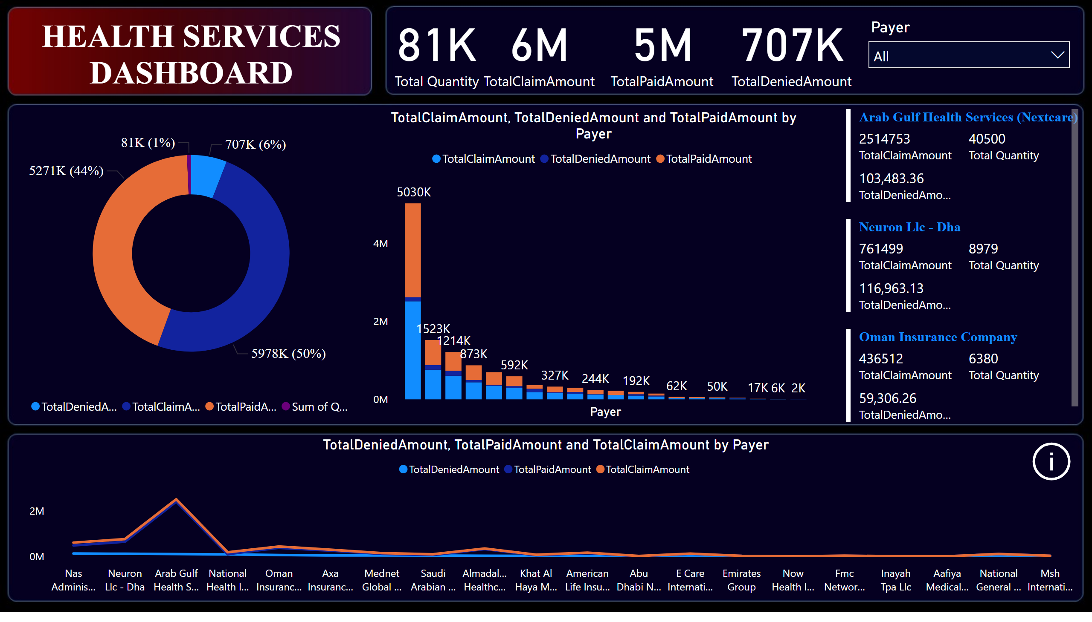
Dashboard
Notes:
card
No alt text provided
columnChart
No alt text provided
lineChart
No alt text provided
multiRowCard
No alt text provided
card
No alt text provided
donutChart
No alt text provided
slicer
No alt text provided
textbox
No alt text provided
card
No alt text provided
card
No alt text provided
actionButton
No alt text provided

Slide 3
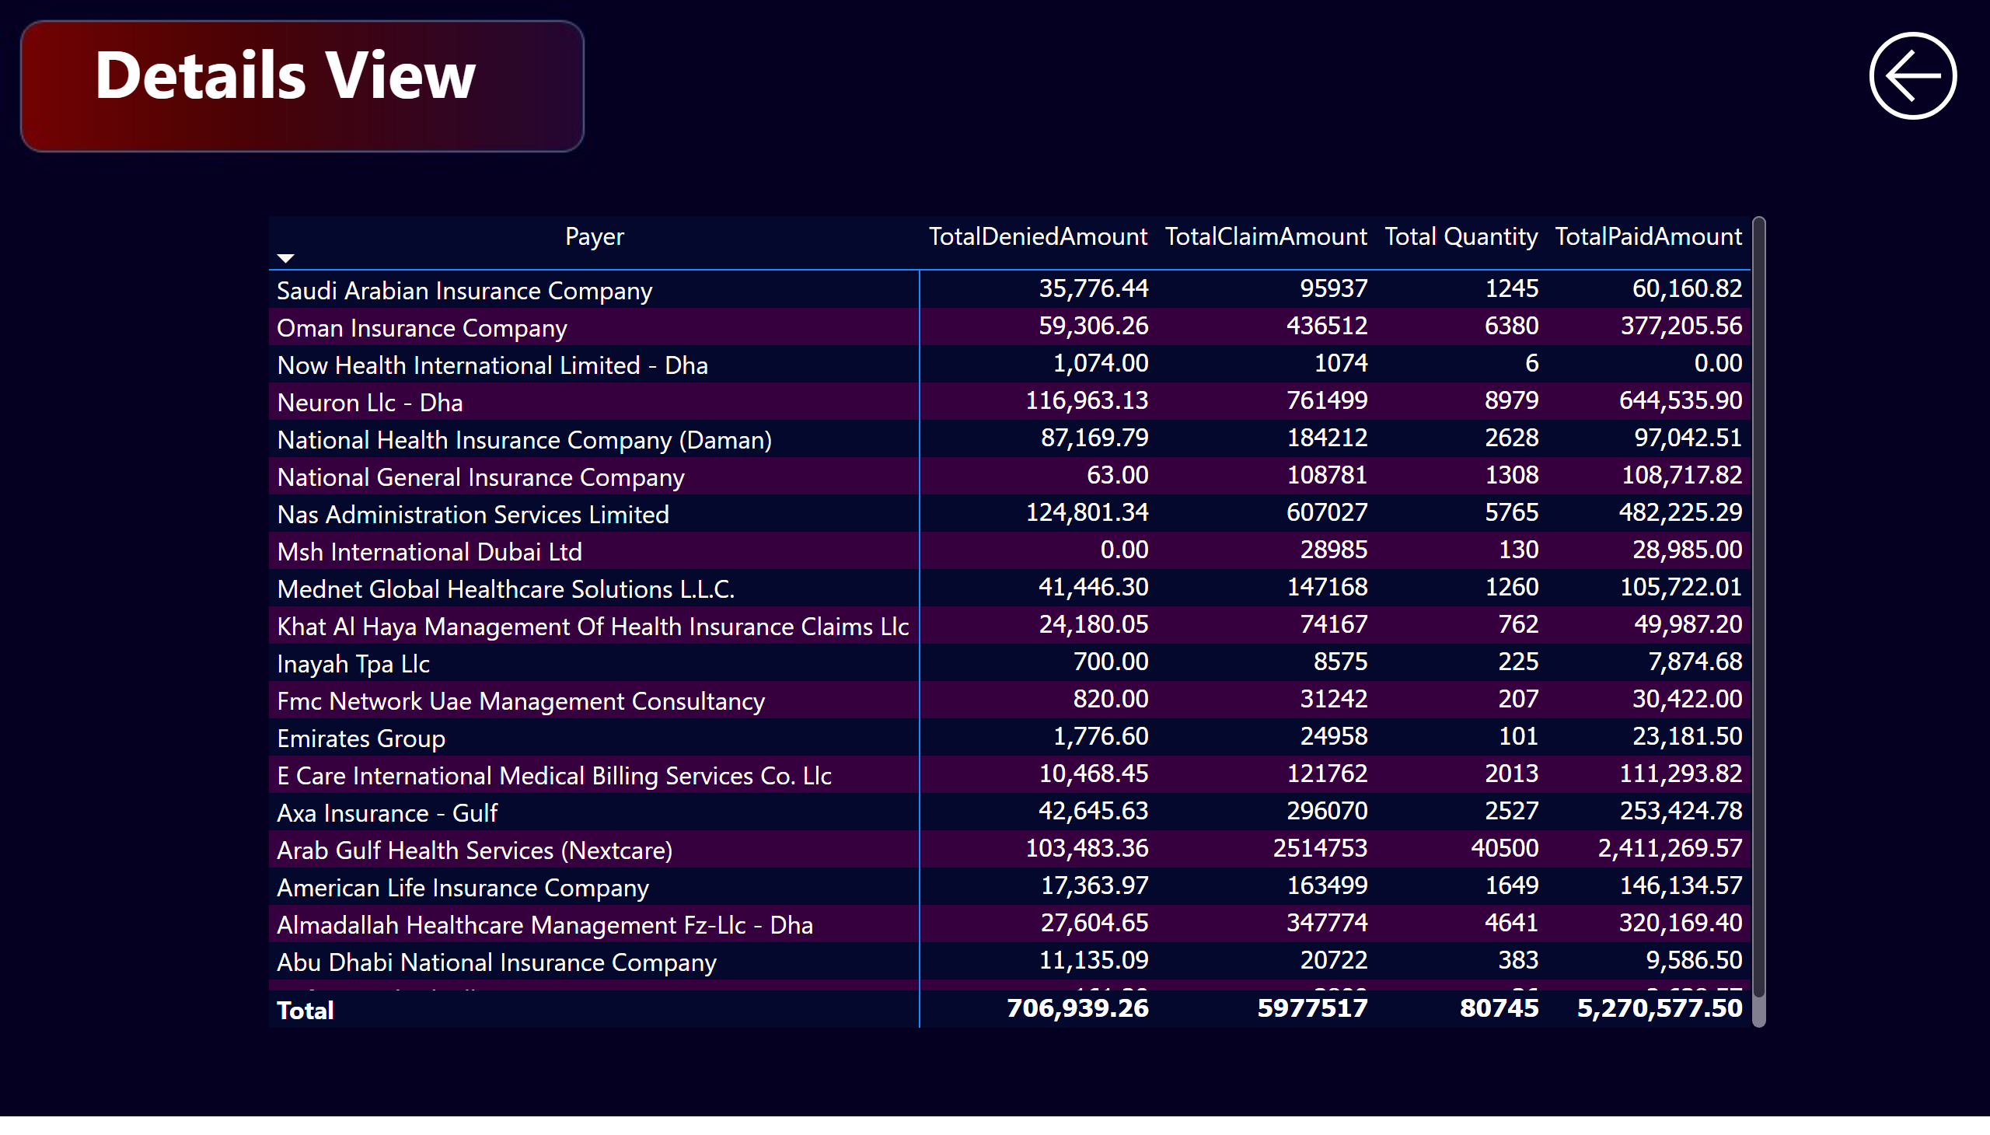
Details View
Notes:
pivotTable
No alt text provided
textbox
No alt text provided
actionButton
No alt text provided

