Slide 1
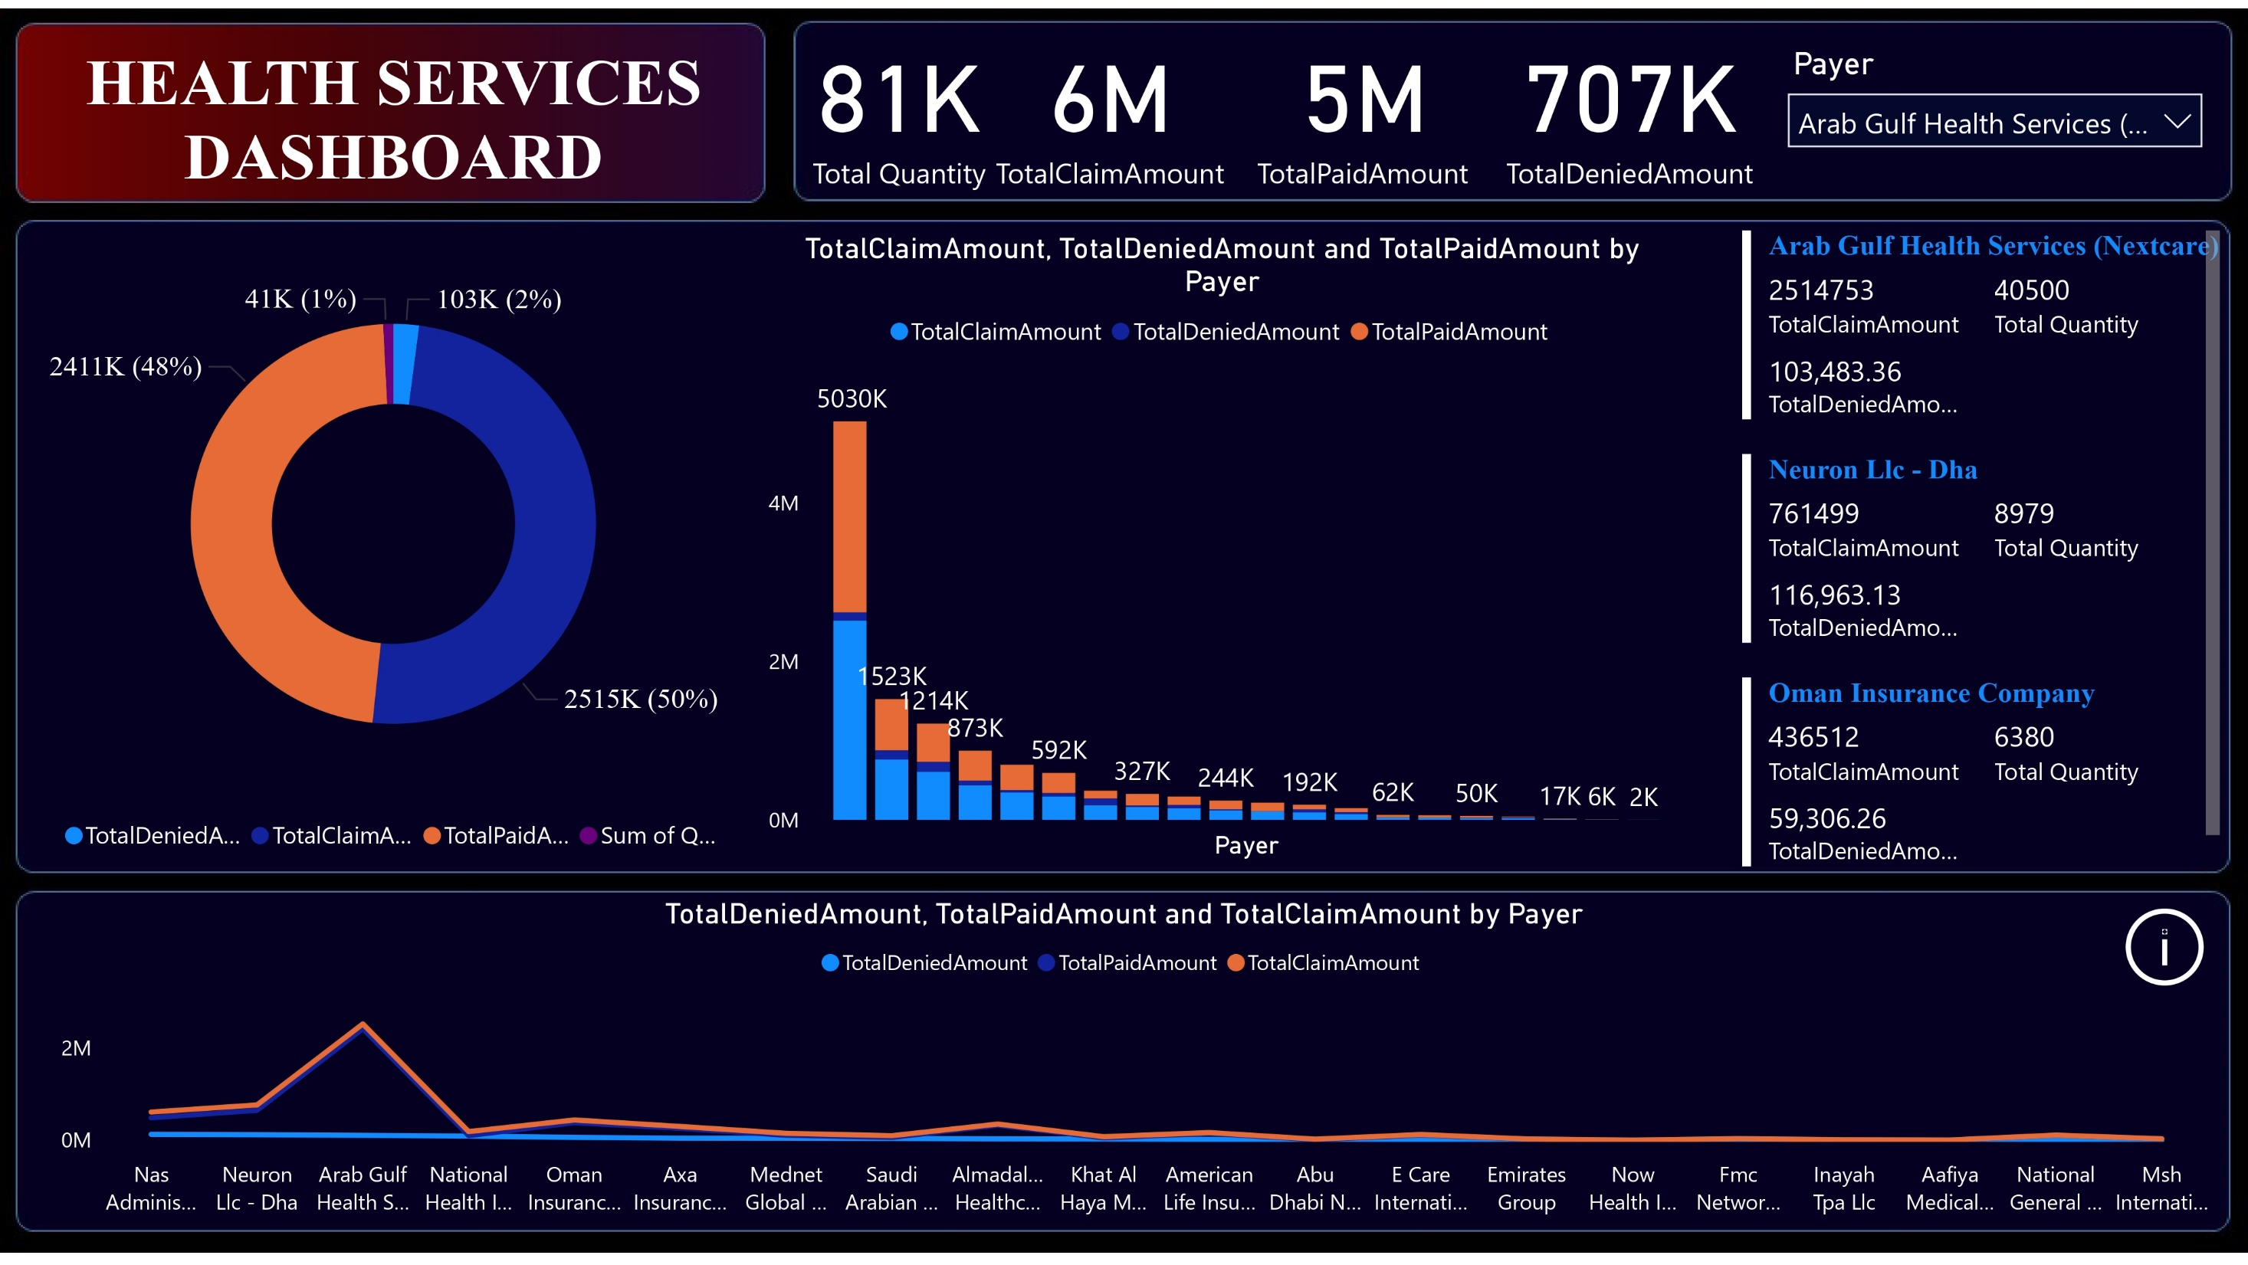

Slide 2
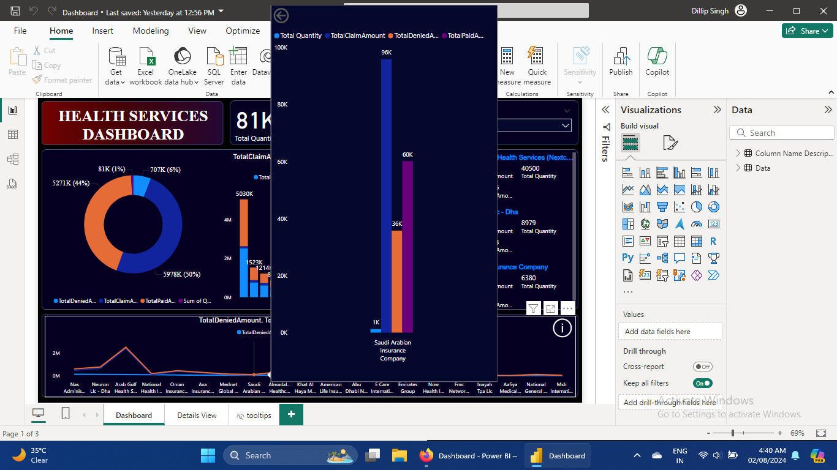

Slide 3
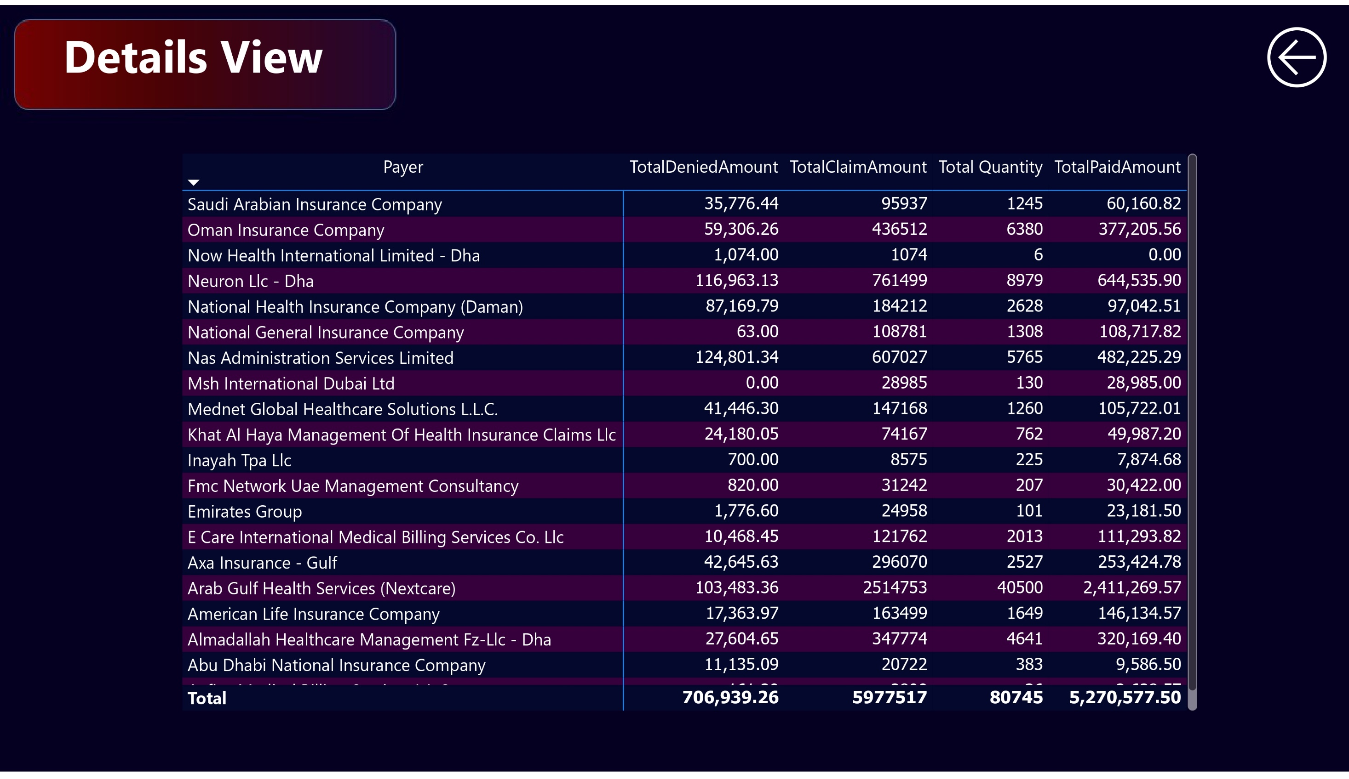

Slide 4

Copy the link and paste it into browser search bar to see Demo IT Health Services Power BI Dashboard
Link :- https://app.powerbi.com/groups/me/apps/a880ec71-7c3d-4313-8f2c-d399c1768829/reports/7f27245c-dddf-4666-8b93-787e0ffe6721/b968cec6f0999dd30dbd?ctid=78202ba4-fad7-4f63-92f2-f9d1a14d8a0b&experience=power-bi
Complete Power BI Assessment Projects
Overall business objectives for this particular exercise
Project Goal :
Track Current Total Claimed Amount, Total Received Amount, Total Denial Amount.
Analyze historical Payer trends for Claimed and Received Amount.
Details Claimed , Received and Denial Amount Analysis.
Data Scope
Health Services Contract Data
Download data from my Github link :- https://github.com/dillipsingh99/Power-BI-Dashboard-for-IT-Health-Services
Metrics Required
Total Quantity
Total Claimed Amount
Total Denial Amount
Total Received Amount
Views Required
Summery Page(Dashboard)
Detailed Page for Granular Analysis

Slide 5
Power BI Dashboard development starts with these steps
Requirement Gathering
Data Collection
Transformation and Modeling
Data Visualization Blueprint
Dashboard Layout and Design
Interactivity and Navigation
Testing
Sharing
Maintenance and Refresh
Steps required
Requirement Gathering :-
a. Identify Stakeholders
Establish a point of contact
b. Understand Business Objectives
Meetings and Communication
c. High level Data Study
Data Sources, Column Description, Data Type
Volume/frequency and Data Quality
d. Define Scope
Document KPI
Timeline and Expectations etc

Slide 6
Data Collection
Data collection with Power BI involves gathering data from various sources, including databases, Excel files, cloud services, and web APIs. Power BI provides powerful tools for importing and transforming data to ensure it is accurate and ready for analysis. Using Power Query, users can clean, reshape, and merge data from different sources into a cohesive dataset. This process facilitates the creation of interactive dashboards and reports, enabling real-time insights and data-driven decision-making. Power BI's robust data connectivity and transformation capabilities make it a vital tool for organizations looking to harness the power of their data efficiently.
There are 200+ data Connectors. Some of the widely used data connector are
a. Excel/CSV
b. Folder connection
c. SQL Server or Any Database
d. Power BI Services
e. Cloud platform – Azure, AWS, GCP ect
f. ERP system – Salesforces, SAP etc
g. Sharepoint
h. Web and JSON
3. Transformation and Modeling
Power BI Transformation and Modeling are crucial aspects of data analytics and visualization. Transformation in Power BI involves cleaning, reshaping, and enriching raw data to make it suitable for analysis. This process is typically done using Power Query, where users can remove duplicates, split columns, filter data, and perform other manipulations to prepare data efficiently.
Modeling in Power BI refers to the creation and management of relationships between different data tables. It involves defining measures, calculated columns, and hierarchies to create a comprehensive data model. A well-structured data model allows for more insightful and interactive reports and dashboards.
Using DAX (Data Analysis Expressions) in Power BI, users can create complex calculations and aggregations, enabling deeper analysis and better decision-making. Together, transformation and modeling in Power BI empower users to unlock the full potential of their data, providing meaningful insights and facilitating data-driven decision-making.

Slide 7
4. Data Visualization Blueprint
A Power BI Data Visualization Blueprint serves as a strategic guide for designing and developing effective and impactful data visualizations. It outlines the steps and best practices for creating visuals that are not only aesthetically pleasing but also meaningful and insightful. The blueprint starts with understanding the audience and defining the objectives of the visualization.
Next, it involves selecting the right type of visual for the data and the message. This includes choosing from various charts, graphs, maps, and custom visuals available in Power BI. The blueprint emphasizes the importance of data accuracy and integrity, ensuring that the data source is reliable and the data model is well-structured.
Additionally, it covers the principles of design, such as using appropriate color schemes, maintaining consistency, and ensuring readability. Interactivity is another key aspect, with guidelines on incorporating features like slicers, filters, and drill-downs to enhance user engagement. Ultimately, a Power BI Data Visualization Blueprint helps in creating compelling and actionable visual reports that drive business decisions.
5. Dashboard Layout and Design
Dashboard layout and design are fundamental to creating effective and user-friendly dashboards in Power BI. A well-designed dashboard provides a clear and concise overview of key metrics and insights, facilitating quick decision-making. The layout should be intuitive, with a logical flow that guides the user through the information seamlessly.
Key elements such as charts, graphs, and tables should be arranged hierarchically, with the most important data prominently displayed at the top. Consistent use of colors, fonts, and styles enhances readability and visual appeal. It's essential to avoid clutter by keeping the design simple and focusing on the most critical information.
Interactivity is a crucial aspect of dashboard design, allowing users to filter data and drill down into details without losing context. Additionally, responsive design ensures that the dashboard is accessible across various devices, maintaining functionality and aesthetics. Ultimately, a well-structured layout and thoughtful design transform raw data into a compelling story, driving informed decisions

Slide 8
6. Interactivity and Navigation
Interactivity and navigation are essential components of Power BI that enhance the user experience and provide deeper insights. Interactivity in Power BI allows users to engage with data through various interactive features like slicers, filters, and drill-through actions. These features enable users to dynamically explore data, uncover patterns, and focus on specific aspects without altering the core dataset.
Slicers act as on-page filters, letting users segment data visually, while drill-through actions enable them to click on a data point and navigate to a detailed report or dashboard. Additionally, tooltips provide contextual information when hovering over visuals, adding another layer of interactivity.
Navigation in Power BI is streamlined through intuitive design, using buttons, bookmarks, and linked pages to create a seamless flow between different reports and dashboards. This ensures users can easily find and analyze the information they need. Well-designed navigation and interactivity transform static reports into dynamic, user-centric experiences, empowering users to make data-driven decisions efficiently.
7. Testing
Power BI testing is a critical step to ensure the accuracy and reliability of reports and dashboards. This process involves validating data sources, checking data transformations, and verifying calculations to ensure that the visualizations reflect the correct information. Testing includes functional tests to verify that all interactive features like slicers, filters, and drill-downs work as intended. Performance testing ensures that dashboards load quickly and handle large datasets efficiently. User acceptance testing (UAT) is also essential, where end-users validate the functionality and usability of the reports. Thorough Power BI testing guarantees high-quality, dependable insights for informed decision-making.

Slide 9
8. Sharing
Power BI project sharing is a pivotal feature that facilitates collaboration and accessibility among team members and stakeholders. Users can share reports and dashboards through Power BI Service, ensuring that everyone has access to the most current data and insights. Sharing can be done via direct links, embedding reports in web applications, or publishing to shared workspaces. Access controls and permissions ensure that sensitive data remains secure while allowing users to interact with and explore the reports. Effective project sharing in Power BI enhances teamwork, enables real-time collaboration, and drives data-informed decision-making across the organization.
9. Maintenance and Refresh
Maintenance and Refresh Power BI maintenance and refresh are essential to keep reports and dashboards up-to-date and accurate. Maintenance involves regularly checking and updating data connections, ensuring that data sources are accessible and performing optimally. Refresh processes can be scheduled to automatically update datasets at specific intervals, ensuring that users always see the most current information. Power BI supports incremental refreshes, which update only the changed data, improving efficiency and performance. Additionally, monitoring the performance and usage of reports helps in optimizing and troubleshooting any issues. Regular maintenance and refresh activities ensure the reliability and relevance of Power BI insights for decision-making.
“The End”

