Slide 1
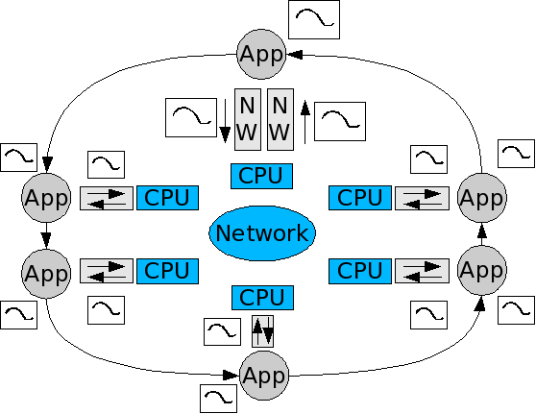
Evaluation of Distributed Control Loops
Distributed control loop application components cross NW components
Datastreams collects data at application and OS layer levels
Global time line built using clock synch and local clock values

Slide 2
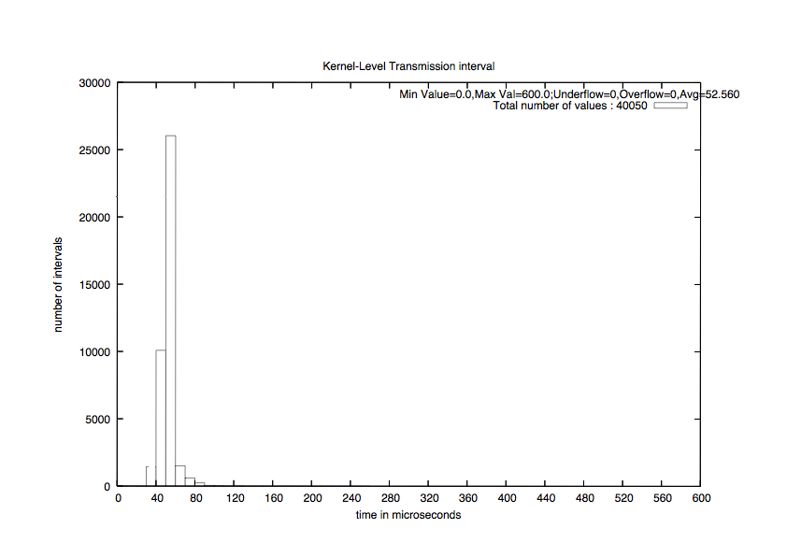
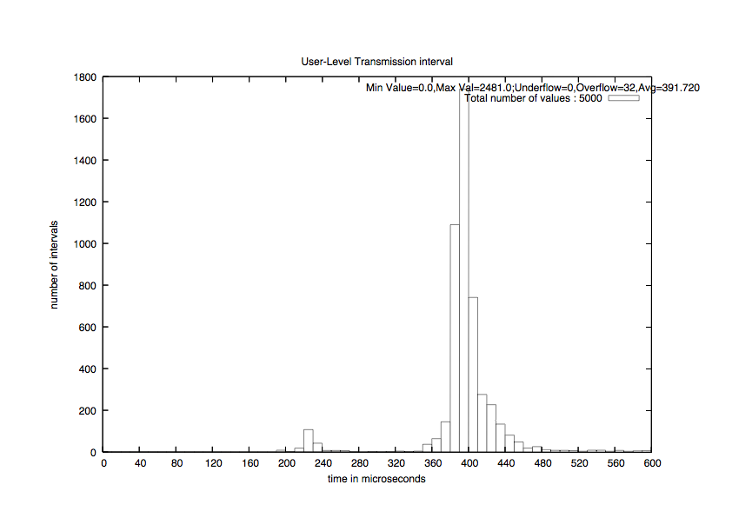
Performance Views
Message transmission time at OS, hardware, and user level can be shown for each edge
NIC-to-NIC
Application-to-Application
Transmission time from testbed117 to testbed118

Slide 3
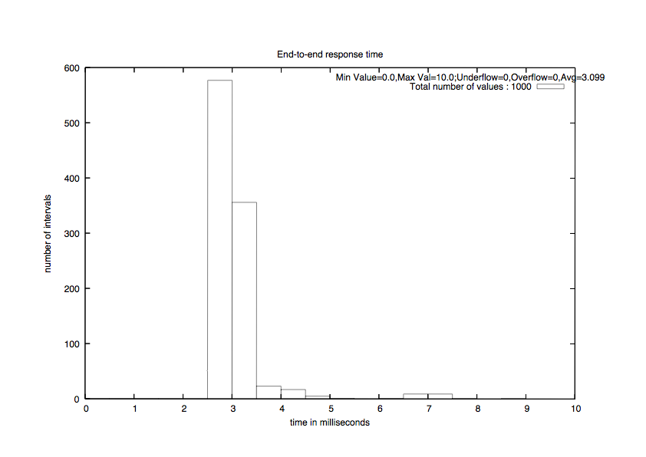
Performance Views
Overall performance of entire network can also be represented; e.g. end-to-end response time

Slide 4
Summary
Clock synchronization kernel patch ensures global timeline accuracy within 30 microseconds
Instrumentation of Linux network stack to trace path of network packets throughout the kernel
Raw data gathered can be easily filtered and converted into visual representations
Automated execution of distributed experiments and postprocessing gathered data
Python-based postprocessing framework easily extensible to add custom filters and output formats

