Slide 1
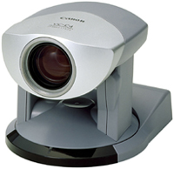
Two-Machine Thread Diagram
Timeserver
NTP
Video
Processing Node
Clksync
Motor
Control
Display
Capture
DSKI
Analyzer
Clksync
KUIM Net
libptz
DSKI
KUIM Net
NISTNet
Router

Slide 2
Experimental Design
NISTNet software is used to introduce delays between the video server machine and the processing node(s)‏
Datastreams software used to construct global timeline with ~ 10us accuracy
Various sub-intervals of the control loop measured, with graphs automatically generated
Following results were mesaured with a 20ms delay introduced by NISTNet

Slide 3
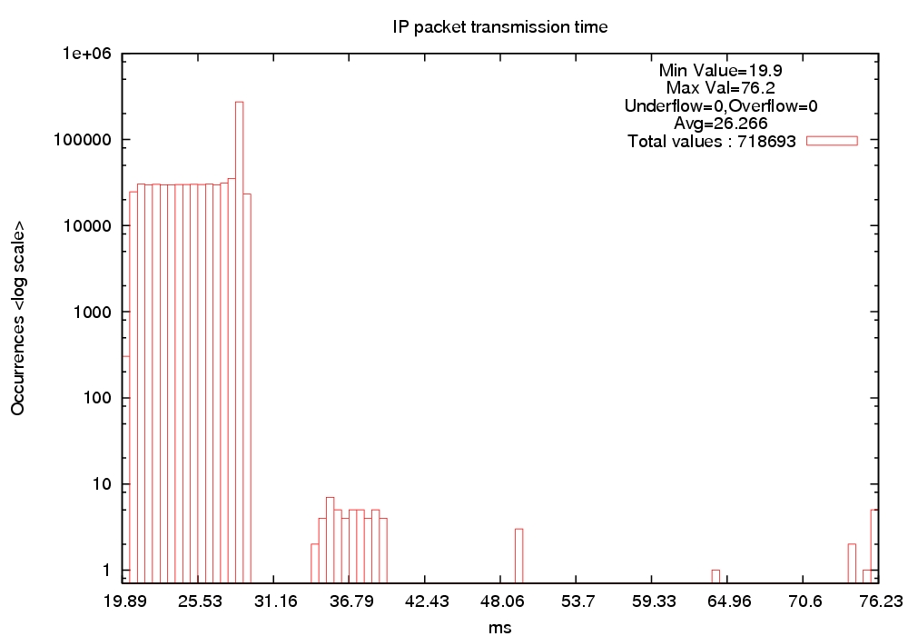
IP Datagram Transmit Time

Slide 4
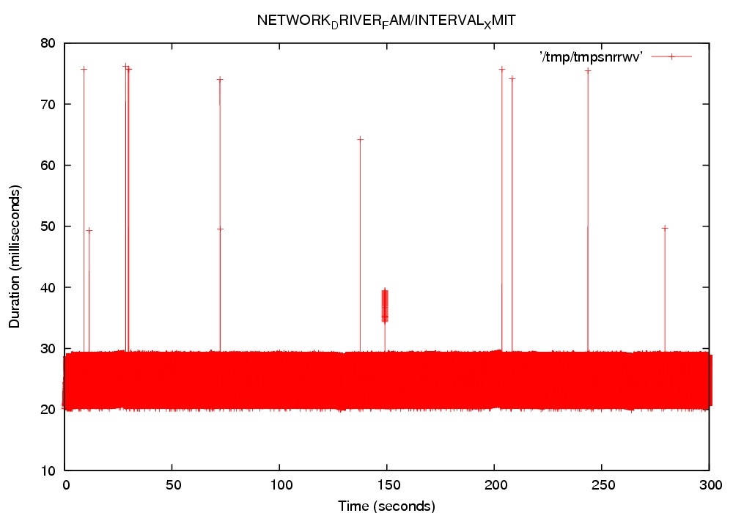
IP Datagram Transmit Time

Slide 5
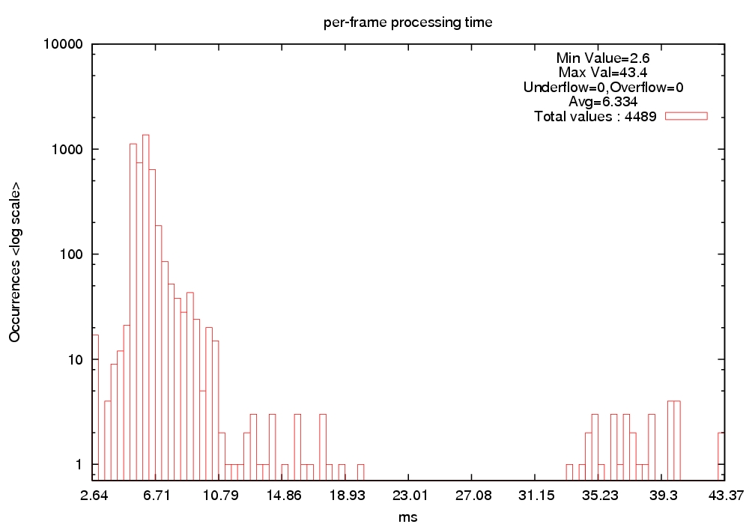
Per-Frame CPU Time

Slide 6
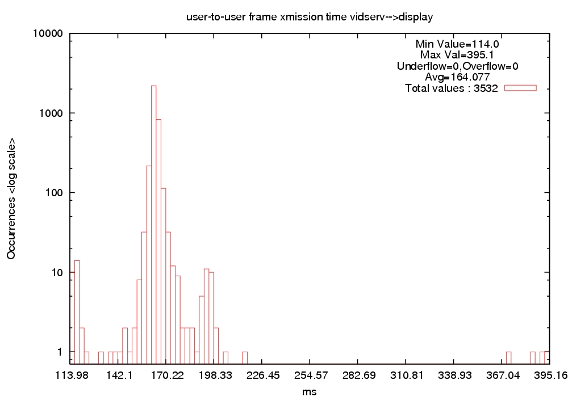
Frame Transmission Time

Slide 7
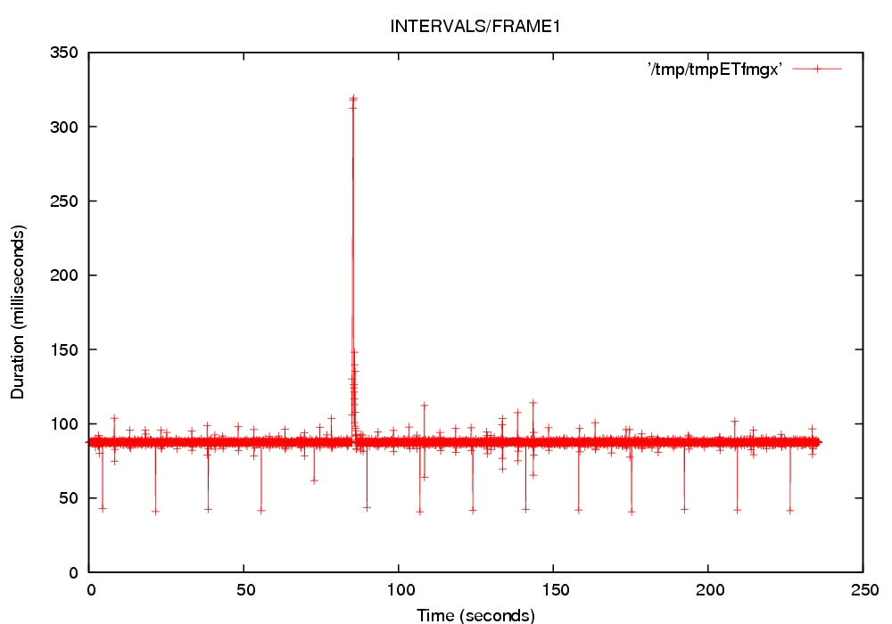
Frame Transmission Time

Slide 8
Aggregate Results
NETSPEC Software automates execution of experiments under different parameter settings
Aggregate graphs show average interval time, bounded by 1 standard deviation
Following graphs show average intervals as a function of NISTNet delay

Slide 9
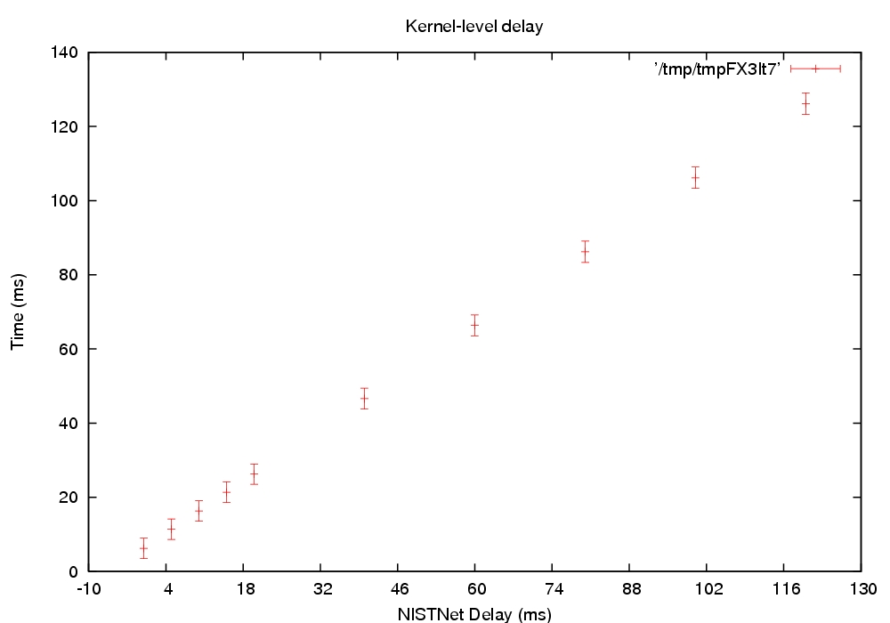
IP Datagram Transmit Time

Slide 10
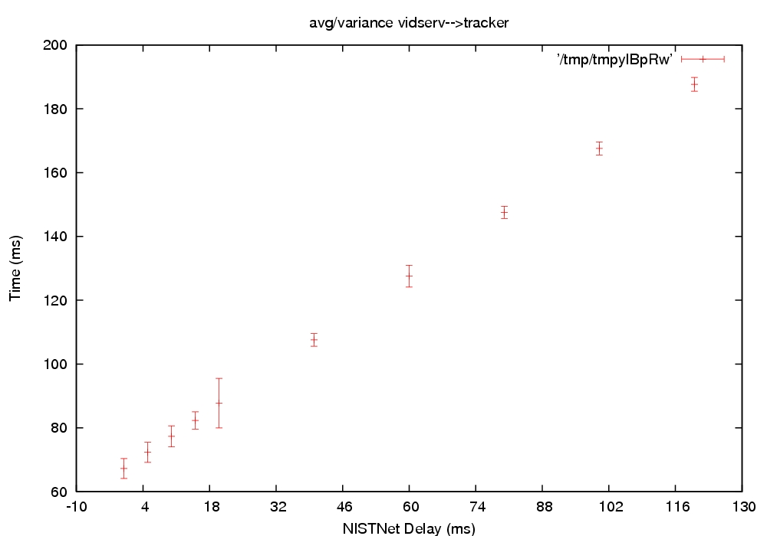
Video Frame Transmission Time

