Slide 1
Advanced GIS
Week 5: Working with spatial data
Notes:
Project due tomorrow at midnight!
We have a lab this week!
Any question -- will be around after the lecture for office hours
Finally spatial data!

Slide 2
Outline
Review: projections
Spatial Data in R
sf package
(Brief) Intro to mapping using ggplot2
Other options for open source GIS besides R/QGIS
Grass GIS
SAGA
GEODA

Slide 3
Coordinate Reference Systems
Coordinate Reference System (CRS): Like plotting (x, y) data, spatial coordinates can only be placed on the Earth’s surface when their coordinate reference system (CRS) is known.
WGS84 (spheroid CRS): lat, lon coordinates measured in degrees from the Earth’s center to a point on the Earth’s surface
UTM zones (projected two-dimensional CRS): X, Y coordinates measured in meters N and E of the origin which is set 500,000 meters W of the central meridian
Notes:
All locational data for vector features is expressed in a specific coordinate system … you can think of this as plotting x,y coordinates for non-spatial data in a euclidean coordinate system spatial coordinates can only be placed on the Earth’s surface when their coordinate reference system (CRS) is known.
The most common coordinate system is WGS84 -- or the lat, lon coordinate systems which measures positions on the earth’s surface relative to their angle from the earth’s center -- lat lon coordinates are a spheroid CRS. Many coordinate systems used for mapping will be projected from 3 to 2 dimensions. An example of this are UTM zones -- which meaure points on the earth’s surface in meters from a fixed origin point. Projected CRS a transformation of unprojected lat and lon coordinates

Slide 4
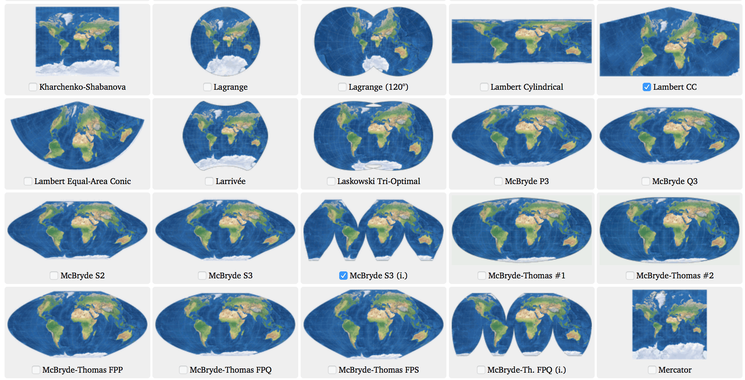
Spatial Projections
Unprojected CRS: plots locations on a sphere using longitude and latitude (but does not project these coordinates into two-dimensional space; eg. WGS84).
Map projections: Ways of transforming locations on the 3-dimensional surface of the earth into 2 dimensions.
You must project your data before computing distance or area.
The map projection you use strongly impacts the way you visualize your data and the accuracy of distance and area measurements.
Notes:
To review -- An Unprojected CRS like WGS84 - plots locations on a sphere using longitude and latitude (but does not project these coordinates into two-dimensional space)
Map projections: Ways of transforming locations on the 3-dimensional surface of the earth into 2 dimensions. Map projecions are important because You must project your data before doing things like computing distance or area. BUT don’t forget, that the map projection you use strongly impacts the way you visualize your data and the accuracy of distance and area measurements.

Slide 5
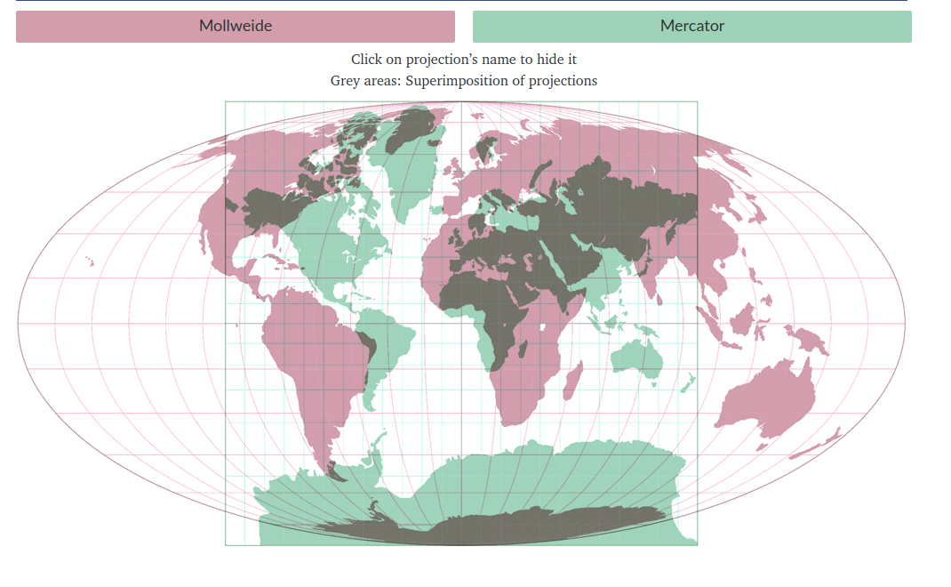
Different Map Projections Show Different Spatial Relationships
In the Mercator projection Greenland appears to be the size of Africa.
On the globe, Africa is about fourteen times larger than Greenland.
Compare Map Projections: https://www.map-projections.net/index.php
Notes:
For instance -- a widely cited example of bias intriduced by map projections is the distortion of continents in the mercator projection - In the Mercator projection (GREEN) Greenland appears to be the size of Africa. (so here we see the mercator projection in green) -- show here
But we knoe that on the globe -- Africa is about fourteen times larger than Greenland. -- we can see this size difference in the mollweide projection which is plotted on top in pink
This is noteable because if you were using the mercator projection for an analysis you would see a distortion of area measurements at a large scale

Slide 6
Review: Common Map Projections
 | Conformal | Equal-area | Azimuthal/equidistant
Properties
Visualization benefits
examples | Mercator, Lambert Conformal Conic | Albers equal area conic, Gall-peters, Mollweide | Orthographic, Gnomonic
Compare map projections: https://map-projections.net/compare.php
Notes:
Let’s see how well you remember three common categories of map projections
Properties of conformal map projections -- mercator is a conformal map projection (Shapes and angles are accurate but area is distorted) -- preserves shape
Equal area (Ratios between areas are the same as on the globe but shape may be distorted) -- preserves size
Equidistant (A straight line drawn between 2 points on the map, and passing through the center of the projection, is the great-circle route and angle between the two points ) - preserves distance
Ask class to fill these in

Slide 7
Review: Common Map Projections
 | Conformal | Equal-area | Azimuthal/equidistant
Properties | Shapes and angles are accurate but area is distorted | Ratios between areas are the same as on the globe but shape may be distorted | A straight line drawn between 2 points on the map, and passing through the center of the projection, is the great-circle route and angle between the two points
Visualization benefits | Good for visualizing small localized areas. Useful for Analyzing and recording motion, navigation | Maps comparing extents of geographic areas, maps communicating accurate area relationships | Useful for air travel and satellite navigation.
examples | Mercator, Lambert Conformal Conic | Albers equal area conic, Gall-peters, Mollweide | Orthographic, Gnomonic
Compare map projections: https://map-projections.net/compare.php
Notes:
So we know that these broad categories of map projecttions are good at preserving shape, size, and distance -- and there are trade offs to each one you choose
Your choice of map projection will always depend on the scale of your analysis -- are you visualizing small of large areas -- and the types of measurements you need to make

Slide 8
Map Projections in R
Each projection has its own CRS which can be identified by numerous formats in R. Two common formats include:
proj.4 strings: a syntax used to identify a CRS by specifying its parameters including the ellipse, datum, projection units, and projection definition.
EPSG codes: 4-5 digit numbers that represent CRS definitions.
Look up epsg codes and proj.4 strings here: https://spatialreference.org/
Notes:
Each projection has its own CRS which can be identified by numerous formats in R. Two common formats include:
proj.4 strings: a syntax used to identify a CRS by specifying its parameters including the ellipse, datum, projection units, and projection definition.
EPSG codes: 4-5 digit numbers that represent CRS definitions.
Ech epsg code will have a proj 4 string but not all proj 4 strings will have an epsg code
Look up epsg codes and proj.4 strings here: https://spatialreference.org/

Slide 9
WGS84 Geographic Coordinate System
epsg: 4269
proj.4 string: "+proj=longlat +ellps=WGS84 +datum=NAD83"
Notes:
WGS84
+proj=longlat: the data are in a geographic (latitude and longitude) coordinate system
datum=NAD83: the datum WGS84 (the datum refers to the 0,0 reference for the coordinate system used in the projection)
+ellps=WGS84: the ellipsoid (how the earth’s roundness is calculated) is WGS84
Note that there are no specified units above. This is because this geographic coordinate reference system is in latitude and longitude which is most often recorded in Decimal Degrees.

Slide 10
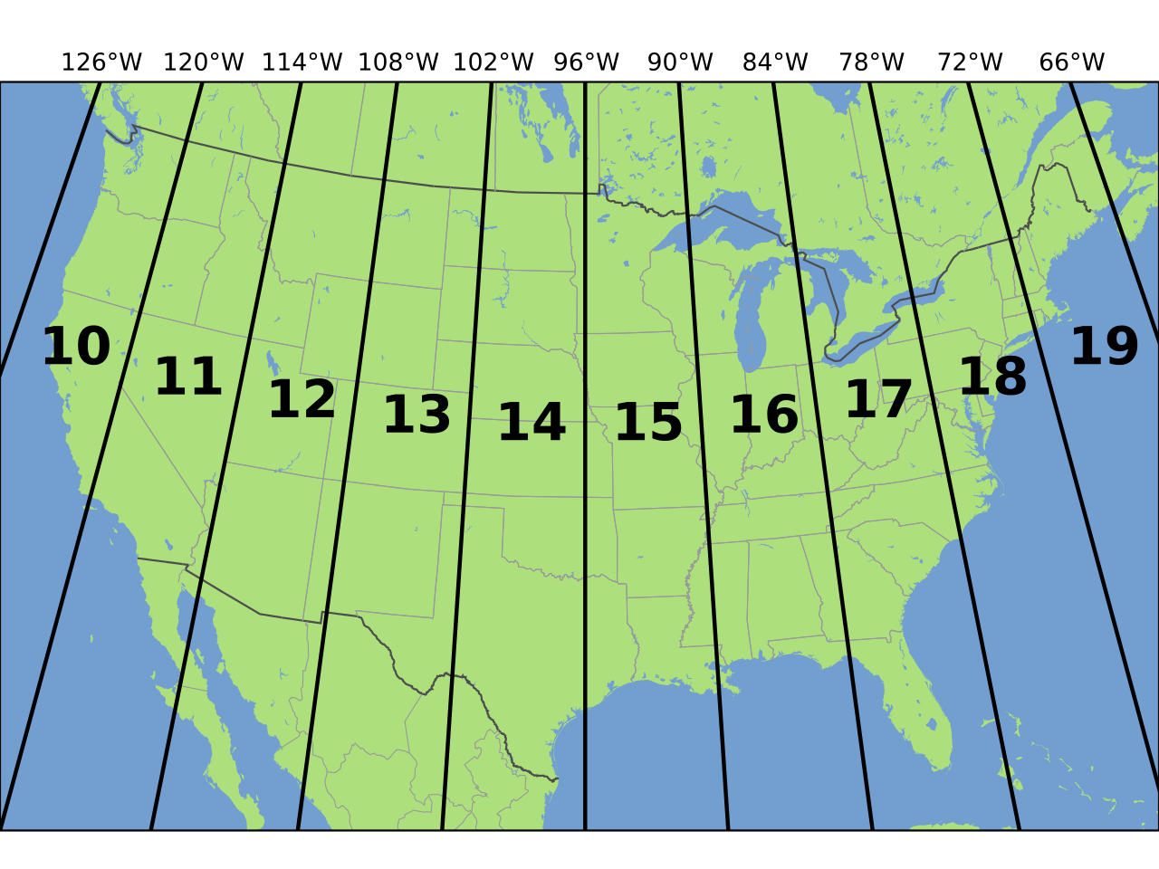
WGS84 Geographic Coordinate System
NAD83 UTM Zone 12
epsg: 4269
proj4string: "+proj=longlat +ellps=WGS84 +datum=NAD83 +no_defs"
epsg: 2956
proj4string: "+proj=utm +zone=12 +ellps=GRS80 +units=m"
*A good coordinate system for collecting and analyzing state level data.
Notes:
Can someone interpret the proj.4 string for this utm zome 12 projecttion -- which is the utm zone where Utah is located
+proj=utm: the projection is UTM, UTM has several zones
+zone=12: the zone containing utah
+units=m: the units for the coordinates are in METERS
+ellps=GRS80: the ellipsoid (how the earth’s roundness is calculated) for the data is GRS80
The importance of having epsg values stored with data besides proj4string values is that the epsg refers to particular, well-known CRS, whose parameters may change (improve) over time; fixing only the proj4string may remove the possibility to benefit from such improvements, and limit some of the provenance of datasets, but may help reproducibility. For instance the the North American Datum of 1983 (NAD 83) will be repaced in 2025 by a new updated datum if you rerun an analysis from this class in 2025 and you use proj4strings to set your projections you;ll have to update NAD83 to the new datum manually -- this will be done automatically if you use epsg codes - although it’s good to know how to use both

Slide 11
Questions?
Notes:
Questions
This review was breif -- if you need to remind yourself about projections or vector data, see the GIS Fundamentals reading on CANVAS

Slide 12
History of R Spatial
R’s spatial ecosystem is rapidly evolving!
R Spatial packages are built for different spatial data types.
sf: Vector Data. The latest iteration of an R Spatial vector package sf builds on its predecessor sp.
raster: Raster Data. The raster package is being replaced by stars.
This week we will focus on sf
sf integrates spatial data into the tidyverse! This means everything we learned about dplyr and ggplot2 works with vector data in R (this was not always the case).
Read more here: https://geocompr.robinlovelace.net/intro.html#the-history-of-r-spatial
Notes:
Now we can move on to spatial data in R!!!
We often refer to R’s spatial analysis capabilities using the sorthad R spatil -- R spatial is composed of a rapidly evolving ecosystem of R packages
And these packages are built for different data types
This week we will be working with the sf package for vector data. Sf is The latest iteration of an R Spatial vector package it on its predecessor sp. IF you have worked with spatial data in R before it’s likely you were using the sp package. I learned the sp package when I took a class on spatial analysis in R in grad school and that was only about 5 years ago!
The great thing about sf is that it integrates spatial data into the tidyverse! This means everything we learned about dplyr and ggplot2 works with vector data in R (this was not always the case) -- it was much clunkier in sp
There is a seperate R package for raster data analysis called raster although it is being rapidly repaced by the stars package -- you’ll learn about these packages in a few weeks

Slide 13
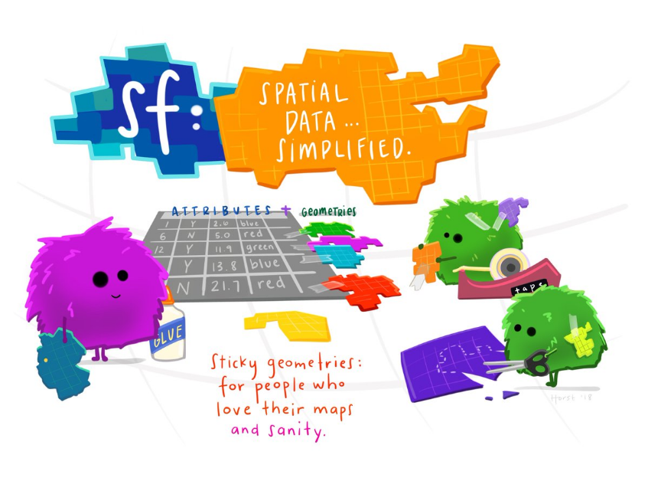
Simple Features (sf)
Feature: what we call spatial objects in R.
a thing, or an object in the world, such as a building or a tree.
Set of features can form a single feature. (A forest stand can be a feature consisting of many trees)
Features have:
a geometry describing where on Earth they are located
attributes which describe their properties
Notes:
Feature: what we call spatial objects in R.
And everything we know about vectors applies to features -- they have geometries and attributes, which describe objects in the world, and they can refer to a single object or a collection of objects
The simple feature package simplifies the analysis of feature data in R -- and if you haven’t used sp or other preceeding packages you’re going to have to take my word for this
This figure shows a cartoon representation of a feature -- it’s got it’s attributes and geometries
And what’s important to note is that these geometries are sticky -- this means that it is really hard to get rid of them no matter how much you transform your spatial feature in R

Slide 14
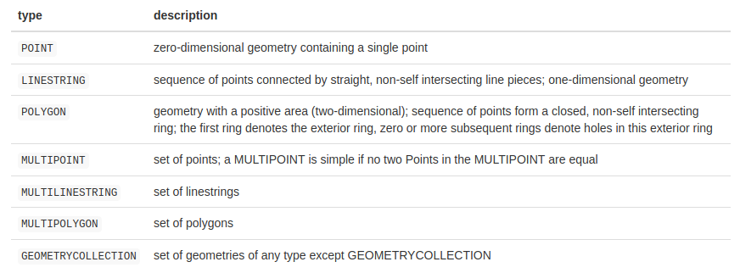
Vector Geometries as Features
Notes:
Vecotr Geometries are the basic building blocks of simple features. Simple features in R can take on one of the 17 geometry types supported by the sf package. You will mostly be dealing with these seven most commonly used types: POINT, LINESTRING, POLYGON, MULTIPOINT, MULTILINESTRING, MULTIPOLYGON and GEOMETRYCOLLECTION.
What distinguishes these feature geometries is they either refer to Single features -- so a point feautre is a single coordinate -- or they refer to multiple features -- a multipoint feature contains a set of points
Same for lines and polygons
A geometry collection is a special feature which can contain a set of geometries of any type -- this is useful because this means that you can combine points, lines, or polygons that share attributes in one feature
Questions?

Slide 15
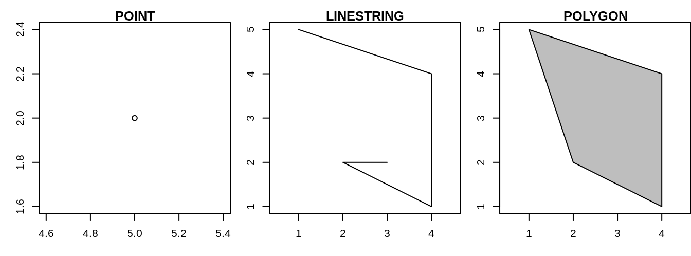
Single Feature Geometries
well-known text (WKT): human-readable text markup description of simple features.
POINT (5 2): coordinate
LINESTRING (1 5, 4 4, 4 1, 2 2, 3 2): sequence of points
POLYGON ((1 5, 2 2, 4 1, 4 4, 1 5)): sequence of points that form a closed, non-intersecting ring
Notes:
Feature geometries are described by well-known text (WKT) which is a human-readable text markup description of coorinates, lines and polygons
Remmeber that points are the building blocks of all vector data -- well known text lets us see those building blocks .
Here we have a point at coordinate (5 2) -- show on image
Here we have a line string which is a series of connected points starting at 1,5 and ending at 3,2
FInally we have a polygon which is also a sequence of points but ending with the same point -- 1 5

Slide 16
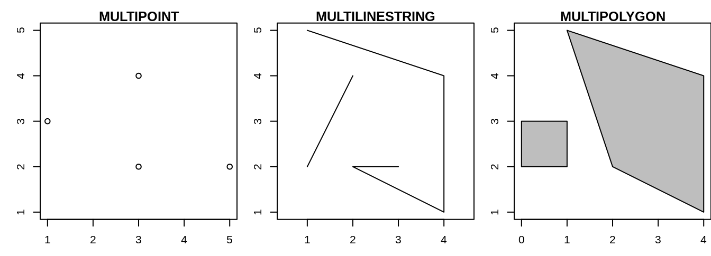
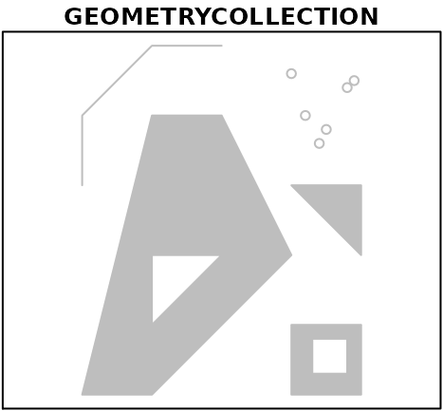
Multi Features and Collections
sf allows multiple geometries to exist within a single feature. These can be the same geometries.
MULTIPOINT (5 2, 1 3, 3 4, 3 2)
MULTILINESTRING ((1 5, 4 4, 4 1, 2 2, 3 2), (1 2, 2 4))
MULTIPOLYGON (((1 5, 2 2, 4 1, 4 4, 1 5), (0 2, 1 2, 1 3, 0 3, 0 2)))
Or any combination of geometries:
GEOMETRYCOLLECTION (MULTIPOINT (5 2, 1 3, 3 4, 3 2), LINESTRING (1 5, 4 4, 4 1, 2 2, 3 2), MULTIPOLYGON (((1 5, 2 2, 4 1, 4 4, 1 5), (0 2, 1 2, 1 3, 0 3, 0 2))))
Notes:
This is the same idea for multi features
Here we have a multipoint feature there the well known text represents a collection of points
And simmilarly for multilinestrings and multipolygons
The well known text for a geometry collection is slightly different in that in addition to the numeric represntation of the geometry -- here we also specify the geometry type

Slide 17
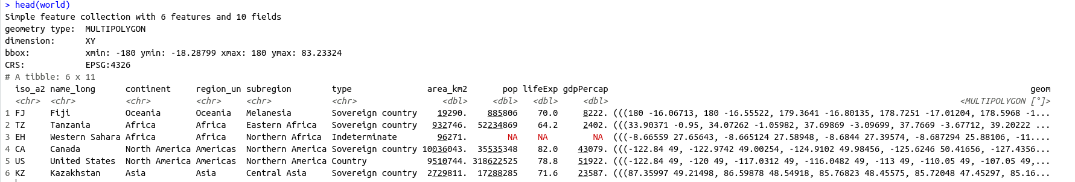
Spatial Data Frames
Spatial data frame: Combines feature geometries and attributes in one place! Geographic geometry data is stored in a special column (called ‘geom’ or ‘geometry’). The contents of this column give sf objects their spatial powers.
class(world) #both a data.frame and a spatial feature!
> "sf" "data.frame"
Notes:
Spatial geometries are fun but it’s much more interesting to know additional attributes for the points lines and polygons we map
So in R the combination of attribute data and well known text representing feature geometries makes up a spatial data frame
A spatial dataframe is identical to the data frames we’ve been working with, the one exception is that is has a special column (called ‘geom’ or ‘geometry’). The contents of this column give sf objects their spatial powers and allow us to map them
If you look at the class of a simple feature like this multipolygon of world countires -- you see that it has two classes it’s a simple feature and a data.frame -- or a spatial data.frame

Slide 18
Spatial Data Frames
Everything we know about data.frames applies to spatial data.frames
sf objects can be treated as data.frames in most operations
sf functions can be combined using %>% operator and with the tidyverse collection of R packages.
The geometry column of sf objects is sticky. This column is kept through all spatial data.frame transformations unless the user deliberately removes it!
world %>% filter(region_un == "Africa") %>% class()
> "sf" "data.frame"
Notes:
The great thing about spatial data.frames is that Everything we know about data.frames -- from dplyr operations to plotting with ggplot -- it also applies to spatial data.frames
This means that we can treat simple features as data frames in most cases and combine spatial operations with pipes and the the tidyverse collection of R packages.
And again The geometry column of sf objects is sticky. This column is kept through all spatial data.frame transformations unless the user deliberately removes it!
So for instance if we filter the world spatial data.frame to only include Africa and check the class of the resulting object it’s still a spatial dataframe --

Slide 19
sf functions
All functions and methods in sf that operate on spatial data are prefixed by “st_”, this makes them easily findable by command-line completion.
#find a polygon centroid
st_centroid()
#calculate polygon area
st_area()
#find the distance between points
st_distance()
Notes:
In addition to giving us access to this new class of spatial objects in R the sf package gives us lots of functions that work specifically with spatial objects -- there are too many of these functions for me to go over each one individually so i’ve listed a few common ones here -- and their names make it easy for you to figure out what they do -- another great thing about sf functions is that they are all prefixed by “st_”, this makes them easily findable by command-line completion. -- or when you type st_ and hit tab you’ll see a list of functions that work on spatial data!

Slide 20
Questions?
Notes:
Questions
BREAK

Slide 21
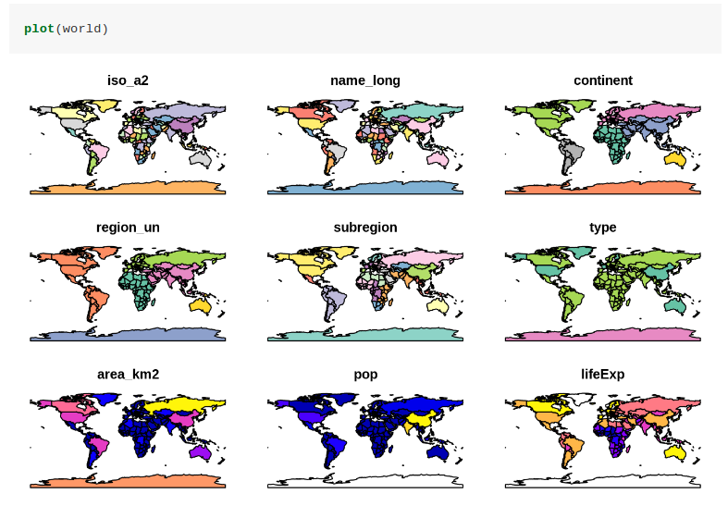
Maps in R!
The plot function in base R is the simplest way to map spatial data
Notes:
The reason we often work with spatial data is so we can make maps! The simplist way to map spatial data is using the plot() function in base R.
We can see an example of what this looks like for the world data.
Why did this produce 9 maps?
Note that instead of creating a single map, as most GIS programs would, the plot() command has created multiple maps, one for each variable in the world datasets. This behavior can be useful for exploring the spatial distribution of different variables
What would you do if you only wanted to plot one map

Slide 22
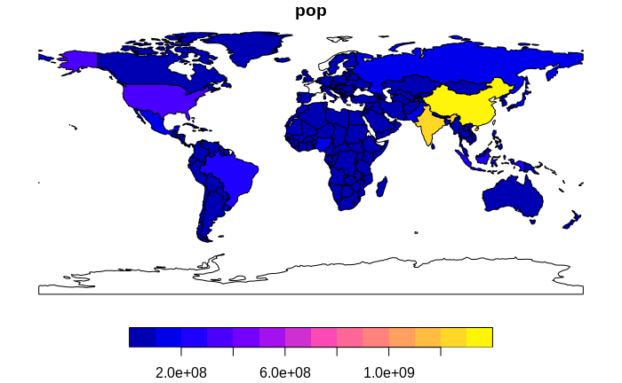
plot(world[,”pop”])
Notes:
You can index spatial data.frames

Slide 23
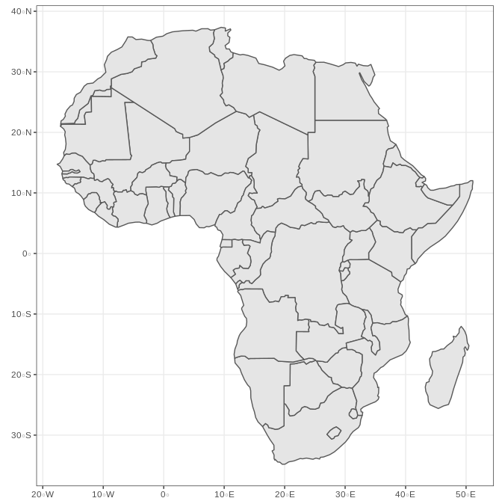
Mapping using ggplot2
geom_sf(): ggplot layer for plotting spatial data
#use ggplot to make a map of Africa
world %>%
filter(region_un == "Africa") %>% ggplot() +
geom_sf() +
theme_bw()
Notes:
Ggplot allows us to make nicer and more coustomized maps in R
Remember ggplot geomes -- there is a special geom for simple features called geom_sf()
And like for non spatial data we can combine pipes and dplyr functions with ggplot to produce maps
So here is we wanted to make a map of africa we would filter the world data by region and pipe the filtered data to ggplot specifying that it should be plotted using geom_sf()

Slide 24
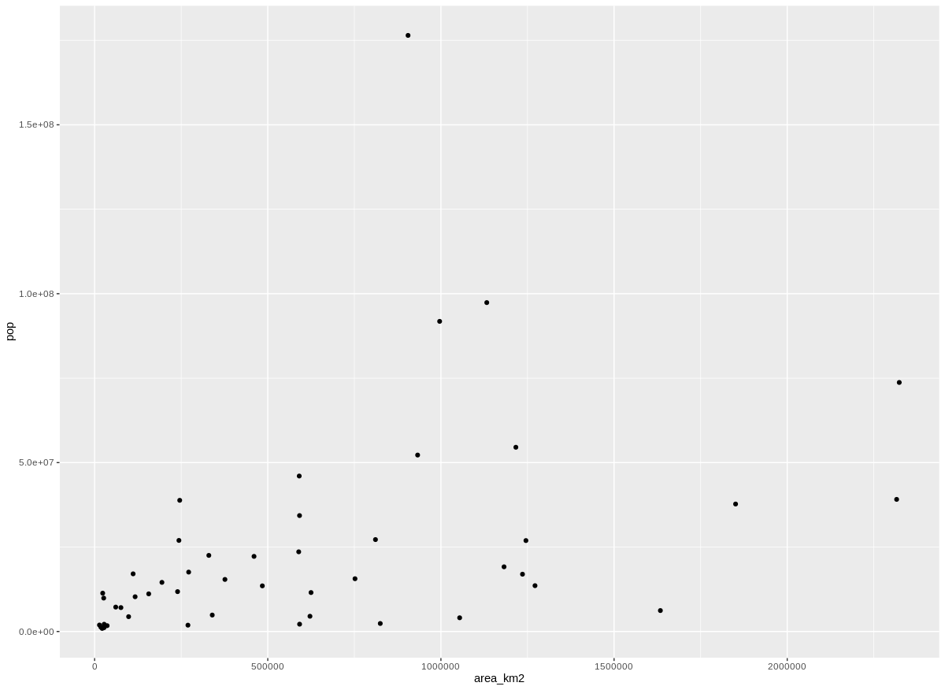
Plotting Attribute Data
#plot population as a function of region size in Africa
world %>%
filter(region_un == "Africa") %>% ggplot() +
geom_point(
aes(x=area_km2, y=pop))
Notes:
What would happen if you used a different geom?
You would plot the attribute data in the filtered spatial data.frame

Slide 25
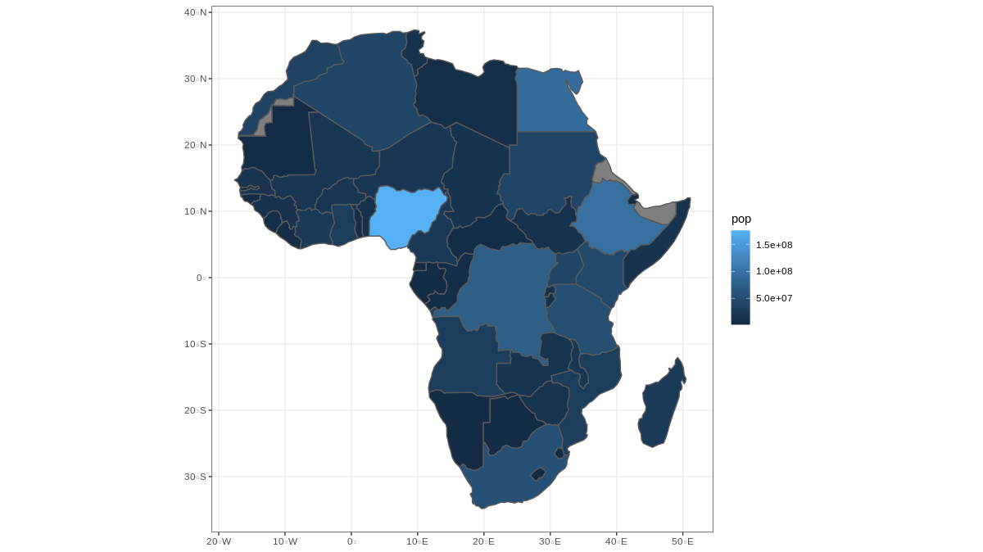
Mapping using ggplot2
geom_sf(): ggplot layer for plotting spatial data
#use ggplot to make a map of population in Africa
world %>%
filter(region_un == "Africa") %>% ggplot() +
geom_sf(aes(fill = pop)) +
theme_bw()
Notes:
Someone talk us through the code here
What is this type of map called?

Slide 26
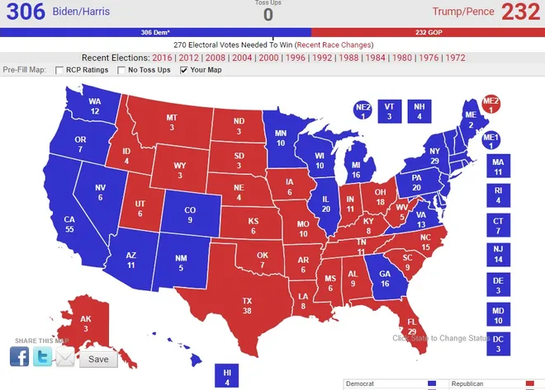
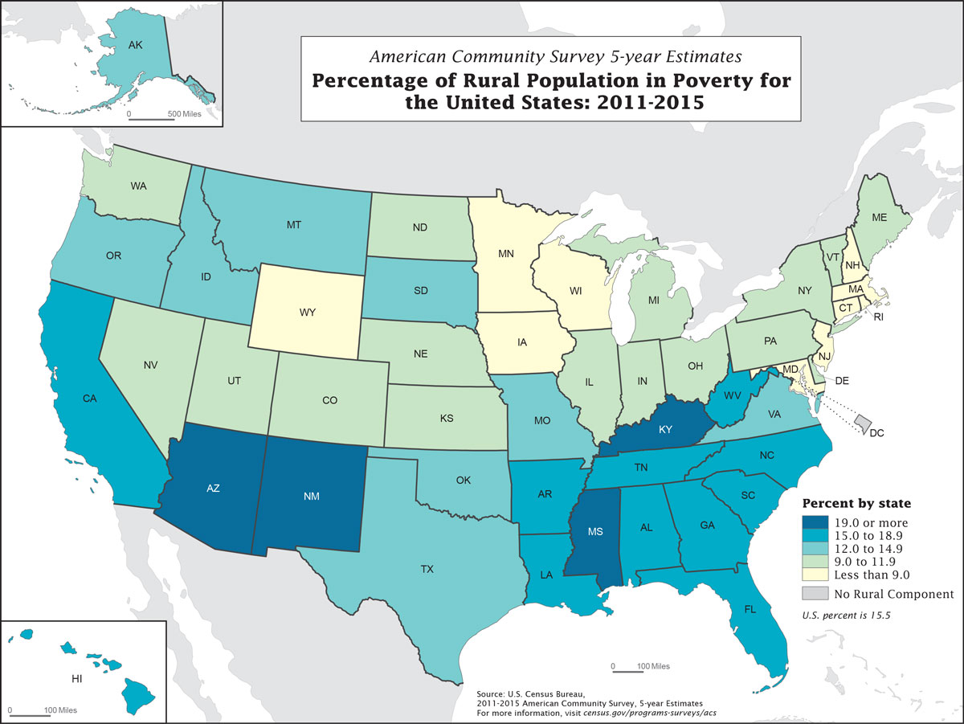
Choropleth Maps
Choropleth maps: thematic maps where areas are shaded or filled to represent different values
Often but not necessarily uses administrative units (country, state, zip code, watershed, etc.)
Notes:
Ggplot map with polygons filled by attribute
Choropleth maps: thematic maps where areas are shaded or filled to represent different values
Often but not necessarily uses administrative units (country, state, zip code, watershed, etc.)
They are one of the most commonly used maps and they’re easy to make and customize in R

Slide 27
Choropleth Map Recommendations
Always Include a legend.
Choose an appropriate method of grouping your data if it is numeric.
Intervals should not overlap
Whether your data is numeric or categorical try to limit the number of categories to 7 or fewer.
Fewer categories on a map helps users to better understand what is being visualized and allows for trends in the data to be more easily identified.
Choose a color-blind friendly color scheme
Avoid using red and green together
Read more about color-blind friendly palettes in R: https://www.r-bloggers.com/2013/10/creating-colorblind-friendly-figures/
Notes:
Always Include a legend.
Choose an appropriate method of grouping your data if it is numeric.
Intervals should not overlap
Whether your data is numeric or categorical try to limit the number of categories to 7 or fewer.
Fewer categories on a map helps users to better understand what is being visualized and allows for trends in the data to be more easily identified.
Choose a color-blind friendly color scheme
Avoid using red and green together
Read more about color-blind friendly palettes in R: https://www.r-bloggers.com/2013/10/creating-colorblind-friendly-figures/

Slide 28
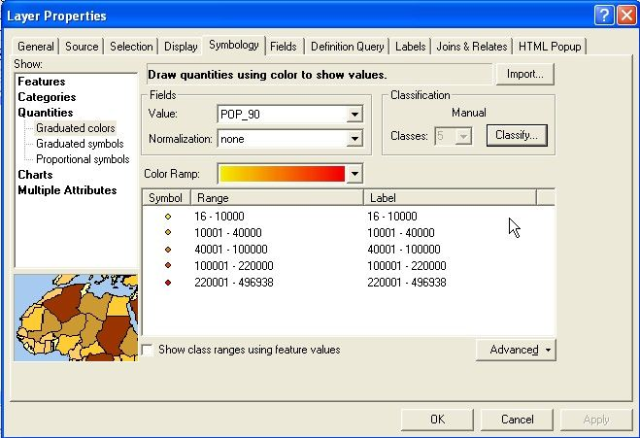
Grouping Numeric Data
Choose an appropriate method of grouping your data if it is numeric.
Equal Interval: divides the data range into equal intervals. Works best when data are evenly distributed. Not sensitive to outliers.
Natural Breaks: groups based on gaps in the data.
Quantile: partitions the data so that every group has an equal number or nearly equal number of values.
Manual: Subject matter expertise can be used to place data into groups.
Notes:
If you’ve made Choropleth maps in arc or another GIS you would have manually specified an algorithm for grouping your data -- likely selecting one of these choices from a drop down menu
Equal Interval: divides the data range into equal intervals. Works best when data are evenly distributed. Not sensitive to outliers.
Natural Breaks: groups based on gaps in the data.
Quantile: partitions the data so that every group has an equal number or nearly equal number of values.
Manual: Subject matter expertise can be used to place data into groups.

Slide 29
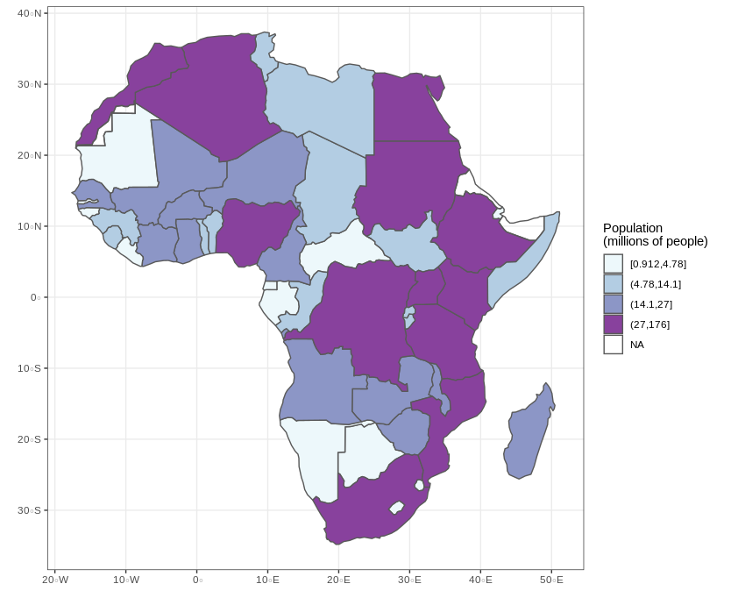
Grouping Numeric Data: Equal Interval
world %>%
filter(region_un == "Africa") %>%
ggplot() +
geom_sf(aes(fill =
cut_number(pop/1000000, 4))) +
scale_fill_brewer(palette = BuPu",
name = "Population\n(millions of
people)") +
theme_bw()
Color brewer palettes:
https://colorbrewer2.org/#type=sequential&scheme=BuPu&n=4
Notes:
You can code intervals into your ggplot maps in R
Equal Interval: divides the data range into equal intervals.
world %>%
filter(region_un == "Africa") %>%
ggplot() +
geom_sf(aes(fill =
cut_number(pop/1000000, 4))) +
scale_fill_brewer(palette = BuPu",
name = "Population\n(millions of
people)") +
theme_bw()

Slide 30
Choropleth Maps in R
Notes:
You can see the contrast between these two maps one on the left shows population on a continuous scale
The one on the right groups population into 4 intervals each of which contains the same number of values

Slide 31
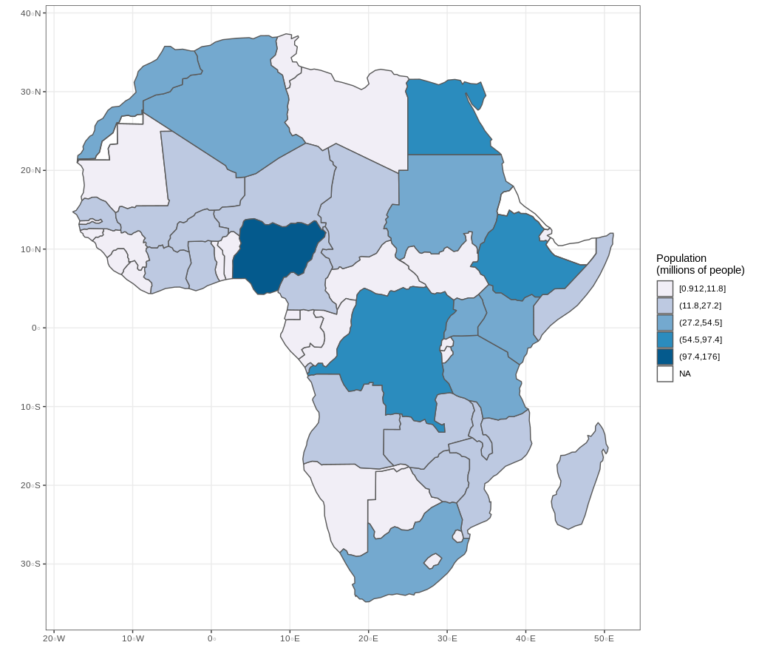
Grouping Numeric Data: Natural Breaks
library(classInt)
natural.breaks <-
classIntervals(africa$pop, n = 5, style = "jenks")
africa <- africa %>%
mutate(pop_class = cut(pop, natural.breaks$brks, include.lowest = T))
africa %>% ggplot() +
geom_sf(aes(fill = pop_class)) +
scale_fill_brewer(palette = "PuBu", name = "Population\n(millions of people)") + theme_bw()
Notes:
It is also possible to use other grouping algorithms to produce choropleth maps in R -- Natural Breaks: groups based on gaps in the data.
You do this using the class intervals function from the library class int
This function lets you specify the number of breaks and the classification scheme -- you can then create a new column in your spatial dataframe where you assign each observation to one of the classes -- what this code is doing
And finally you would use the classified breaks as the fill for your map polygons -- resulting in a map where population is split into 5 classes -- Natural Breaks: groups based on gaps in the data.
You can also use the class intervals function to create qualtile and other breaks --
If this code isn’t fully making sense that’s ok, i just want you to have it as a reference for better coustomizing chropleth maps

Slide 32
Mapping using ggplot2
geom_sf(): ggplot layer for plotting spatial data
#use ggplot to make a map of population in Africa
world %>%
filter(region_un == "Africa") %>% ggplot() +
geom_sf(aes(fill = pop)) +
theme_bw()
Notes:
But remeber that the default fill also produces a chropleth map

Slide 33
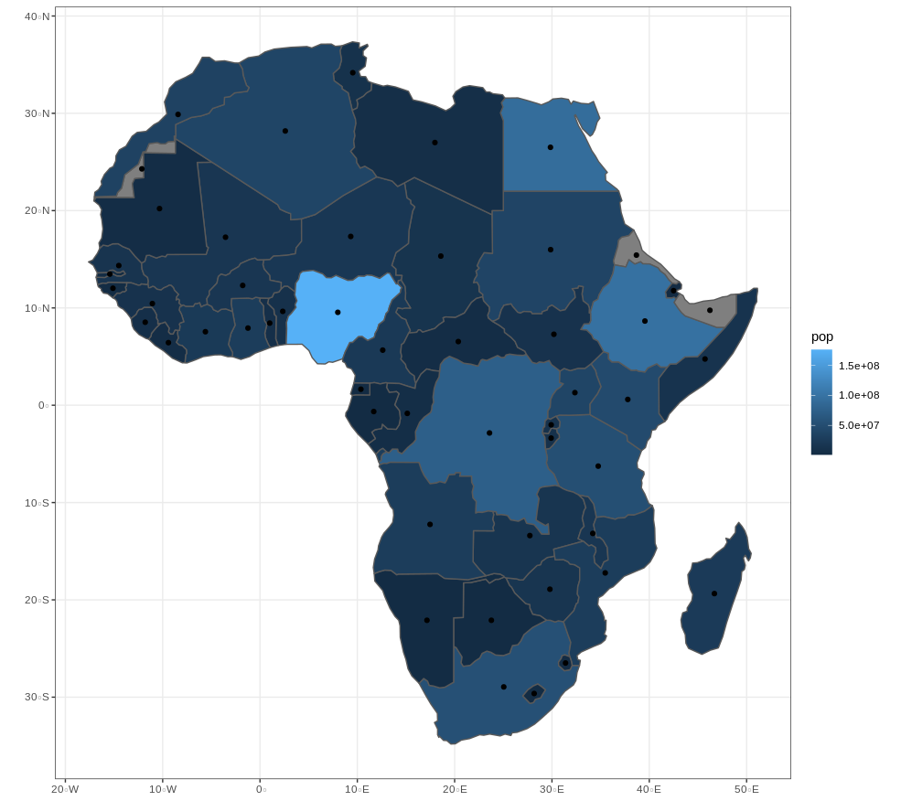
Layering Geometries
You can create more complex maps in R by layering multiple geometries with geom_sf()
When subsequent sf objects have a different coordinate reference system from the first object, geom_sf will transform them to the reference system of the first object!
centroids <- st_centroid(africa)
world %>%
filter(region_un == "Africa") %>% ggplot() +
geom_sf(aes(fill = pop)) +
geom_sf(data = centroids) +
theme_bw()
Notes:
You can create more complex maps in R by layering multiple geometries with geom_sf()
What is this code -- using the sf function st_centroid() doing?
You can see how we can layer points onto filled polygons using a second geom_sf()
A cool thing about mapping spatial objects in R is that When subsequent sf objects have a different coordinate reference system from the first object, geom_sf will transform them to the reference system of the first object! -- which is pretty handy

Slide 34
Questions?
Notes:
Questions
-- I want to wrap up class by taking us outside of R and talking about some options for other open source GIS software and telling you about some examples that show the promises of approaching GIS with an open source philosophy

Slide 35

Closed GIS
“Will we secure knowledge by and for a clerisy of “geographical knowledge elites” or will we establish more bottom-up production of geographical knowledge?”
Crampton, J. W. (2011). Mapping: A critical introduction to cartography and GIS (Vol. 11). John Wiley & Sons.
https://www.as.uky.edu/users/jcr228
Notes:
I pulled this quote from a book on critical cartography by Jeremy W Crampton -- and I pose this question to you as the future of GIS
“Will we secure knowledge by and for a clerisy of “geographical knowledge elites” or will we establish more bottom-up production of geographical knowledge?”
What does a bottom-up production of geographical knowledge mean to you
What would this take?

Slide 36
Benefits of Open GIS
Open source makes for better software.
Linus's law: "given enough eyeballs, all bugs are shallow".
Free software makes GIS more accessible to people who cannot afford expensive software licenses
Open source software is available to people with different points of view—diverse backgrounds, goals, perspectives, expertise—spurring creativity.
Notes:
Open source makes for better software.
Linus's law: "given enough eyeballs, all bugs are shallow".
Free software makes GIS more accessible to people who cannot afford expensive software licenses
Open source software is available to people with different points of view—diverse backgrounds, goals, perspectives, expertise—spurring creativity.

Slide 37

Possibilities of opening GIS: CLEAR Project
Citizen Science - who collects spatial data? Who decides what data to collect?
“The Fish Tag Citizen Science project aims to create a database of tags that have been found and map where they start and where they end up, using plastic pollution to map currents as well as to think about the scales and currents of accountability when plastic is a global pollutant.” - https://civiclaboratory.nl/2017/11/07/citizen-science-collection-of-beached-fish-tags-new-project/
Notes:
One possiblity of opening GIS is opening it up to Citizen scentists - who collects spatial data? Who decides what data to collect?
“The Fish Tag Citizen Science project aims to create a database of tags that have been found and map where they start and where they end up, using plastic pollution to map currents as well as to think about the scales and currents of accountability when plastic is a global pollutant.” - https://civiclaboratory.nl/2017/11/07/citizen-science-collection-of-beached-fish-tags-new-project/

Slide 38
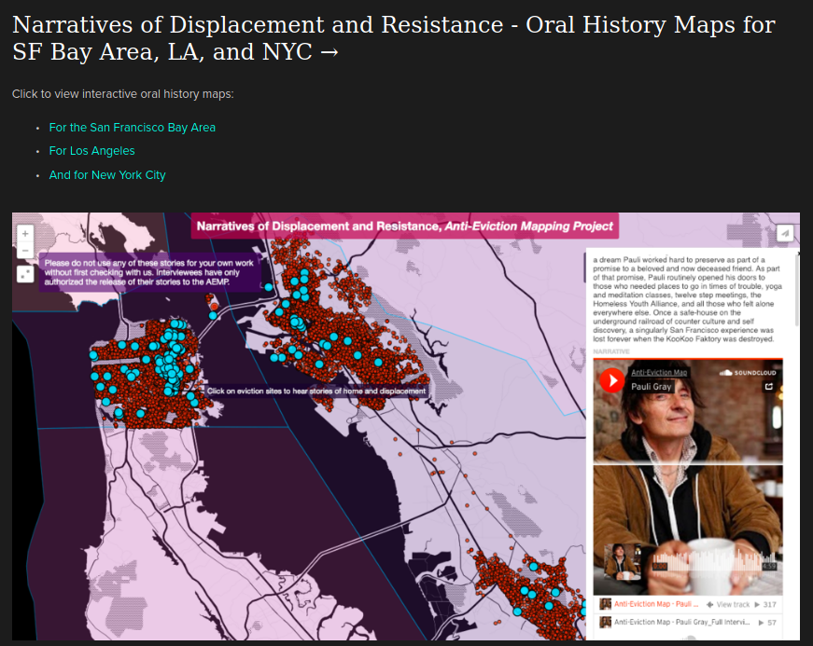
Possibilities of opening GIS: Anti-Eviction Mapping Project
Scholar-activist partnership
“our project maps sites of resistance, while remembering spaces lost and struggled for”
Manissa M. Maharawal and Erin McElroy
https://antievictionmap.com/
Notes:
Another possibility is Scholar-activist partnerships like the anti-eviction mapping project
“our project maps sites of resistance, while remembering spaces lost and struggled for”
Manissa M. Maharawal and Erin McElroy
https://antievictionmap.com/

Slide 39
Other Free and Open Source Software (FOSS) GIS
All Purpose FOSS GIS
QGIS: https://www.qgis.org/en/site/ (Python)
GRASS GIS: https://grass.osgeo.org/ (C/Python)
SAGA: https://sourceforge.net/projects/saga-gis/ (C++, mainly used for raster processing)
Spatial Data Analysis (correlation and regression)
GEODA: https://geodacenter.github.io/
Notes:
R is only one tool in your open source GIS tool box there are many other Free and Open Source Software (FOSS) GIS
QGIS most popular -- This means that you have access to GDAL, GRASS and SAGA through QGIS (Graser and Olaya 2015).
Grass GIS and SAGA are two other all purpose GIS software although Grass was historiacally mainly used for saster processing and is recently introducing vector capbilityes and SAGA continues to be used mainly for raster processing
I use QGIS and have never missed arc since switching over
Another great open source GIS tool is GEODA -- it has more focused functionalities on building spatial models and is used primarily for spatial correlation and regression analysis
I’m pointing these tools out to you because while we’re learning to use R for programing spatial visualizations and analysis -- it’s nice to also have point and click options

Slide 40
Bridges between R and Open Source GIS Software
R (CLI): Command-Line Interface, code
GIS Software (GUI): Graphical User Interface, point and click
QGIS: https://www.qgis.org/en/site/ (library: RQGIS)
GRASS GIS: https://grass.osgeo.org/ (library: rgrass7)
SAGA: https://sourceforge.net/projects/saga-gis/ (library: RSAGA)
Notes:
The other cool thing is that R can communicate qith QGIS, GRass GIS and saga, there are R packages -- listed here that allow you to run geoalgorithms outside these GIS GUI -- or graphical user interfaces -- this means that you can use R to automate point and click spatial analyses!
So I highly reccomend adding one of these gis guis to your open source GIS toolbox -- i’m a fan of qgis -- these are also great options if you no longer have access to arc on your personal computer but still need to use a GIS

Slide 41
Questions?
Notes:
Questions

Slide 42
Coming-up
Assignment 5 (Due Sun Feb 21 @ 11:59 pm)
Review:
Reading, creating and writing shapefiles
projections.
Mapping using ggplot2
Course Topic Schedule Change:
Next week: Mapping and Cartography (Dr. S)
Weeks 7 and 8: R and Google Earth Engine with Dr. Hernandez
Sign up for a GEE account : https://signup.earthengine.google.com/#!/
Week 9: Project Part 2 (mapping)
Notes:
Coming up we have assignment 5 -- which is due on sunday and as always we’ll have a coding work day on thursday when you can work on this assignment
Also some adjustments for the upcomming weeks -- next week I will give the lecture on mapping and cartography in R (this was previously scheaduled for week 8 in our syllabus)
and then Dr. Hernandez will take over for lectures over the next two weeks introducing you to Raster analysis and how to integrate R with google earth engine -- in preperation for this you should look into signing up for a google earth engine account if you don’t have one already
And then you will work on the second part of the class project which will be focused on mapping your data
-- remember the first part of this project is due tomorrow

