Slide 1

Co-Victory
Raju, S.K Rajesh, Manish

Slide 2
Agenda
Introduction
Website Design
Content Strategy
Case Studies
Features and Functionality
Data Integration
Impact Assessment
Budget Allocation
Wow Factor
MODELING
Result
Meet Our Team
Conclusion
TEAME > Co-Victory

Slide 3
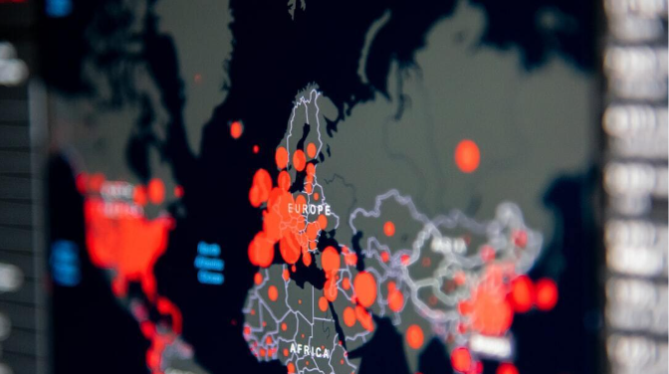
Introduction
Objectives, Importance, Challenges
Objectives: Creating a centralized platform for accurate COVID-19 information and resources, promoting public awareness and preventive measures.
Importance: Addressing the critical need forrellable and up-to-date COVID-19 information, fostering community support, and facilitating access to essential resources
Challenges: Navigating through misinformation, ensuring data credibility, and maintaining relevance amidst evolving pandemic dynamics
Photos provided by Pexels

Slide 4

Website Design: User Interface, Layout, Navigation
Responsive Design, User Experience, Information Architecture
Responsive Design
Ensuring an optimal viewing experience across various devices, providing easy access to COVID-19 information and resources.
User Experience
Focusing on intuitive and user-friendly design, prioritizing ease of access, readability, and interactive elements for enhanced engagement.
Information Architecture
Organizing content and resources in a coherent and logical manner, facilitating efficient navigation and seamless access to relevant information.

Slide 5
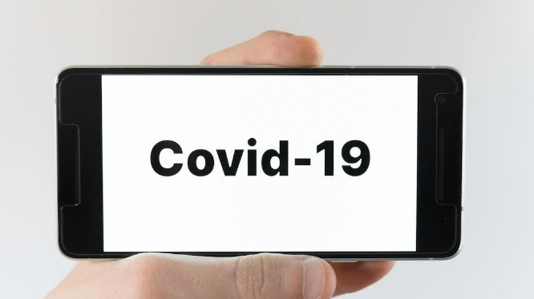
Content Strategy: Informational Content, Updates, Resources
Content Relevance, Timeliness, Credibility
Content Relevance
Curating content that directly addresses GOVID-19-related cancerns, ensuring the information is pertinent and valuable to the audience.
Timeliness
Providing real-time updates and insights, ensuring that the information is current, accurate, and aligns with the evolving situation
Credibility
Ensuring that all content and resources provided on the website are from reputable sources and undergo through verification processes.

Slide 6

Case Studies: Successful Implementation Examples, Lessons Learned
Best Practices, Success Stories, Implementation Insights
Best Practices
Exploring successful strategies and practices implemented in other similar projects to learn and incorporate them into the COVID-19 Website Project.
Success Stories
Showcasing successful case studies and projects to highlight effective approaches and provide inspiration for the COVID-19 Website Project.
Implementation Insights
Gaining valuable insights from the implementation experiences of other projects to inform the development and operation of the COVID-19 Website Project.
Photos provided by Pexels

Slide 7
Features and Functionality: Tools, Search Function, Notifications
Interactive Features. Search Capabilities, Alerts
Interactive Features
Integrating interactive tools that engage users, provide valuable insights, and facilitate active participation in the COVID 19 Information ecosystem.
Search Capabilities
Offering robust search functionality to enable users to locate specific information, resources, and updates efficiently.
Alerts
Implementing notification systems to deliver critical updates, alerts, and relevant information directly in users' devices.

Slide 8
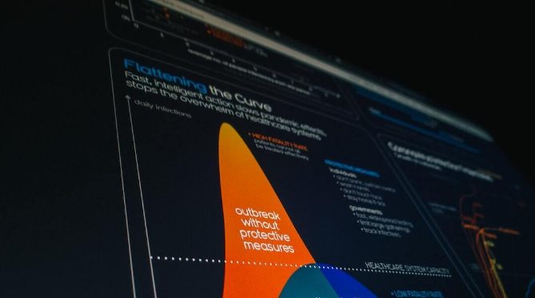
Data Integration: Real-time Data, APIs, Dashboards
Data Sources, Integration Methods, Visualization
Data Sources
Aggregating real-time data from reliable sources, including health organizations, government reports, and verified databases.
Integration Methods
Utilizing APIs and other integration methods to collect, organize, and present the data in a coherent and user-friendly manner.
Visualization
Presenting data through intuitive and informative dashboards, charts, and visual representations for enhanced understanding.

Slide 9

Impact Assessment: User Feedback, Analytics, Key Performance Indicators
Feedback Analysis, Metrics Tracking, Performance Evaluation
Feedback Analysis
Analyzing user feedback to understand user experiences, address concerns, and make strategic improvements to the website.
Metrics Tracking
Utilizing analytics and metrics to track user engagement, content relevance, and overall performance of the website.
Performance Evaluation
Evaluating key performance indicators (KPIs) to assess the impact and effectiveness of the COVID-19 Website Project over time.

Slide 10
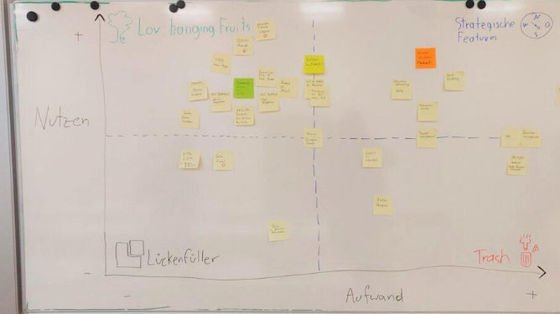
Budget Allocation: Costs, Resource Planning, Funding Sources
Budget Breakdown, Resource Allocation, Funding Options
Budget Breakdown
Segmenting the budget into different categories, including development, maintenance, marketing, and contingency funds.
Resource Allocation
Allocating resources effectively to ensure the successful development, operation, and maintenance of the COVID-19 Website Project.
Funding Options
Exploring various funding sources, including public grants, private partnerships, and crowdfunding initiatives, to support the project.

Slide 11

WOW FACTOR
It is easy to use
Multi users access
the user experience in navigating pandemic information.
the website stands out as a beacon of innovation and solidarity
we can face the challenges of COVID-19 with resilience and the WOW factor
User easily update data view

Slide 12
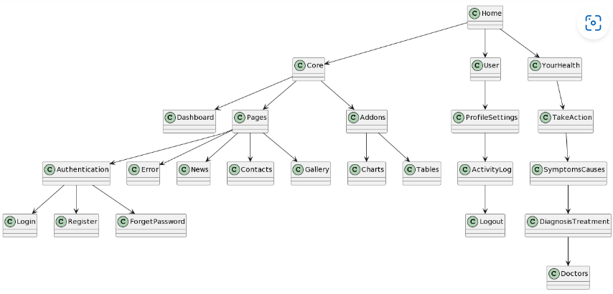
MODELING

Slide 13
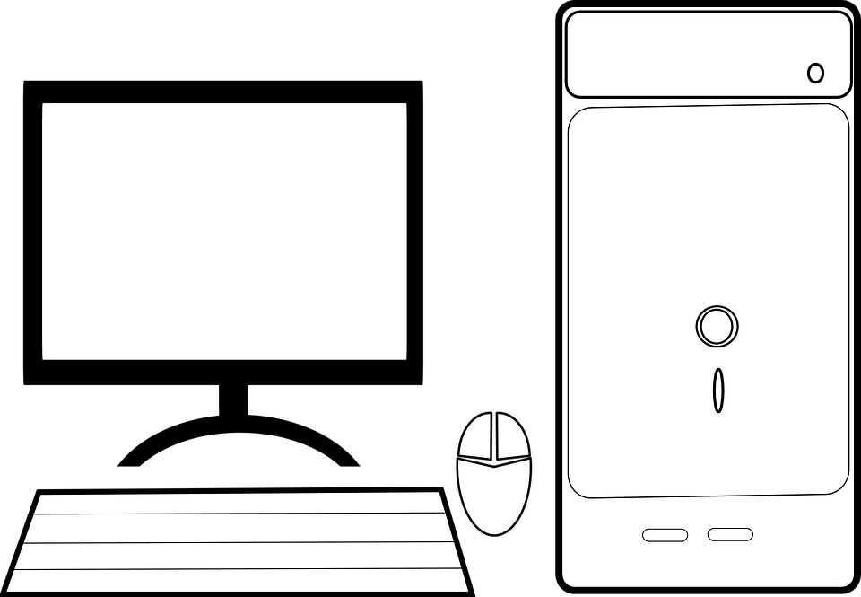
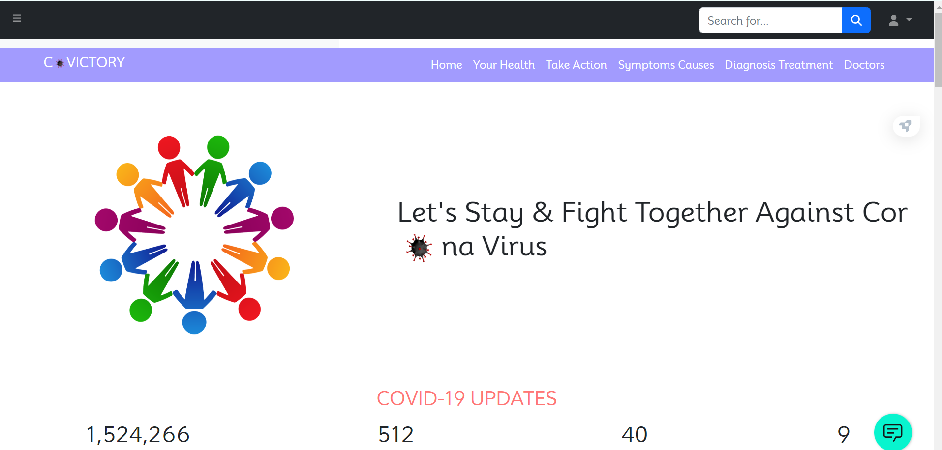
RESULT

Slide 14

Conclusion: Key Learnings, Future Roadmap, Recommendations
Lessons Learned, Strategic Direction, Next Steps
Lessons Learned
Reflecting on challenges, successes, and experiences to derive meaningful Insights and valuable lessons for future endeavors.
Strategic Direction
Outlining a strategic madmap and direction for the future development, growth. and continuous improvement of the COVID-19 Website Project
Next Steps
Presenting actionable recommendations and initiatives to drive progress, innovation, and the sustained impact of the project.
Photos provided by Pexels

Slide 15

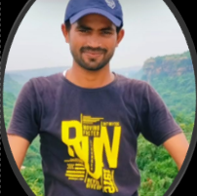
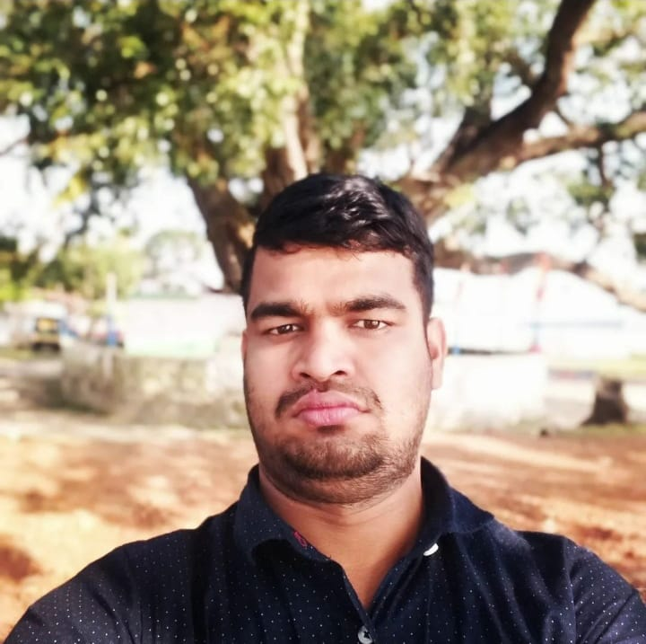
MEET OUR TEAM
RAJU KUMAR
MANISH PATEL
S.K RAJESH
Student of NSTI Howrah, ​Dasnagar​​
ADIT-IBM​​
Roll No.- 330
Student of NSTI Howrah, ​Dasnagar​​
ADIT-IBM​​
Roll No.- 321​
Student of NSTI Howrah, ​Dasnagar​​
ADIT-IBM​​
Roll No.- 321​
TEAME > Co-Victory

Slide 16
Thank You….

