Slide 1

Final Project
Big Data Case Study in Life Sciences: Using Cassandra to store and retrieve conservation scores for mutation annotation
Perera, Dilmi
csci e63 Big Data Analytics, 2015
Harvard Extension School
Professor: Zoran B. Djordjević
@Dilmi Perera

Slide 2
Overview
Technology used
  NoSQL: Apache Cassandra
  Apache Cassandra Bulk Load
Problem Definition
  Overview
  Current methods used and their limitations
Why choose Cassandra?
  Advantage compared to RDBMS.
  Advantage compared to other NoSQL DBs
Implementation details
  Installing and configuring Cassandra on Ubuntu.
  Data Model
  Using Cassandra Bulk Loader for Inserting data
  Implementing solution in Java
Challenges faced/ Lessons learned
@Dilmi Perera

Slide 3
NoSQL and Apache Cassandra
NoSQL-
  Database technologies designed to handle the burgeoning size of data which regular RDBMS are not able to handle.
Cassandra –
  High performance, highly scalable distributed database.
  Suitable for structured data.
  Partitioned row store data model with tunable consistency
  Tables can be created, dropped, and altered at runtime without blocking updates and queries.
@Dilmi Perera

Slide 4
Apache Cassandra Bulk Load
Bulk Loader – When you need to upload a large amount of data (> ~ 10 million rows) into a Cassandra DB, it is recommended that you use the bulk loader option.
It uses sstableloader which is a tool that, given a set of sstable data files, streams them to a live cluster. It does not simply copy the set of sstables to every node, but only transfers the relevant part of the data to each, conforming to the replication strategy of the cluster.
There are two primary use cases for this tool:
  Loading pre-existing sstables, typically snapshots, into another cluster with different node counts or replication strategy.
  Bulk loading external data into a cluster: for this you will have to first generate sstables for the data to load, as we will see later in this post.
In the case of this demo, we will be using the 2nd use case.
[1] http://www.datastax.com/dev/blog/bulk-loading
@Dilmi Perera

Slide 5
Problem Definition
Overview
  Annotating mutations with sequence conservation scores (PhastCons) is an important part of the analysis process. However, PhastCons for each base pair of the human genome amounts to a large amount of data in the order of several gigabytes (~20GBs) which makes it extremely difficult(virtually impossible) to effectively store and retrieve using traditional RDBMS.
Currently used methods and their limitations
  The common method for analyzing this kind of data is keeping them in text files and using scripts for retrieving data. But when annotating large amounts of mutations from large amounts of samples, the time taken for file read writes in the data retrieval process adds huge delays to data analysis pipelines.
Proposed solution
  Use Apache Cassandra for fast and accurate retrieval of sequence conservation scores for annotating mutations.
@Dilmi Perera

Slide 6
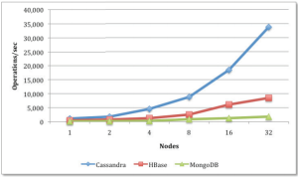
Why choose Cassandra?
Benefits of choosing Cassandra for given application–
  Data is in a column-based format as opposed to document-based or graph-based. So the two main options are Cassandra and HBase
  Application involves mainly read operations and Cassandra has been shown to out perform all other NoSQL DBs in this regard.
  The Partition key, cluster key organization structure of the data model of Cassandra is well suited for the dataset
@Dilmi Perera

Slide 7
Data sets used
PhastCons
  Download URL allows you to create a wigFix file
  http://hgdownload.cse.ucsc.edu/goldenPath/hg19/phastCons46way/placentalMammals/chr1.phastCons46way.placental.wigFix.gz
  This file needs to be converted to .csv format using the following
  “awk 'BEGIN { OFS = "\t" } NR > 1 && NF == 1 {print "chr1,"(10918+NR-2)","$1}'”
  The converted .csv file should look like “chrom”, “base”, “score” chr1,10918,0.254
  chr1,10919,0.252
  chr1,10920,0.250
  chr1,10921,0.248
Mutation Data
  Mutation data can have any amount of columns but the first three columns should be in the following format.
  chr1,10919,10920
  chr1,10921,10922
  chr1,10920,10921
  chr1,10922,10925
@Your Name

Slide 8
Implementation Details
Data Model – The Cassandra data model is a partitioned row store with tunable consistency. This model is ideal for storing PhastCons score data.
The “chrom” or chromosome variable will be the partition key which would allow the meaningful distribution of data in a per-chromosome manner across a distributed system which would allow for efficient parallel retrieval of data.
The clustering key would be the “base” variable or the location of the base pair in the chromosome and the data will be ordered based on this.
@Your Name

Slide 9
Implementation Details
Install Cassandra on Ubuntu
  Check java version (must be 1.7)
  Add the DataStax Community repository to the /etc/apt/sources.list.d/cassandra.sources.list using “echo "deb http://debian.datastax.com/community stable main" | sudo tee -a /etc/apt/sources.list.d/cassandra.sources.list”
  Add the DataStax repository key to your aptitude trusted keys.“curl -L http://debian.datastax.com/debian/repo_key | sudo apt-key add -”
  Install the latest package:
    sudo apt-get update
    sudo apt-get install dsc21
    sudo apt-get install cassandra-tools
Check by typing “cqlsh” to see if the cassandra prompt appears
@Your Name

Slide 10
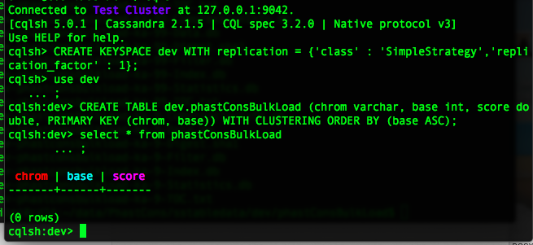
Implementation Details
Create table in database
@Your Name

Slide 11
Implementation Details
Generate sstable from .csv files
  Schema for bulk loading table.
  public static final String SCHEMA = String.format("CREATE TABLE dev.phastConsBulkLoad
  (” chrom varchar, base int, score double,
  PRIMARY KEY (chrom, base) WITH CLUSTERING ORDER BY (base ASC) ”);
  INSERT statement to bulk load. It is like prepared statement. You fill in place holder for each data.
  public static final String INSERT_STMT = String.format("INSERT INTO dev.phastConsBulkLoad (”chrom , base , score) VALUES (?, ?, ?)”);
@Your Name

Slide 12
Implementation Details
Generate sstable from .csv files
  Prepare SSTable writer
CQLSSTableWriter.Builder builder = CQLSSTableWriter.builder();
  set output directory
builder.inDirectory(outputDir)
  set target schema
.forTable(SCHEMA)
  set CQL statement to put data
.using(INSERT_STMT);
  Generate CQLSSTableWriter
  CQLSSTableWriter writer = builder.build();
@Your Name

Slide 13
Implementation Details
Generate sstable from .csv files
  Write to SSTable while reading data
  List<String> line;
  while ((line = csvReader.read()) != null)
  { writer.addRow(line.get(0),
  new Integer(line.get(1)),
  new Double(line.get(2)));
  }
@Your Name

Slide 14
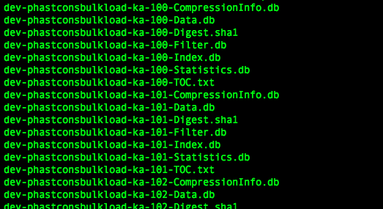
Implementation Details
List of files being created
@Your Name

Slide 15
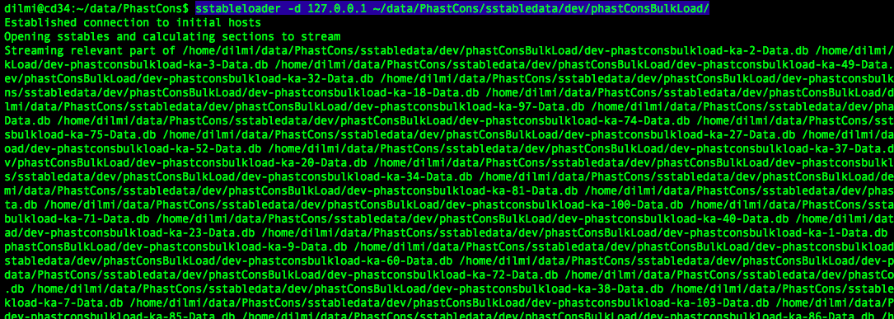
Implementation Details
Load files to data base using sstableloader
@Your Name

Slide 16
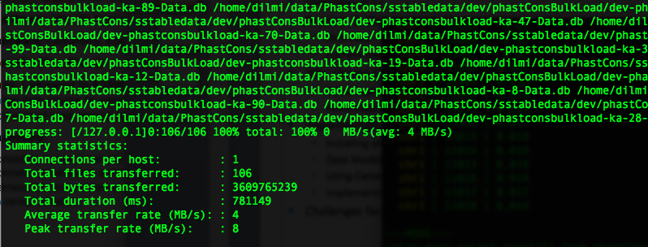
Implementation Details
Load files to data base using sstableloader
@Your Name

Slide 17
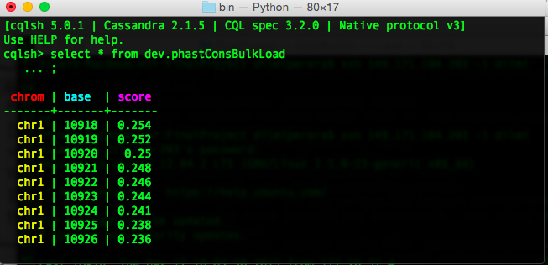
Implementation Details
Check whether files were correctly loaded
@Your Name

Slide 18
Implementation Details
Java implementation for annotating mutations using PhastCons
  Read mutation file in the following format (in 0 base coordinates, can have any number of columns after the first 3)
  chr1,10919,10920,..,..,..,..
  chr1,10921,10922,..,..,..,..
  chr1,10920,10925,..,..,..,..
  E.g For a mutation located in the following location
    chr1 10920 10925
    public double getScore(String chrom, int start, int end ) {
    String query="SELECT * FROM dev.phastConsBulkLoad WHERE chrom='"+chrom+"' and base>”+start+"' and base<”+end+1+";";
    ResultSet results = session.execute(query);
    Read the returned result set and provide average score for region
@Your Name

Slide 19
“Aha!” moments
Watch out for Memory requirements while generating sstables.
  I tried on my Mac and I ran out of memory.
  If you would like to test this out on your own PC/Mac, I would suggest you use a reduced version of the (~4GB .csv file)
Maven repository
  You need the marven repo for running the CQLSSTableWriter component.
  However, the guava library that comes with the marven repository is an older version(14.0). You need the newer version (16.0) and it need to be added seperately.
@Your Name

