Slide 1
REAL TIME IMAGE CLASSIFIER APP
Team
Dilkhush Mihirsen
Jonathan Thangadurai

Slide 2
Agenda
Problem Statement
Bull Diagram
Octopus Diagram
Technology Stack
Working
Screenshot
Summary

Slide 3
Problem Statement
Our aim is to develop a machine learning model for recognizing images and to train it efficiently by feeding it datasets taken from various sources which offer labeled data. This model will then be fused into an android application. Ultimately, we obtain an application running on Android which will obtain a live feed from the camera and calculate the probability of what the image is when the camera is pointed at an object.

Slide 4
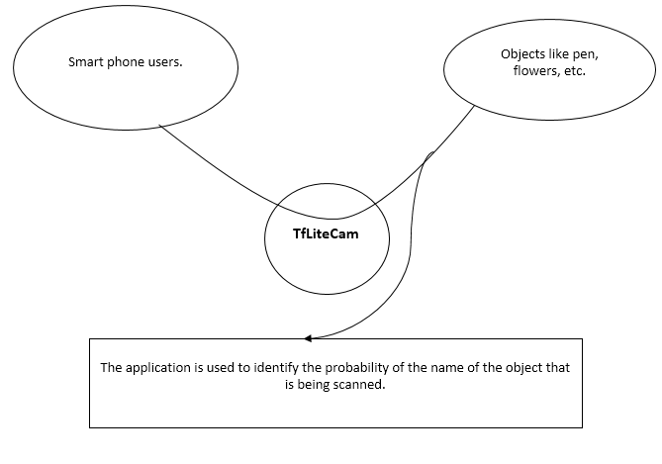
Bull Diagram

Slide 5
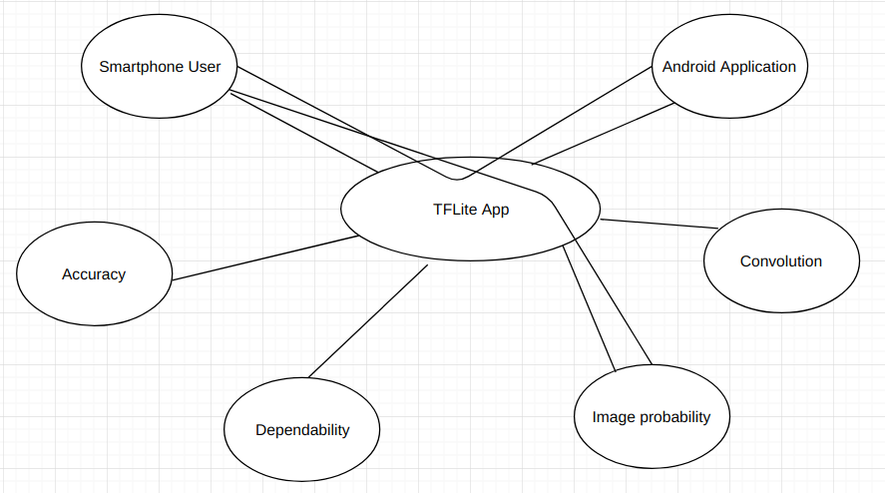
Octopus Diagram

Slide 6





Technology Stack

Slide 7
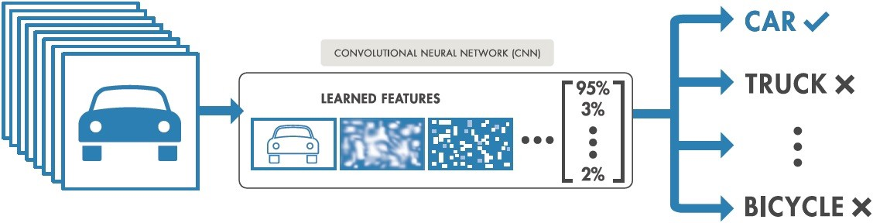
Working

Slide 8
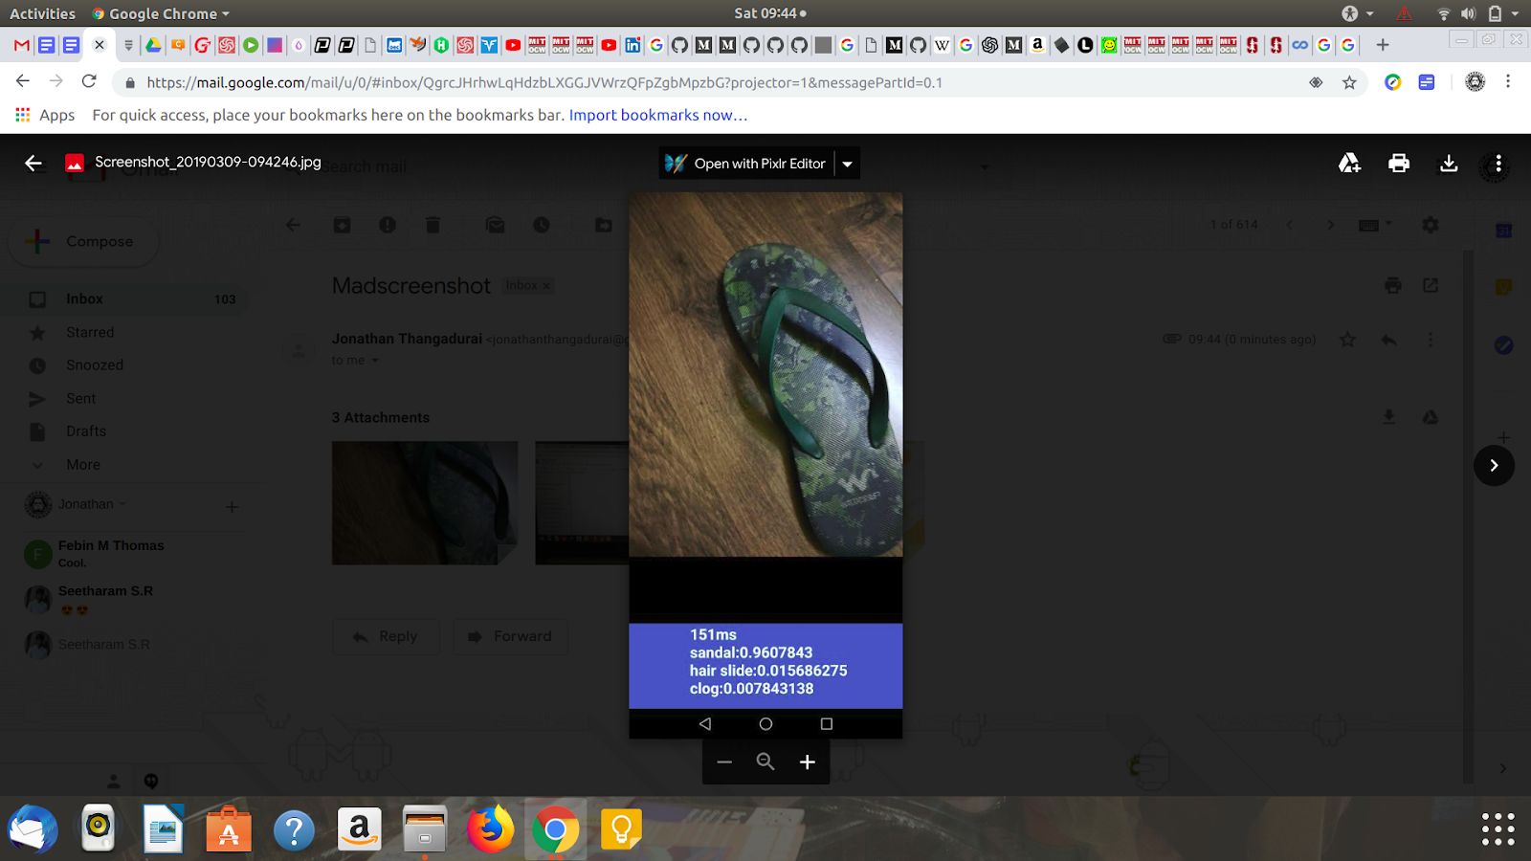
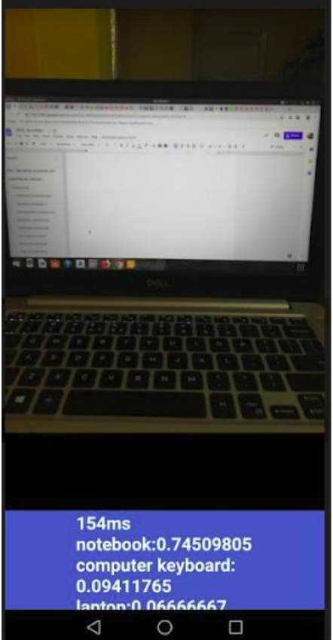
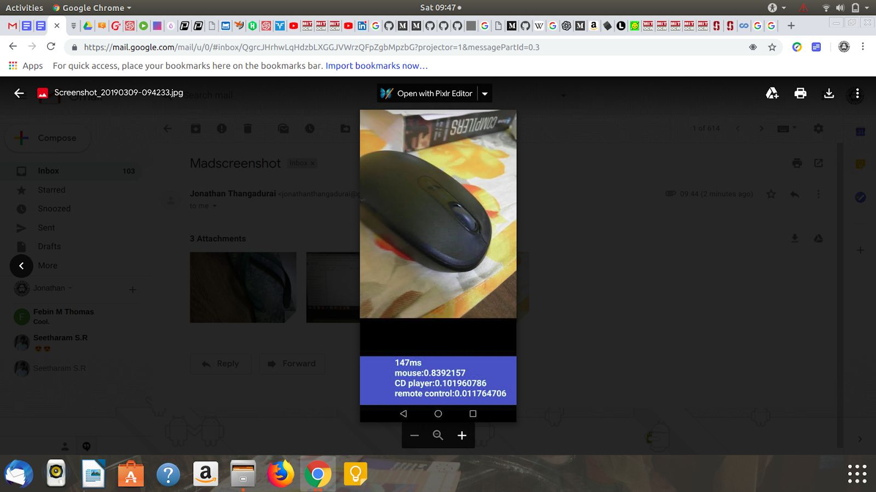
Screenshots

Slide 9
Summary
The tensorflow module which has been wrapped into the Android Application after training has achieved an accuracy quotient of 0.85 .
The Application can be further trained by feeding additional datasets to achieve a higher accuracy quotient.

