Slide 1
How do you really feel?
IMDB vs THE PEOPLE
<p> Dilly, Henry, Lyn </p>

Slide 2
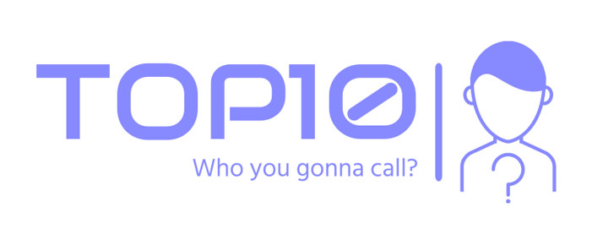
HI! WE ARE…
<p> Top 10 Analyst </p>
A company where we disprove common social beliefs in order to benefit society and reflect change to aspects of different side of business.

Slide 3
TABLE OF CONTENTS.
01
02
03
04
05
06
Introduction
(Motivation tools, Background)
Cleaning
Twitter
Sentinel Analysis
Results
Conclusion

Slide 4
Background
01
<p> Why this topic? </p>

Slide 5
Background CONTINUES..
<p> As a group we decided to study the relationship between what movie critics rate a movie and how people actually felt about a movie </p>

Slide 6
Motivation MATERIALS
Motivation
We noticed that a lot of the movies that say they're good aren't good. So instead of wasting our time with average movies, we want a good movie we enjoy.
Tools
Python
Pandas
Twitter Api
NLP(sentential analysis)
Tableau
Google excel
Google powerpoint

Slide 7
Does IMDB reflect the views of the people or their own?
Big Sean

Slide 8


DATASETS
<p> Kaggle </p>
Used to pull ratings and find the top 5 movies made after 2010
<p> Twitter </p>
Pull tweets out of twitter to use for are machine learning aspect

Slide 9
Cleaning Data
02
<p> Sorting data to find are top 5 movie </p>

Slide 10
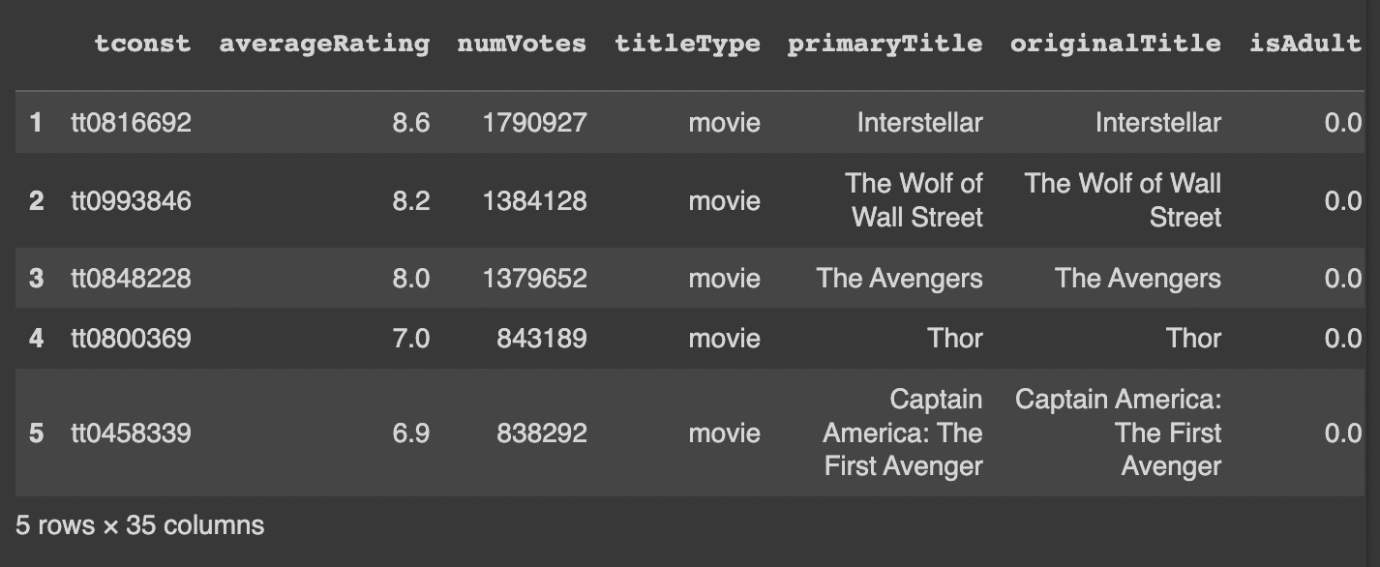

Slide 11
LET’S REVIEW THE DATA.
Average Rating
Top Movie
Difference
7.74
Interstellar
The varying numbers of votes for each movie
Random Fact
Most movies on the list were produced by Disney

Slide 12
Twitter Tweet
03
<p> Pulling tweets and sorting them </p>

Slide 13
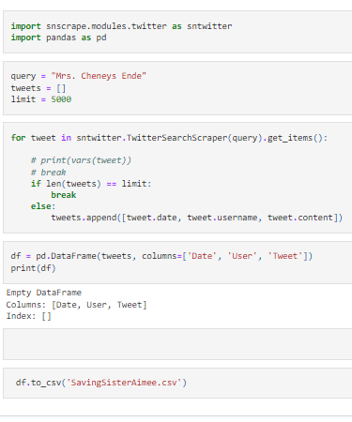
Code Used…
Used the snscrape and pandas to scrape the information and convert it to a csv file where it was later sorted

Slide 14
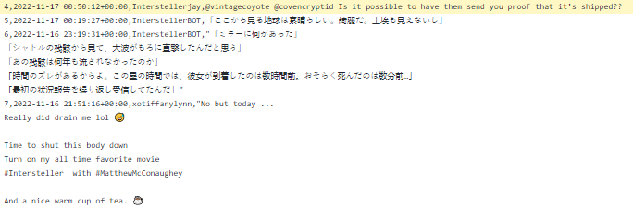
Results (interstellar) >>>

Slide 15
Sentinel Analysis
04
<p> Defining whether a tweet is positive or negative using machine learning </p>

Slide 16
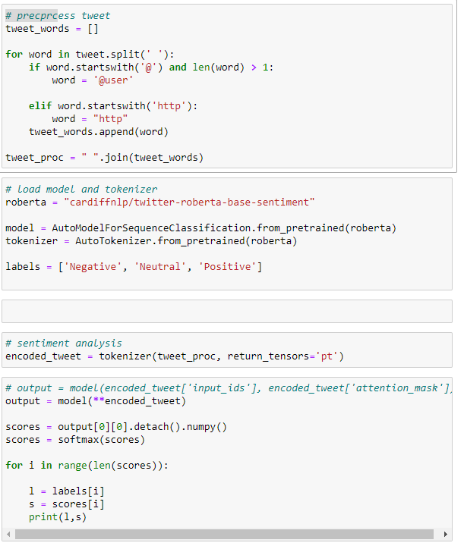
Code Used…
Used to analyze tweets and categorize them into positive negative or neutral

Slide 17
Results
05
<p> Data and Diagrams </p>

Slide 18
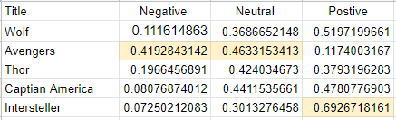
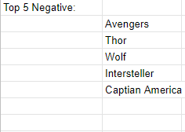
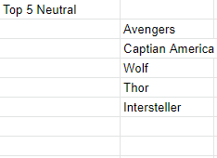
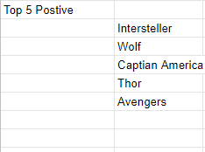

Slide 19
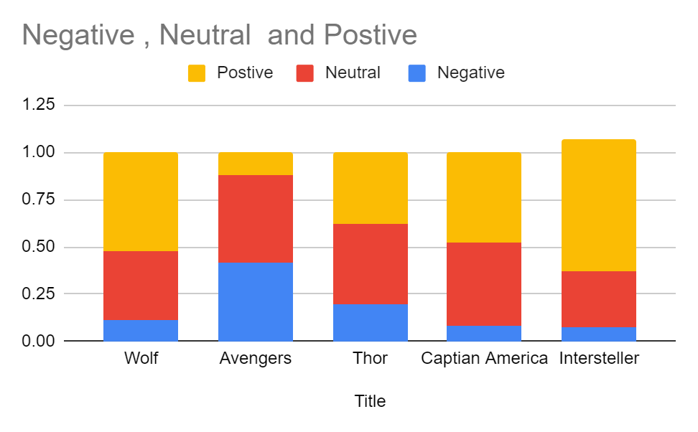

Slide 20
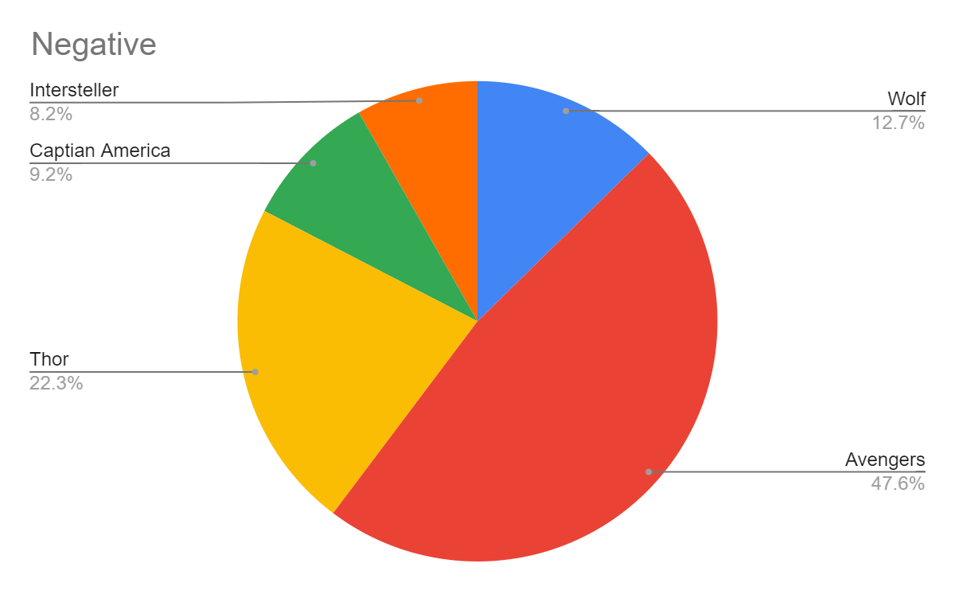
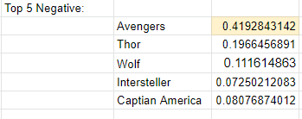

Slide 21
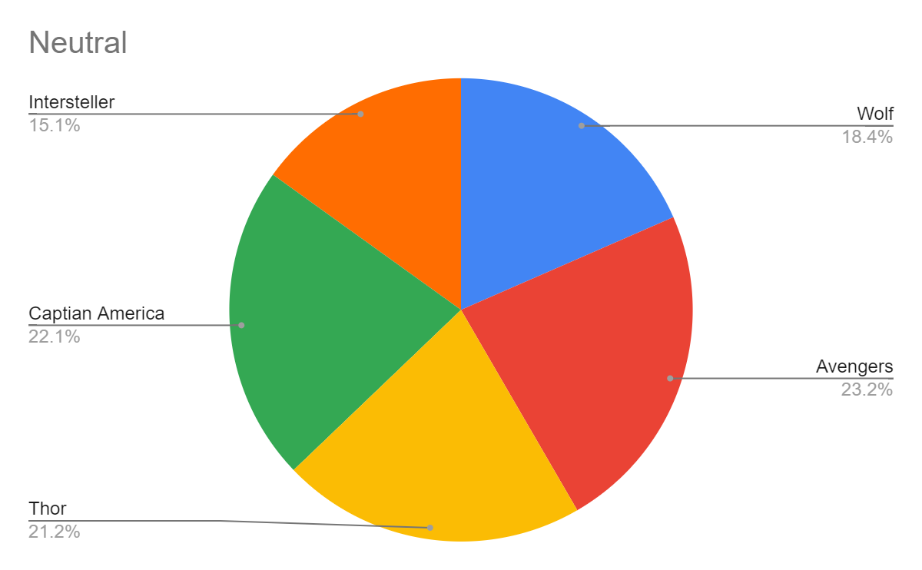

Slide 22
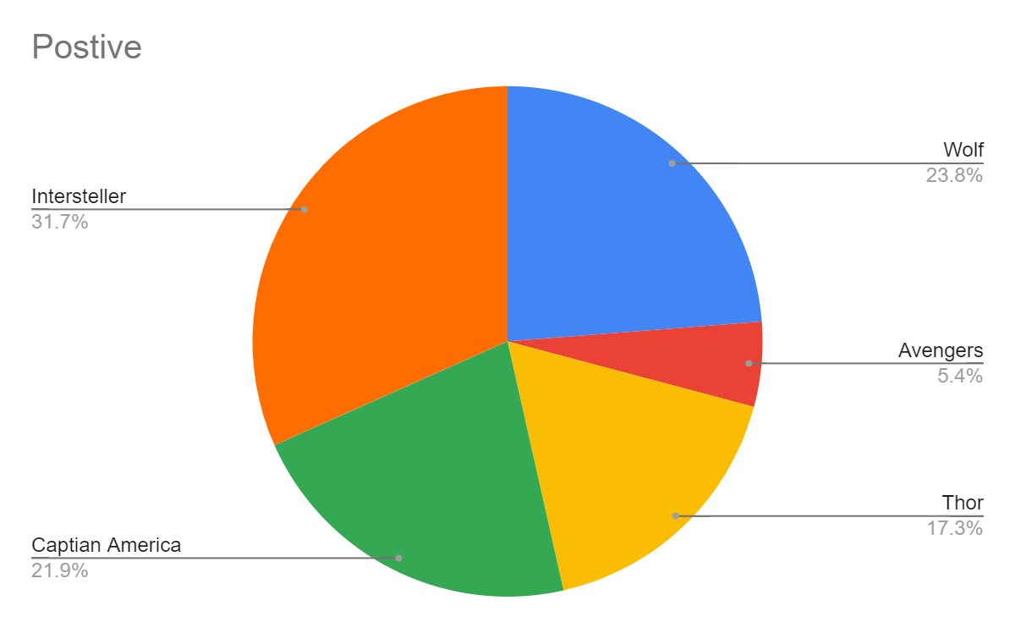

Slide 23
Conclusion
06
<p> Discovery </p>

Slide 24
Does IMDB reflect the views of the people or their own?
Big Sean

Slide 25
Small Difference

Slide 26
With research in the matter we can conclude that IMBD does reflect the views of the people

Slide 27
THANK YOU!
hello@mail.com
555-111-222
mydomain.com
Do you have any questions?

Slide 28
CREDITS.
Presentation Template: SlidesMania
Sample Images: Unsplash
Fonts used in this presentation: Roboto Mono and Roboto Bold

