Slide 1
Git Workflow
Carlo DiLorenzo

Slide 2
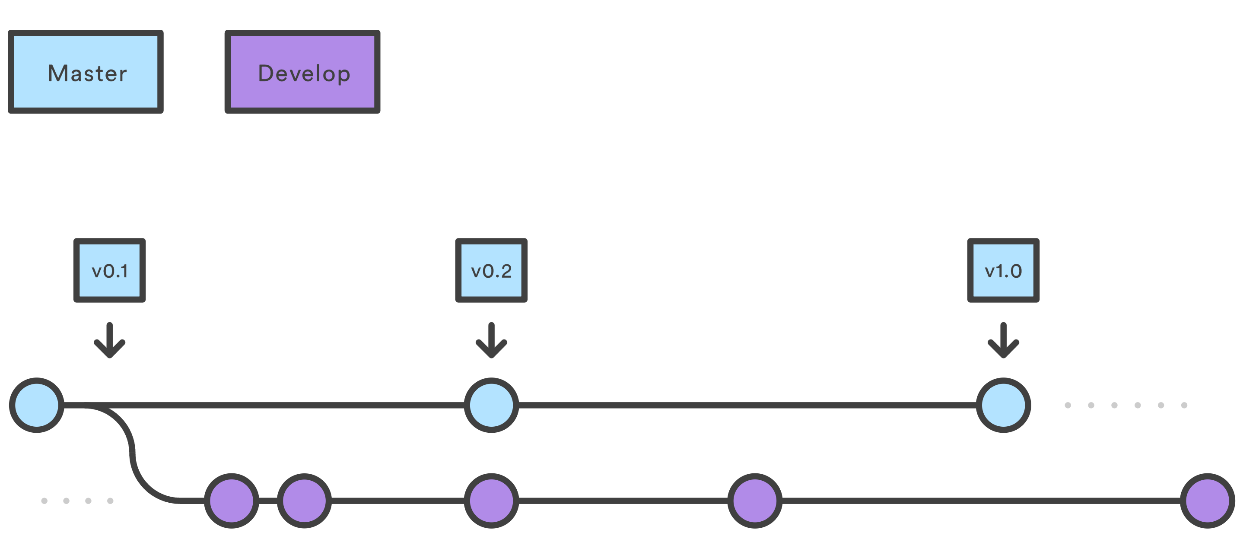
Historical Branches
This workflow uses two branches to record the history of the project.
Master - Stores the official release history
Develop - Serves as an integration branch for features.

Slide 3
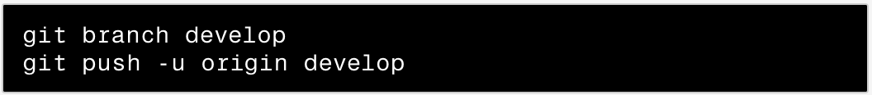
Create a Develop Branch
The first step is to complement the default master with a develop branch. A simple way to do this is for one developer to create an empty develop branch locally and push it to the server

Slide 4
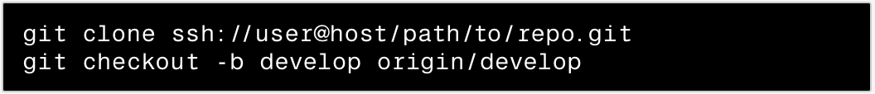
Clone Repo
Each developer should clone central repo with the develop branch to there local machine.
Everybody now has a local copy of the historical branches set up.

Slide 5
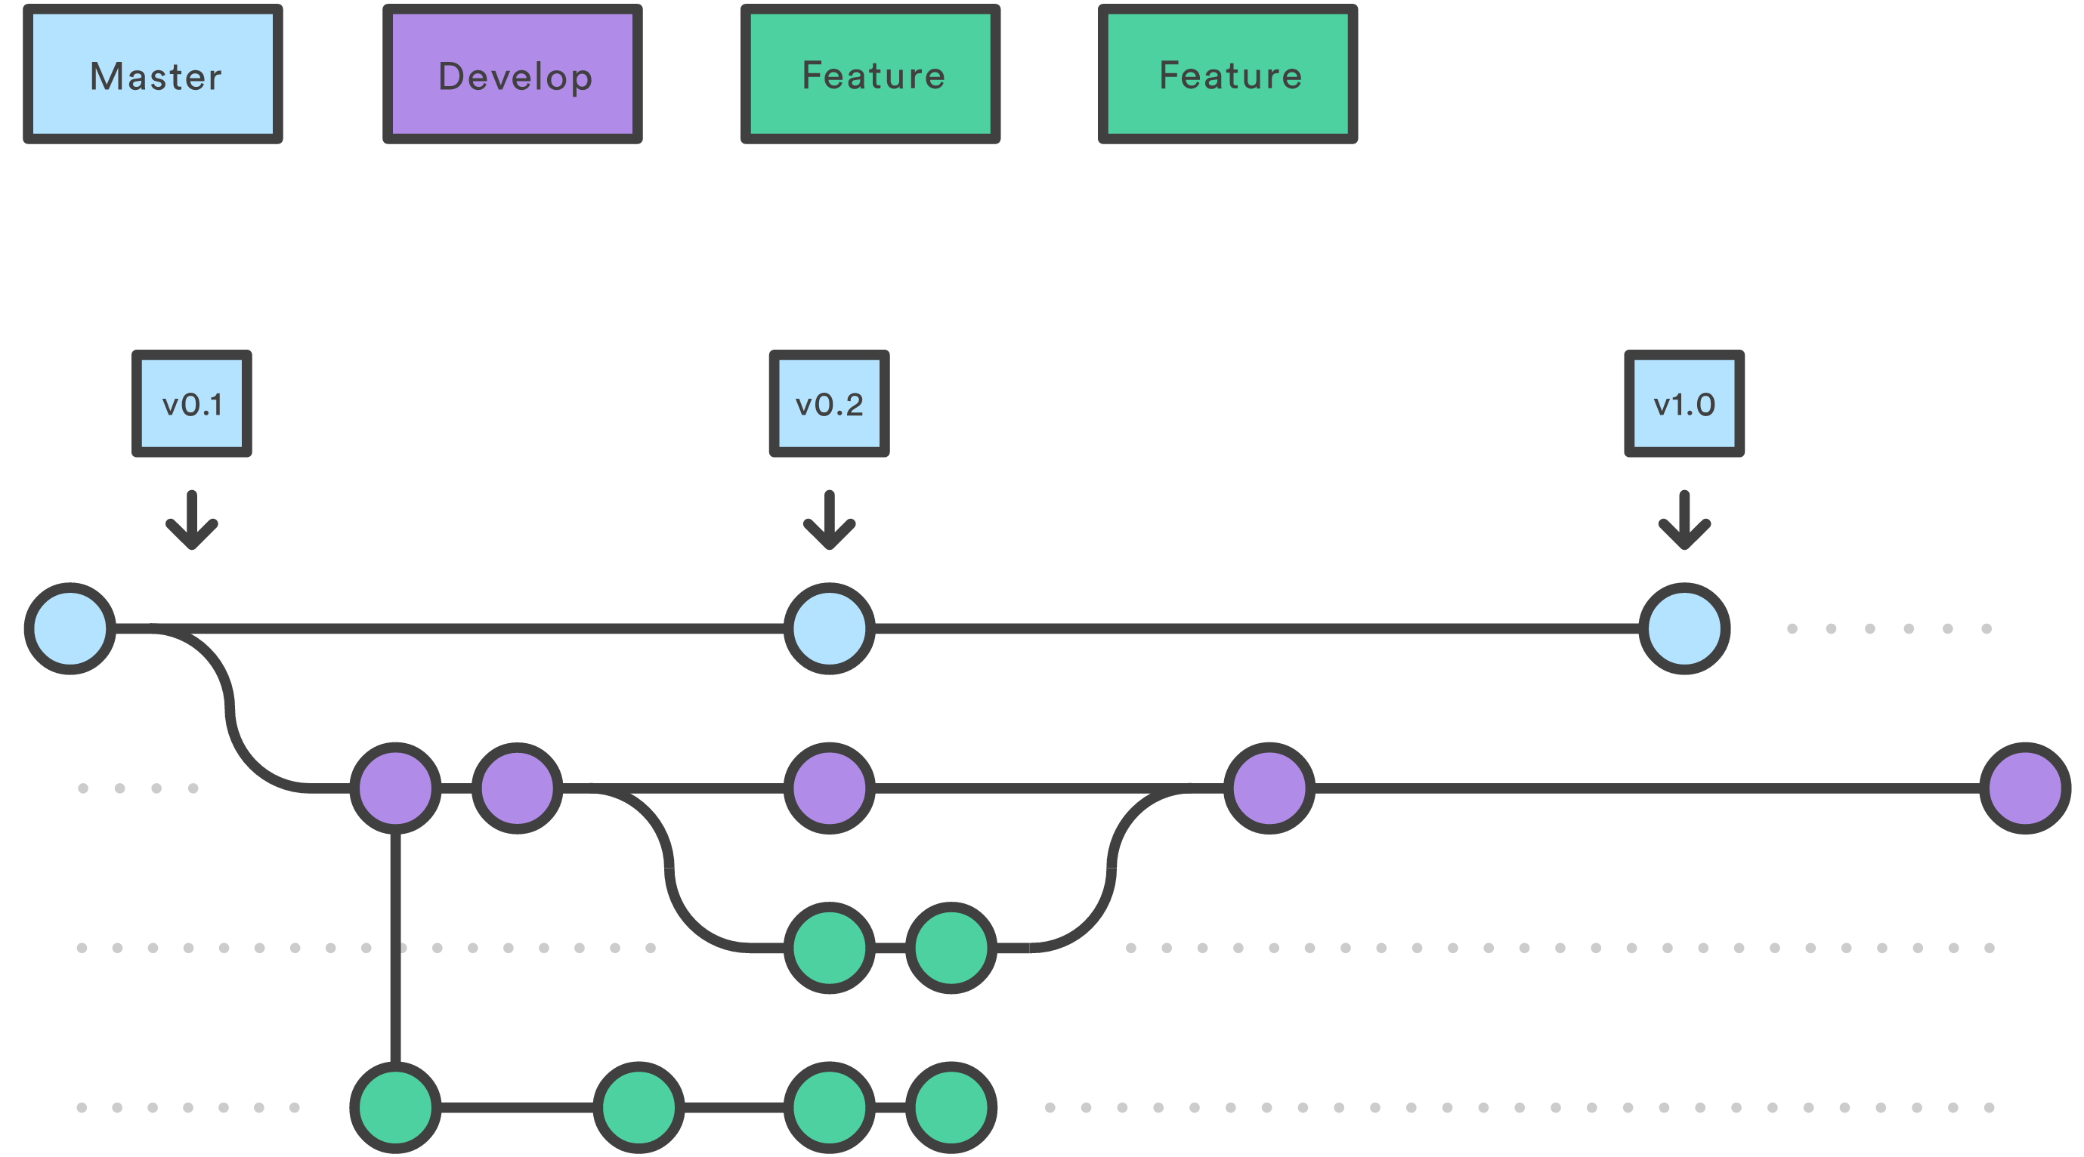
Feature Branches
Uses develop as its parent branch. When feature is complete it gets merged into develop. Features should never interact directly with master.

Slide 6
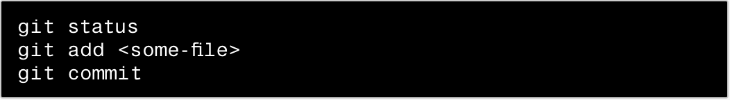
Begin new features
First create a branch for a features. (make name descriptive)
Add commits to the feature branch in the usual fashion: edit, stage, commit.

Slide 7
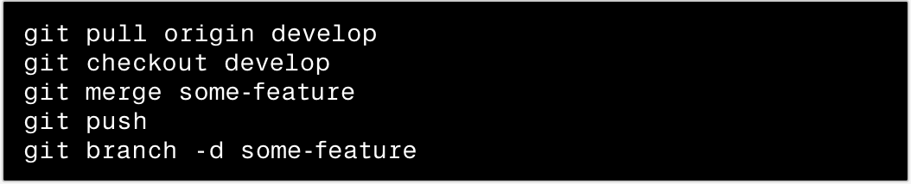
Finishes a Feature
Merge into local develop branch and push into central repo.

Slide 8
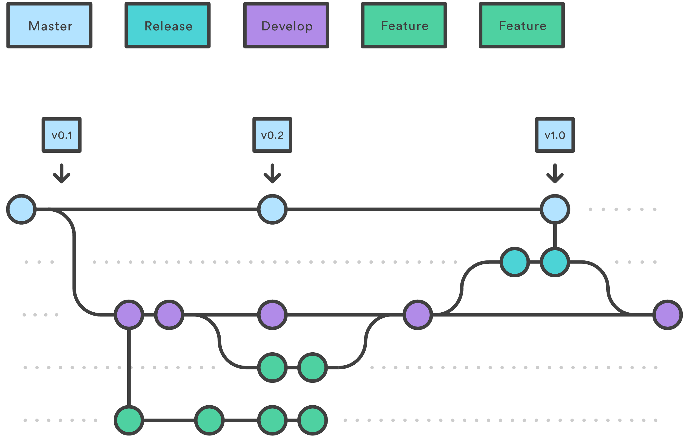
Release Branches
Fork a release branch off of develop.
Check for bugs and other release-oriented tasks.
Once it's ready merged into master.

Slide 9
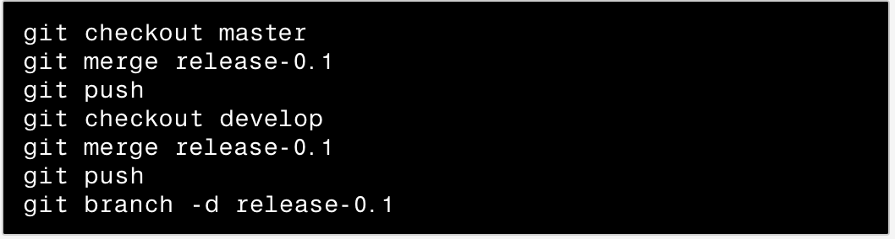
Prepare a Release
Create new branch from develop branch.
When the release branch is ready to be merge.

Slide 10
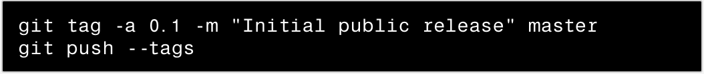
Prepare a Release
Tag the commit for easy reference.

Slide 11
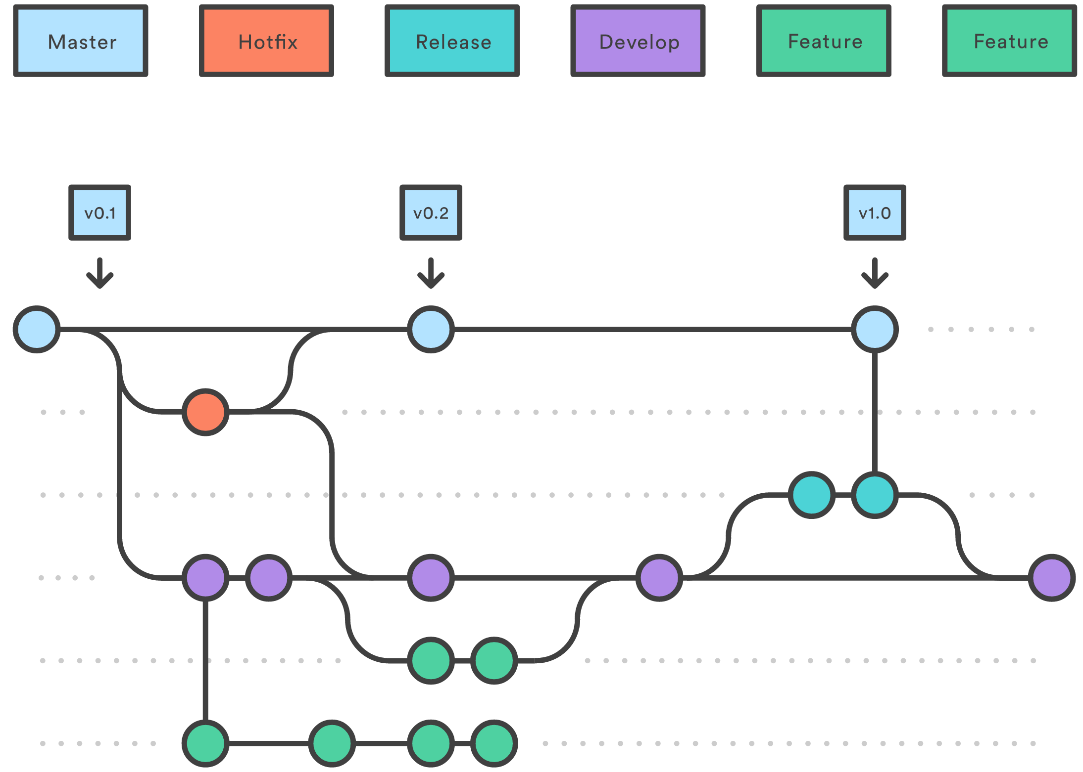
Maintenance Branches
Maintenance or “hotfix” branches are used to quickly patch production releases.

Slide 12
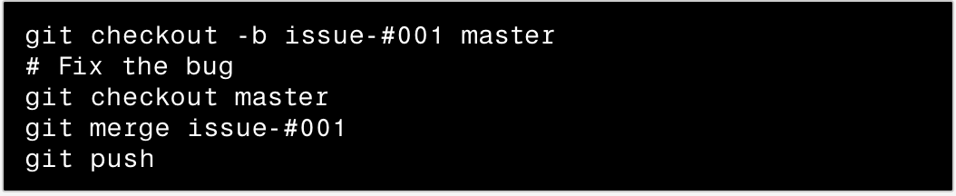
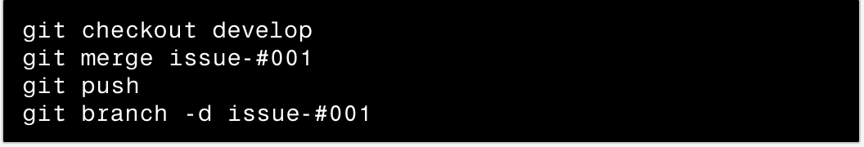
Prepare a Maintenance Branch
When an end-user discovers a bug fork from master.
After fixing bug merge the branch back to master.

