Slide 1

INTRODUCTION TO MACHINE LEARNING
Training, Evaluation & Model Evaluation Strategies
Topic 3 — Training, Overfitting & Interpretability • Topic 4 — Cross-Validation & Metrics
2nd-year CS / IT · Online live (MS Teams) · Lecturer: Dilrabo Khidirova
Notes:
Two topics, one 90-minute arc: first how a model learns and how we read it, then how we evaluate it properly.

Slide 2
ROADMAP
What we'll cover — two topics, one story
01
What training involves
02
Overfitting & bias-variance
predict → loss → adjust → repeat
the generalization problem
03
Interpretability & SHAP
04
Cross-validation
why did the model predict that?
evaluate on every part of the data
05
Metrics
06
Coding lab
classification & regression scores
implement it in NumPy (AutoCode)
Model Training, Evaluation & Strategies
2
Notes:
Topics 3 and 4 flow together: learn & interpret a model, then evaluate it rigorously.

Slide 3
TOPIC 3
Training, Evaluation & Interpretation
How a model learns from data — and how we understand what it learned.
Notes:
Outcomes: describe training; explain over/underfitting; interpret models with SHAP.

Slide 4
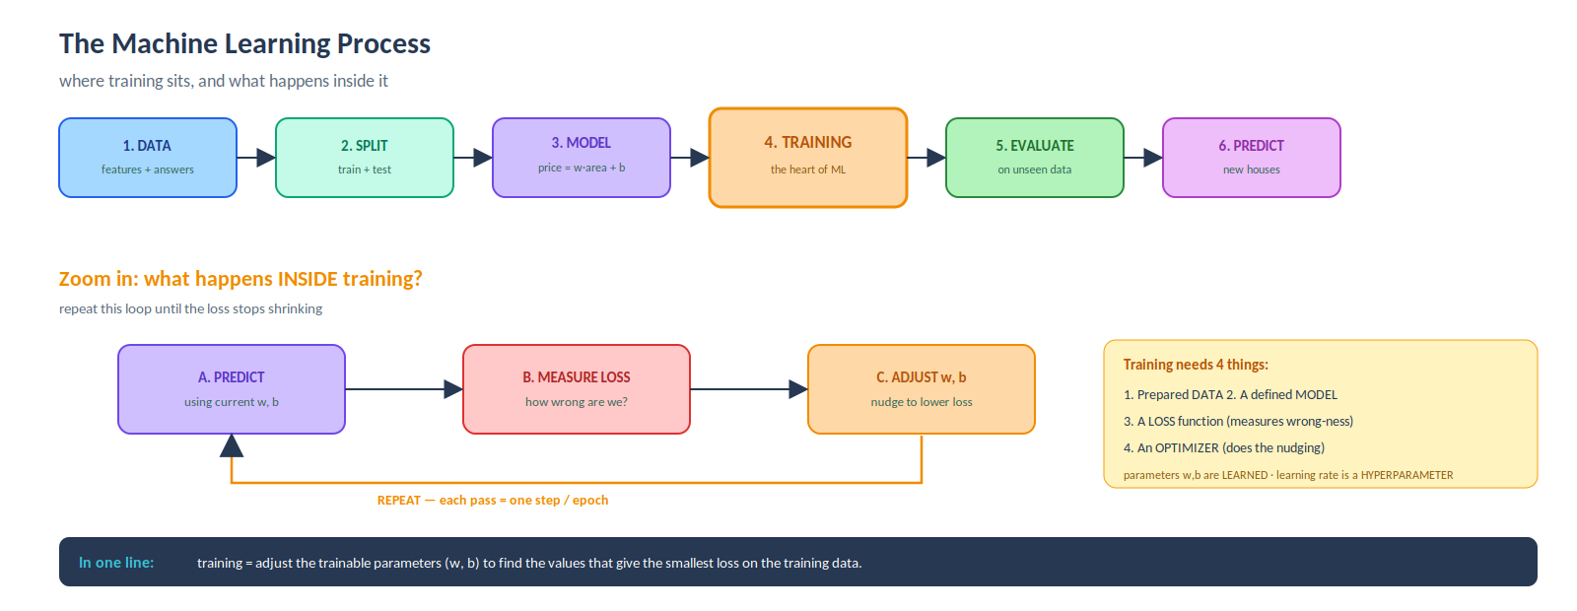
OUTCOME 1
What training a model involves
Model Training, Evaluation & Strategies
4
Notes:
Walk the pipeline, then the A→B→C loop. Training = adjust parameters to minimise loss.

Slide 5
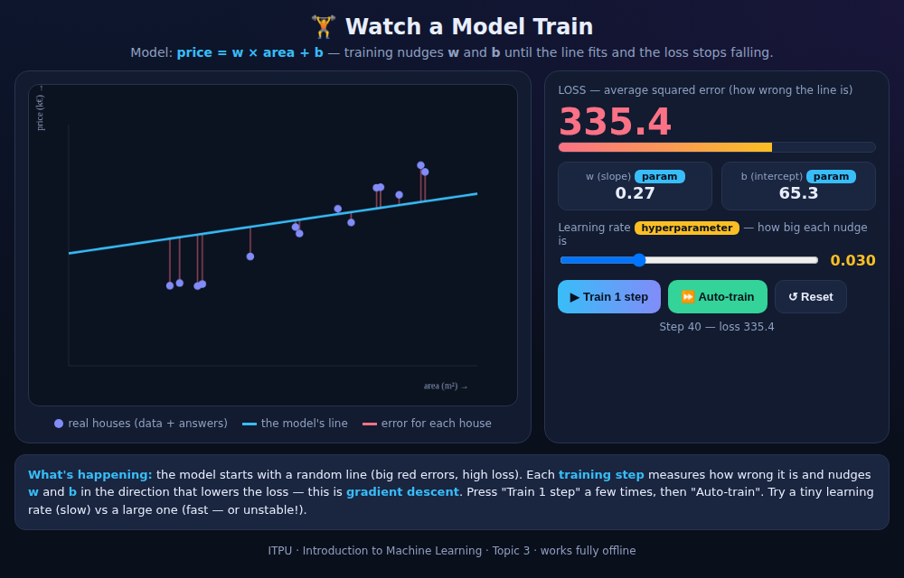
THE CORE DISTINCTION
Parameters vs hyperparameters
Parameters
LEARNED by the model during training.
examples: w (slope), b (intercept), neural-net weights
Hyperparameters
SET BY YOU before training.
examples: learning rate, number of epochs, tree depth
▲ Watch a Model Train — the loss shrinks as w, b adjust; the slider is the learning rate.
Model Training, Evaluation & Strategies
5
Notes:
Live: press Train step, watch loss fall. Crank the learning rate to show divergence.

Slide 6
THE SAME IDEA IN CODE
The training loop — ~10 lines of NumPy
# model: price = w * area + b w, b = 0.0, 0.0 # parameters (start random) lr = 0.1 # hyperparameter (you set) for step in range(300): err = (w*area_s + b) - price # A. predict grad_w = np.mean(2 * err * area_s) # B. measure grad_b = np.mean(2 * err) w -= lr * grad_w # C. adjust b -= lr * grad_b # loss 7731 -> 0.85 (the line now fits)
Read it as the loop
A. predict
with current w, b
B. measure
the loss (gradient)
C. adjust
nudge w, b down
repeat
until loss is small
Model Training, Evaluation & Strategies
6
Notes:
The app and the code are the same four steps. Feature scaling keeps it stable.

Slide 7
OUTCOME 1 (CONT.)
Always judge on UNSEEN data
The mistake: a model with 99% accuracy on the data it trained on — that looks great but proves nothing.
X_train, X_test, y_train, y_test = train_test_split( X, y, test_size=0.3) model.fit(X_train, y_train) train_acc = accuracy(y_train, model.predict(X_train)) test_acc = accuracy(y_test, model.predict(X_test)) # Training accuracy: 100% # Test accuracy: 84% <- the GAP = overfitting
The gap is the signal
A big difference between training and test scores means the model memorised instead of learning the pattern.
That gap is your early warning of overfitting.
Model Training, Evaluation & Strategies
7
Notes:
Train score is vanity; test score is truth. The gap = overfitting.

Slide 8
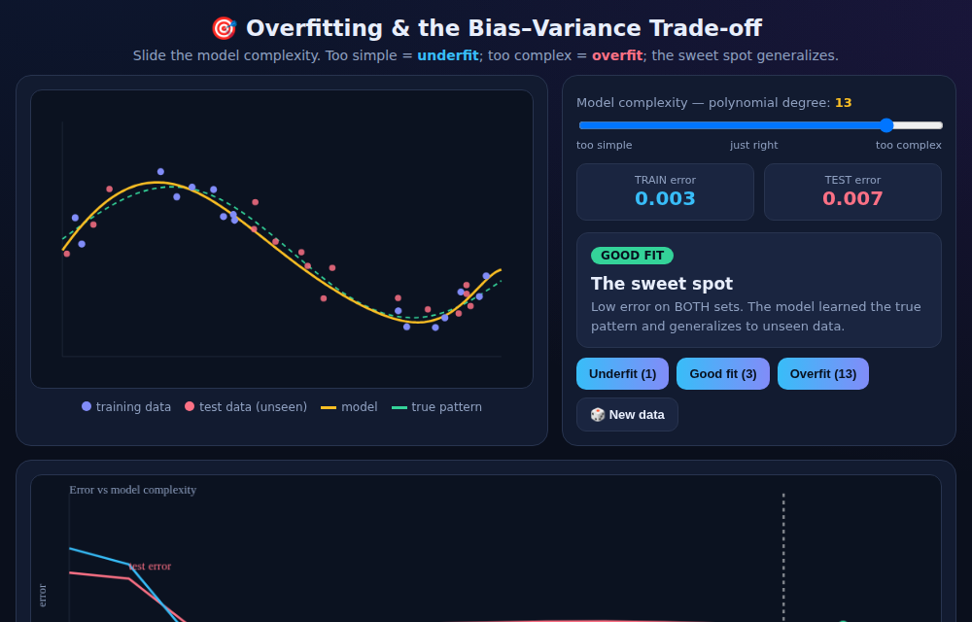
OUTCOME 2
Overfitting, underfitting & the bias–variance trade-off
Underfit
too simple — high bias — misses the pattern
Good fit
learns the true pattern — generalizes
Overfit
too complex — high variance — chases noise
Model Training, Evaluation & Strategies
8
Notes:
Slide complexity underfit→good→overfit; test-error U-curve marks the sweet spot.

Slide 9
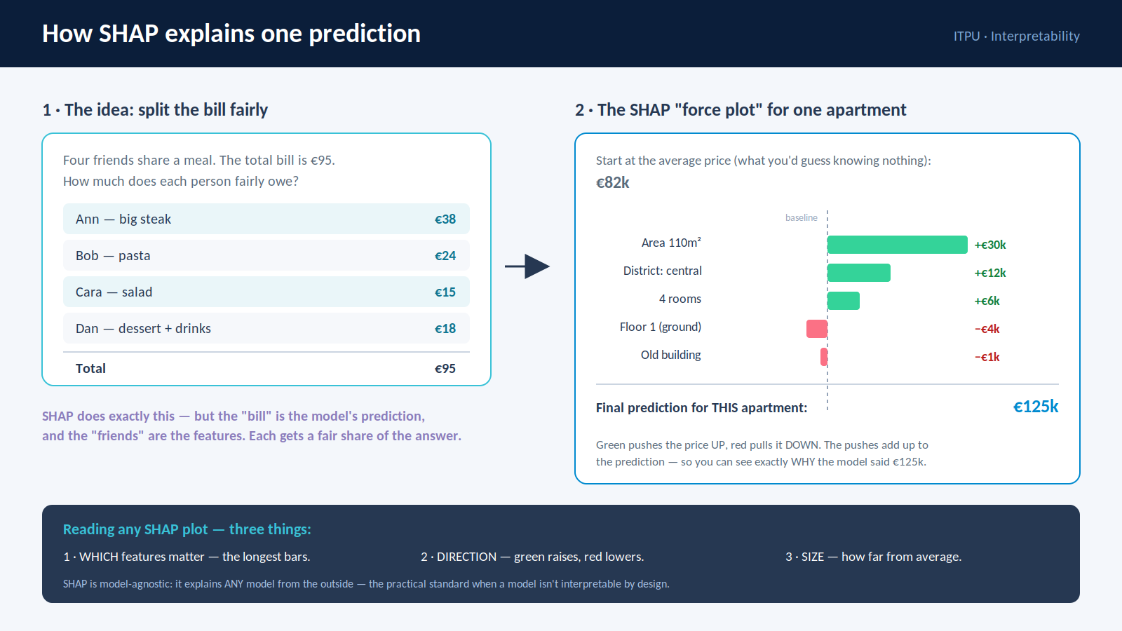
OUTCOME 3
Interpretability — why did the model predict that?
The idea
Some models are readable by design (linear reg, shallow tree). Complex ones aren't.
SHAP
splits a prediction into each feature's fair share — how much it pushed the answer up or down from the average.
Model-agnostic: explains ANY model.
Model Training, Evaluation & Strategies
9
Notes:
Restaurant bill = splitting the prediction fairly. Read: which features, direction, size.

Slide 10
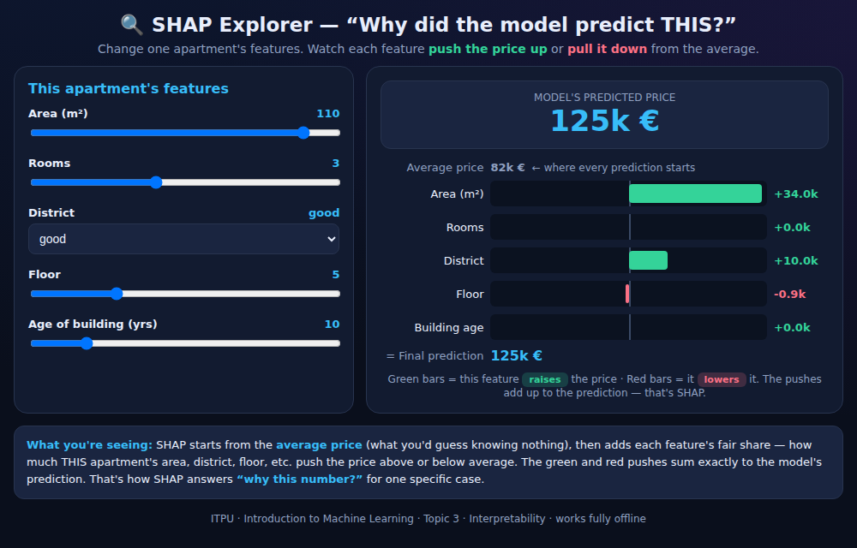
INTERPRETABILITY IN PRACTICE
Reading SHAP — push-bars & the beeswarm
How to read any SHAP plot
1 · Which
the longest bars = features that matter most
2 · Direction
green pushes up, red pulls down
3 · Size
how far from the average baseline
Drag a feature → its bar grows and the prediction updates. SHAP made tangible.
Model Training, Evaluation & Strategies
10
Notes:
Ask class green/red before each drag. Then show the real beeswarm in the notebook.

Slide 11
TOPIC 4
Model Evaluation Strategies
From one lucky split to a rigorous, systematic score.
Notes:
Outcomes: describe CV techniques; compute classification & regression metrics.

Slide 12
OUTCOME 1
Why cross-validation beats a single split
One split
K-fold cross-validation
You get ONE score. It depends on which points happened to land in the test set — lucky or unlucky.
Split into K folds. Each fold validates once while the rest train. Average the K scores.
scores: [0.85, 0.90, 0.85, 0.75, 0.78] → avg 0.83
→ unreliable, high variance in the estimate
→ every point is validated once → reliable
Model Training, Evaluation & Strategies
12
Notes:
The average over folds is what you report — not one lucky split.

Slide 13
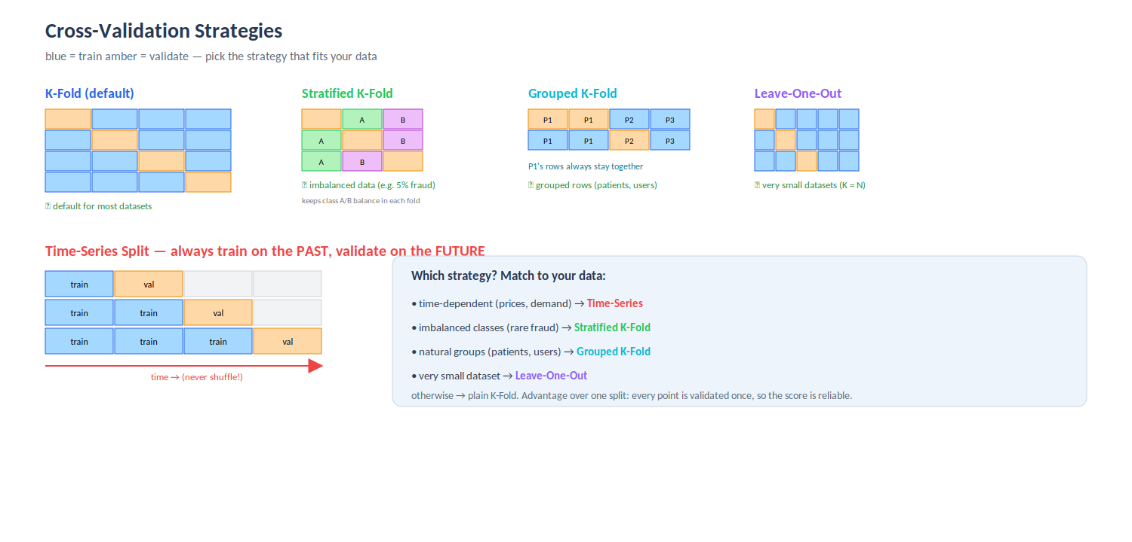
OUTCOME 1 (CONT.)
Five strategies — match the split to your data
Model Training, Evaluation & Strategies
13
Notes:
Engaging Q: time-dependent? imbalanced? grouped? Ask before revealing each answer.

Slide 14
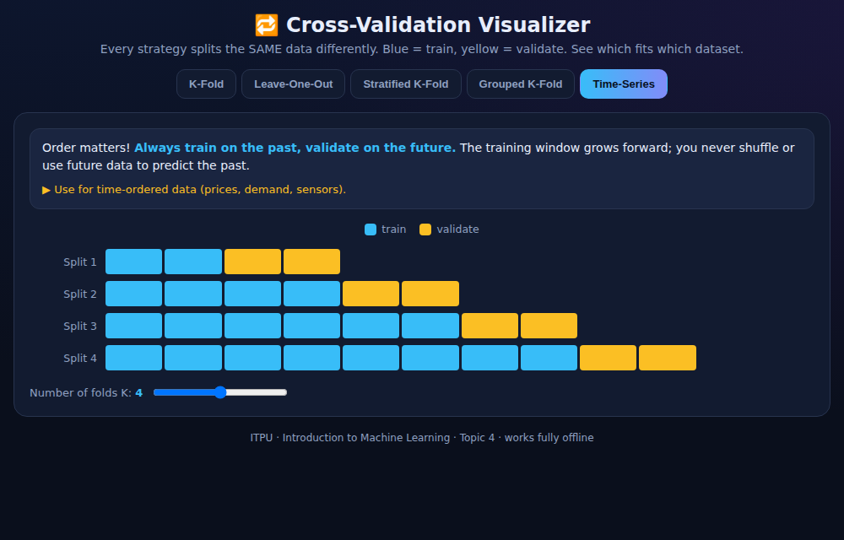
THE ONE PEOPLE GET WRONG
Time-series — never shuffle time
Order carries the signal
Always train on the PAST and validate on the FUTURE. The training window grows forward.
Shuffling a time-series lets the model peek at the future to predict the past — a silent, fatal bug.
Use for: prices, demand, sensors, any time-ordered data.
Model Training, Evaluation & Strategies
14
Notes:
The classic pitfall. Show the expanding window; validation is always after training.

Slide 15
OUTCOME 2
Classification metrics
Accuracy
(TP+TN) / all
overall correctness — weak on imbalanced data
Precision
TP / (TP+FP)
when we say positive, how often right?
Recall
TP / (TP+FN)
of all real positives, how many caught?
F1
2·P·R / (P+R)
one number balancing precision & recall
Model Training, Evaluation & Strategies
15
Notes:
Precision protects against false alarms; recall against misses. F1 needs both high.

Slide 16
CHOOSING A METRIC
Precision vs recall — it depends on the cost
Recall matters most
Precision matters most
When a MISS is dangerous
When a FALSE ALARM is costly
Cancer screening, fraud detection, security threats — better a false alarm than a missed case.
Spam filter, ad targeting, recommending expensive action — better to stay silent than cry wolf.
Model Training, Evaluation & Strategies
16
Notes:
Ask students to place: self-driving car brake? → recall. This trade-off is the exam favourite.

Slide 17
OUTCOME 3
Regression metrics
MSE
mean((y - ŷ)²)
average squared error — punishes big misses
RMSE
√MSE
same units as the target — most reported
MAE
mean(|y - ŷ|)
robust to outliers
MAPE
mean(|(y-ŷ)/y|)·100
error as a % — easy to explain
R²
1 − SSres/SStot
fraction of variation explained (1 = perfect)
Model Training, Evaluation & Strategies
17
Notes:
RMSE if big errors matter; MAE if outliers shouldn't dominate; R² for variance explained.

Slide 18
PRACTICE
Coding lab — implement the metrics (AutoCode)
One notebook continues from Topic 3. NumPy only — the same functions AutoCode's unit tests will check.
Exercise 1
Exercise 2
Exercise 3
Classification metrics
Regression metrics
Cross-validation
accuracy · precision · recall · F1
MSE · RMSE · MAE · MAPE · R²
K-fold & time-series index splits
Each exercise: broken/blank starter code → run a self-check → open the hidden solution. Then submit to AutoCode.
Model Training, Evaluation & Strategies
18
Notes:
Breakout rooms code the blanks; self-check; then AutoCode unit tests grade them.

Slide 19
Key takeaways
1
Training — adjust parameters to minimise loss; you set the hyperparameters
You can now
Generalize — judge on unseen data; mind the train–test gap
• train a model and explain what it learned
• spot overfitting
• evaluate properly with CV
• pick the right metric
2
3
Bias–variance — underfit = high bias, overfit = high variance; aim for the sweet spot
4
Interpret — read simple models directly; use SHAP for the rest
5
Cross-validate — average over folds; match the strategy to the data
6
Metrics — precision vs recall by cost; RMSE/MAE/R² for regression
Thank you!
Notes:
Recap by asking students to state each line. Exit ticket next.

