Slide 1
iTPU
How Machines Learn
& How They Handle Uncertainty
Topic 7: Calculus Basics | Topic 8: Probability & Statistics in ML
Notes:
Welcome. Today we answer two big questions: how does a machine actually LEARN (calculus), and how does it deal with not being sure (probability & statistics). Ask everyone to take out their phones and open menti.com - we will vote many times today.

Slide 2
Agenda
Today's journey - 90 minutes
0-5
min
Warm-up
Menti word cloud
5-47
min
PART 1 Calculus
derivative, gradient, optimization, gradient descent + 'Be the algorithm'
47-85
min
PART 2 Probability & Stats
Bayes, distributions, LLN/CLT, testing, correlation + 'Name that distribution'
85-90
min
Wrap-up
Menti final challenge + exit ticket
Look for these tags: MENTI = vote on your phone ACTIVITY = work with a partner
iTPU
Calculus & Probability in ML
Notes:
Quick roadmap. Two parts, lots of voting. Tell them the MENTI and ACTIVITY tags so they know when to get active.

Slide 3
MENTI | Word cloud
~3 min
menti.com code: ____ ____
In ONE word: what does it mean for a machine to 'learn'?
Live answers appear here on Menti
Type 1-2 words on menti.com - watch the cloud grow!
Notes:
Let the cloud grow. Typical words: data, patterns, improve, mistakes, training. Pick 'improve' or 'mistakes' and say: exactly - a model learns by making mistakes and reducing them step by step. Today we see the maths of 'reducing mistakes'.

Slide 4
PART 1
Calculus - how a model learns
Learning = reducing error, one small step at a time
Notes:
Calculus is the study of change. In ML we care about one question: if I change a model setting a little, how does the error change?

Slide 5
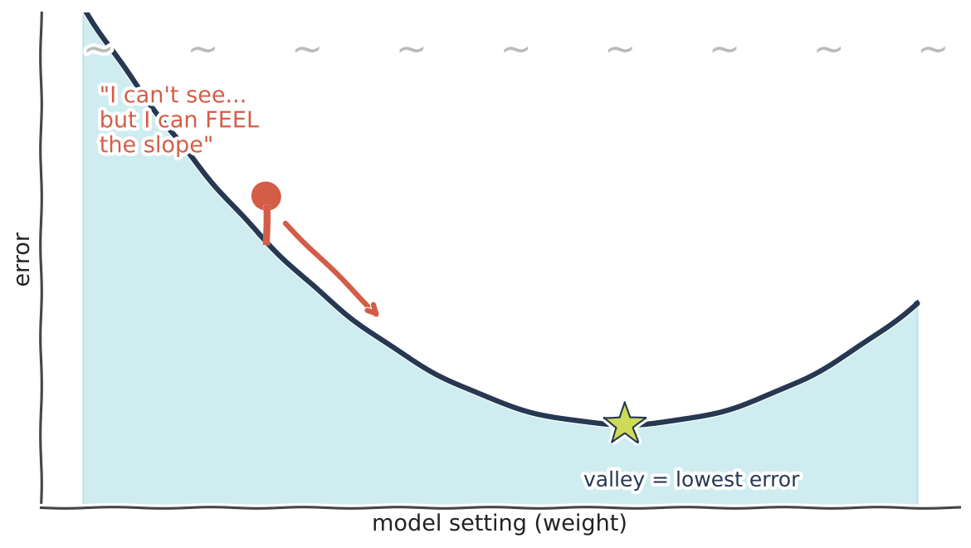
The hook
~3 min
You are blindfolded on a mountain...
KEY IDEA
Goal: reach the valley (lowest point)
You can't see - but you can feel the slope under your feet
Feel slope -> step downhill -> repeat
In ML: the mountain is the ERROR; your position is the model's WEIGHTS. Training = walking down.
iTPU
Part 1 | Calculus - how a model learns
Notes:
Story time. Ask: 'You are blindfolded on a mountain and must reach the valley. What do you do?' Let 2-3 students answer. Answer: feel which way the ground slopes and step downhill, again and again. That is exactly gradient descent - and calculus is the tool that 'feels the slope'.

Slide 6
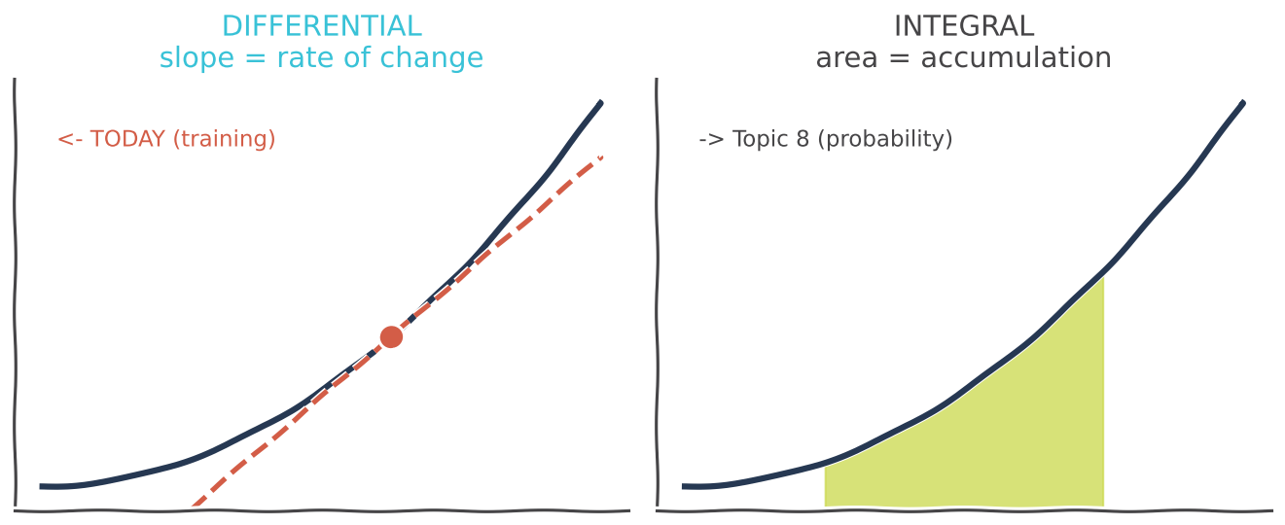
Two branches
Calculus = the study of change
DIFFERENTIAL: rates of change (slopes) | INTEGRAL: accumulation (areas) | Today = differential -> it trains models
In ML: integrals return in probability (area under a curve = probability).
iTPU
Part 1 | Calculus - how a model learns
Notes:
Two branches. Differential = how fast something changes. Integral = how much accumulates. Training uses differential, so that's our focus. Integrals come back in Topic 8 because probability is area under a curve.

Slide 7
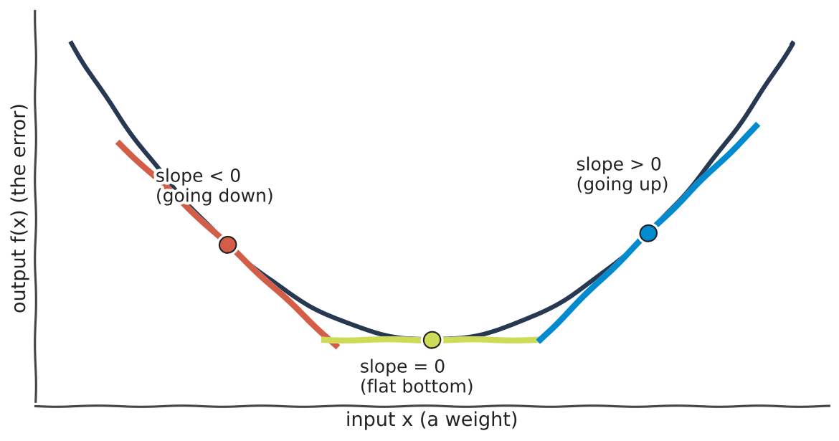
Derivative
~4 min
Derivative = the slope at a point
KEY IDEA
Tells how fast the output changes if we nudge the input
Negative slope -> going down
Zero slope -> flat (a valley or a peak)
Positive slope -> going up
In ML: input = a weight, output = the error. The derivative says which way to move the weight.
iTPU
Part 1 | Calculus - how a model learns
Notes:
Everyday example: the speedometer. Position changes over time; the derivative of position is speed. Point at the three coloured tangents: down, flat, up. Key sentence: 'the derivative tells us which direction makes the error smaller'. Example: f(x)=x^2-2x+1, derivative 2x-2, at x=3 slope is 4 -> going up, so move left.

Slide 8
MENTI | Quiz
A ball rests at the very bottom of a valley. What is the derivative (slope) there?
A) Positive
B) Zero
C) Negative
D) Infinite
Notes:
Answer: B, zero. At the bottom the ground is flat. That is why a training algorithm knows it has arrived: the slope becomes (almost) zero.

Slide 9
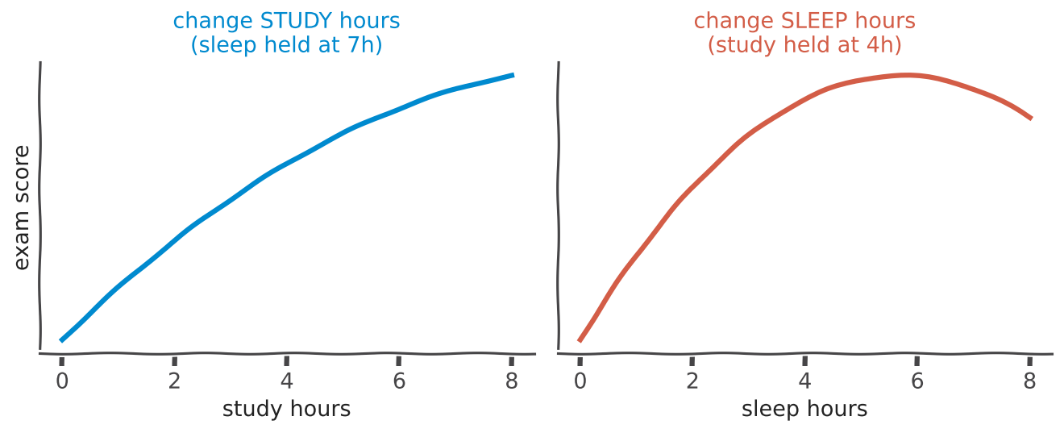
Partial derivative
~3 min
Partial derivative = change ONE thing at a time
Many inputs? Nudge only one, freeze the others | 'How does my score change if I sleep 1 more hour - same study time?' | One partial derivative per input
In ML: a model has thousands of weights - we need each weight's own effect on the error.
iTPU
Part 1 | Calculus - how a model learns
Notes:
Exam score depends on study hours AND sleep hours. The partial derivative with respect to sleep: sleep one more hour, keep study the same, how does the score change? Notice sleep helps, then too much sleep hurts - the slope changes sign. Math: f(x,y)=x^2+y^2, df/dx=2x, df/dy=2y.

Slide 10
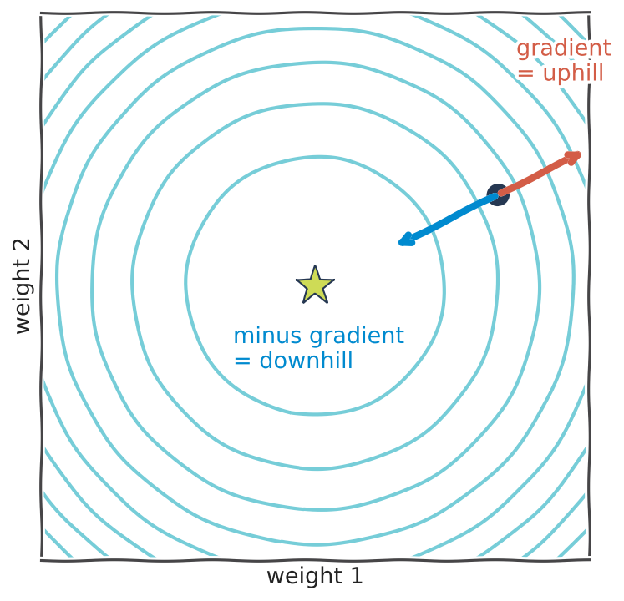
Gradient
~4 min
Gradient = all partial derivatives in one arrow
KEY IDEA
Gradient = [df/dx, df/dy, ...] - a vector
It points in the steepest UPHILL direction
Minus gradient = steepest DOWNHILL
f(x,y)=x^2+y^2 at (2,1): gradient = [4, 2]
In ML: we step in the minus-gradient direction to reduce the loss.
iTPU
Part 1 | Calculus - how a model learns
Notes:
The map shows the error landscape from above: rings are equal-error lines, the star is the minimum. At the dot, the red arrow is the gradient - uphill. The blue arrow is minus gradient - downhill, straight toward the star. Link to Topic 6: the gradient is a VECTOR.

Slide 11
The family
~3 min
The derivative family - from simple to big
Derivative
Partial
Gradient
Jacobian
Hessian
1 input, 1 output
result: a NUMBER
'slope of a curve'
many inputs
change ONE
result: a NUMBER
'slope in one direction'
many inputs, 1 output
result: a VECTOR
'the uphill arrow' (the star of ML!)
many inputs, many outputs
result: a MATRIX
'gradient of a whole layer'
2nd derivatives
result: a MATRIX (symmetric)
'curvature: bowl or dome?'
Number -> vector -> matrix (Topic 6 again!)
iTPU
Part 1 | Calculus - how a model learns
Notes:
Walk left to right. Each one is a bigger version of the previous. The gradient is highlighted because it drives training. Jacobian: for functions with several outputs, like a neural-network layer. Hessian: second derivatives, it measures curvature. Keep Jacobian and Hessian light - name them, one sentence each.

Slide 12
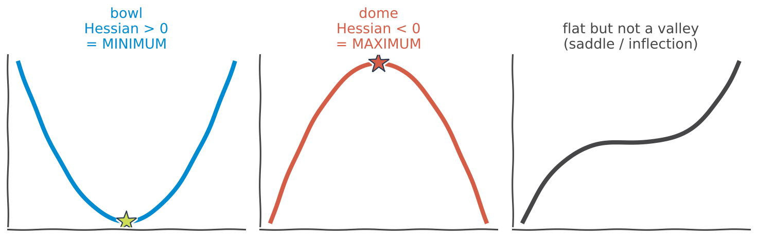
Hessian
Hessian = curvature: is this a valley or a hill?
Matrix of 2nd derivatives - always symmetric | Positive (bowl) -> MINIMUM | Negative (dome) -> MAXIMUM | Mixed -> saddle: flat but not a valley
In ML: convex (bowl-shaped) losses have one minimum - training is easy and safe.
iTPU
Part 1 | Calculus - how a model learns
Notes:
The gradient says flat; the Hessian says what KIND of flat. Bowl = minimum, dome = maximum, the third shape is flat but not a valley. Link to Topic 6: 'positive definite' Hessian means bowl. Example: f=x^2+y^2 has Hessian [[2,0],[0,2]] - positive -> a bowl -> minimum at (0,0).

Slide 13
MENTI | Quiz
Which tool tells you whether a flat point is a bowl (minimum) or a dome (maximum)?
A) Derivative
B) Gradient
C) Jacobian
D) Hessian
Notes:
Answer: D, the Hessian - it measures curvature.

Slide 14
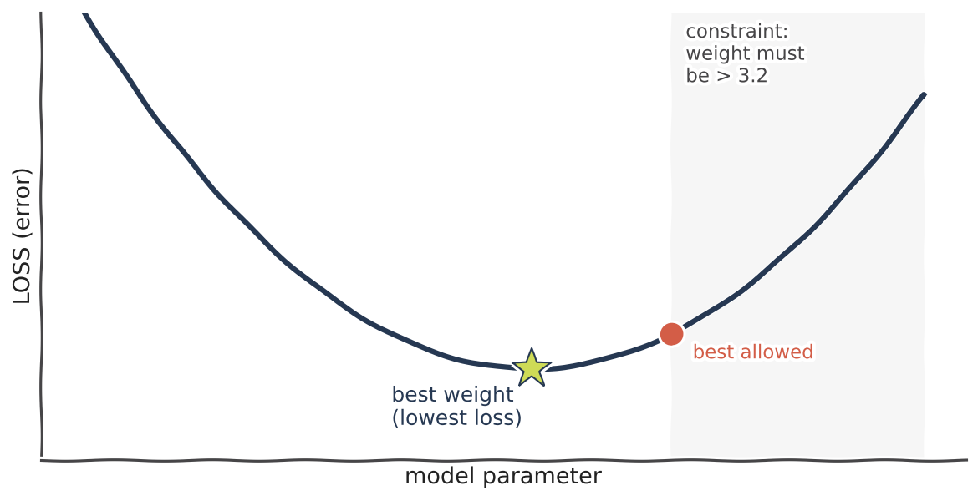
Optimization
Optimization = find the lowest point
KEY IDEA
Find the input that makes a function smallest
Unconstrained: set gradient = 0, check with the Hessian
Constrained: extra rules (e.g. weight > 3.2) -> Lagrange multipliers
In ML: TRAINING = OPTIMIZATION: find weights that minimise the LOSS.
iTPU
Part 1 | Calculus - how a model learns
Notes:
Optimization means searching for the best value. The loss curve measures how wrong the model is. Unconstrained: the star, where the slope is zero. Constrained: if a rule forbids part of the space (grey), the best ALLOWED point is the red dot. Lagrange multipliers solve that - optional, just mention.

Slide 15
Gradient descent
Gradient descent - the algorithm behind ML
new weight = old weight - learning rate x gradient
1
COMPUTE
2
STEP
3
REPEAT
the gradient of the loss (which way is uphill?)
a small step the opposite way (downhill)
until the gradient is ~0 (you reached the valley)
The MINUS sign = go downhill. Learning rate = size of your step.
iTPU
Part 1 | Calculus - how a model learns
Notes:
This formula is the most important line in ML training. Read it slowly. The minus is 'go downhill', the gradient is 'which way is uphill', the learning rate is 'how big a step'. Three-step loop.

Slide 16
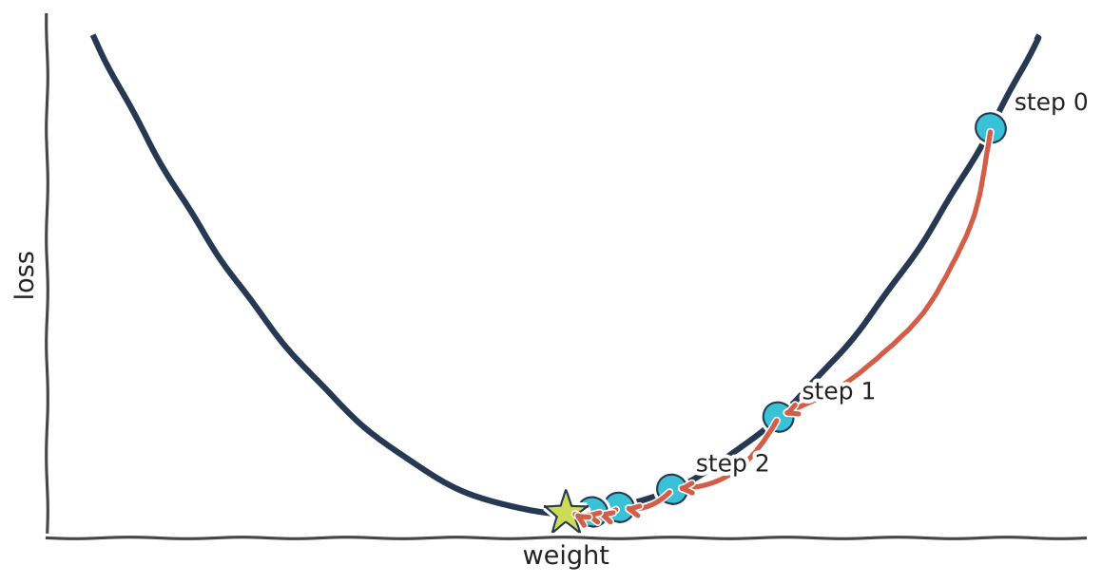
In action
Watch it roll downhill
KEY IDEA
Start anywhere (random weights)
Big slope -> big steps at first
Near the bottom the slope shrinks -> steps shrink
Stops when slope ~ 0
In ML: every neural network, regression and more is trained with this loop.
iTPU
Part 1 | Calculus - how a model learns
Notes:
Point at step 0: steep, so a big jump. Steps get smaller automatically because the gradient gets smaller near the bottom. Nobody tells it to slow down - the maths does it.

Slide 17
ACTIVITY
~4 min
Be the algorithm! (pairs, paper & pen)
Your mission
Step
x
gradient 2x
x_new
Loss: f(x) = x²
Gradient: 2x
Start: x = 3
Learning rate: 0.25
Rule: x_new = x - 0.25 × 2x
Do 3 steps. What pattern do you see?
1
3
?
?
2
?
?
?
3
?
?
?
Fastest correct pair shouts 'CONVERGED!'
iTPU
Part 1 | Calculus - how a model learns
Notes:
Give 3 minutes. Students compute by hand. Step 1: grad=6, x_new=3-1.5=1.5. Step 2: grad=3, x_new=0.75. Step 3: grad=1.5, x_new=0.375. Pattern: x halves each step and approaches 0, the minimum.

Slide 18
Answer
~1 min
Answer: x halves every step -> heading to 0
Step
x
gradient 2x
x_new
1
3
6
1.5
2
1.5
3
0.75
3
0.75
1.5
0.375
3 -> 1.5 -> 0.75 -> 0.375 -> ... -> 0 = the minimum of x². You just trained a model!
iTPU
Part 1 | Calculus - how a model learns
Notes:
Reveal. Celebrate the fastest pair. Emphasise: steps get smaller on their own because the gradient shrinks.

Slide 19
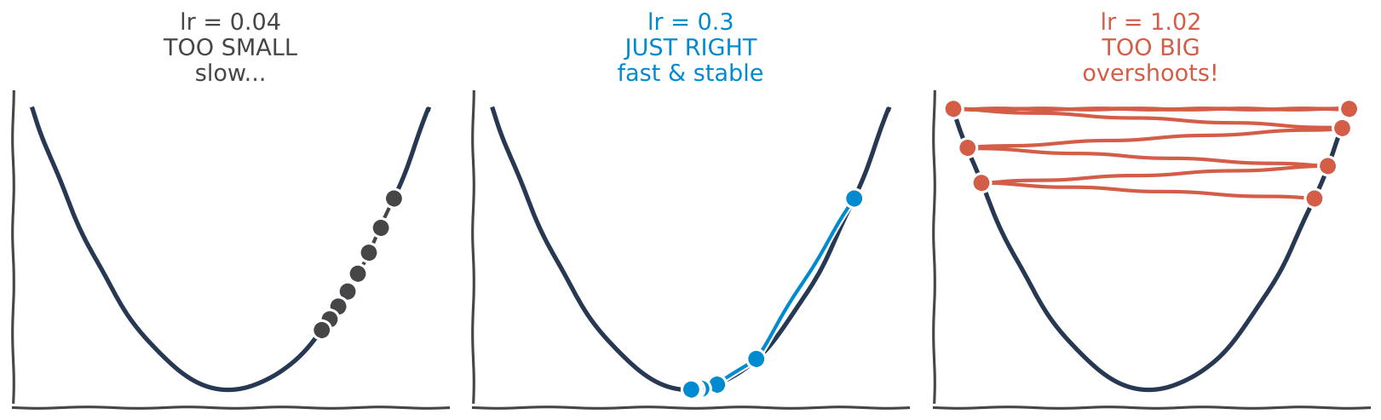
Learning rate
~3 min
The learning rate: not too small, not too big
Too small: correct but painfully slow | Just right: fast and stable | Too big: jumps over the valley, can explode
In ML: choosing the learning rate is one of the most important tuning decisions.
iTPU
Part 1 | Calculus - how a model learns
Notes:
Goldilocks. Tiny steps: you arrive... next week. Huge steps: you jump from one side of the valley to the other and never land. In our activity, what would happen with lr = 1.0? x_new = x - 2x = -x: it bounces 3, -3, 3 forever!

Slide 20
MENTI | Multiple choice
~2 min
menti.com code: ____ ____
You set the learning rate to 5.0 on f(x) = x². What happens?
A) Very slow but correct
B) Perfect - converges fast
C) Overshoots and the loss explodes
D) Nothing changes
Vote on your phone now - 45 seconds
Notes:
Answer: C. x_new = x - 5*2x = -9x. From 3: -27, 243... it explodes.

Slide 21
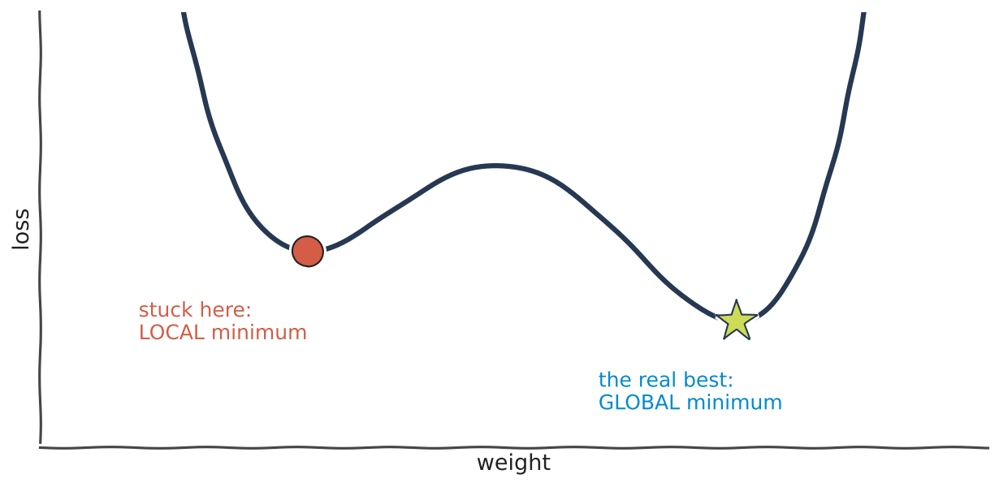
The trap
~3 min
Local minima: stuck in a small valley
KEY IDEA
Gradient descent only feels the slope where it stands
A small dip also has slope 0 -> it stops
But a deeper valley may exist elsewhere
In ML: real loss surfaces have many dips - we need smarter versions of gradient descent.
iTPU
Part 1 | Calculus - how a model learns
Notes:
Story: the blindfolded hiker reaches a small hollow, feels flat ground and sits down - but the real valley is over the next hill. That's a local minimum. Ask: how could the hiker escape? (take random steps, carry momentum...). That leads to SGD.

Slide 22
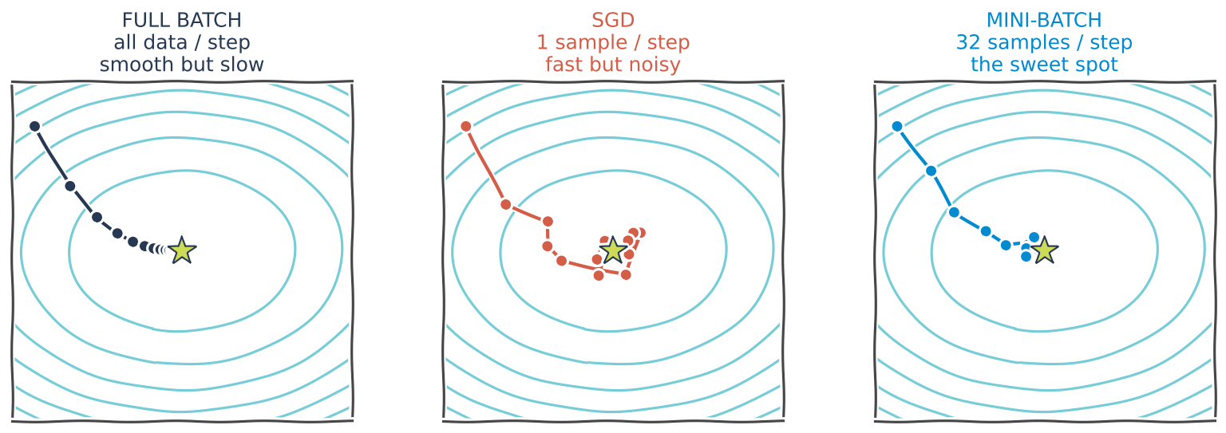
The fixes
~3 min
Batch vs SGD vs mini-batch
Full batch: all data per step - smooth but slow | SGD: 1 sample per step - fast, noisy, noise helps escape traps | Mini-batch: ~32 samples - the sweet spot | Upgrades: Momentum, Adam
In ML: deep learning is trained with mini-batch gradient descent (usually with Adam).
iTPU
Part 1 | Calculus - how a model learns
Notes:
Compare the three paths. Full batch walks carefully. SGD staggers like a tired person but gets there fast, and the wobble can shake it out of a local dip. Mini-batch is the compromise everyone uses. This is exactly practice exercise 3.

Slide 23
MENTI | Open ended
Name an ML algorithm you know that is trained with gradient descent
Live answers appear here on Menti
Type your answer on menti.com
Notes:
Expect: linear regression, logistic regression, neural networks, deep learning, SVM, matrix factorization, LLMs. Say: nearly every modern model - even ChatGPT-style models - is trained with (mini-batch) gradient descent.

Slide 24
Part 1 recap
~2 min
Calculus in 5 lines
Derivative
slope: how the error changes when a weight moves
Gradient
vector of partial derivatives - points uphill
Hessian
curvature - bowl (minimum) or dome (maximum)
Gradient descent
w = w - lr x gradient, repeat until slope ~ 0
Watch out
learning rate size + local minima -> use mini-batch / SGD
iTPU
Part 1 | Calculus - how a model learns
Notes:
Read together. One-line summary: training = rolling downhill to the lowest error. Stretch break of 30 seconds before Part 2.

Slide 25
PART 2
Probability & Statistics
A model is never 100% sure - these tools measure how sure it is
Notes:
Switch gear. After learning, a model must deal with uncertainty: noisy data, unknown future.

Slide 26
The hook
~3 min
'70% chance of rain' - what does that even mean?
Your spam filter says 0.92. A doctor-AI says 0.30. These numbers ARE probabilities.
PROBABILITY -> looks FORWARD
STATISTICS <- looks BACKWARD
Known model -> predict data
Observed data -> infer the model
'This coin is fair. In 100 flips I expect about 50 heads.'
'I saw 70 heads in 100 flips. Is this coin really fair?'
iTPU
Part 2 | Probability & Statistics - handling uncertainty
Notes:
Ask: what does 70% chance of rain mean? Collect answers. Then: ML models output probabilities all the time. Key distinction: probability goes from model to data (predict), statistics goes from data back to model (infer). ML uses both.

Slide 27
Basics
~3 min
Sample space, events and probability
Sample space
Event
Probability
In ML
ALL possible outcomes
Die: {1,2,3,4,5,6}
Email: {spam, not spam}
an outcome we care about
'roll an even number'
'email is spam'
a number from 0 to 1
0 = impossible
1 = certain
P(even) = 3/6 = 0.5
a classifier outputs
P(spam) = 0.92
0.92 + 0.08 = 1
(probabilities sum to 1)
iTPU
Part 2 | Probability & Statistics - handling uncertainty
Notes:
Build from the die example to the email example. Stress: probabilities of all outcomes add up to 1 - that's why softmax outputs sum to 1.

Slide 28
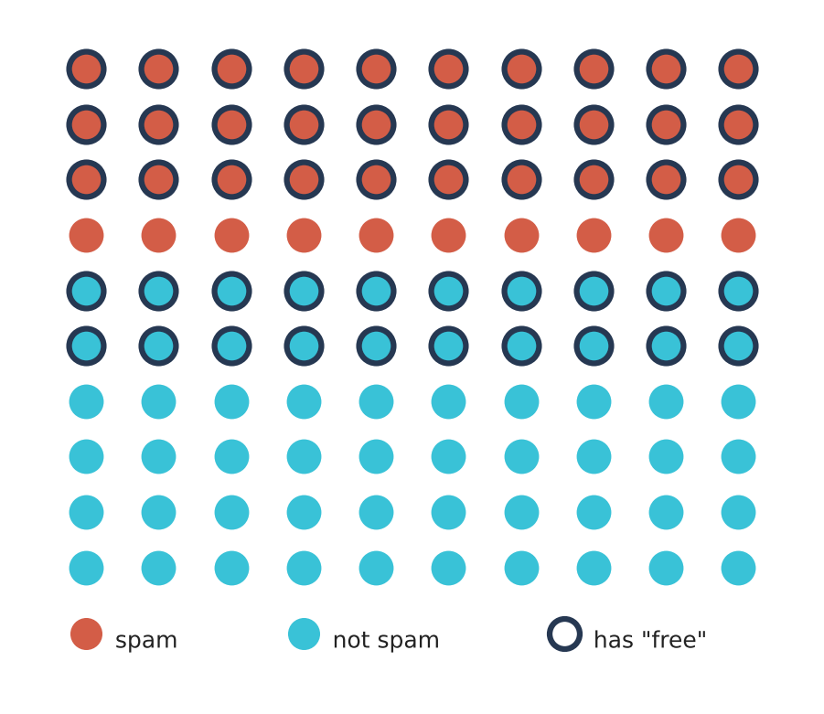
Conditional
~4 min
Conditional probability P(A | B)
KEY IDEA
100 emails: 40 spam (red), 50 contain 'free' (ring)
30 are spam AND contain 'free'
P(spam | 'free') = 30 / 50 = 0.6
Independent: knowing B tells nothing about A (two coin flips)
In ML: Naive Bayes assumes words are independent given the class - simple but powerful.
iTPU
Part 2 | Probability & Statistics - handling uncertainty
Notes:
Count on the picture. 'Given' means: shrink your world to only the ringed emails. There are 50 rings, 30 of them red: 30/50 = 60%. Compare with P(spam) overall = 40%. Seeing the word 'free' raised our belief - that's conditional probability. Independence: two coin flips - the first tells nothing about the second.

Slide 29
MENTI | Quiz - vote with your gut!
A disease affects 1% of people. The test catches 99% of cases, false alarm rate 5%. You test POSITIVE. Chance you are sick?
A) 99%
B) 90%
C) 50%
D) 17%
Notes:
Don't reveal yet. Most students pick 99% or 90%. Show the result bars, then go to the next slide.

Slide 30
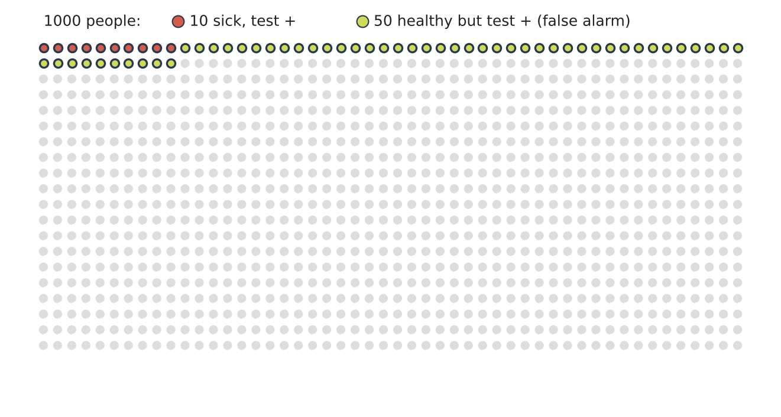
Bayes' theorem
~4 min
Reveal: only ~17%! Count the people
KEY IDEA
Of 1000 people, 10 are sick -> ~10 test positive
990 healthy x 5% -> ~50 false alarms
Positives = 60, truly sick = 10
10 / 60 = 17%
In ML: P(A|B) = P(B|A) x P(A) / P(B). Rare classes stay rare - watch base rates!
iTPU
Part 2 | Probability & Statistics - handling uncertainty
Notes:
Count with them: 10 red, 50 lime. Out of 60 positives, only 10 are sick. Formula: 0.99*0.01 / (0.99*0.01 + 0.05*0.99) = 0.167. ML lesson: with rare classes (fraud, disease) a 'positive' is often a false alarm. Bayes = start with a prior, add evidence, get an updated belief.

Slide 31
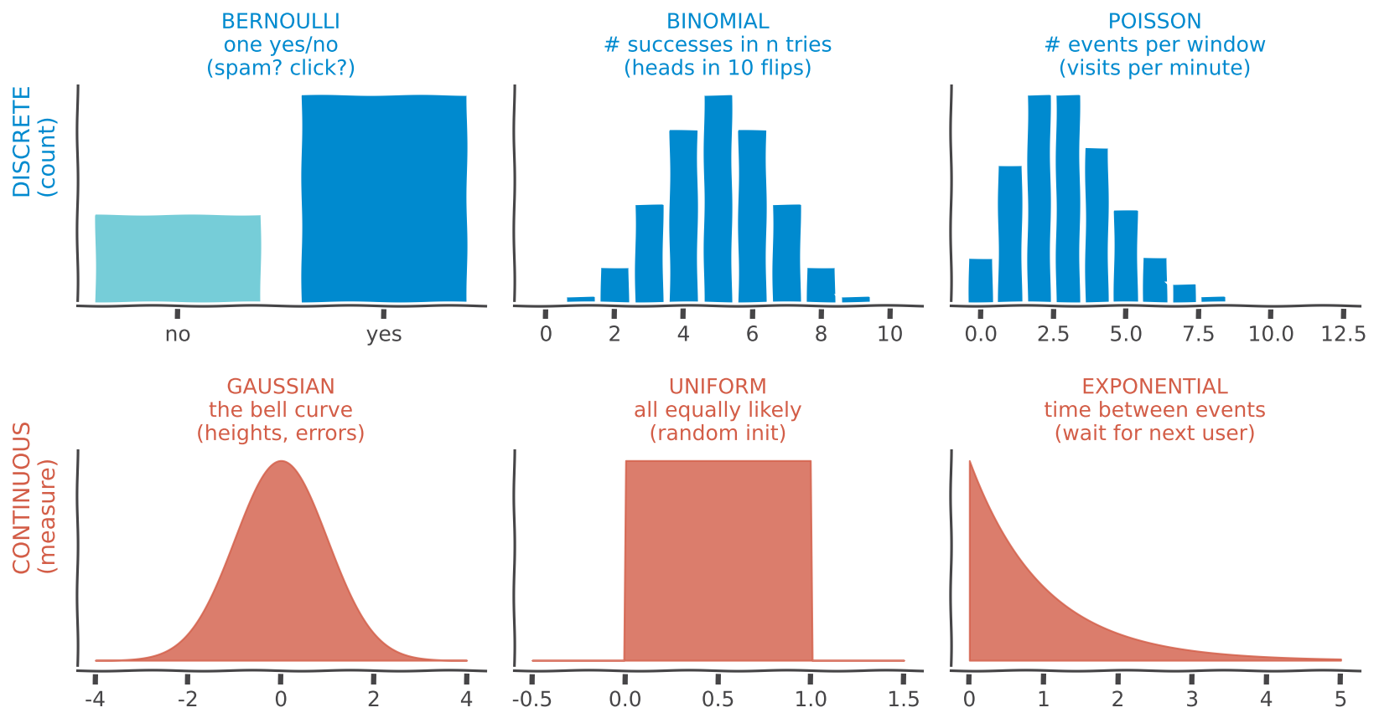
Distributions
~4 min
Random variables & their distributions
KEY IDEA
Random variable = a number decided by chance
DISCRETE: countable (0,1,2...)
CONTINUOUS: any value in a range
Also: Multinomial (many categories), Geometric (tries until 1st success)
In ML: a model's output is often a distribution - e.g. softmax = multinomial over classes.
iTPU
Part 2 | Probability & Statistics - handling uncertainty
Notes:
Tour the gallery with a real example per shape. Top row we count, bottom row we measure. Mention Multinomial (like Bernoulli with many categories - classifying digits 0-9) and Geometric (how many tries until the first success).

Slide 32
ACTIVITY
~4 min
Name that distribution! (pairs, then Menti)
1
Is this email spam? (yes / no, once)
2
Number of heads in 20 coin flips
3
Customers arriving at a shop per hour
4
Heights of all students in this university
5
Waiting time until the next bus arrives
6
The face of one fair die roll
Choose from: Bernoulli | Binomial | Poisson | Gaussian | Exponential | Uniform
Then vote each one on Menti (quiz mode = leaderboard!)
iTPU
Part 2 | Probability & Statistics - handling uncertainty
Notes:
Two minutes in pairs, then run six quick Menti quiz questions. Answers on next slide.

Slide 33
Answers
~1 min
Name that distribution - answers
1. spam yes/no, once
Bernoulli
2. heads in 20 flips
Binomial
3. customers per hour
Poisson
4. student heights
Gaussian
5. waiting for the bus
Exponential
6. one fair die roll
Uniform (discrete)
Trick: yes/no -> Bernoulli. Count of yes -> Binomial. Count per time -> Poisson. Time between -> Exponential.
iTPU
Part 2 | Probability & Statistics - handling uncertainty
Notes:
Reveal and give the memory trick at the bottom.

Slide 34
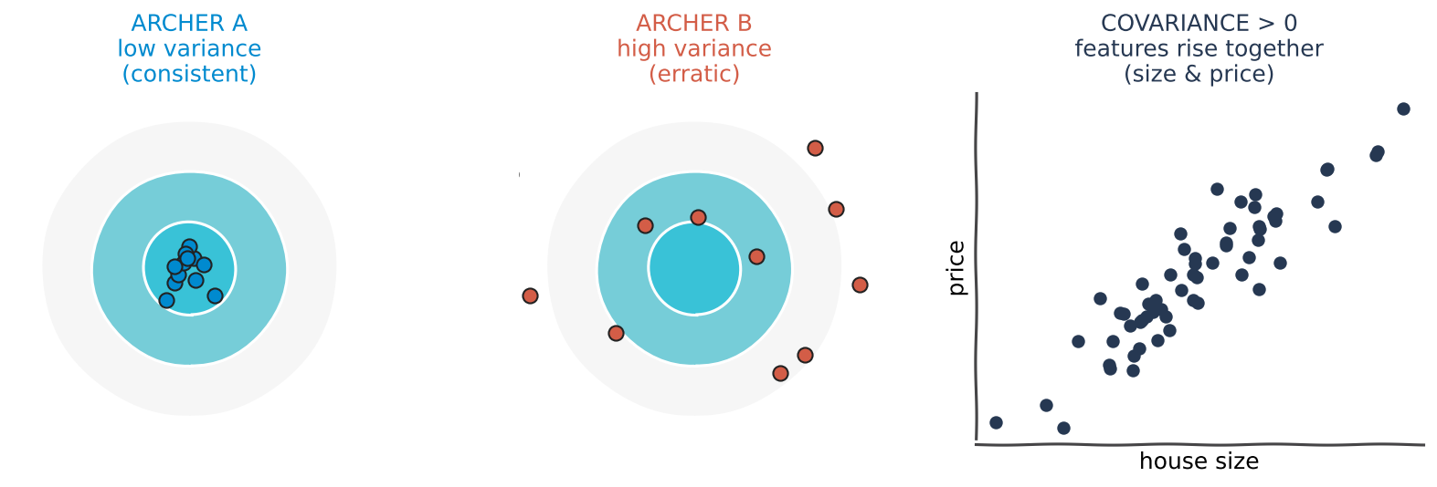
Expectation & spread
Expected value, variance, covariance
Expected value = long-run average: fair die -> 3.5 | Variance = how spread out (archer A vs B) | Covariance = do two features move together?
In ML: loss = EXPECTED error; covariance matrix is the heart of PCA (Topic 6).
iTPU
Part 2 | Probability & Statistics - handling uncertainty
Notes:
Expected value: you never roll 3.5, but the long-run average is 3.5. Two archers with the same average but different spread - variance measures spread. Covariance: bigger house, higher price - they move together. PCA uses the covariance matrix to find directions of biggest spread.

Slide 35
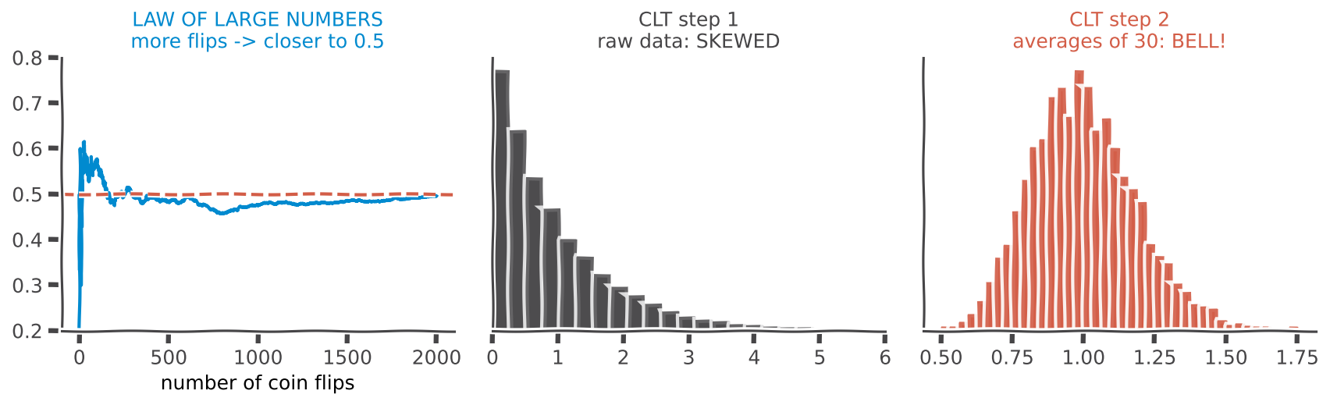
Big data laws
~4 min
Law of Large Numbers & Central Limit Theorem
LLN: more data -> average gets closer to the truth | CLT: averages of many samples form a BELL curve | ...even when the raw data is skewed!
In ML: LLN = why more data makes models more stable; CLT = why we can build confidence intervals.
iTPU
Part 2 | Probability & Statistics - handling uncertainty
Notes:
Left: coin flips - early the average jumps around, later it settles at 0.5. Middle: very skewed data. Right: take averages of 30 values, many times - a bell appears. That's the magic of the CLT and why the normal curve is everywhere.

Slide 36
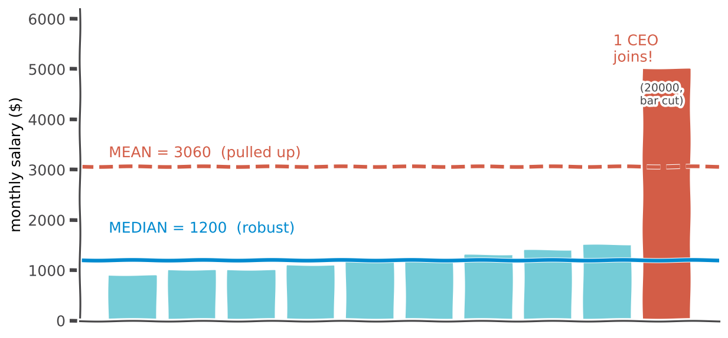
Descriptive stats
~3 min
Describe the data: centre and spread
KEY IDEA
Centre: mean, median, mode
Spread: range, variance, standard deviation
One CEO joins -> mean jumps to 3060, median stays 1200
In ML: that's why we impute with the MEDIAN when there are outliers (Topic 5!).
iTPU
Part 2 | Probability & Statistics - handling uncertainty
Notes:
Room of 9 teachers earning about 1200. A CEO walks in. The average salary jumps to 3060 - does anyone earn that? No. The median stays 1200. Mode = most common value. Descriptive statistics describe the data you have.

Slide 37
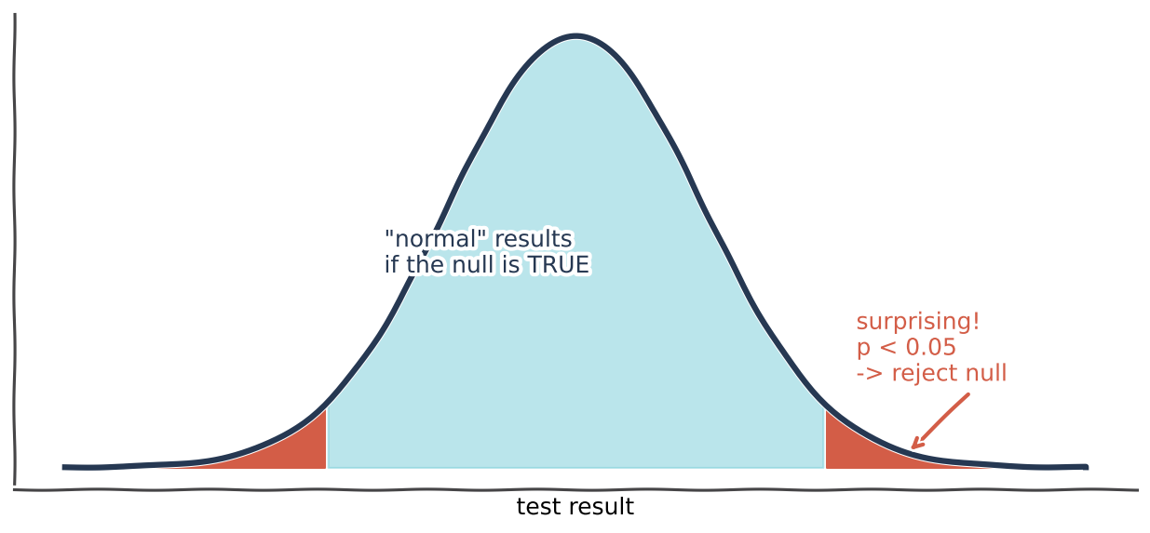
Hypothesis test
~4 min
Inferential stats: the courtroom
KEY IDEA
Null hypothesis H0 = 'innocent' (no effect)
Alternative H1 = 'guilty' (there is an effect)
p-value = how surprising the evidence is IF H0 were true
p < 0.05 -> surprising -> reject H0
In ML: is model B REALLY better than model A, or just lucky on this test set?
iTPU
Part 2 | Probability & Statistics - handling uncertainty
Notes:
Courtroom: we assume innocent (the null) until the evidence is too surprising. The p-value measures how surprising. Red tails = rare results if innocent. Land in the tail -> reject the null. ML example: model B scored 1% higher - real improvement or luck? A test answers that.

Slide 38
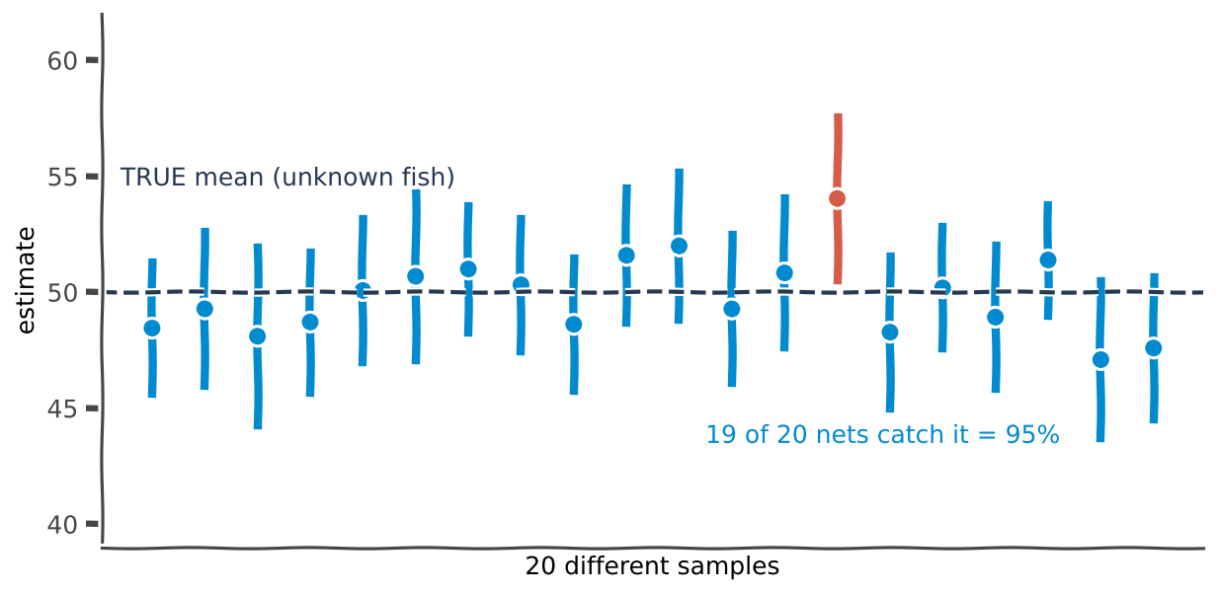
Confidence interval
~3 min
Confidence interval = a fishing net
KEY IDEA
We can't see the true mean (the fish)
Each sample throws a net (interval)
95% CI: 95 of 100 such nets catch the fish
Wider net = more data needed to shrink it
In ML: report accuracy as 87% +/- 2%, not just 87% - that's honest ML.
iTPU
Part 2 | Probability & Statistics - handling uncertainty
Notes:
Each vertical line is an interval from a different sample. 19 of 20 catch the true mean; the red one missed. That's what 95% means - about the method, not one interval. Practice exercise 1 asks them to compute these.

Slide 39
MENTI | True or false
'p = 0.03' means there is a 3% chance that the null hypothesis is true.
A) True
B) False
Notes:
Answer: FALSE - the most common misunderstanding in science. p = 0.03 means: IF the null were true, results this extreme would appear only 3% of the time.

Slide 40
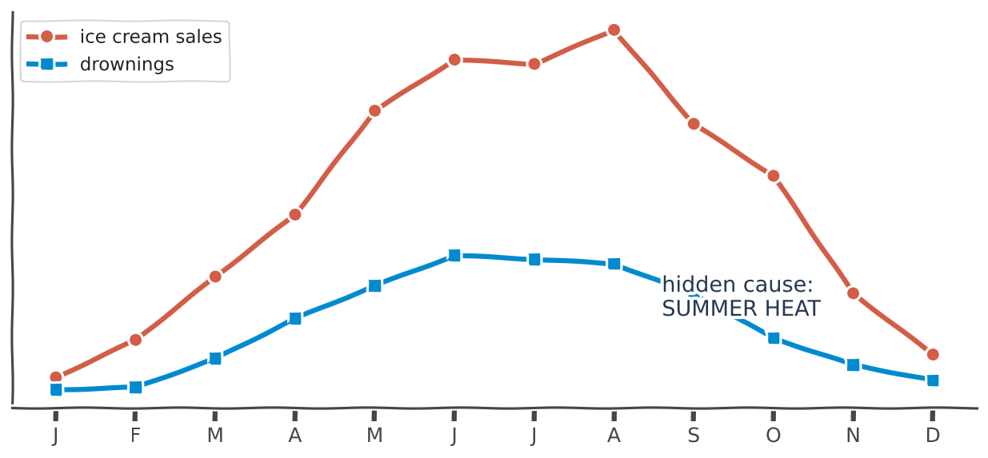
Correlation
~3 min
Correlation is NOT causation
KEY IDEA
Correlation: two things move together (-1 to +1)
Causation: one MAKES the other happen
Ice cream doesn't cause drowning - summer heat drives both
In ML: models learn CORRELATIONS. Never read a model's pattern as a cause without an experiment.
iTPU
Part 2 | Probability & Statistics - handling uncertainty
Notes:
Ask: should we ban ice cream to stop drownings? Laughter. The hidden cause is summer heat. ML models find patterns, not reasons.

Slide 41
MENTI | Multiple choice - quick fire
Correlation or causation? Vote for each statement:
1) Fires with more firefighters cause more damage
2) In a randomised trial, a new drug lowered blood pressure
3) Countries that eat more chocolate win more Nobel prizes
Notes:
1) correlation - hidden cause: bigger fires need more firefighters AND cause more damage. 2) causation - randomised experiments can show cause. 3) correlation - wealth drives both.

Slide 42
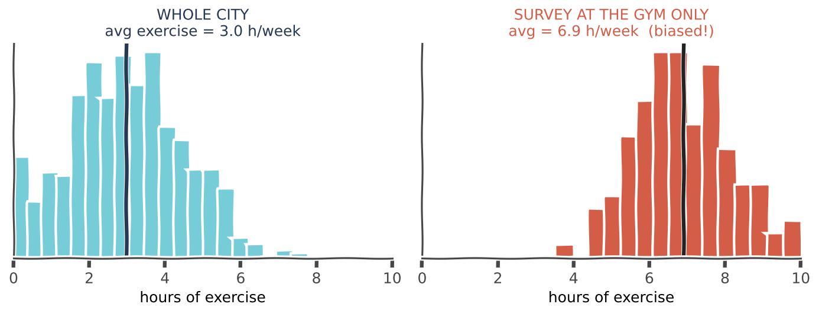
Sampling
~3 min
Population vs sample: beware of bias
Population = everyone; sample = the ones we measured | Survey only at the gym -> 6.9 h vs true 3.0 h | Biased sample = biased model
In ML: if training data is not representative (one city, one language, one gender) the model fails on the rest.
iTPU
Part 2 | Probability & Statistics - handling uncertainty
Notes:
A study of exercise habits done only at the gym. The answer is way off, not because of maths, but because of WHO we asked. ML version: a face-recognition model trained mostly on one group performs badly on others. Representative data matters more than big data.

Slide 43
Why it matters
~2 min
Where probability & statistics power ML
Feature selection
Model evaluation
Uncertainty
Generalization
chi-squared test and correlation show which features are related to the target
confidence intervals and hypothesis tests: is the improvement real?
probabilities and calibration: when the model says 90%, is it right 90% of the time?
representative samples + LLN: will it work on NEW data?
Practice: confidence intervals | ECDF | chi-squared test | two-sample KS test
iTPU
Part 2 | Probability & Statistics - handling uncertainty
Notes:
Connect every concept to a real ML task. Calibration: a well-calibrated model that says 90% is right about 90% of the time. Then preview the practice: ECDF = fraction of data below each value; chi-squared = are two categories related; KS = do two samples come from the same distribution.

Slide 44
Part 2 recap
~2 min
Probability & statistics in 5 lines
Direction
probability predicts forward; statistics infers backward
Bayes
update belief with evidence - rare stays rare (17%!)
Distributions
Bernoulli, Binomial, Poisson / Gaussian, Uniform, Exponential
LLN & CLT
more data -> truer averages; averages -> bell curve
Inference
p-values, confidence intervals; correlation is not causation
iTPU
Part 2 | Probability & Statistics - handling uncertainty
Notes:
One-line summary: ML is managing uncertainty with numbers.

Slide 45
MENTI | Final challenge
~4 min
Final challenge - quiz mode, leaderboard!
1. The gradient points... ? (uphill / downhill / sideways)
2. lr too big -> ? (slow / overshoot / perfect)
3. Fair die: expected value = ? (3 / 3.5 / 6)
4. Customers per hour follow a ...? (Poisson / Gaussian / Uniform)
5. Outliers in data -> use the ...? (mean / median)
Fastest correct answers win - winner gets bragging rights!
Notes:
Build these as 5 Menti Quiz questions (20 s each). Answers: 1 uphill, 2 overshoot, 3 3.5, 4 Poisson, 5 median. Show the leaderboard.

Slide 46
Big picture
~2 min
How today's two topics work together
Calculus
Probability
Statistics
finds the best weights
(gradient descent)
defines 'good'
(loss = expected error, likelihood)
tells if we can TRUST it
(tests, confidence intervals)
Two things to remember
1. Training = rolling downhill to the lowest error.
2. ML = managing uncertainty with numbers - and being honest about it.
iTPU
Calculus & Probability in ML
Notes:
Tie it together: calculus finds the weights, probability defines what good means, statistics tells us if we can trust the result.

Slide 47
MENTI | Open ended - exit ticket
~2 min
menti.com code: ____ ____
1) One thing I learned today. 2) One thing that is still confusing.
Live answers appear here on Menti
Answer both on menti.com before you leave
Notes:
Read a few answers aloud. Use the 'still confusing' answers to plan the start of the practice session.

Slide 48
iTPU
Thank you!
Notes:
Close. Remind them the practice is auto-checked by unit tests in AutoCode.

