Slide 1
iTPU
Feature Engineering &
Linear Algebra in ML
Topics 5 & 6 | 90-minute lesson
From raw messy data to the maths that powers every model.

Slide 2
Agenda
Today's lesson - two parts
PART 1 - Feature Engineering
PART 2 - Linear Algebra
- What feature engineering is
- Scalars, vectors, matrices
- The feature matrix & vocabulary
- Two roles: points & transformations
- 5 techniques: encode, bin, impute,
- Vector operations & the dot product
handle outliers, scale
- Matrix operations (with examples)
- Manual vs automatic + selection
- Dependence vs independence
- Data leakage - the silent killer
- Why LA is the foundation of ML
~45 min
~40 min
iTPU
Feature Engineering & Linear Algebra

Slide 3
PART 1
Feature Engineering
Turning raw, messy data into a clean numeric table

Slide 4
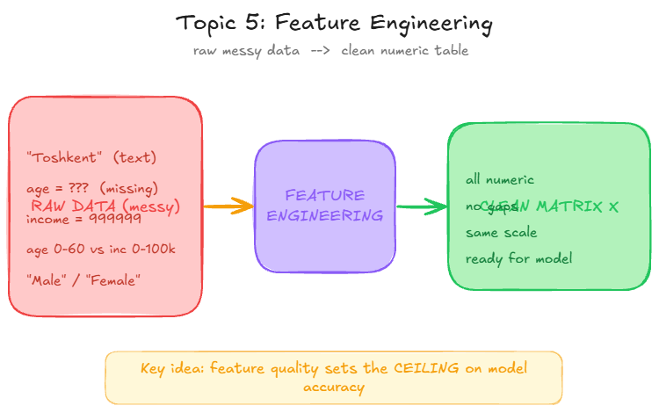
What is FE?
Feature engineering: from mess to model-ready
iTPU
Feature Engineering & Linear Algebra

Slide 5
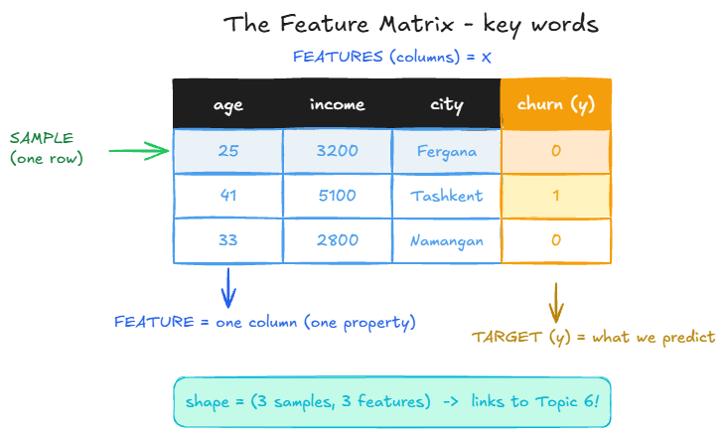
Vocabulary
The feature matrix - the words we will use
iTPU
Feature Engineering & Linear Algebra

Slide 6
Quick check 1
In a feature matrix, what does ONE ROW represent?
A) One feature (a single column / property)
B) One sample (a single observation)
C) The target we want to predict
Discuss with your neighbour - 60 seconds

Slide 7
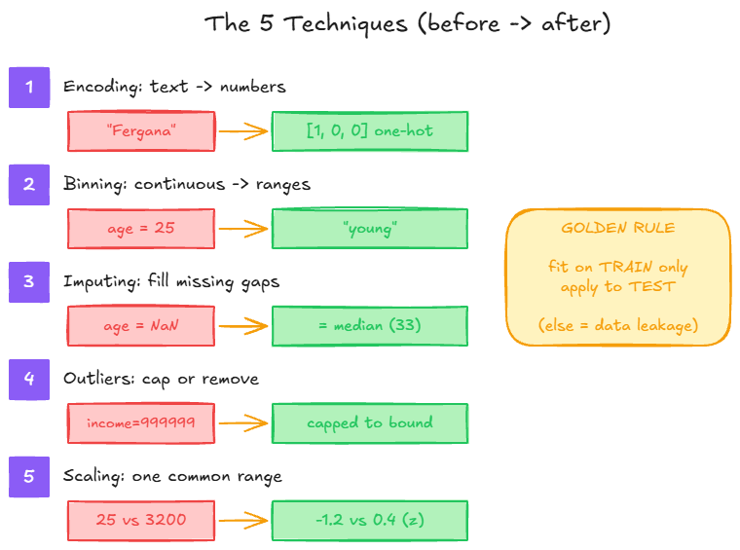
5 techniques
The 5 core techniques (before -> after)
iTPU
Feature Engineering & Linear Algebra

Slide 8
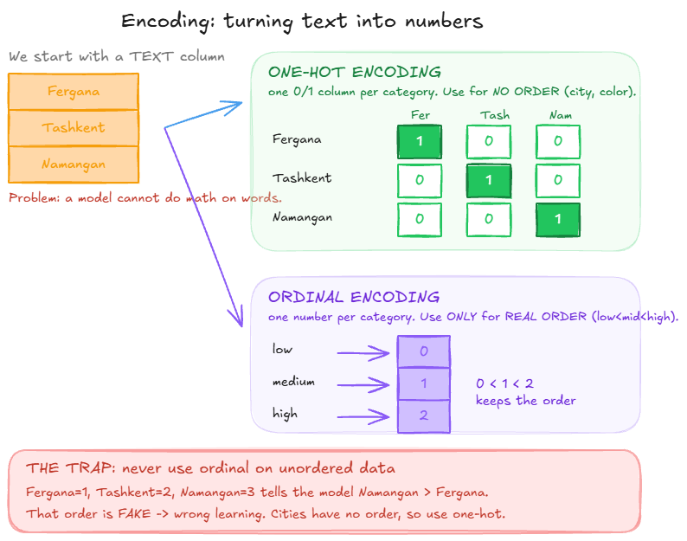
Encoding
Encoding text: one-hot vs ordinal
iTPU
Feature Engineering & Linear Algebra

Slide 9
Quick check 2
The column "city" has Fergana, Tashkent, Namangan. Which encoding?
A) Ordinal - map them to 1, 2, 3
B) One-hot - a 0/1 column per city
C) Leave it as text
Discuss with your neighbour - 60 seconds

Slide 10
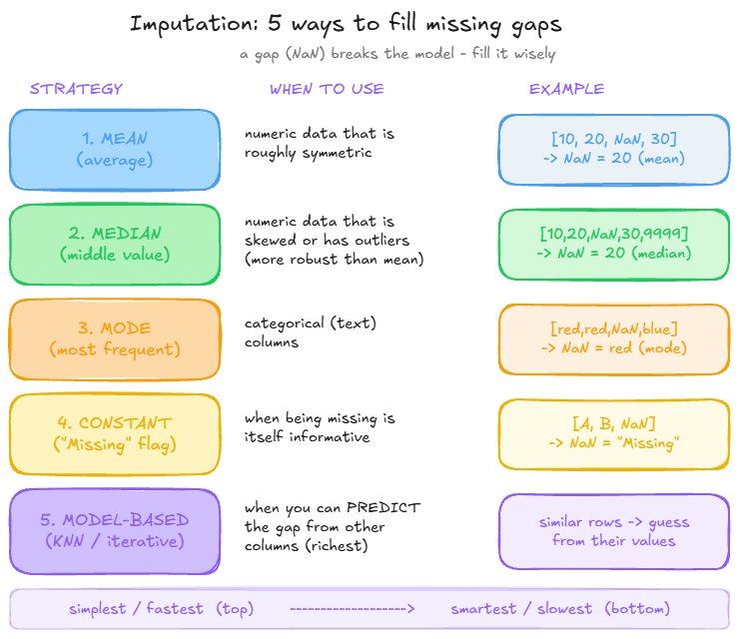
Imputation
Filling missing values - 5 strategies
iTPU
Feature Engineering & Linear Algebra

Slide 11
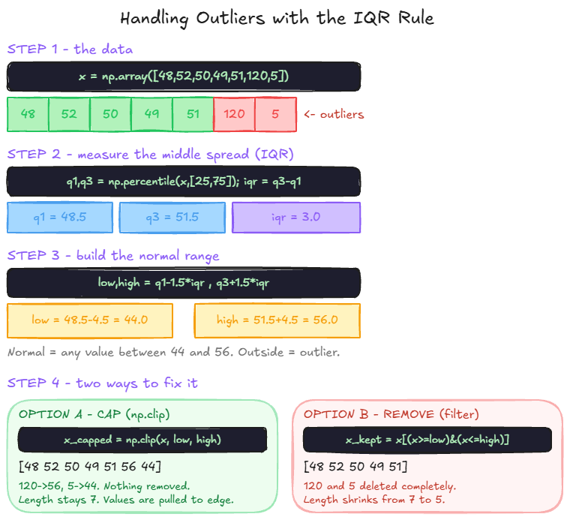
Outliers
Handling outliers with the IQR rule
iTPU
Feature Engineering & Linear Algebra

Slide 12
Quick check 3
An income column has one value of 999999 (an outlier). Best fill value for other gaps?
A) The mean (average)
B) The median (robust to the outlier)
C) Zero
Discuss with your neighbour - 60 seconds

Slide 13
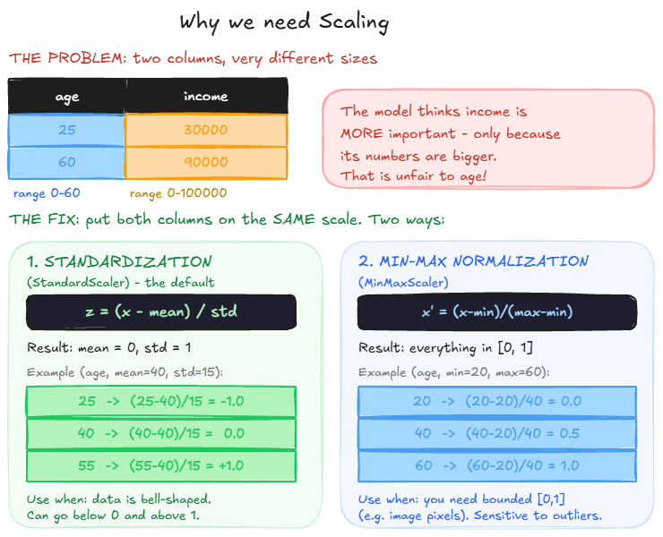
Scaling
Why we scale - putting columns on one range
iTPU
Feature Engineering & Linear Algebra

Slide 14
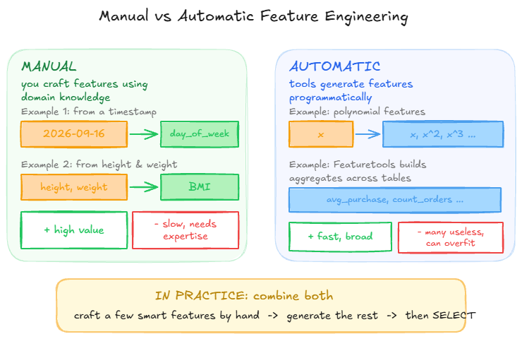
Manual vs auto
Manual vs automatic + feature selection
iTPU
Feature Engineering & Linear Algebra

Slide 15
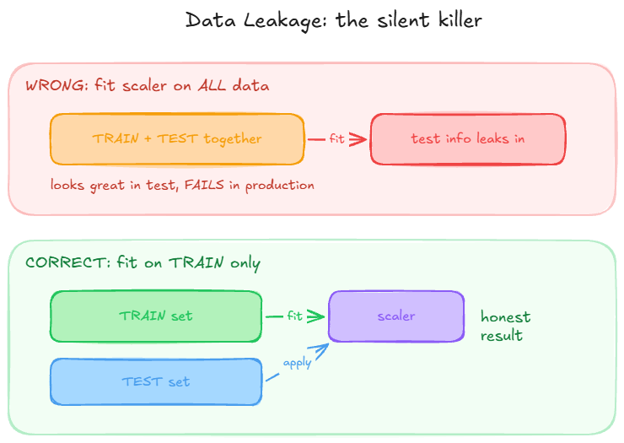
Leakage
Data leakage - the silent killer
iTPU
Feature Engineering & Linear Algebra

Slide 16
Part 1 recap
Feature Engineering - key answers
One row =
a SAMPLE; one column = a FEATURE; y = the TARGET
city (no order) ->
one-hot; size low<mid<high -> ordinal
outliers / skew ->
impute with MEDIAN, not mean
scaling ->
StandardScaler: mean 0, std 1 (fit on TRAIN only)
leakage =
test info reaching training -> fake high score
iTPU
Feature Engineering & Linear Algebra

Slide 17
PART 2
Linear Algebra in ML
The mathematics that operates on the clean matrix

Slide 18
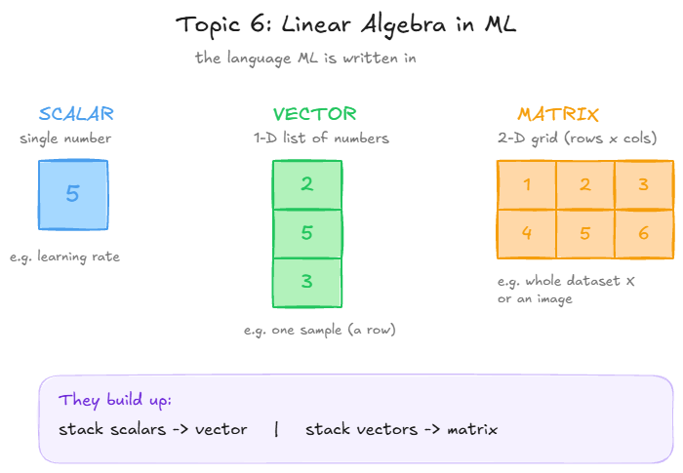
Building blocks
Scalar, vector, matrix
iTPU
Feature Engineering & Linear Algebra

Slide 19
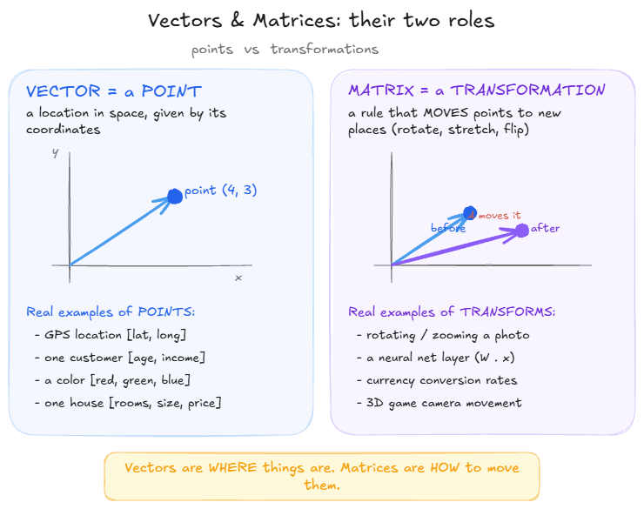
Two roles
Vectors are points; matrices are transformations
iTPU
Feature Engineering & Linear Algebra

Slide 20
Quick check 4
Your phone's GPS shows you at [latitude, longitude]. That is a...
A) Vector - a POINT in space
B) Matrix - a transformation
C) Scalar - a single number
Discuss with your neighbour - 60 seconds

Slide 21
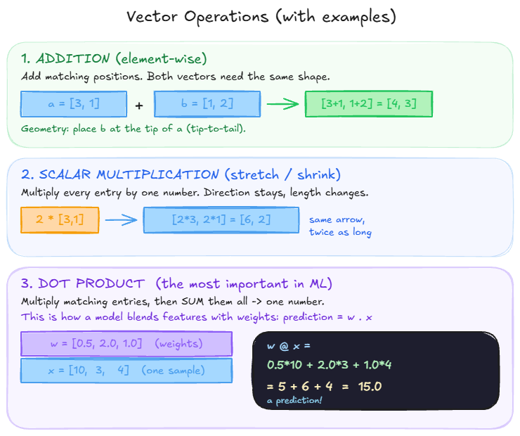
Vector ops
Vector operations: add, scale, dot
iTPU
Feature Engineering & Linear Algebra

Slide 22
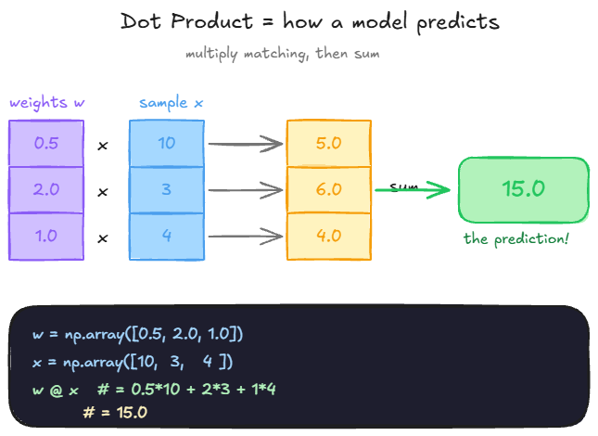
Dot product
The dot product = how a model predicts
iTPU
Feature Engineering & Linear Algebra

Slide 23
Quick check 5
w = [1, 2, 0] and x = [3, 4, 5]. What is the dot product w . x ?
A) 11
B) 12
C) 9
Discuss with your neighbour - 60 seconds

Slide 24
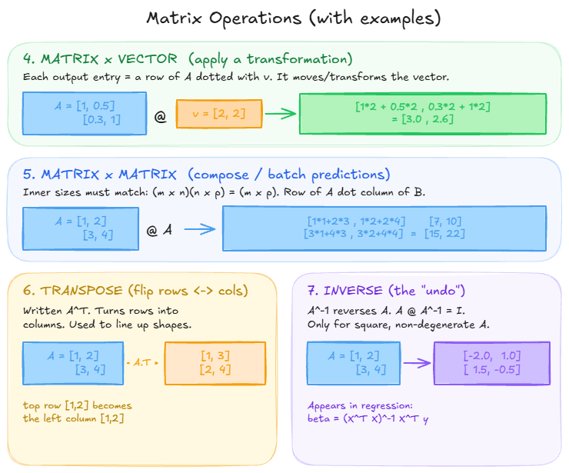
Matrix ops
Matrix operations (with worked examples)
iTPU
Feature Engineering & Linear Algebra

Slide 25
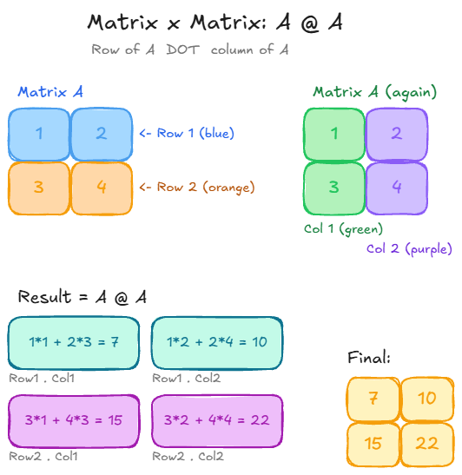
Worked example
Matrix x matrix, step by step: A @ A
iTPU
Feature Engineering & Linear Algebra

Slide 26
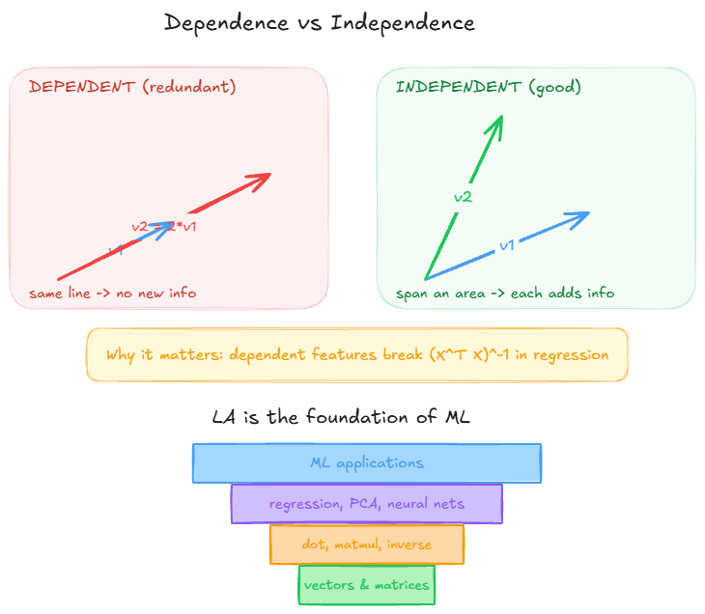
Dependence
Dependence vs independence; LA as ML's foundation
iTPU
Feature Engineering & Linear Algebra

Slide 27
Part 2 recap
Linear Algebra - key answers
scalar / vector / matrix
= single number / 1-D list / 2-D grid
vector =
a POINT; matrix = a TRANSFORMATION
dot product w.x
= multiply matching, sum -> one prediction
A @ A, A.T, inv(A)
= transform, flip rows<->cols, undo
dependent columns
break (X^T X)^-1 -> keep features independent
iTPU
Feature Engineering & Linear Algebra

Slide 28
Big picture
How the two topics connect
Topic 5
Topic 6
Result
+
=
Feature engineering builds the clean matrix X
Linear algebra operates on X (dot products, matmul)
a model that learns and predicts
Two things to remember
1. Clean the matrix first - feature quality sets the ceiling on model accuracy.
2. Data is a matrix, and learning is solving matrix equations.
iTPU
Feature Engineering & Linear Algebra

Slide 29
iTPU
Thank you!
Questions? Next: hands-on breakout activities for both topics.

