Slide 1
Uncertainty-Calibrated Graph Neural Networks for Wildfire Spread Prediction under Stochastic Simulation

Slide 2
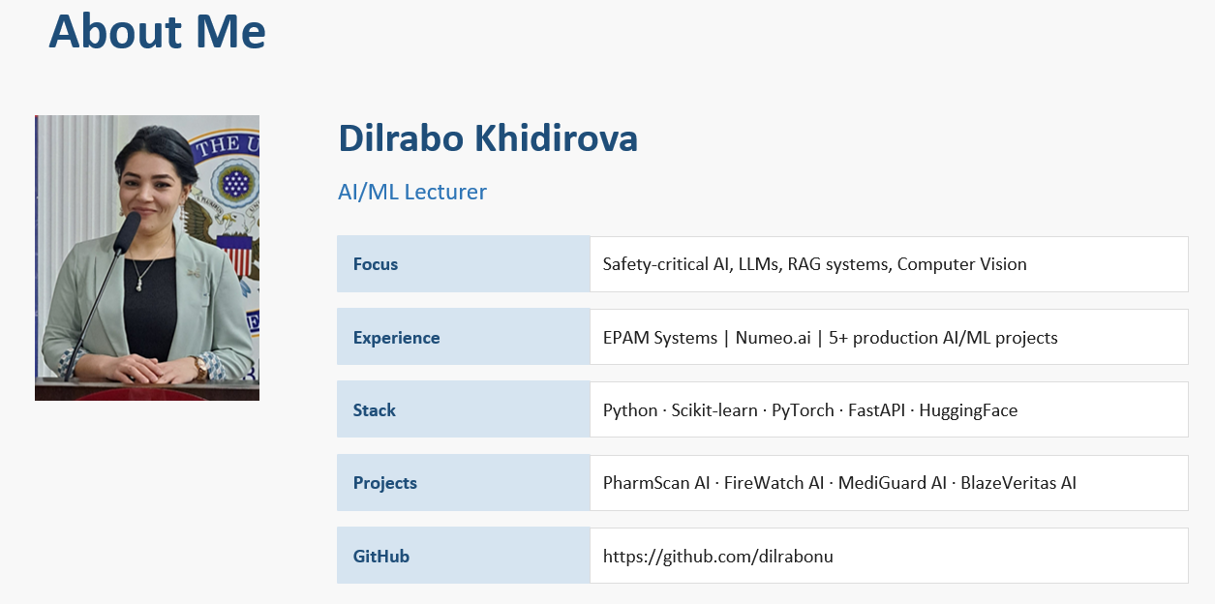
Section

Slide 3
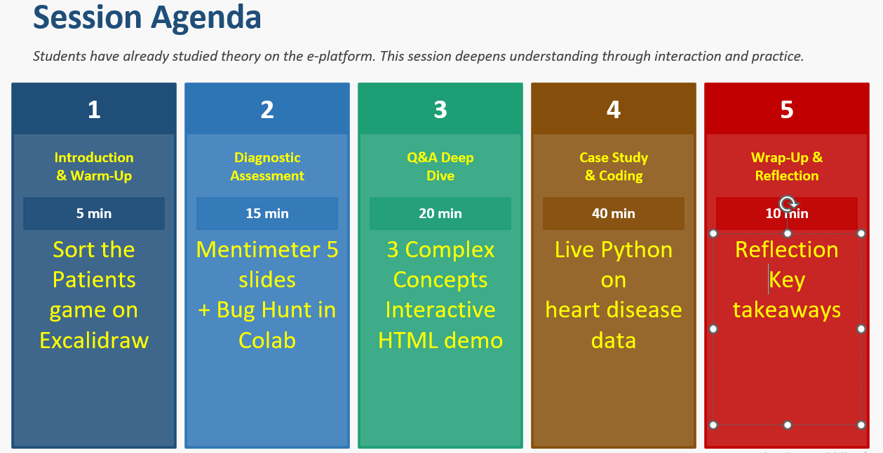

Slide 4
Learning Objectives
Explain how Decision Trees make decisions
Describe how Random Forest improves accuracy
Interpret model decisions in real-world scenarios
Build and evaluate models in Python
Understand overfitting and model complexity

Slide 5
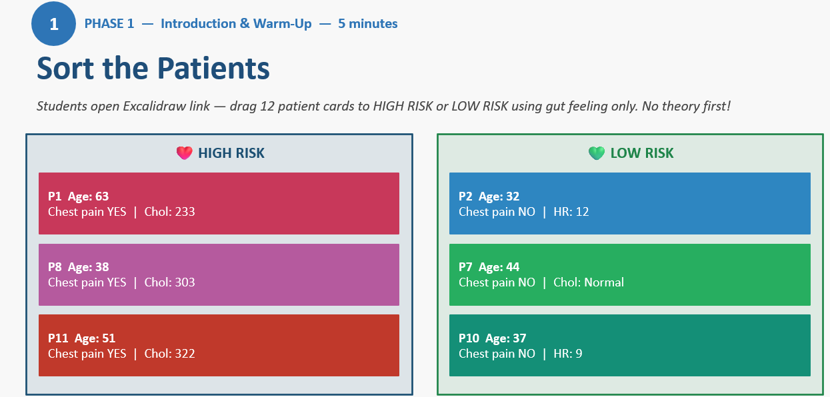

Slide 6
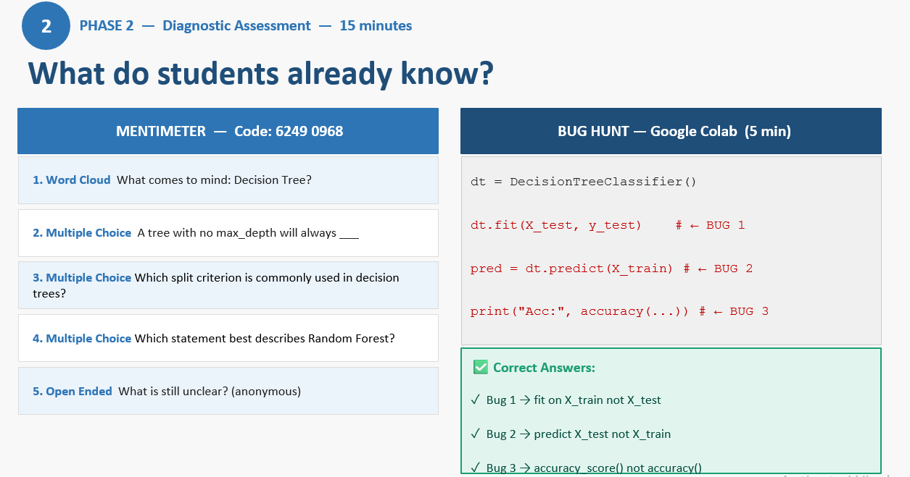
Problem statement:

Slide 7
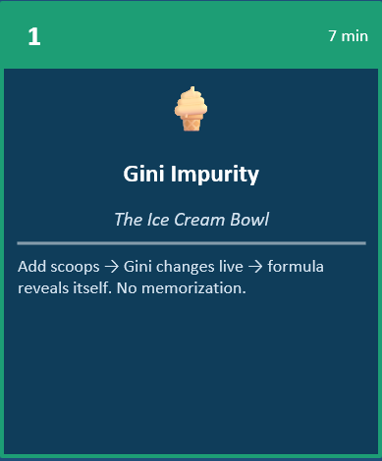
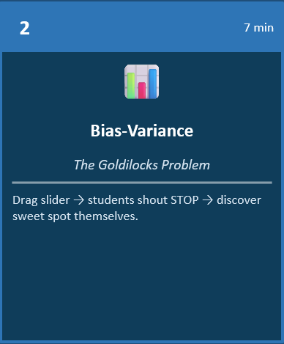
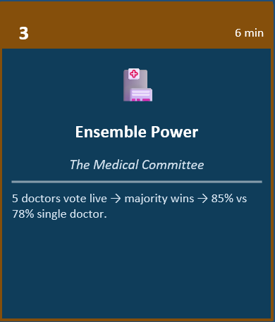
PHASE 3 — Q&A Deep Dive — 20 minutes
3

Slide 8
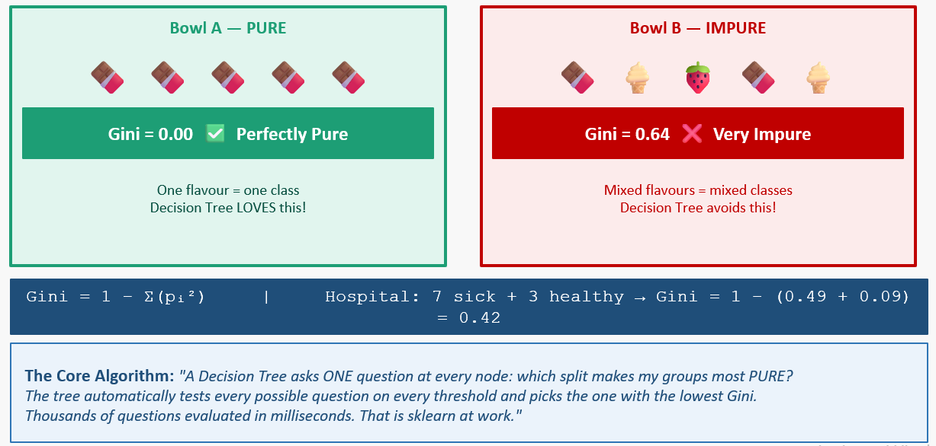
Concept 1: Gini Impurity — The Ice Cream Bowl

Slide 9
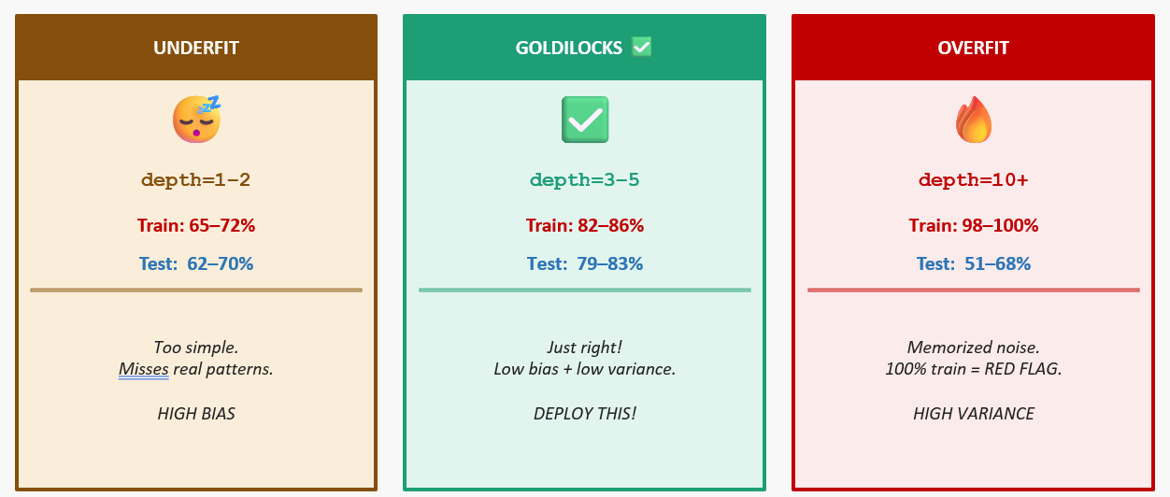
Concept 2: Bias-Variance Tradeoff

Slide 10
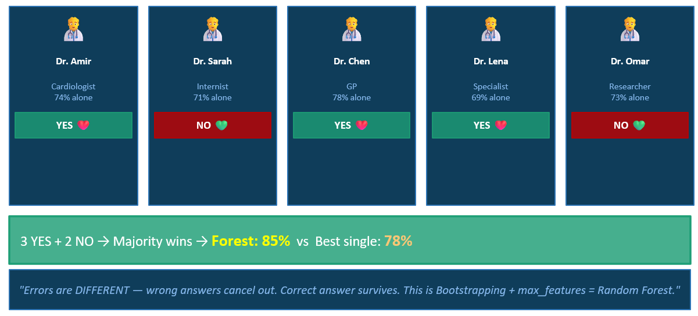
Concept 3: Ensemble Power — The Medical Committee

Slide 11
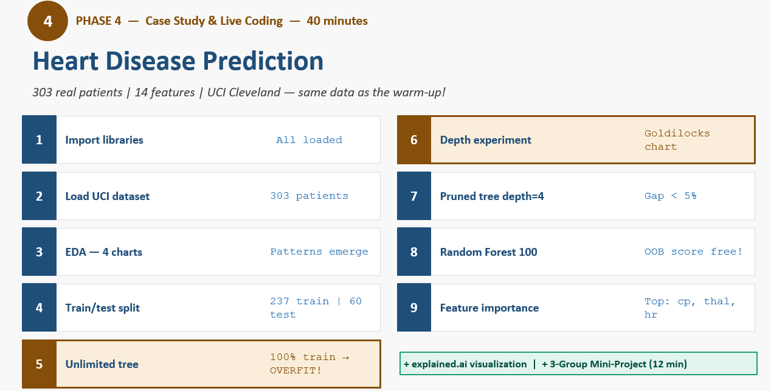

Slide 12
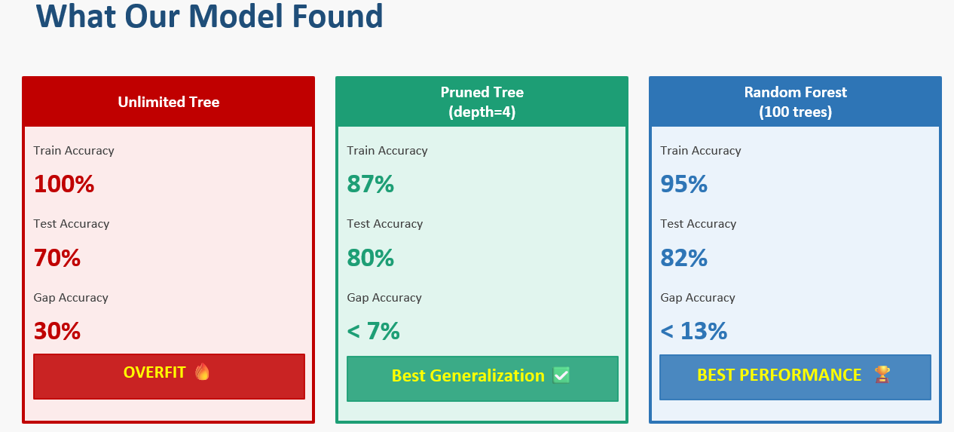

Slide 13
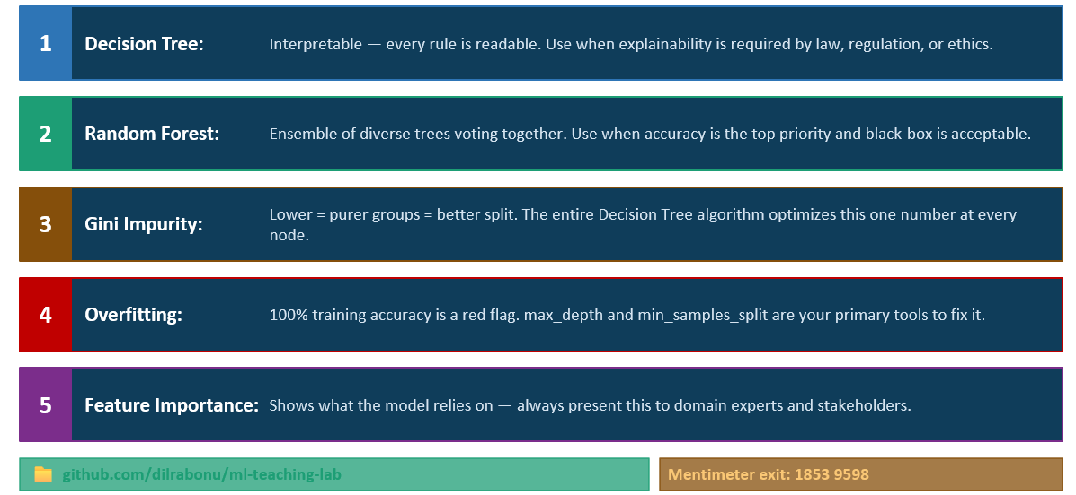

Slide 14

Thank You / Q&A
Dilrabo Khidirova
dilrabo.khidirova91@gmail.com

