Slide 1
Final Project Data Management and Masking on Azure
Reddy, Dilip

Slide 2
Problem Statement
Cyber security is a big challenge in the current world. Most of the companies has a need to mask enterprise data to protect from outside intrusions and accidental loss of protected data. So, Data Masking is an important technology used to maintain data security even in case of external threats. Data exposure to the right user is essential to properly organize and maintain data processes to meet ongoing information lifecycle needs.

Slide 3
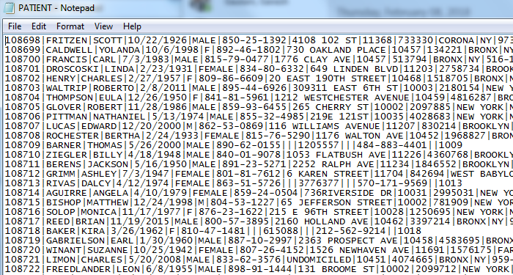
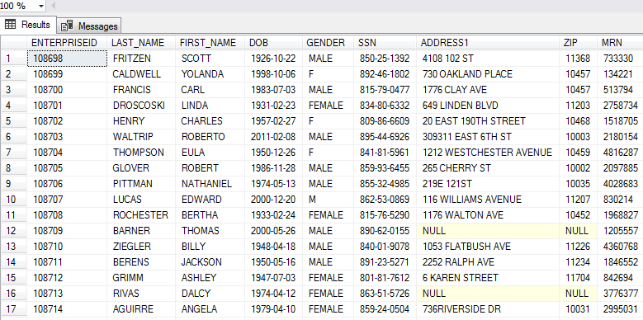
Data Set
Data set obtained at : https://www.challenge.gov/challenge/patient-matching-algorithm-challenge/
This is a fake PHI data set with list of lung cancer patients and associated providers
Data set includes, patient First Name, Last Name, DOB, SSN Address
It also includes Provider First Name, Last Name, NPI
Patient File Patient Table (After loading file)

Slide 4
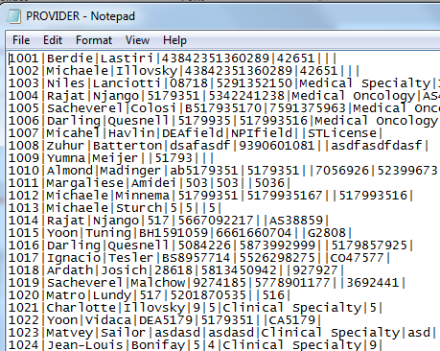
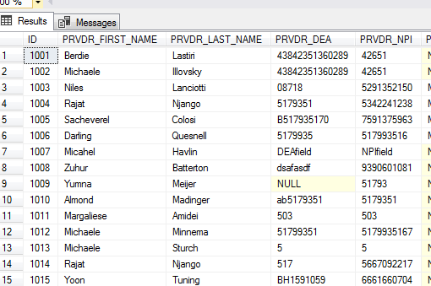
Data Set
Provider File
Provider Table(After loading data)

Slide 5




Technology and Software
Azure Data masking service is used to mask the data
Visual studio is used to create data factory
.NET code is used to create data factory
SQL Server is the database used to mask the data in the tables
Tableau is used for visualization

Slide 6
Hardware
Intel Core i5-5300U CPU 2.30 GHZ
16 GB RAM
64 bit Windows 7 operating system

Slide 7
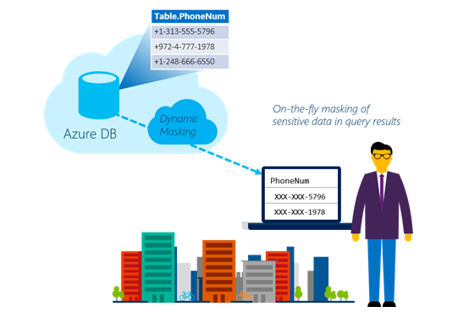
Why Data Masking
To limit sensitive data exposure by obfuscating it to non-privileged users
Limit exposure of sensitive data to app users
Avoid exposure of sensitive data to Engineers ,Users….

Slide 8
Azure Dynamic Data Masking
Dynamic data masking helps prevent unauthorized access to sensitive data by enabling customers to designate how much of the sensitive data to reveal with minimal impact on the application layer. It’s a policy-based security feature that hides the sensitive data in the result set of a query over designated database fields, while the data in the database is not changed.
You enable DDM by defining masking rules on designated database fields, which determine how you want the data in these fields to appear in query results. You can define a partial mask which exposes some of the data in the selected field such as the first and last few characters, while masking out the rest. Or, you can define a full mask which doesn't leave any of the data exposed and always replaces the field's data with a constant value.

Slide 9
Dynamic Data Masking Workflow
Identify the data set
Create a SQL server and a SQL database in azure portal
Login to database and create tables and multiple users with access to the newly created database
Create azure storage account and container
Upload files to storage container
Using Visual Studio .NET, create azure data factory to load the data from flat file into the SQL database
Mask the data using azure data masking service on the sql server for the required users
View the data on Tableau or any other visualization tool

Slide 10
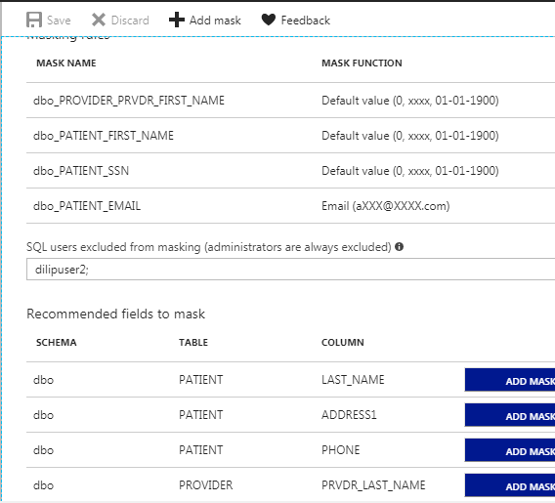
Azure Dynamic Data Masking
Azure Dynamic Data Masking prevents the abuse of sensitive data by hiding it from users
Alters the table not the data (DDL vs DML)
Configuration using Azure portal
Policy-driven at the table and column level, for a defined set of users
Data masking applied in real-time to query results based on policy
Multiple masking functions available (e.g. full, partial) for various sensitive data categories (e.g. Credit Card Numbers, SSN, etc.)

Slide 11
Benefits of Azure DDM
It is especially simple to create a data masking policy in Azure Portal
There is no need to modify database procedures or application code
DDM introduces little if any performance impact on database operations
DDM supports AAD authentication, and AAD users and groups can be granted DDM exclusion permissions

Slide 12
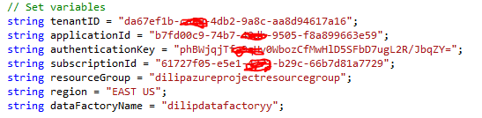
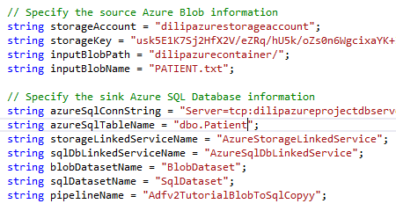
Code Review
O ver view of steps
Install Visual Studio 2017
Capture all ID’s/Keys from azure portal
Set the variables
Specify Azure Blob and SQL database information

Slide 13
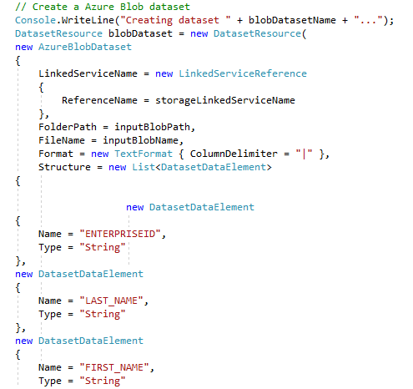
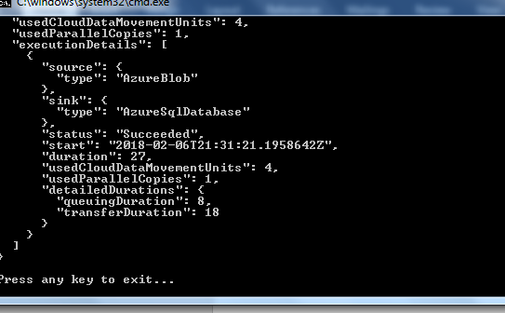
Code Review
Create Azure Blob dataset
Run the code to create data factory and make sure there are no errors.
Complete code is in GitHub repository

Slide 14
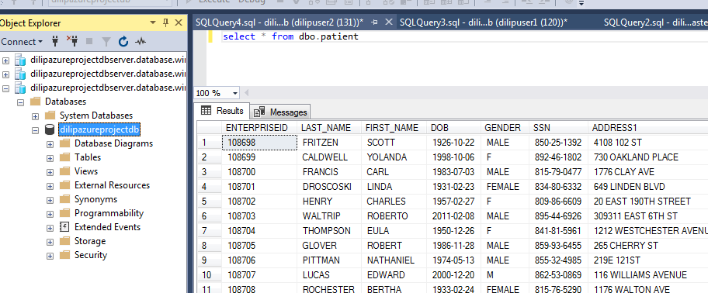
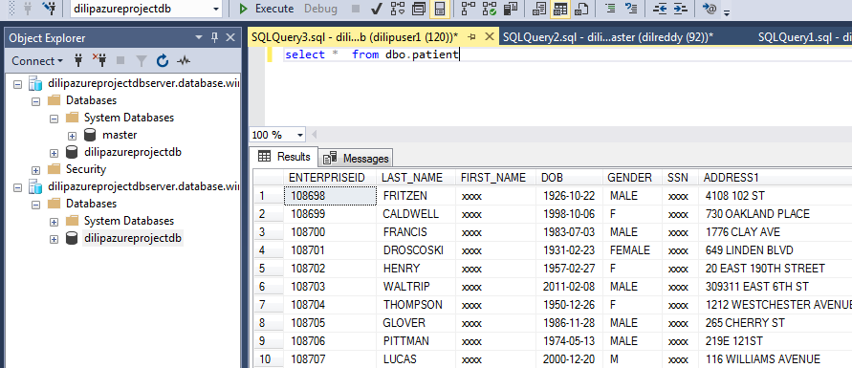
Results
Login to SQL database and check the masked data in the database
FIRST_NAME and SSN columns are masked
Unmasked Data Masked Data

Slide 15
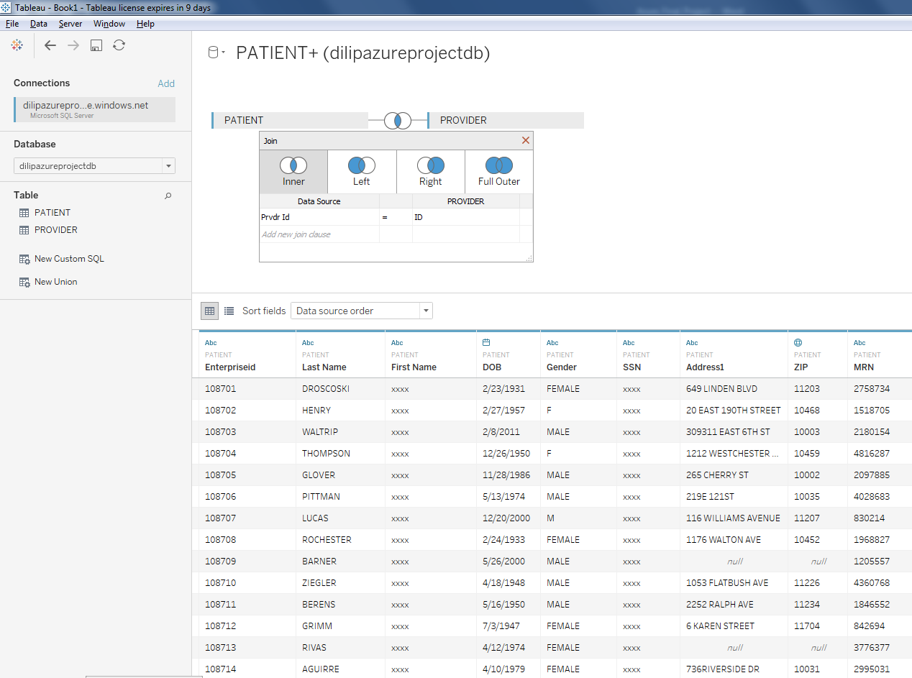
Visualization
Login to Tableau and visualize the data in Tableau report

Slide 16
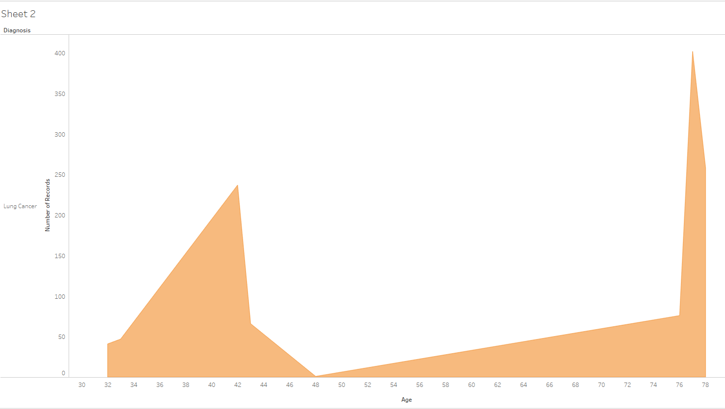
Visualization
For the same data set, I created lung cancer graph for each age group in tableau dash board.
The below graph shows number of lung cancer patients against age group.

Slide 17
Lessons Learned
Only dynamic data masking is possible/available. This doesn’t change the base data but just changes the view of the data based on the user access. This might be an issue in some cases where you need to mask the base data and not change the view of the data
Persistent data masking is not available in Azure as of today

Slide 18
YouTube URLs, GitHub URL, Last Page
Two minute (short):
https://youtu.be/6K-Yg_f0LiI
15 minutes (long):
https://youtu.be/3jxA-Lr5IQU
GitHub Repository with all artifacts:
https://github.com/dilreddy143/AzureFinalProject
https://docs.microsoft.com/en-us/azure/data-factory/quickstart-create-data-factory-dot-net
https://azure.microsoft.com/en-us/blog/dynamic-data-masking-generally-available/

