Slide 1
BEM 146 chapter 2: Workers
Wage determination
  Competitive model wages=MRP (McJobs)
    Lots of companies can hire at w*, lots of workers can work
  Sources of wage deviations (Mincerian)
  A way to “price” labor supply variables and explore unexplained residuals
Agency risk-incentive tradeoff
  Sources of “agency costs”
Multitasking
  Difficult to incentivize two activities → bundling tasks (job design) is key
How well do financial incentives work?

Slide 2
Departures from the competitive model
Human capital
  General (language, software) vs firm-specific
Compensating differentials
Discrimination: Controlling for human capital, workers of different types might be treated differently due to ethnicity, gender, religion or other observable factors;
  Beauty, height (job qualifications or discrimination?)
Upward sloping wage profiles: When workers have long-term relationships with companies, wages may go up even MRP goes down
Wage compression: Workers who have widely different MRP’s have similar wages (i.e. wages are statistically “compressed”).
Interindustry wage differentials: Controlling for skill, education and other variables, people are paid different amounts for the very same job depending on the industry they are in (e.g. legal secretaries at high-priced law firms earn more than government secretaries).
Internal labor markets:
  Hard to enter (referrals are important); firm accumulates information about skill & fit; wages are often tied to promotions; often have tournaments

Slide 3
Compensating differentials
Table RISK: Fatality rates in the 10 most dangerous jobs in the U.S. (BLS, 2002)
Can be + (“combat pay”) or - (“psychic income”)
  Student interns
  Night surcharge for taxi drivers
  Summer lifeguard
  Bangladeshi honey farmers
rank | Job | Annual fatalities per 100,000 | Wage
1 | Timber cutters | 118 | Up to $80,000/yr
2 | Fishery | 71 | up to$1000/day
3 | Pilots & navigators | 70 | GA $52,000/yr
4 | Structural metal workers | 58 | $20/hr
5 | Driver-sales workers | 38 | n.a.
6 | Roofers | 37 | $16/hr
7 | Electrical power installers | 33 | $21/hr
8 | Farm occupations | 28 | $8.50/hr
9 | Construction laborers | 28 | $13.36/hr
10 | Truck drivers | 25 | n.a.

Slide 4
Mincerian wage equation FIX UP
W(it) = a + b*age(it) +c*education(i)+d*grades(i)+e*skill(it)+ f*danger(it)+g*fun(it)+ h*Race(i)+k*Female(i)+m*(job tenure)+n*(industry)+e(it)
In practice…omitted variables so we estimate
W(it) = a + b*age(it) +c*education(i)+ h*race(i)+k*Female(i)+ e*(it)
(Are discrimination effects “statistical discrimination” based on unobserved skill/value differences?)

Slide 5
Upward-sloping wage profiles
Typical wage profile is always increasing but productivity slows down.
  I.e. in wage equation, age + job tenure coefficients +
Nominal increases (“inflation is a dean’s best friend”): money illusion? GET PICTURE FROM GIBBS
Why?
  Measurement (e.g. not true in sports)
  Ties worker to the firm
  Firm “saves” on the worker’s behalf
  “Career concerns”– incentive to work hard to prove your value early on (→ “face time” etc)
  Costly to shirk at the end
  Academic tenure: Why?

Slide 6
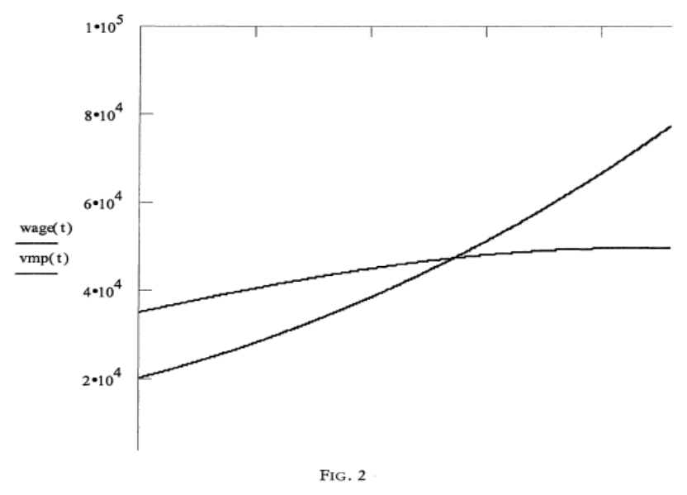
Upward sloping wage profiles
Wages (steeper) vs value of marginal product (flatter) with job tenure (yrs on job) (from Lazear Safelite auto glass study)

Slide 7
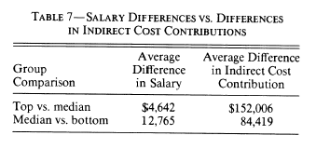
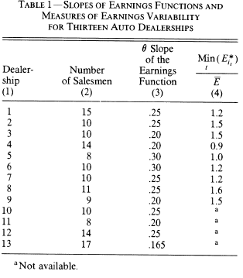
Wage compression
Wages are typically “compressed” relative to measurable productivity differences
Why?
  Measurement error (e.g. sports, trading big diffs)
  Status (taste for relative pay)
  “influence costs” of lobbying for pay reduced by compression
  Nonwage compensation on less visible dimensions
  Greater w/ smaller, more social, and public universities

Slide 8
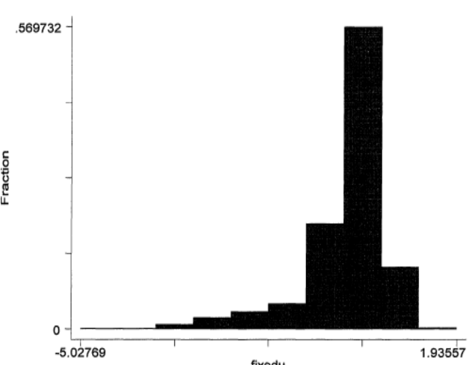
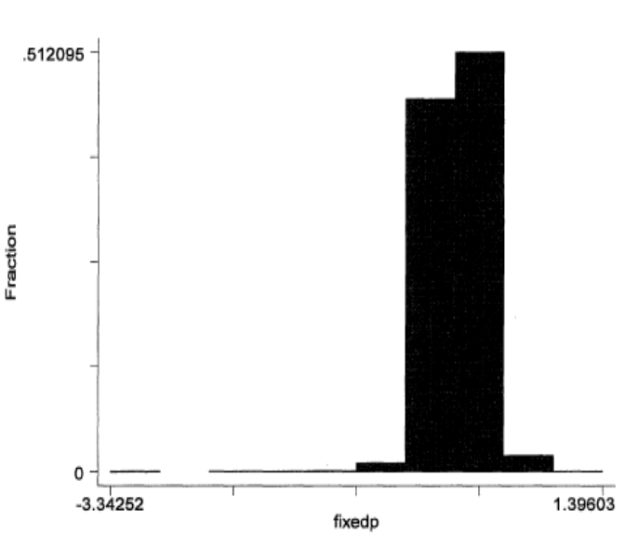
Wage compression at Safelite
Fixed effects estimates (i.e. worker-specific averages) for
output (top)
pay (bottom)

Slide 9
Inter-industry wage differentials
Persistent differentials across industries for (virtually) identical work (e.g. janitors at law firms vs non profits)
Why?
  “Local” social comparison→ local wage compression→ industry differentials
Why no movement to high-pay industries?
  There is…but it’s nonprice competition

Slide 10
Discrimination
Gender and race variables in Mincerian equation are significant. Discrimination in “audit studies” (e.g. lower callback rates for black applicants)
Explanations?
Tastes
  Compensating differential internalizing externality on workers or customers (e.g. black basketball players)
  Philadelphia waitstaff audit study
  → Workers who are hired should outperform (e.g. black NFL coaches)
“Statistical discrimination”
  Identity variables proxy for unobserved productivity
Self-fulfilling equilibrium traps
  Black workers don’t expect a return to skills, so don’t acquire skills. A role for “role models” to “break” the equilibrium.
Q: If discrimination is a mistake, why don’t some firms take advantage?

Slide 11
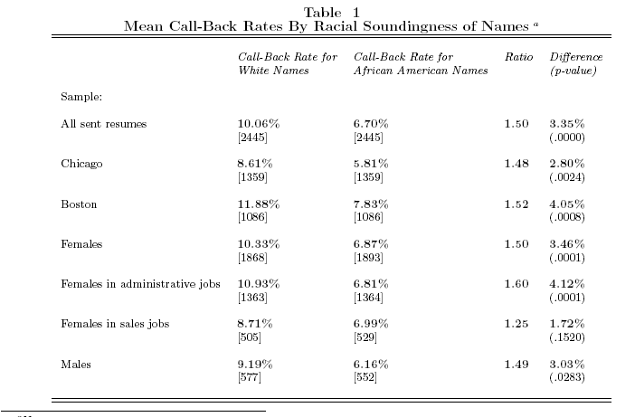
Rates of employers responding to identical resumes (except for names)

Slide 12
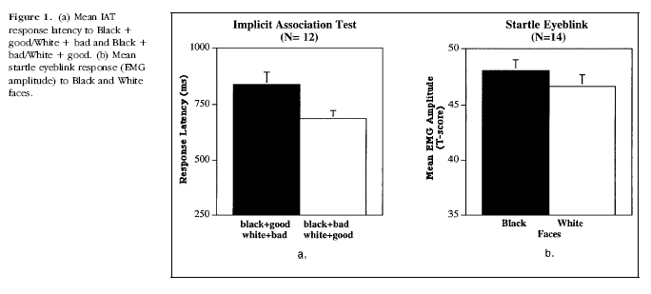
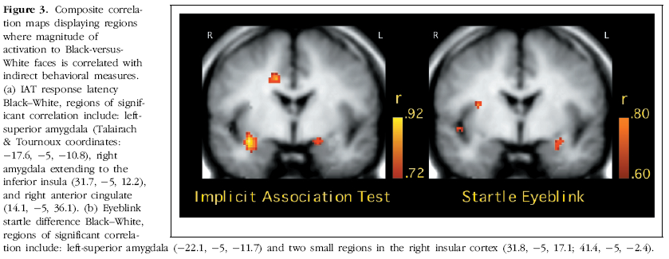
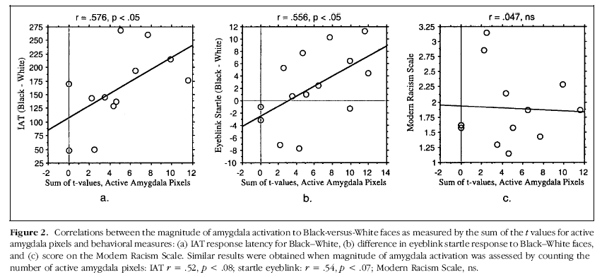
Implicit amygdala reactions to race

Slide 13
Beauty & height
Postlewaite et al (height at adolescence)
Hamermesh beauty premium
Height of US presidents

Slide 14
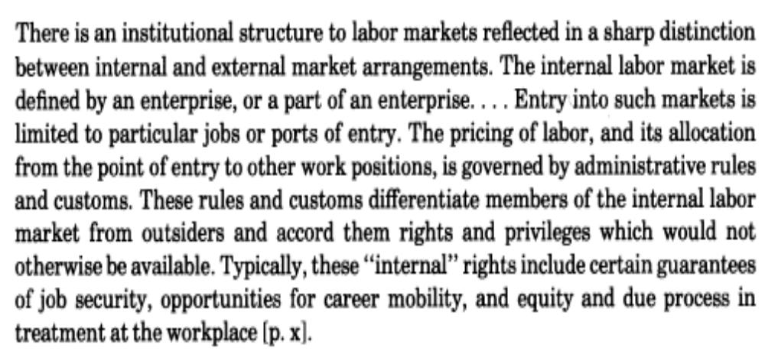
Internal labor markets
Limited entry port
Prices adjusted by rules & customs (e.g. Wharton pay, promotions rigid)
→ Upward sloping wages, wage compression

Slide 15
Internal labor markets
Why ILM’s?
  Firm-specific human capital
    Knowing about power, getting things done, networks
    Information about worker skill (predicts decline in exit rates)
  Discrimination? (like a club)

Slide 16
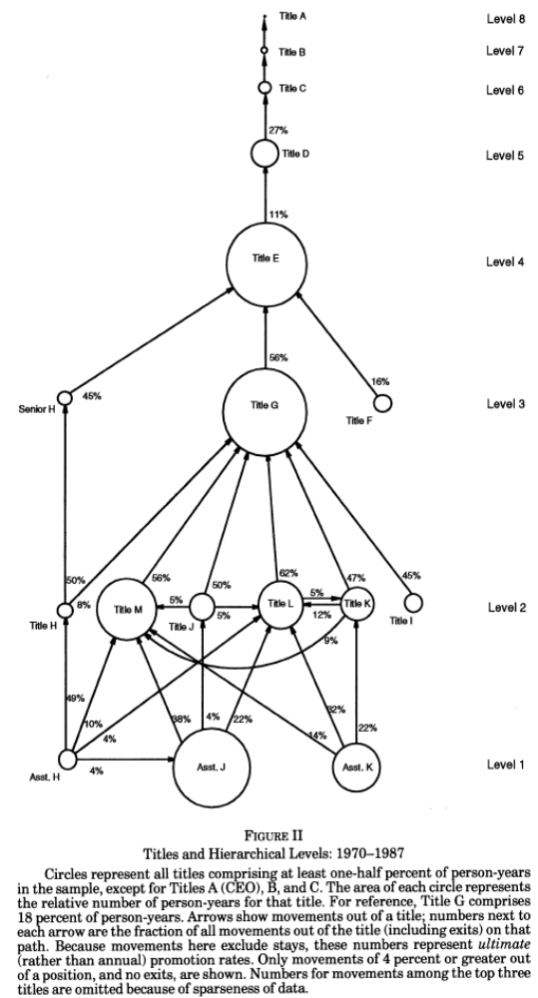
Firm hierarchy

Slide 17
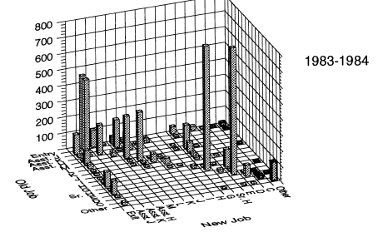
Entry, exit and transition in BGH
Entries exclusively at lower levels
Exits spread across levels (decline slightly)
Some upward promotion

Slide 18
Entry, exit and incumbency bias
 | Level
 | 1 | 2 | 3 | 4 | 5-8
% entries who are outside hires | 99 | 26 | 30 | 25 | 10
Exit rate (%/yr) | 11.4 | 11.5 | 11.0 | 9.6 | 8.2
“Incumbency bias: (Outside hires - inside promotions) difference
age | n.a. | 1.3 | 2.2 | 4.8 | -2.2
yrs. schooling | n.a. | .7 | .4 | .5 | .9
yrs. work experience | n.a. | .6 | 1.8 | 4.3 | -3.1

Slide 19
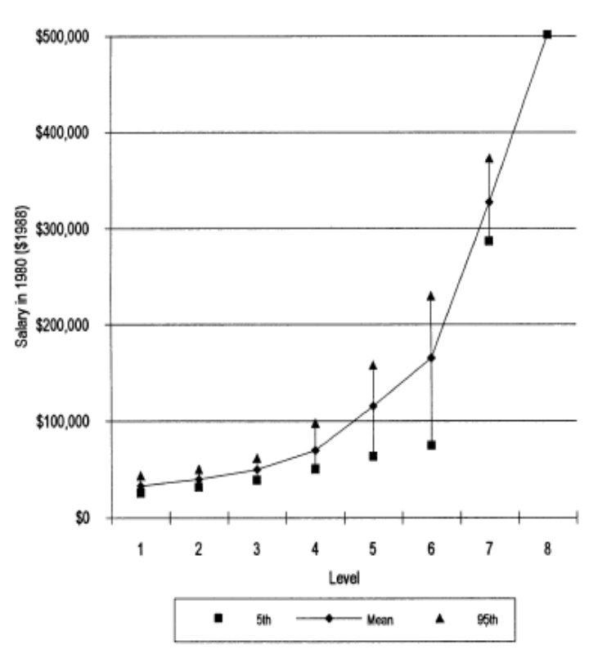
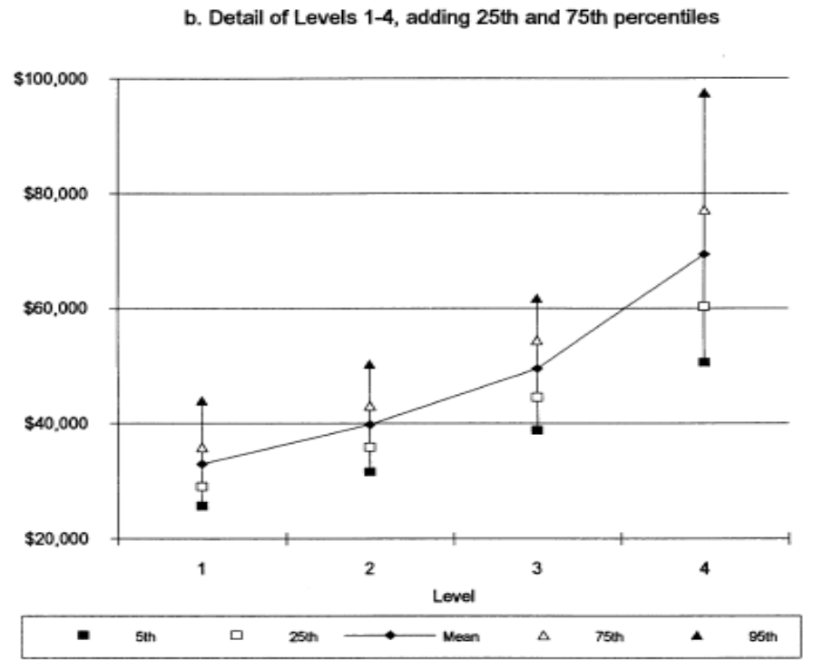
Pay dispersion at BGH firm

Slide 20
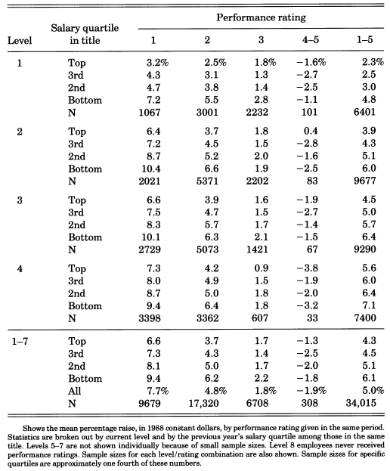
BKH firm
Raises compress salaries
.1% bad evaluations!

Slide 21
Multitasking
Two activities

Slide 22
Risk-incentive tradeoff model
List of notation
e agent effort
x measurement error
Z output observed by principal (=e+x)
y observable correlate of x used to reduced measurement error
γ weight on y in adjustment for measurement error
w wage paid to agent
α fixed component of the wage
β the “piece” rate or unit bonus based on adjusted observed output
r degree of risk-aversion of the agent (higher r is more risk-averse)

Slide 23
Risk-incentive tradeoff
w=α + β(e+x-γ y)
Employee utility α + βe – c(e) – ½ rβ2 var ( x- γy)
Firm expected profit net of wages P(e)-(α + βe)
Optimal effort e* β = c’(e*)
Optimal informativeness γ* = r (x, y) σ(x)/σ(y)
Optimal incentive β* = P’(e)/[1+rc’’(e)var (x-γ*y)]

Slide 24
Rank-order tournaments
Choose efforts e_{i}, luck θ_{i}
  Rank by total output e_{i}+θ_{i}
  Higher ranks earn higher prizes
Advantage:
  Easier to judge relative output
  Fixed wage payments
Disadvantage
  Incentive to sabotage opponents
Evidence
    Experimental
    Chicken broilers
    Golf
    Convexity of top exec pay jump

Slide 25
Empirics (Prendergast)
Piece rates work
  Partly sorting (low-output workers leave), partly increases output
Contracts do not include all the features theory prescribes
  Rare performance benchmarks
Team-based incentives work surprisingly well

Slide 26
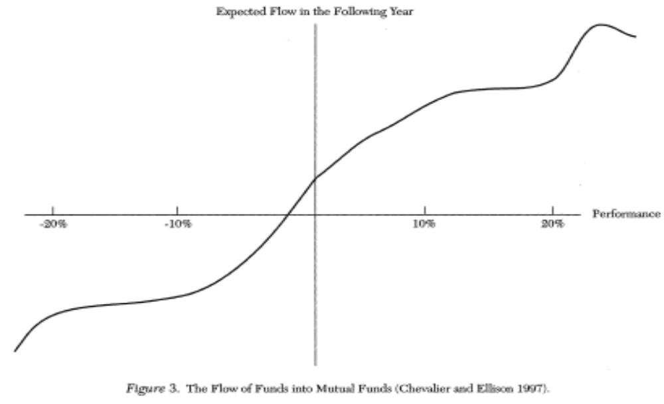
Response of mutual fund managers: Risk modulated by shape of funds flow

Slide 27
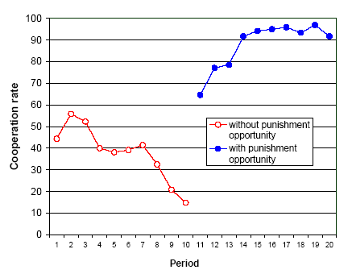
“Peer pressure” and punishment in repeated public goods games

