Slide 1
Random Walk Model

Slide 2
Random Walk Model
One of the simplest models, yet the random walk model is widely used in the area of finance. A common and serious departure from random behavior is called a random walk.

Slide 3
Random Walk Model
By definition, a series is said to follow a random walk if the first differences are random.

Slide 4
Random Walk Model
By definition, a series is said to follow a random walk if the first differences are random.
What is meant by first differences is the difference from one observation to the next.

Slide 5
Random Walk Model
Think about the process of walking to class. You have a set goal, you are achieving an objective.
However, while walking you use a sequence of stumbling, unpredictable steps, the difference between each step has no “rhyme or reason.”

Slide 6
Random Walk Model
In a random walk model, the series itself is not random.
However, its differences—the changes from one period to the next—are random.
This type of behavior is typical of stock price data.

Slide 7
Random Walk Model
X_{t} = X_{t-1} + e_{t}
where: X_{t} is the value in time period t,
X_{t-1} is the value in time period t-1 (one time period before)
e_{t} is the value of the error term in time period t.

Slide 8
Random Walk Model
Since the random walk was defined in terms of first differences, it may be easier to see the model expressed as:
X_{t} - X_{t-1} = e_{t}

Slide 9
Random Walk Model
When the original series is changed to a first differences series, the series is transformed.
When an x-value is changed to a z-score by the formula [(x-μ)/σ], the original data was transformed from an x-value to a z-score.

Slide 10

Why Transform a Series?
Forecast future trends to aid in decision making
If series follows random walk, original series offers little or no insights
May need to analyze first differenced series

Slide 11
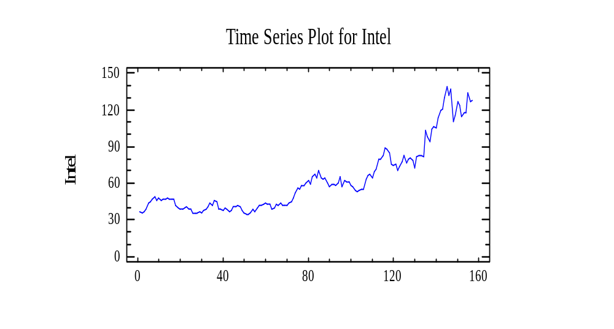
Intel Closing Prices [6/16/97-6/12/00]

Slide 12
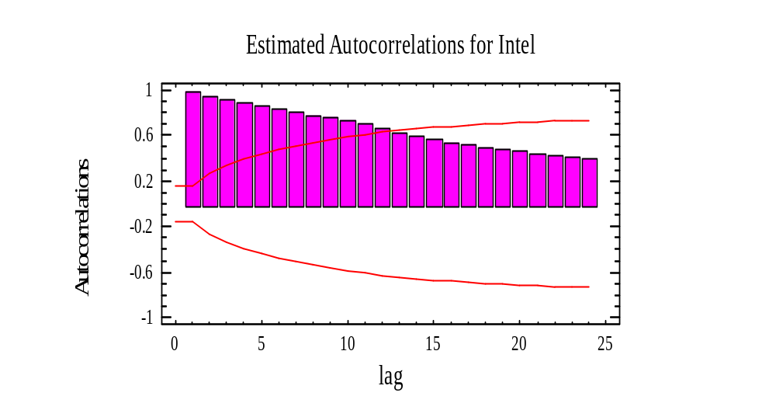
Intel Closing Prices
[Original Series]

Slide 13
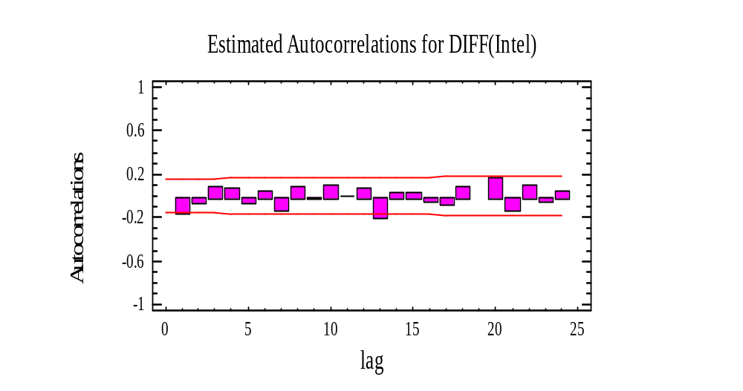
Intel Closing Prices [First Differenced Series]

Slide 14
Intel Closing Prices
[Original Series]
H₀: The series is random
H₁: The series is not random
Note: The use of [original] in Notes for Data Analysis is for emphasis only ... “original” is not generally used when stating the null and alternate hypotheses.

Slide 15

Intel Closing Prices
[Original Series]

Slide 16
Intel Closing Prices
[Original Series]
Test for Randomness of original series Intel Closing Prices [6/16/97-6/12/00]
Runs up and down
---------------------------
Number of runs up and down = 76
Expected number of runs = 104.333
p-value = 1.16648E-7

Slide 17
Intel Closing Prices
[Original Series]
The (second) test counts the number of times the sequence rose or fell. The number of such runs equals 76, as compared to an expected value of 104.333 if the sequence were random.
Since the p-value for this test is less than 0.05, we can reject H₀: The series is random at the 95% confidence level.

Slide 18
Intel Closing Prices
[Original Series]
Thus the [original] series for Intel Closing Prices is not random.
[In a random walk model, the series itself is not random.]

Slide 19
Intel Closing Prices [First Differenced Series]
H₀: The series is random
H₁: The series is not random
Note: Use of [first differenced] in Notes for Data Analysis is for emphasis only ... “first differenced” is not generally used when stating the null and alternate hypotheses.

Slide 20
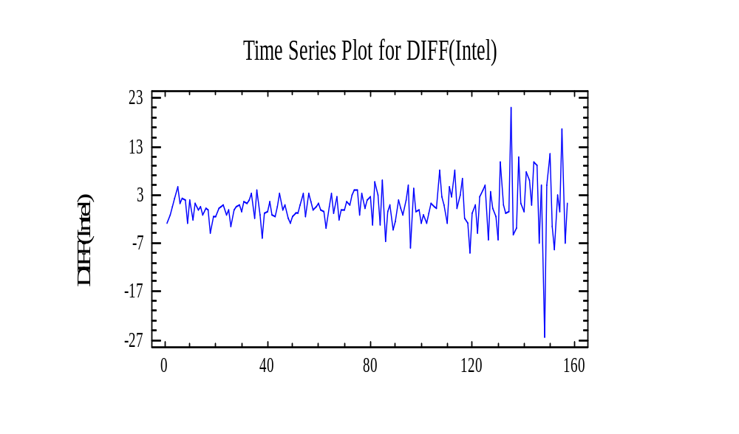
Intel Closing Prices [First Differenced Series]

Slide 21
Intel Closing Prices [First Differenced Series]
Test for Randomness of first difference (DIFF) Intel Closing Prices [6/16/97-6/12/00]
Runs up and down
---------------------------
Number of runs up and down = 99
Expected number of runs = 104.333
p-value = 0.357469

Slide 22
Intel Closing Prices [First Differenced Series]
The (second) test counts the number of times the sequence rose or fell. The number of such runs equals 99, as compared to an expected value of 104.333 if the sequence were random. Since the p-value for this test is greater than 0.05, we can not reject H₀: The series is random at the 95% or higher confidence level.

Slide 23
Intel Closing Prices [First Differenced Series]
Thus the [first differenced] series for Intel Closing Prices is random.
[… its differences—the changes from one period to the next—are random.]

Slide 24
Intel Closing Prices
Thus, for Intel Closing Prices [6/16/97-6/12/00]
The series (Intel Closing Prices) is not random.
However, its differences—the changes from one period to the next—are random.
Intel Closing Prices behavior typical of stock price data…that is, the series is a random walk model.

Slide 25

Questions?

Slide 26

ANOVA

