Slide 1
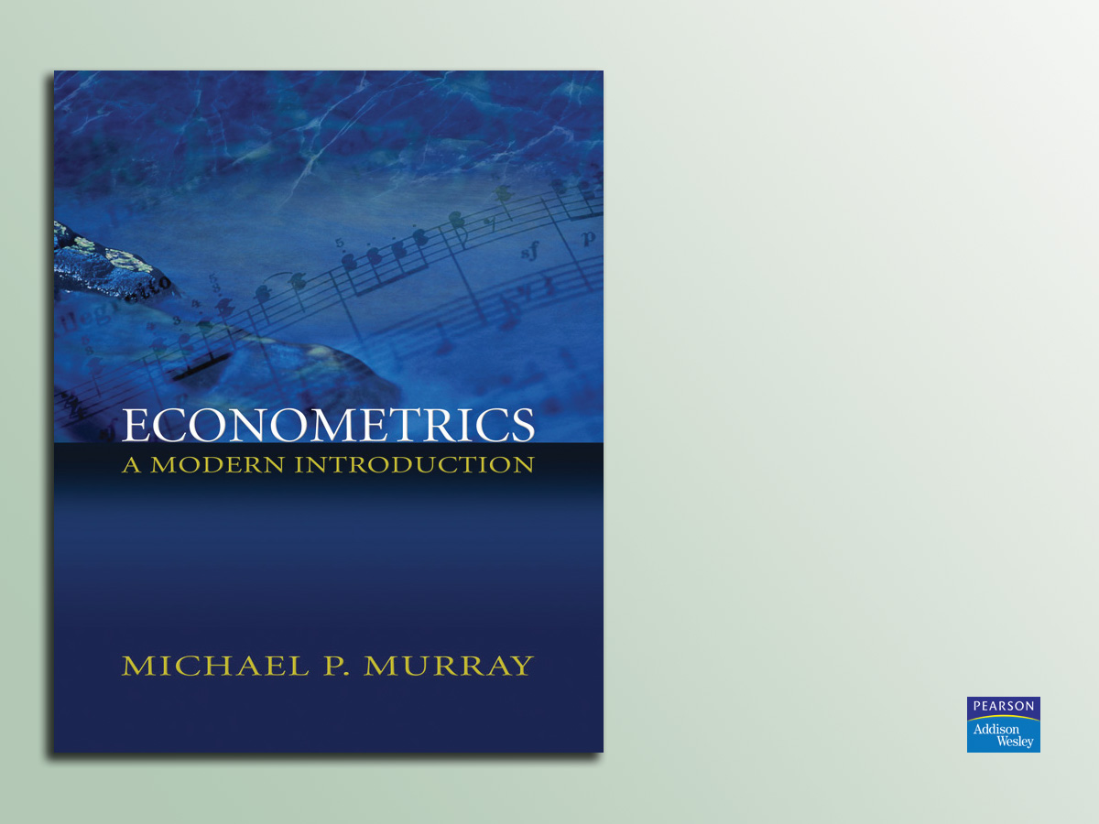
Lecture 20:
Instrumental Variables
(Chapter 13.4–13.6)

Slide 2

Agenda
Review
Example: Public Housing (Chapter 13.5)
Example: Wage Equations and IV Estimation (Chapter 13.4)
2SLS (Chapter 13.5)
Weak Instruments (Chapter 13.5)
Testing E(X_{i}ε_{i} ) = 0 (Chapter 13.6)

Slide 3
Review
In practice, correlation between X and
ε is endemic.
Much of econometric work involves studying the process determining the explanators, to see how they might be correlated with ε.

Slide 4
Review (cont.)
The ideal X variable has been
randomly assigned.
If X has been randomly assigned, then
it contains no information about ε.
However, true randomization is relatively uncommon.

Slide 5
Review (cont.)
Often, an explanator is partially determined in a way that is random, or at least uncorrelated with ε.
However, the explanator is also influenced by omitted variables, or determined endogenously, or is in some other way correlated with ε.

Slide 6
Review (cont.)
Fortunately, econometricians have discovered a method for separating out the random elements of explanators from the elements that may be correlated with ε.
Unfortunately, this method requires the data to include an instrumental variable with certain key properties.

Slide 7
Review (cont.)
An Instrumental Variable is a
variable that is correlated with X but uncorrelated with ε.
If Z_{i} is an instrumental variable:
  E(Z_{i} X_{i} ) ≠ 0
  E(Z_{i} ε_{i} ) = 0

Slide 8
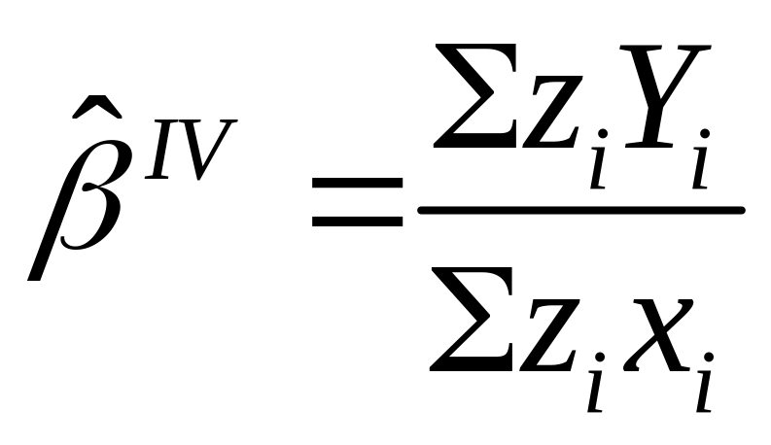
Review (cont.)

Slide 9
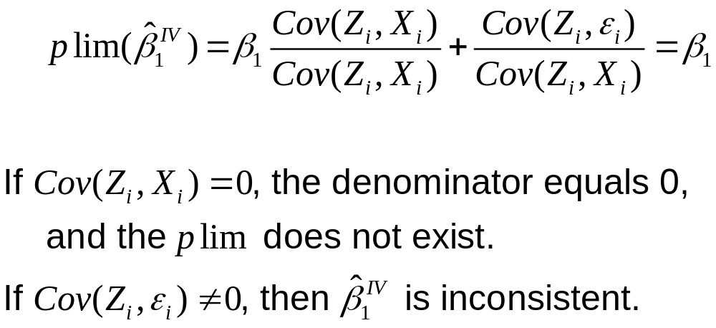
Review (cont.)
What is the probability limit of IV?

Slide 10
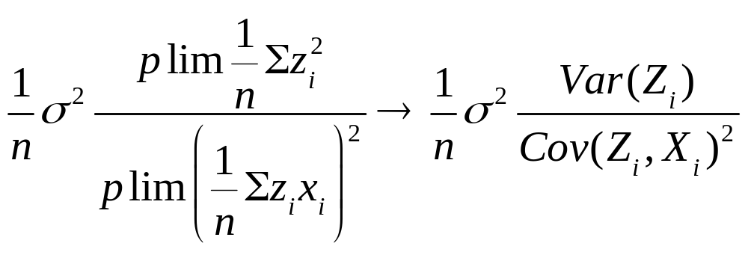
Review (cont.)
The asymptotic variance of β ^{IV} is
The greater the covariance between
X and Z, the lower the asymptotic variance.

Slide 11
Review (cont.)
To estimate a multiple regression consistently, we need at least one instrumental variable for each troublesome explanator.

Slide 12
Review (cont.)
When we have just enough instruments for consistent estimation, we say the regression equation is exactly identified.
When we have more than enough instruments, the regression equation is over identified.
When we do not have enough instruments, the equation is under identified (and inconsistent).

Slide 13
Example: Public Housing (Chapter 13.5)
Does living in a housing project increase children’s chances of being held back
in school?
Currie and Yelowitz estimated a child’s chance of being held back in school as a function of living in a housing project and a variety of control variables (household
head’s age, gender, race, education, and marital status).

Slide 14
Example: Public Housing (cont.)
The coefficient on D_{i}^{Project} was positive and statistically significant, suggesting that children who live in housing projects are more likely to be held back in school than other children from similar households.
But is our OLS regression misleading?

Slide 15
Example: Public Housing (cont.)
Curry and Yelowitz argued that families choosing to move into public housing are likely to differ in unobserved ways from other families.
Such families are likely to have
poorer alternative housing options than families that choose not to enter a housing project.

Slide 16
Example: Public Housing (cont.)
We would expect a family with worse outside housing options to have fewer resources in general. Such families would be less equipped to support their children’s academic efforts. As such, we should expect a bias towards finding that children in housing projects do worse in school.

Slide 17
Example: Public Housing (cont.)
Currie and Yelowitz used public housing
rules to construct an instrumental variable.
First, they restricted their attention to
families with two children.
According to the public housing rules,
boys and girls cannot share a room.
Two-child families with one boy and one
girl are assigned a three-bedroom
apartment; otherwise, they receive a two-bedroom apartment.

Slide 18
Example: Public Housing (cont.)
The gender composition of a two-child family is essentially random and is unlikely to be correlated with other determinants of children’s success in school.
The gender composition of a two-child family affects the attractiveness of the public housing option, and thus the family’s decision to move into a project.
Gender composition is a valid instrument.

Slide 19
Example: Public Housing
Using instrumental variables, Currie and Yelowitz found that children living in public housing were actually 11 percentage points LESS likely to be held back in school
(p < 0.10)
Public housing does not appear to be as detrimental as is widely believed, once we control for the fact that families in public housing have very poor alternatives.

Slide 20
Wage Equations and IV Estimation
(Chapter 13.4)
We have estimated wages as a function of education, experience or age, sex, and race.
Many other variables influence wages, and could plausibly influence years of schooling.
A regression of wages against education suffers from omitted variables bias.

Slide 21
Wage Equations and IV
Parenting is a key omitted variable in a wage equation.
Good parents encourage their children in school, helping them achieve
more education.
Good parents also support children in many other ways that influence wages.

Slide 22
Wage Equations and IV (cont.)
Wage equations may also suffer from measurement error.
Individuals may mis-report their years of education on surveys.

Slide 23
Wage Equations and IV (cont.)
Ashenfelter and Rouse collected a dataset of wages and education for identical twins.
Twins will have the same age, race,
and parenting.
If we regress the difference in twins’ wages against the difference in twins’ education, we can difference out all factors that twins have in common.

Slide 24
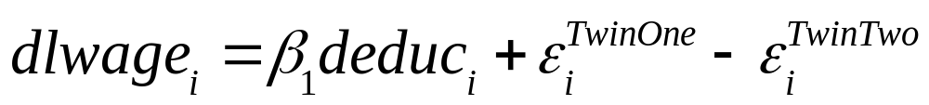
Wage Equations and IV (cont.)
i indexes pairs of twins.
dlwage is the difference in log wages between the two twins.
deduc is the difference in self-reported years of education.
Many potential sources of omitted variables bias disappear from the regression.

Slide 25
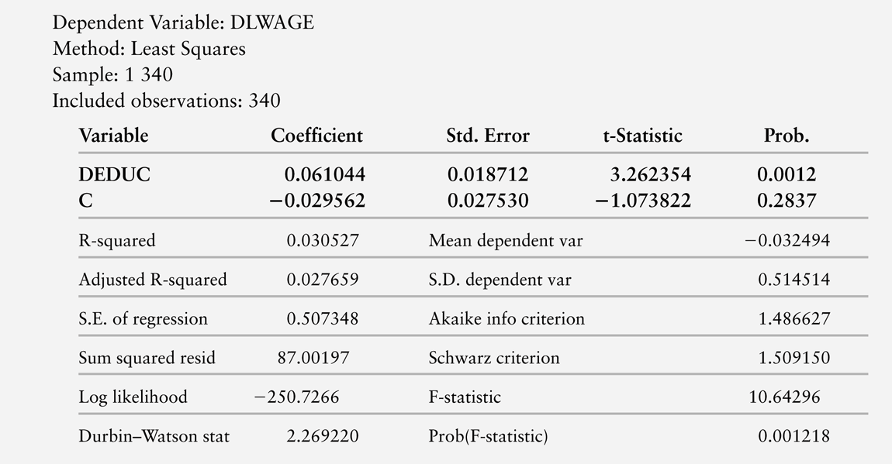
TABLE 13.1
The Return to Education for Twins (OLS): Differences in Log Wages and Years of School

Slide 26
Wage Equations and IV
Working with differences between twins, a one-year increase in education predicts a 6% increase in wages.
Running the regression for twins individually, we estimate that a one-year increase in education predicts an 11% increase in wages.
Omitted Variables Bias appears to add 5 percentage points to the estimate. Or does it?

Slide 27
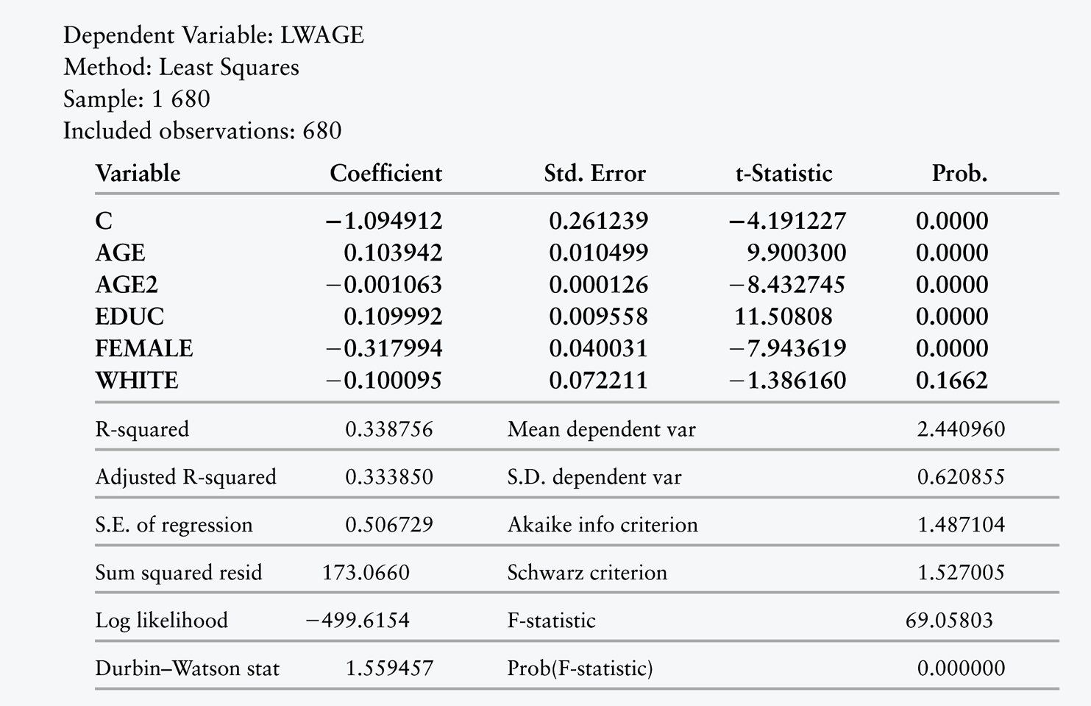
TABLE 13.2
The Return to Education for Twins (OLS):
One Twin’s Log Wage, Education, and so on

Slide 28
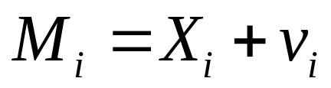
Wage Equations and IV
What about the measurement error in the self-reported years of schooling.
Measurement error also induces a correlation between our included explanator and the error term.
Instead of observing X_{i} , we observe

Slide 29
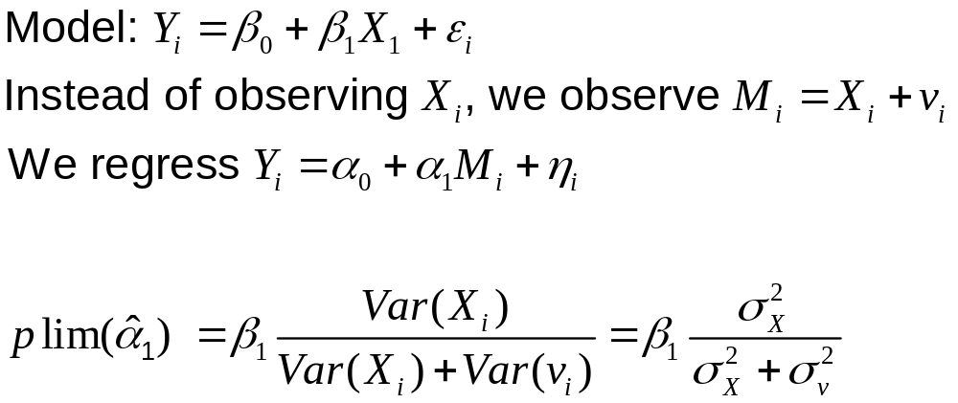
Wage Equations and IV (cont.)

Slide 30
Wage Equations and IV (cont.)
Mismeasuring X leads to ATTENUATION BIAS. The estimated coefficient is biased towards 0.
The magnitude of the bias depends on the relative variances of X and v.

Slide 31
Wage Equations and IV (cont.)
Ashenfelter and Krueger collected an instrumental variable for education. They have not only self-reported years of education, but also each twin’s report of the other’s schooling.
Twin-reported schooling is clearly correlated with actual schooling.
Twin-reports may have their own errors, but these errors are unlikely to be correlated with the self-report errors.

Slide 32
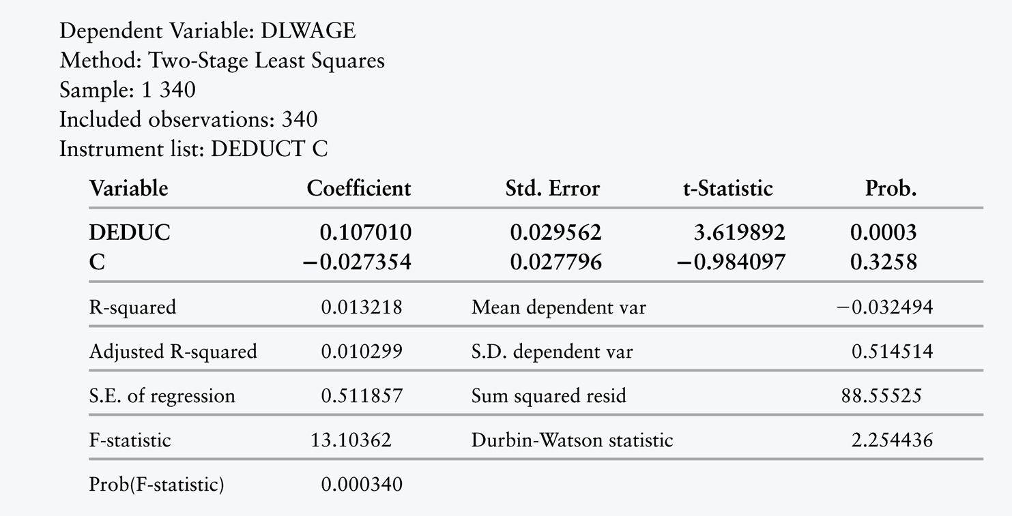
TABLE 13.3
The Return to Education for Twins (IV): Differences in Log Wages and Years of School

Slide 33
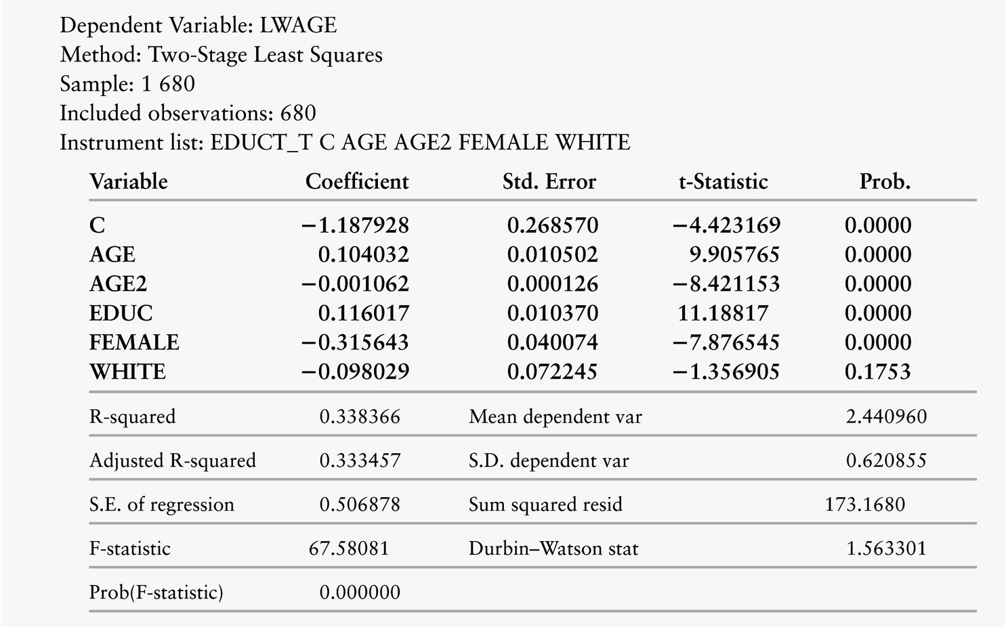
TABLE 13.4
The Return to Education for Twins (IV): Each Twin’s Log Wage, Education, and so on

Slide 34
Wage Equations and IV
We now have 4 estimates of the effect of education on wages:
  Individual data, no IV: 11%
  Differences between twins, no IV: 6%
  Individual data, IV: 12%
  Differences between twins, IV: 11%

Slide 35
Wage Equations and IV (cont.)
Instrumenting for education has a very
small effect on the individual-level regression. The estimate goes from 11% to 12%.
Instrumenting for education has a very
large effect on the differences-between-twins regression. The estimate goes from 6%
to 11%.
The differences-between-twins estimator is very close to the individual regression when using IV, but not when using OLS.

Slide 36
Checking Understanding
Why does instrumenting for years of schooling have such a large effect on the regression with differences-between-twins but not on the regression with individual data?

Slide 37
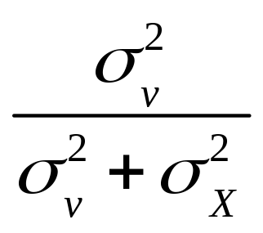
Checking Understanding (cont.)
IV is a remedy for measurement error.
The magnitude of measurement error bias depends on
Twins tend to get the same amount of schooling. There is very little variance in the differences between twins’ schooling. There is much more variance in years of schooling at the individual level.

Slide 38
Two-Stage Least Squares (Chapter 13.5)
When we have just enough instruments for consistent estimation, we say the regression equation is exactly identified.
When we have more than enough instruments, the regression equation is
over identified.
When we do not have enough instruments, the equation is under identified
(and inconsistent).

Slide 39
2SLS
When the regression is under identified,
then we do not have a consistent estimator.
When the regression is exactly identified,
then we simply use Instrumental Variables Least Squares.
When the regression is over identified, we have more instruments than we need.
The methods we learned last time are only suitable for the exactly identified case.

Slide 40
2SLS (cont.)
When the regression equation is over identified, we have more instruments than we need.
We could simply discard the additional instruments, but then we throw out valuable information. Ignoring valid instruments is inefficient.

Slide 41
2SLS (cont.)
How can we combine multiple instruments?
We can construct a new instrument that is a linear combination of the instruments.
We want to combine the instruments to maximize the correlation with the troublesome explanator. That way, we use the most information available about X.

Slide 42
2SLS (cont.)
We could then use the newly constructed instrumental variable to perform IVLS.
In practice, however, econometricians use a slightly simpler procedure.
They use the new instruments to replace the explanators in OLS.

Slide 43
2SLS (cont.)
This strategy requires a two-stage process, called Two-Stage Least Squares (2SLS
or TSLS).
In stage one, we construct a new instrument that is a linear combination of the original instruments.
In stage two, we replace the troublesome variables with their fitted values from the
first stage.

Slide 44
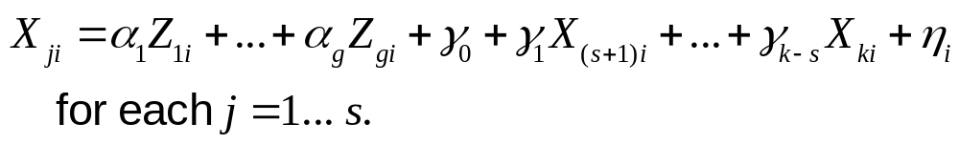
2SLS (cont.)
Divide the k explanators into two sets, s-troublesome X ’s and k +1- s
non-troublesome X ’s (including the constant). Regress each troublesome X on ALL g instruments and ALL
k +1- s non-troublesome explanators

Slide 45
2SLS (cont.)
Regress Y against the
non-troublesome explanators and
the fitted values of the troublesome explanators (from the first-stage auxilliary regressions).

Slide 46
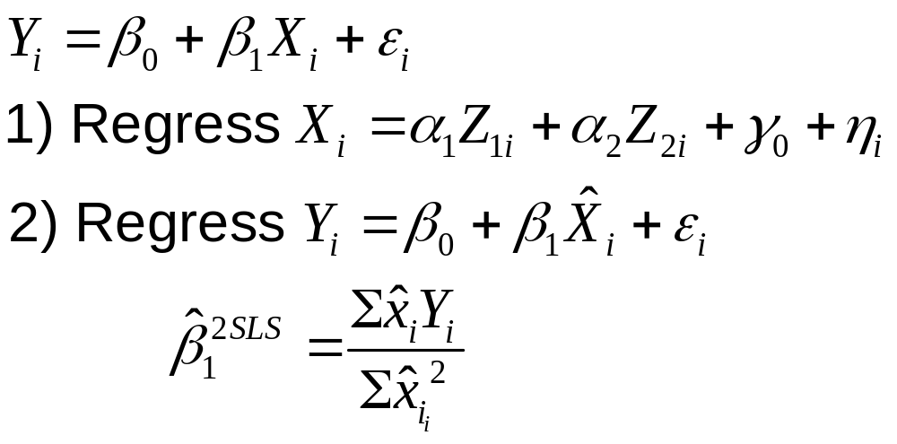
2SLS (cont.)
If we have only one explanator and two instruments, then

Slide 47
2SLS (cont.)
There is a catch: we need to correct the estimated standard errors from the second stage to adjust them for the first stage.
Most software packages can make these adjustments.
However, if you conduct 2SLS by hand, you need to adjust the formulas for e.s.e.’s (and also for F-tests). See Chapter 13.5.

Slide 48
2SLS (cont.)
How do we implement 2SLS using
our software?

Slide 49
Weak Instruments (Chapter 13.5)
All we have required for Z_{i} to be a valid instrument is
  Cov(Z_{i} ,X_{i} ) ≠ 0
  Cov(Z_{i} ,ε_{i} ) = 0
We have asked only that Z_{i} be correlated
with X_{i}. We have not said anything about HOW correlated the two variables must be. We have noted that the higher the correlation, the lower the variance.

Slide 50
Weak Instruments (cont.)
If an instrument is too weakly correlated with the trouble explanator, then IV estimation will do little to overcome OLS’s bias in even quite large samples.
We call such weakly correlated instruments “weak instruments.”

Slide 51
Weak Instruments (cont.)
For example, Angrist and Krueger famously attempted to instrument for years of schooling using quarter of birth.
Their reasoning was that compulsory schooling laws are based on age, yet the age at which students begin school depends on quarter of birth.
In many states, students start school in the calendar year in which they turn 6.

Slide 52
Weak Instruments (cont.)
A student who is born in January will generally start 1st grade nearly a year younger than a student who is born in December.
January-born students tend to be in 9th grade when they reach the end of compulsory schooling and can choose to drop out.
December-born students tend to be in 10th grade when they can drop out.

Slide 53
Weak Instruments (cont.)
Thus, quarter of birth is correlated with years of schooling for students who drop out at the end of the compulsory schooling period.
However, this connection is tenuous.
How can we test to see whether an instrument is weak?

Slide 54
Weak Instruments (cont.)
Stock and Yogo have computed critical values for tests of weak instruments.
The null hypothesis is that all Z_{i} have a coefficient of 0 in the 1st stage regression.
The choice of critical value depends on the desired reduction in the bias of OLS.

Slide 55
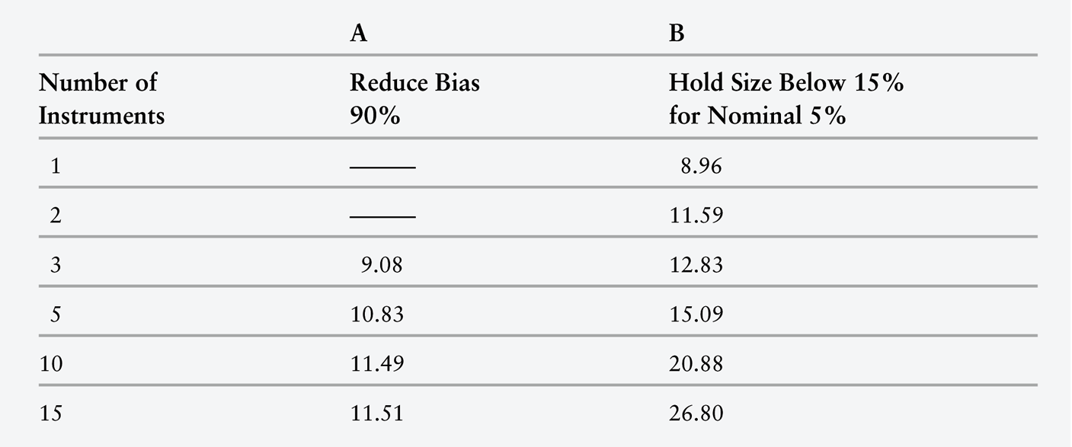
TABLE 13.5 Critical Values for Testing the Null Hypothesis that Instruments are Weak

Slide 56
Testing E(X_{i}ε_{i}) = 0 (Chapter 13.6)
IVLS and 2SLS are somewhat complicated procedures, requiring us to find enough
valid instruments to identify the
regression equation.
Furthermore, they are not transparent processes, and are hard to explain to
non-economists.
Furthermore, unless Z and X are highly correlated, using instrumental variables will increase the variance of the estimator.

Slide 57
Testing E(X_{i}ε_{i}) = 0 (cont.)
We would prefer to use OLS when
we can.
OLS is consistent when E(X_{i}ε_{i}) = 0
(and variances are finite).

Slide 58
Testing E(X_{i}ε_{i}) = 0 (cont.)
Hausman and Wu proposed a test for the null hypothesis that NO explanators are correlated with ε_{i} : the Hausman–Wu specification test.
We must have valid instruments. The Hausman–Wu test cannot be performed when IV methods are unavailable, but it can offer guidance on whether the IV methods are necessary.

Slide 59
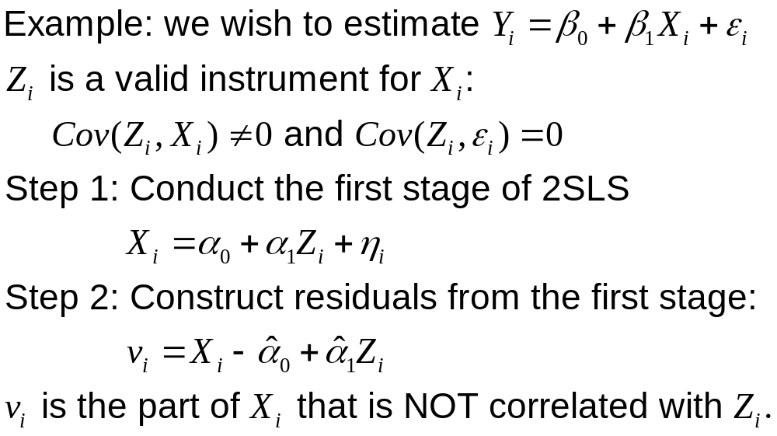
Testing E(X_{i}ε_{i}) = 0 (cont.)

Slide 60
Testing E(X_{i}ε_{i}) = 0 (cont.)
If X_{i} is uncorrelated with ε_{i} , then v_{i} will also be uncorrelated with ε_{i}
However, if X_{i} IS correlated with ε_{i} , then v_{i} will be correlated with ε_{i}
In that case, v_{i} would be able to predict Y_{i} , even in the presence of X_{i}

Slide 61
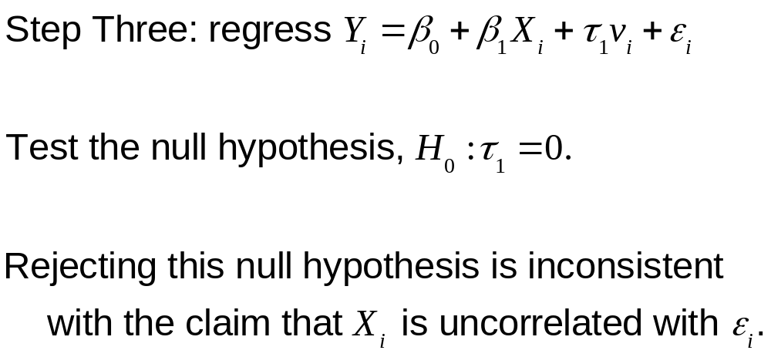
Testing E(X_{i}ε_{i}) = 0 (cont.)

Slide 62
Testing E(X_{i}ε_{i}) = 0 (cont.)
Recall that we earlier estimated the returns
to education using twins data.
To eliminate various possible omitted variables, we regressed the difference between twins in wages against the
difference between twins in education.
It appeared that instrumenting for the difference between twins in education made
a very large difference.

Slide 63
Testing E(X_{i}ε_{i}) = 0 (cont.)
Now let’s test whether the difference between twins’ schooling (deduc) is a troublesome variable.
When we regress dlwage against deduc and resz (the residual from stage 1 of 2SLS), we can reject the null hypothesis that the coefficient on resz is zero. We therefore reject the null hypothesis that deduc is not a troublesome variable.

Slide 64
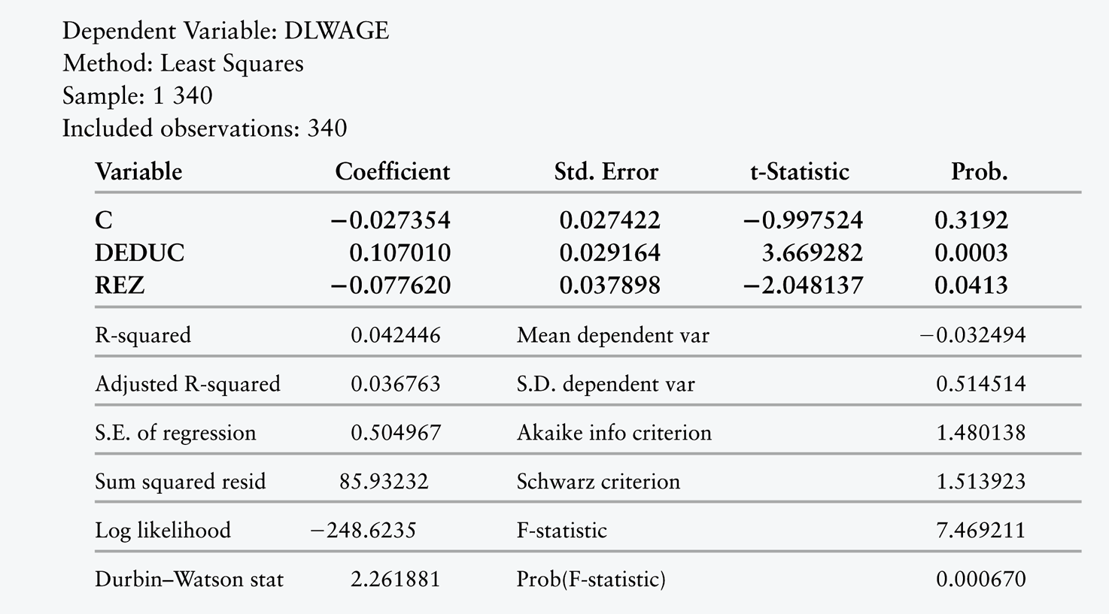
TABLE 13.6 Hausman–Wu Test of
E(X_{i}ε_{i}) Equaling Zero

Slide 65
Review
In practice, correlation between X and
ε is endemic.
Much of econometric work involves studying the process determining the explanators, to see how they might be correlated with ε.

Slide 66
Review (cont.)
Often, an explanator is partially determined in a way that is random, or at least uncorrelated with ε.
However, the explanator is also influenced by omitted variables, or determined endogenously, or is in some other way correlated with ε.

Slide 67
Review (cont.)
Fortunately, econometricians have discovered a method for separating out the random elements of explanators from the elements that may be correlated with ε.
Unfortunately, this method requires the data to include an instrumental variable with certain key properties.

Slide 68
Review (cont.)
An Instrumental Variable is a
variable that is correlated with X but uncorrelated with ε.
If Z_{i} is an instrumental variable:
  E(Z_{i} X_{i} ) ≠ 0
  E(Z_{i}ε_{i} ) = 0

Slide 69

Review (cont.)

Slide 70
Review (cont.)
What is the probability limit of IVLS?

Slide 71
Review (cont.)
The asymptotic variance of β ^{IV} is
The greater the covariance between X and Z, the lower the asymptotic variance.

Slide 72
Review (cont.)
To estimate a multiple regression consistently, we need at least one instrumental variable for each troublesome explanator.

Slide 73
Review (cont.)
When we have just enough instruments for consistent estimation, we say the regression equation is exactly identified.
When we have more than enough instruments, the regression equation is over identified.
When we do not have enough instruments,
the equation is under identified
(and inconsistent).

Slide 74
Review (cont.)
When the regression is under identified,
then we do not have a consistent estimator.
When the regression is exactly identified,
then we simply use Instrumental Variables Least Squares.
When the regression is over identified, we have more instruments than we need. The methods we learned last time are only suitable for the exactly identified case.

Slide 75
Review (cont.)
When the regression equation is over identified, we have more instruments than we need.
We construct a new instrument that combines the original instruments.

Slide 76
Review (cont.)
This strategy requires a two-stage process, called Two-Stage Least Squares (2SLS
or TSLS).
In stage one, we construct a new instrument that is a linear combination of the original instruments.
In stage two, we replace the troublesome variables with their fitted values from the
first stage.

Slide 77
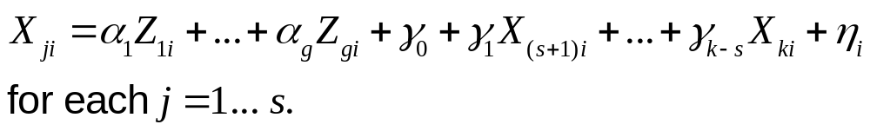
Review (cont.)
Divide the k explanators into two sets, s-troublesome X ’s and k +1- s
non-troublesome X ’s (including the constant). Regress each troublesome X on ALL g instruments and ALL
k +1- s non-troublesome explanators.

Slide 78
Review (cont.)
Regress Y against the non-troublesome explanators and the
fitted values of the troublesome explanators (from the first-stage auxilliary regressions).

Slide 79
Review (cont.)
If we have only one explanator and two instruments, then

Slide 80
Review (cont.)
Instrumental variables methods are much less efficient than OLS.
The stronger the correlation between the instruments and the explanators, the more efficient IV is.
If the correlation between Z and X is too low, then Z is a weak instrument, and 2SLS is not a helpful procedure.

Slide 81
Review (cont.)
The main trick to using instrumental variables is finding the instruments in the first place.
When reading studies that employ instruments, be skeptical. Are the authors reasonably convincing that their proposed instruments are valid?

Slide 82
Review (cont.)
Instrumental variables can be a powerful technique for drawing
causal inferences from not-entirely-random processes.
However, IV must be used with care.
If instruments are weak, or correlated with ε, then IV will still be biased.

