Slide 1
Investment in Human Capital
Dilşat Tuğba Dalkıran
Meltem Topaloğlu
Bilkent University
22.05.2012

Slide 2
Outline
Motivation
Purpose of the study
Code Modifications
Results

Slide 3
Introduction
Education reforms
  Longer school days/years
  Improved teacher quality
  Internet and computer access in schools
  Funding and adequacy of educational supplies
Main aim: increase human capital, improvement in growth

Slide 4
Introduction
Education reforms = increased expenses
Tax !
Chile increased business taxes
“4+4+4” in Turkey

Slide 5
Purpose of the Study
Generate a dynamic general equilibrium model to find the optimal time for a growth as a result of human capital investment

Slide 6
Model Modifications
Trkdy0
Generate the SAM table according to 2010 data
Introduce Cobb-Douglas production with three production factors (K,L,H)
Introduce a tax rate for education which is levied on consumers
Human capital starts to accumulate 10 periods later

Slide 7
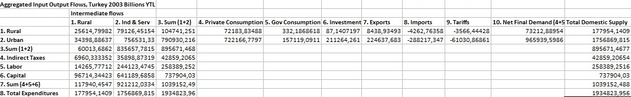
Input-Output flows

Slide 8
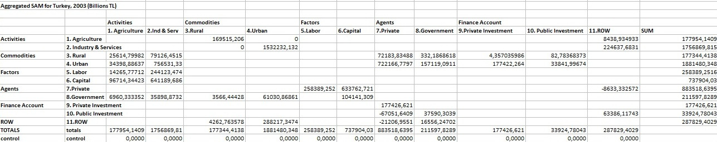
SAM

Slide 9

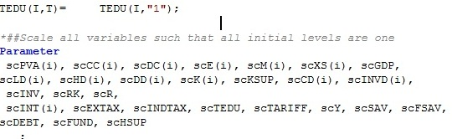

Model Modifications

Slide 10
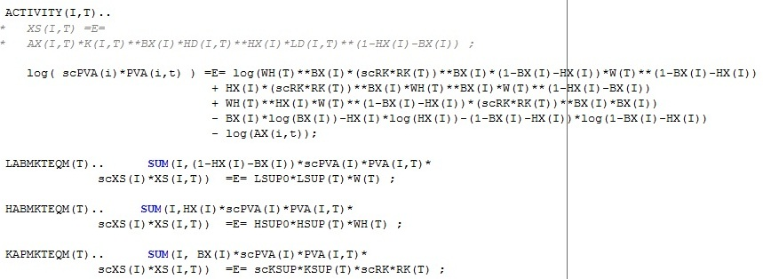

Model Modifications

Slide 11
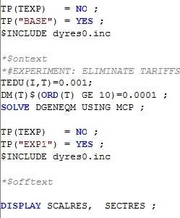
Model Modifications

Slide 12
Results

