Slide 1
Users

Slide 2
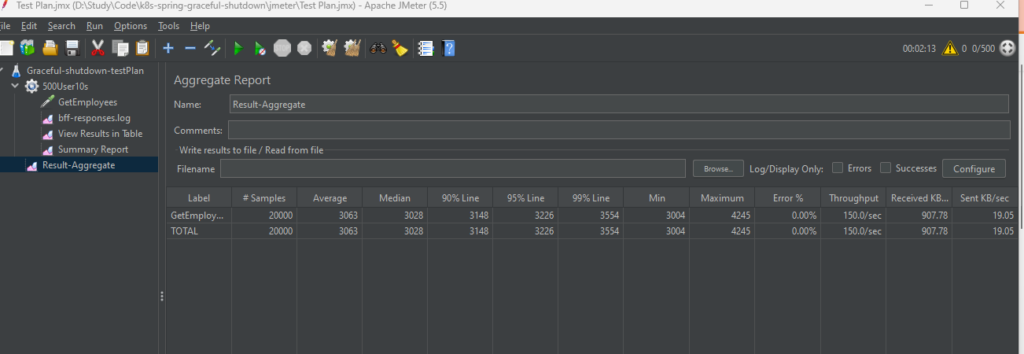
Sample load run

Slide 3
Immediate shutdown

Slide 4
Immediate shutdown

Slide 5
Immediate shutdown

Slide 6
Graceful shutdown

