Slide 1
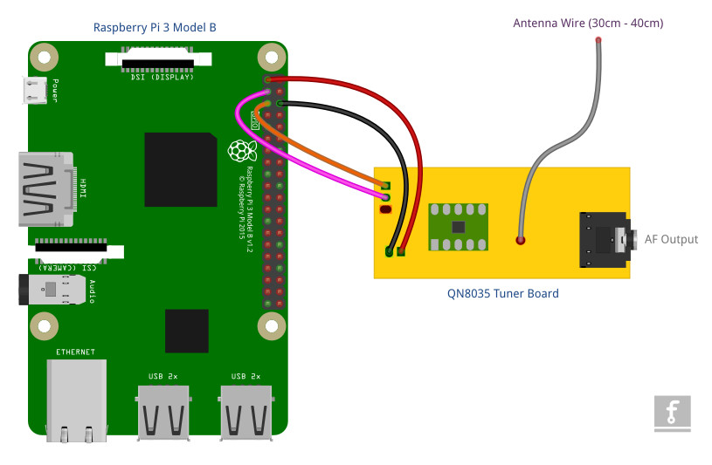
QN8035 Tuner and Raspberry Pi 3 connection diagram
Terminal | Raspberry Pi Pin | QN8035 Pin
SDA | 3 | J3 - 2
SCL | 5 | J3 - 1
VCC (3.3V) | 1 | J2 - 1
GND | 6 | J2 - 2

