Slide 1
Contribute to open-source projects through documentation
Rhonda Glennon
Technical Publications Manager
Mapzen

Slide 2
Contribute through documentation
Fix simple problems, typographic errors, and broken links
Improve content
Write tutorials and expand steps
Write localized content or translations
Resolve bugs tagged with “Help Wanted” (used to indicate community assistance is welcomed)
Workflow example using mapzen.com/documentation and github.com

Slide 3
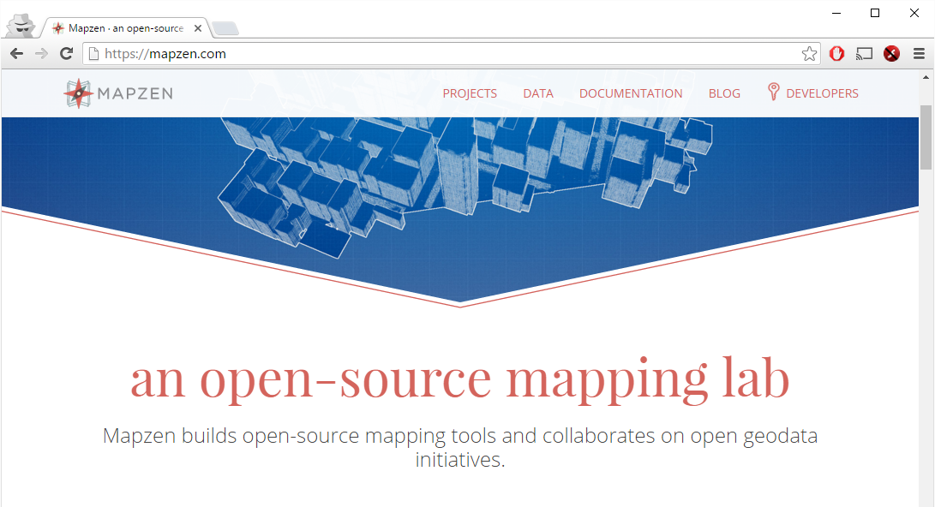


Slide 4
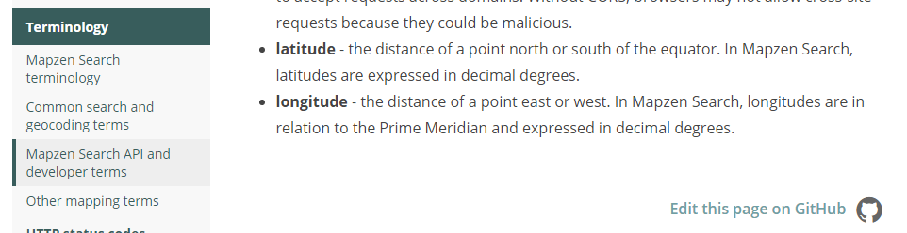
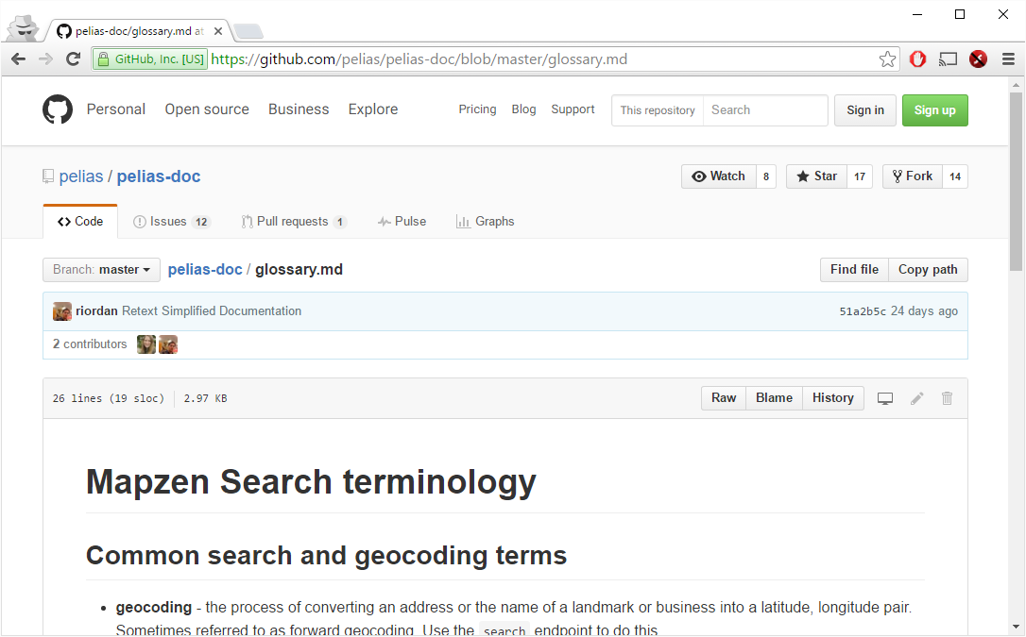
Find the documentation source files

Slide 5
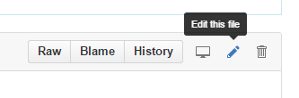
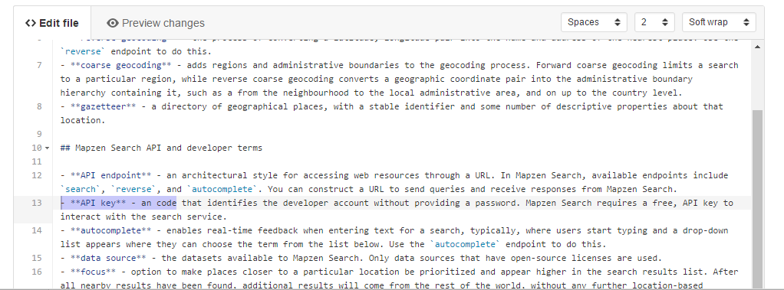
Make content changes
Sign in to your GitHub account
Click Edit this file button
Automatically creates a version that you can edit
Make updates – markdown (.md) format

Slide 6
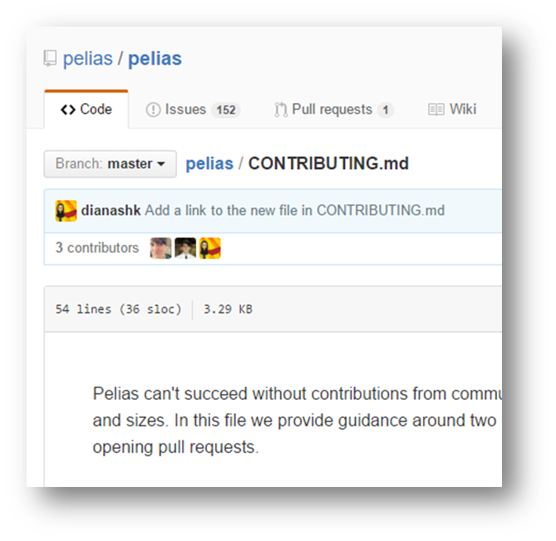
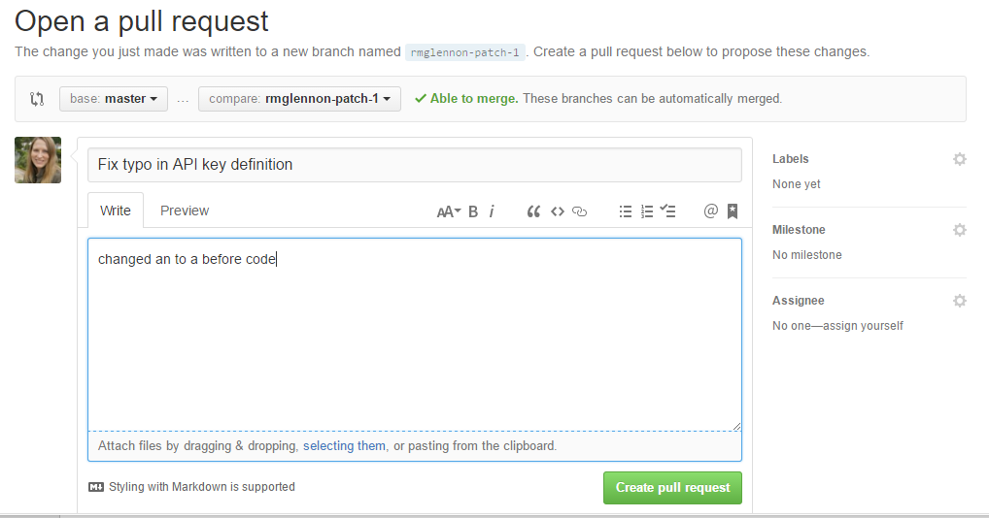
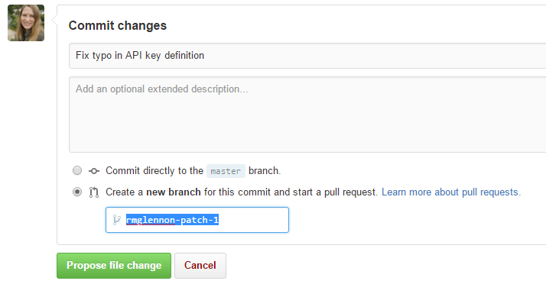
Save edits and propose updating the source
Follow contribution guidelines
Commit changes in your own branch
Open a pull request to propose changes
Community managers review and accept

Slide 7
Open documentation to users
Foster community engagement
Make a connection with users
Discover user needs based on what gets updated in documentation
Empower users
Increase speed of documentation improvements
Improve documentation quality and coverage

Slide 8

www.mapzen.com/documentation
@rmglennon @mapzen

