Slide 1
Air Purifying Robot
Team 1: Fusion Force

Slide 2
Team Members
12213968 WooSeok Kang
12225241 Nilufar Kurbonova
12225243 Dilshod Obidov
12194876 Avazbek Kakhkhorov
12194900 Abdullokh Asatullaev

Slide 3
Contents
Fine dust problem in South Korea
Prioritizing process of air purifying robot
Turtlebot3 Simulation
3D Modeling
3D Print
Packages
Expected Output
Marketing Strategies

Slide 4
Problem&Solution and prioritizing process of Air Purifying robot
WooSeok Kang (12213968)

Slide 5
Fine dust problem in South Korea
South Korea has second highest ultra fine dust level among OECD member countries in 2018.¹⁾
“Regardless of particle size, exposure to PM can produce several diseases, including cardiovascular and respiratory morbidity and death.”²⁾
“S. Korea’s Ultrafine Dust Level 2nd Highest among OECD Members in 2018.” S. Korea’s Ultrafine Dust Level 2nd Highest Among OECD Members in 2018 l, 24 Nov. 2023, world.kbs.co.kr/service/news_view.htm?lang=e&Seq_Code=143424.
“Ultrafine Particles: A Review about Their Health Effects, Presence, Generation, and Measurement in Indoor Environments.” Building and Environment, Pergamon, 19 Mar. 2022, www.sciencedirect.com/science/article/pii/S0360132322002347.

Slide 6
Solution on the fine dust problem
Air purifying robot moves around depending on the fine dust level of each room and cleanse the indoor air in a prioritized order.
Air purifying robot increases social welfare by decreasing casualties and lessening the burden of national health insurance.

Slide 7
Prioritizing process of Air Purifying robot
Air Purifying robot detects ultra fine dust level of each room through the sensor
The robot prioritizes the room with the highest ultra fine dust level.
The robot moves to the prioritized room and turns on the purification.
After the ultra fine dust level reaches below ‘Good’ standard, the robot moves to the room with second highest dust level.
The robot repeats the process until all room has ‘Good’ level of fine dust.
The robot comes back to the initial point and turns the power off.

Slide 8
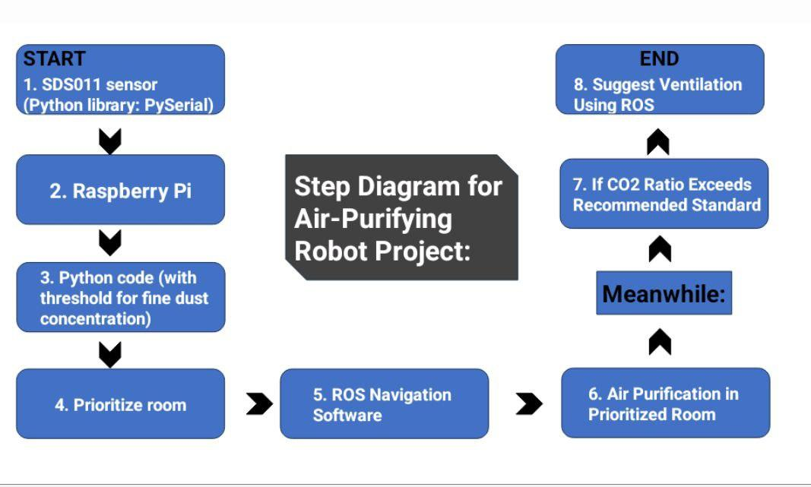
Prioritizing process of Air Purifying robot (Diagram)

Slide 9
Turtlebot3 Simulation
Abdullokh Asatullaev 12194900

Slide 10
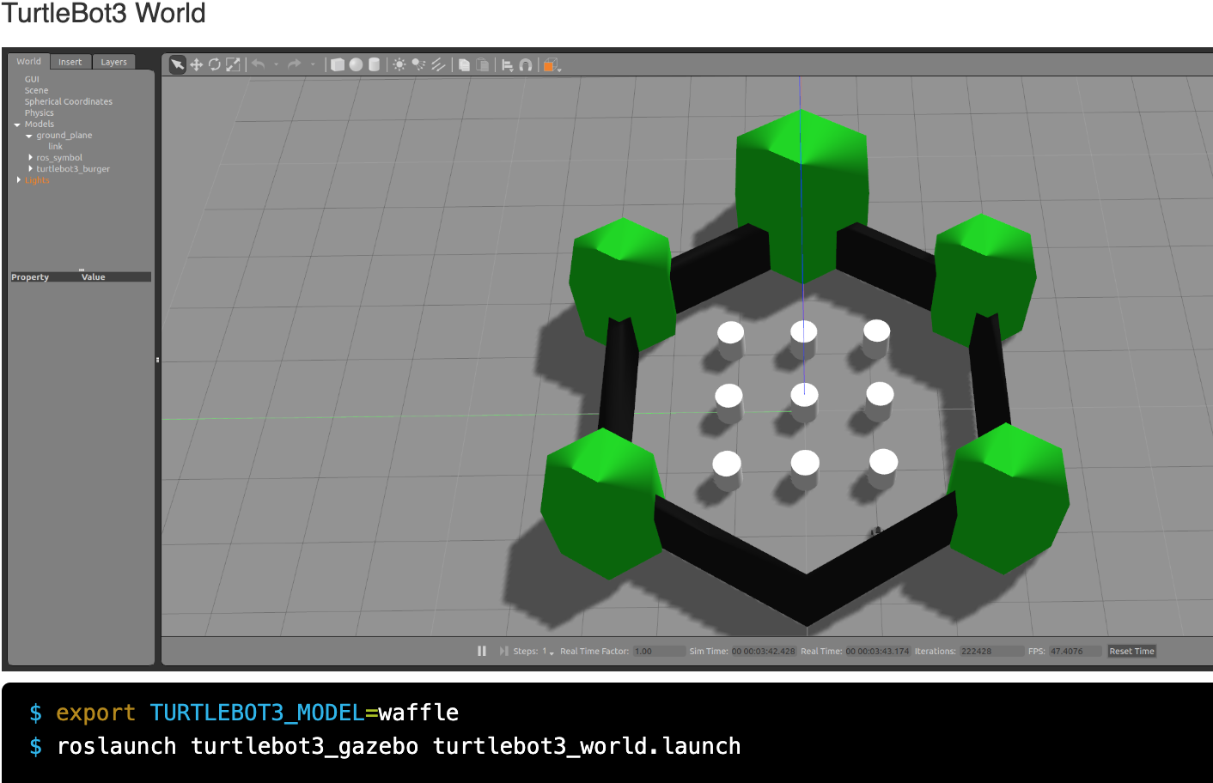
TurtleBot3 Gazebo Simulation—a high-tech virtual testing ground for robots. This advanced platform allows us to experiment and fine-tune robotic systems in a simulated environment. Here, we can evaluate and improve algorithms with precision, reducing risks in the real world. It's a digital playground that not only minimizes challenges but also sparks innovation.
Exploring Gazebo simulation with TurtleBot Model Waffle is like a virtual journey where we can improve and refine our robot, merging the digital and real worlds for an exciting experience.

Slide 11
In Gazebo simulation, two key tasks are accomplished with TurtleBot.
successfully controlling the TurtleBot using a keyboard interface. In order to teleoperate the TurtleBot3 with the keyboard, teleoperation node should be launched with below command in a new terminal window.
implementing a collision avoidance mechanism, enhancing the robot's ability to navigate its environment safely. A simple collision avoidance node is prepared which keeps certain distance from obstacles and make turns to avoid collision. Collision avoidance node is launched with below command
These experiences showcase the versatility and practical applications of TurtleBot within the Gazebo simulation environment.

Slide 12
3D Modeling
Nilufar Kurbonova 12225241

Slide 13
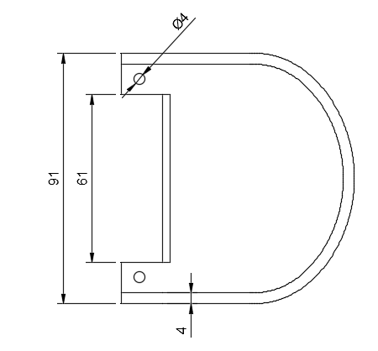
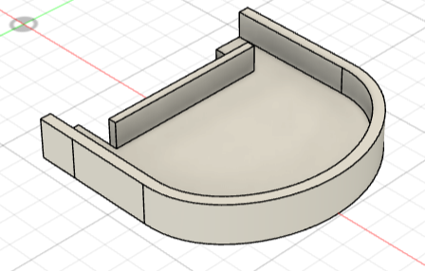
Air-purifier holder (add-on)
Link for model folder: https://github.com/dilshod-obidov/FusionForce/tree/main/Add-on

Slide 14
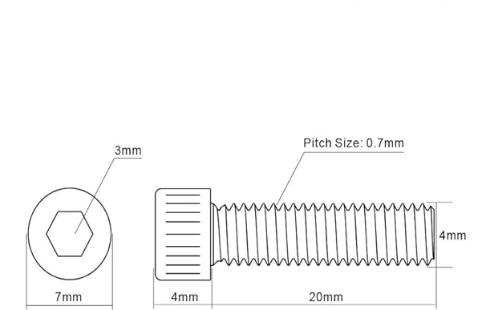
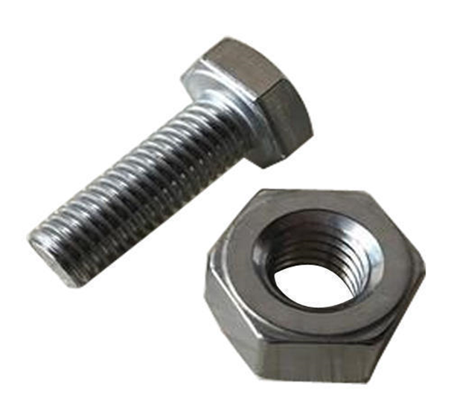
Screw and Nut
Nilufar Kurbonova 12225241

Slide 15
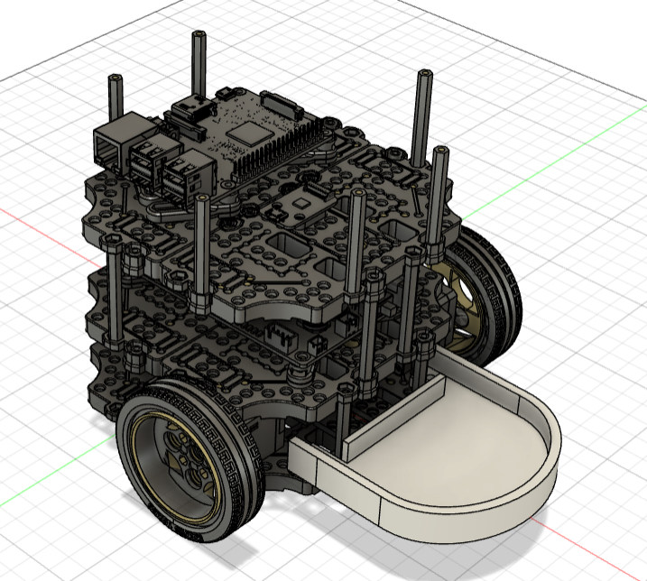
Air-purifier holder (add-on)

Slide 16
3D Print
Dilshod Obidov 12225243

Slide 17
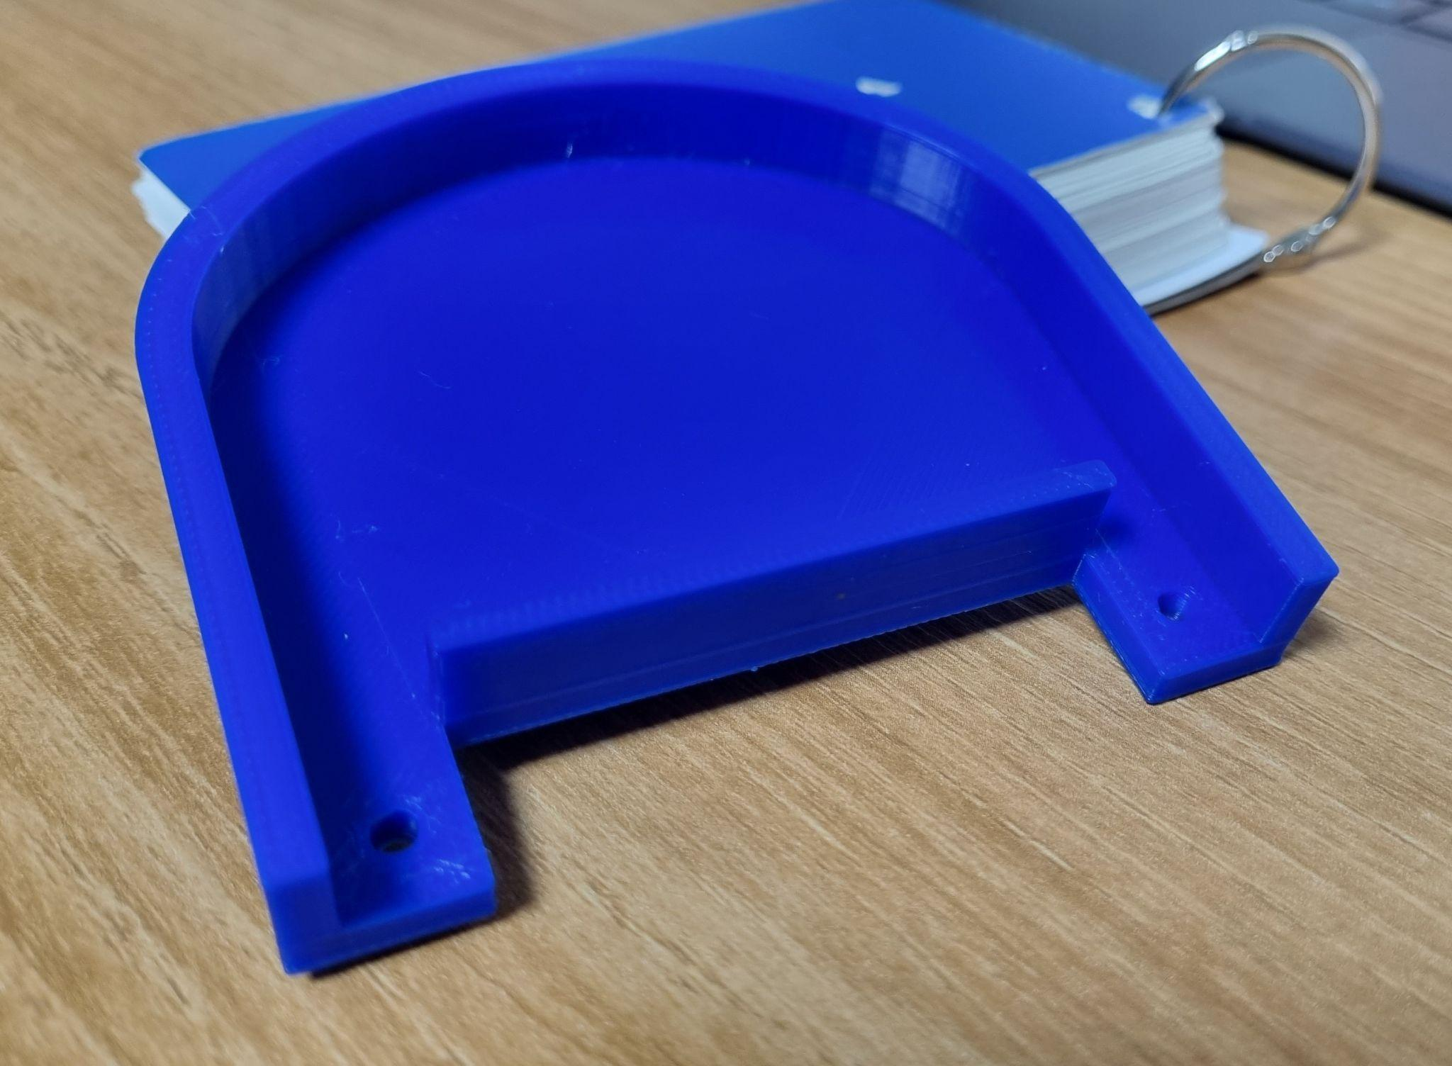
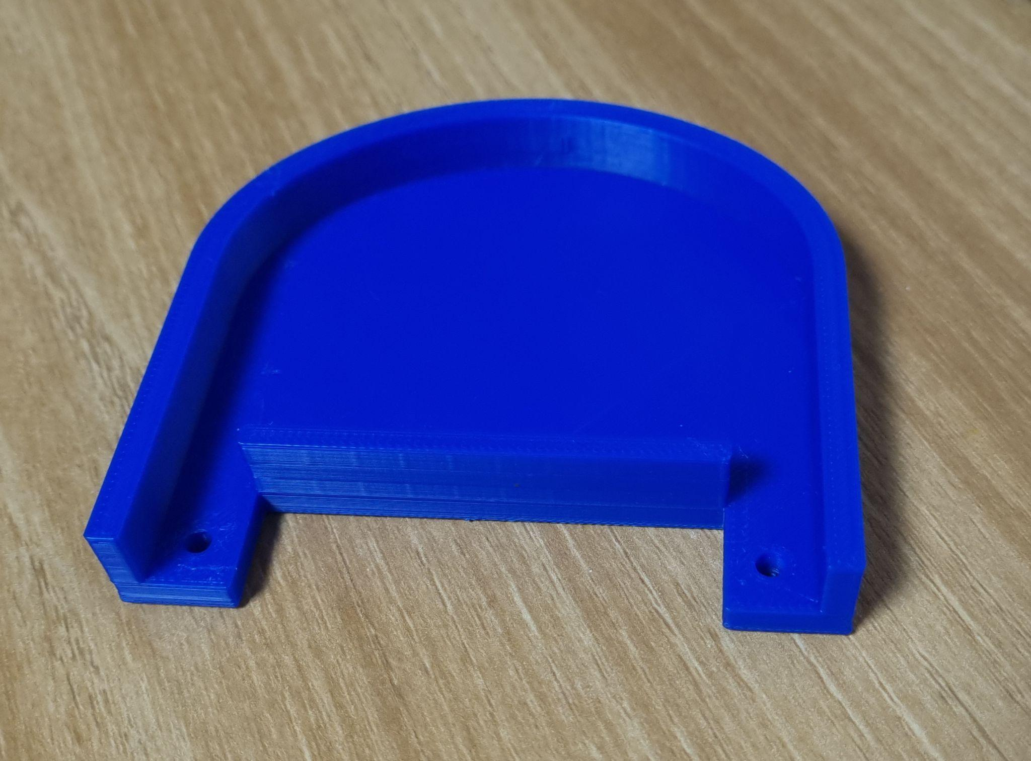
Add-on printed

Slide 18
Packages
Dilshod Obidov 12225243

Slide 19
Turtlebot3 Packages
Links for packages
https://github.com/ROBOTIS-GIT/turtlebot3
https://github.com/ROBOTIS-GIT/turtlebot3_msgs
https://github.com/ROBOTIS-GIT/turtlebot3/tree/master/turtlebot3_navigation
https://github.com/ROBOTIS-GIT/turtlebot3/tree/master/turtlebot3_slam
Turtlebot3
Turtlebot3_msgs
Turtlebot3_navigation
Turtlebot3_slam

Slide 20
Packages to Develop
air_quality_ros
air_purifier

Slide 21
Other Packages
Links for packages
https://github.com/ros-planning/navigation
https://github.com/ros-planning/navigation/tree/noetic-devel/amcl
https://github.com/ros-planning/navigation/tree/noetic-devel/map_server
https://github.com/ros-perception/slam_gmapping
move_base
acml
map_server
gmapping

Slide 22
Expected Output
Nilufar Kurbonova 12225241

Slide 23
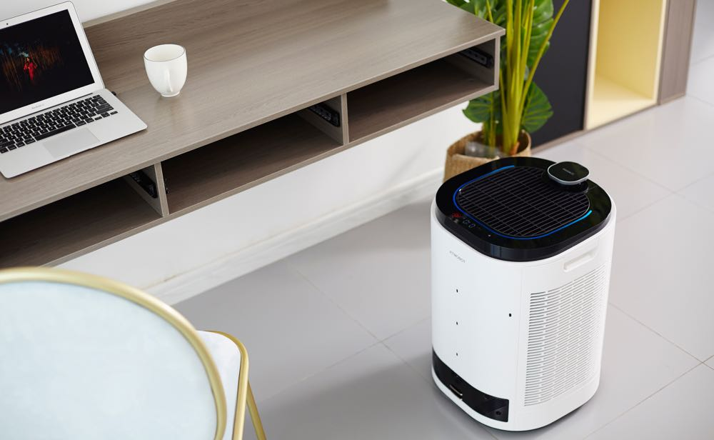
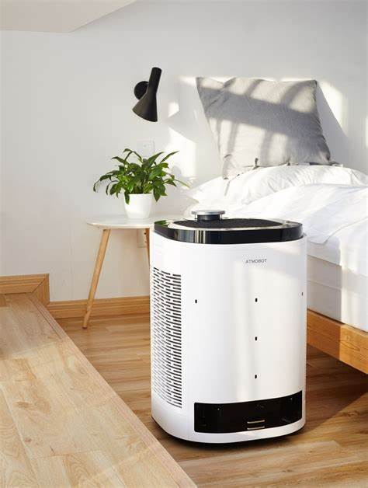
Air-purifier Robot
https://www.techguide.com.au/news/appliances/ecovacs-introduces-atmobot-robot-air-purifier-can-go-room-room/

Slide 24
Marketing strategies
Avazbek 12194876

Slide 25
Marketing strategies
Unique selling point- stands out due to its cutting edge technology and autonomous functionality
Target audience analysis- includes homeowners, tech enthusiasts, health conscious individuals
Marketing channels- utilize multi channel approach for maximum outreach
Content marketing- revolves around educating consumers about indoor air quality issues
Influencer partnerships- collaborate with influencers in the home automation, health, and technology sectors.

Slide 26
Marketing strategies
6. Customer engagement- live demonstrations, webinars, and free trials
7. SEO and online visibility- prioritize SEO optimization to enhance online visibility
8. Customer testimonials and reviews- positive feedback from satisfied customers significantly impacts potential buyers’ decisions
9. Sales promotions and offers- introduce sales promotion and limited-time offers, bundied deals to incentivize purchases
10. Conclusion

Slide 27
Thank You

