Slide 1
MBTA Database
CS 779 - Summer II 2019
Final Presentation
John Liao
Notes:
Good afternoon, my name is John Liao and I will be presenting on my final project for CS 779, which is designing and implementing an MBTA ETL for an Oracle database.

Slide 2
Outline
Introduction
Concept
MBTA API
Database Design
Ingesting Data
Dumping Data
Future
Notes:
Here is an outline of what I will be talking about this afternoon. First, I will tell a little bit about myself. Then I will talk about the concept behind why I chose this type of project. Next I will talk about the MBTA (for those not familiar) and how the API is structured.
Finally, I will talk about the database design by walking through the ERD diagram, triggers, indexes, and stored procedures I implemented.
I will also talk about ingesting the API raw data and dumping it.
There is room for additional enhancements to the project and I will cover those briefly at the end.

Slide 3

Introduction
Systems Engineer @ Hanscom AFB (Bedford, MA)
Tufts 2012, BS ME
Boston University 2020, MS CS
Notes:
A little bit about myself. I am a Systems engineer working at Hanscom airforce base. I graduated from Tufts in 2012 with my Bachelor in Mechanical Engineering and scheduled to finish my Masters Degree in CS in 2020.

Slide 4
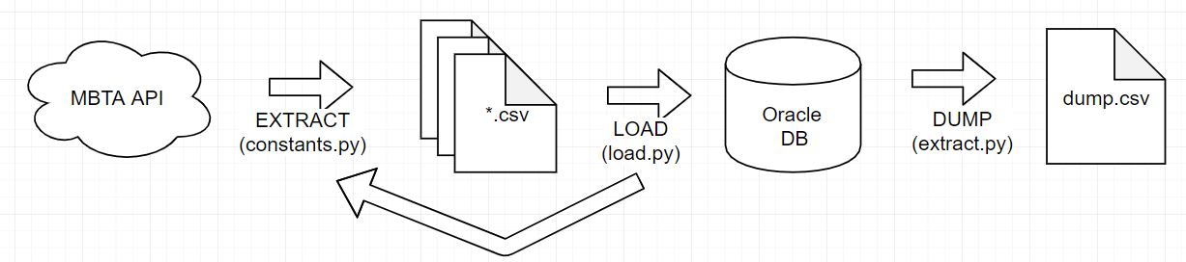
Concept
MBTA API provides a wealth of data, but only “realtime” data
Project creates an ETL that feeds into a data warehouse
Focus on Vehicle temporal and location data
“Soup to nuts” type project
“Big Data” and analytics
Open source and data easily accessible
Project source code available at https://github.com/johnsliao/cs779-mbta-db
Notes:
When I was brainstorming ideas for my project, I wanted to pursue something that would be interesting and meaningful. I have worked with the MBTA API in the past for my own pet projects (built a Python wrapper around version 2 of the API).
The API is rich and provides a wealth of data and is easy to get access to. Unfortunately, the API does not provide historical level data.
This project focuses on building a data warehouse and storage for historical vehicle data. Temporal and geospatial data is stored.
The database is aimed at the direction of big data and eventual analytics
The project focuses on a soup-to-nuts, for a data warehouse: fetching raw unstructured data, processing and cleaning it, inserting it into a database, and dumping aggregated data. This process can be run repeatedly.
The source code is available at the URL on github.

Slide 5
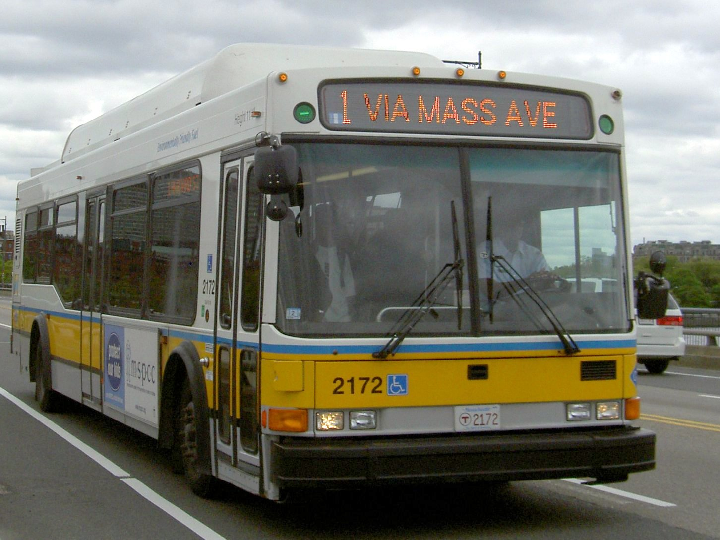
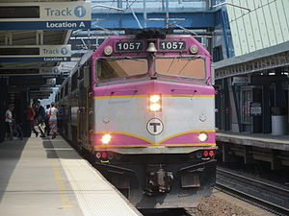

MBTA API
MBTA provides a rich restful API that is easily accessible
GTFS (General Transit Feed Specification) and GTFS-realtime data
JSON data returned
API Endpoints Used
https://api-v3.mbta.com/routes
https://api-v3.mbta.com/stops
https://api-v3.mbta.com/lines
https://api-v3.mbta.com/vehicles
Notes:
As mentioned, the MBTA provides a wealth of information and follows an open standard (GTFS), which stands for general transit feed specification.
You do not need an API key to be able to hit their API endpoints. You can click on these links and they will return a JSON response.
There are numerous API endpoints. For this particular project, I narrowed the scope and focused on 4 endpoints: routes, stops, lines, and vehicles.
I will show some examples of what the responses look like in the next couple slides.

Slide 6
data": [{
"attributes": {
"bearing": 315,
"current_status": "STOPPED_AT",
"current_stop_sequence": 180,
"direction_id": 0,
"label": "3868-3697",
"latitude": 42.351200103759766,
"longitude": -71.1163330078125,
"speed": null,
"updated_at": "2019-08-15T12:03:51-04:00"
},
"id": "G-10131",
"relationships": {
"route": {
"data": {
"id": "Green-B",
"type": "route"
}
},
"stop": {
"data": {
"id": "70141",
"type": "stop"
}
},
},
"type": "vehicle"
},
...
https://api-v3.mbta.com/vehicles
Notes:
Here is a sample response from the vehicles endpoint.
The responses from the API are in JSON format.
I have highlighted fields that were saved and stored in the database, including bearing, status, lat, lon, label, speed, and when the data was last updated.
A few different datatypes were used when creating the tables: varchar, floats, number and date types.

Slide 7
"data": [{
"attributes": {
"color": "DA291C",
"description": "Rapid Transit",
"direction_destinations": ["Ashmont/Braintree","Alewife"],
"direction_names": ["South","North"],
"fare_class": "Rapid Transit",
"long_name": "Red Line",
"short_name": "",
"sort_order": 10010,
"text_color": "FFFFFF",
"type": 1
},
"id": "Red",
"links": {
"self": "/routes/Red"
},
"relationships": {
"line": {
"data": {"id": "line-Red","type": "line"}
},
},
"type": "route"
},
...
https://api-v3.mbta.com/routes
Notes:
Here is a sample response from the routes endpoint.
Again, The responses from the api endpoint are JSON format.
I have highlighted fields that were saved and stored in the database.
When I was putting together the ERD diagram, note that there are multivalued fields (direction_destination, direction_names) that needed to be handled properly for a normalized database design.
I went ahead and used bridge tables to resolve the many-to-many relationships.

Slide 8
Database Design
Oracle 12.x used for database
Normalized database design, denormalized where it makes sense
At least 2nd normal form
Historical table VEHICLES_DATA_HISTORY created
Triggers, Stored Procedures, Indexes added
Notes:
Oracle was the DMBS of choice for the database
The database design followed a normalized database design and denormalized where it makes sense. It goes up to at least the 2nd normal form.
For recording historical data and eventually dumping the data, a historical table is maintained of the vehicle data and that’s stored in a vehicle_data_history table.
The historical data is maintained using triggers, stored procedures, and indexes to speed up querying.

Slide 9
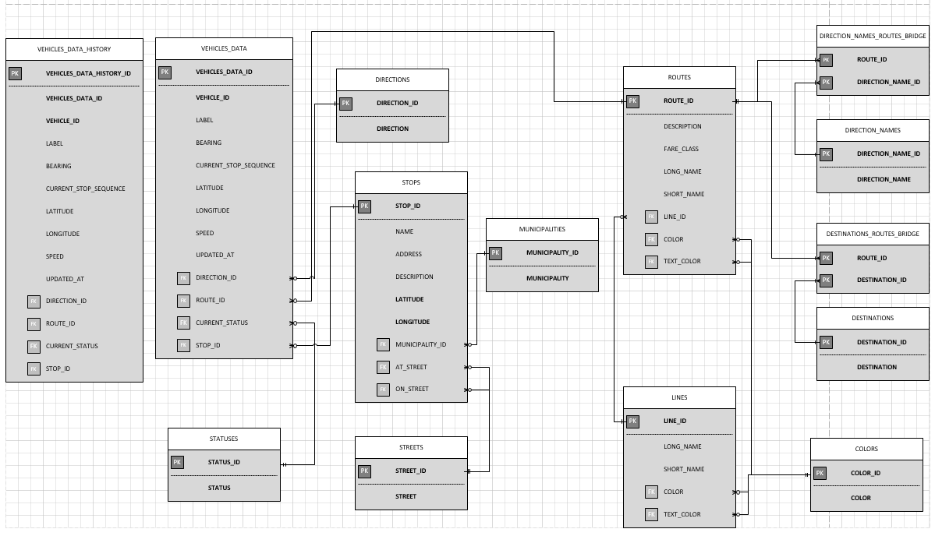
ERD
Insert ERD Here
Notes:
Here is the ERD diagram of the database design.
One important thing I learned is that keeping a map of all the tables and references were key in helping me craft the tables properly.
Starting from the left:
Vehicles data history
A copy of the vehicles data table with all the corresponding relationships. The arrows were not draw for clarity. When dumping, JOINS will be performed to grab all pertinent data.
A column for vehicles_data_id is used to ensure no duplicate rows are entered.
Vehicles data table
A table that contains information for all MBTA transportation - trains, subways, and buses. Interesting attributes such as lat, lon, speed are tracked and keyed in.
When loading and reading data in, vehicle_id and updated_at are checked to ensure that no duplicate data is added.
There are several foreign keys referencing other tables such as direction, current status, stop id.
Statuses are values including “in transit to”, “stopped at”, etc.
Directions are a 0 or 1, referencing whether it is going inbound or outbound
Stops table references streets and municipalities, these include train stations or bus stops.
Routes table has routes that vehicles will take including information on their destinations and directions
Lines contains train lines, e.g. Red Line, Orange Line, etc
Colors contain hex code for the actual color of the trains
As previously mentioned, there is a many to many relationship between routes and direction names (inbound/outbound) and destination routes (alewife/braintree). I implemented a bridge table to resolve that potential issue.
One disadvantage is that in order to account for all potential possibilities, a cartesian product is created between routes and destination names including bus stops (dudley square, watertown station).
This can create a huge number of combinations that do not exist, but could in the future. This could be further optimized if an actual specification was created to show all possible combinations.
Any questions?

Slide 10
Historical Data
VEHICLE_DATA_HISTORY table created to maintain history
Data cannot be deleted - enforced by trigger
Indexes added to FKs to make lookups faster
VEHICLE_DATA_HISTORY table updated with stored procedure
Notes:
As shown in the ERD, a historical data table is maintained.
A trigger was implemented to make sure that data cannot be deleted.
Indexes are added to foreign keys to make lookups faster when dumping data.
The table is updated using a stored procedure.

Slide 11
Trigger & Index
-- Add Trigger
CREATE OR REPLACE TRIGGER VEHICLES_HISTORY
BEFORE DELETE ON VEHICLES_DATA_HISTORY
BEGIN
raise_application_error(-20001,'Vehicle History records can not be deleted');
END;
-- Add Index
CREATE INDEX i_route_id ON VEHICLES_DATA_HISTORY(route_id);
CREATE INDEX i_stop_id ON VEHICLES_DATA_HISTORY(stop_id);
Notes:
This slide shows a simple implementation of the trigger and indexes added to the vehicles history table.

Slide 12
Stored Procedure
CREATE OR REPLACE Procedure DAILY_VEHICLES_DATA_BACKUP
IS
BEGIN
-- Select vehicle_data_ids from vehicles_data table that do not exist in vehicles_data_history table
INSERT INTO VEHICLES_DATA_HISTORY (vehicle_data_id, vehicle_id, bearing, current_stop_sequence,
latitude, longitude, speed, updated_at, direction_id,
route_id, label, current_status, stop_id)
SELECT vehicle_data_id, vehicle_id, bearing, current_stop_sequence, latitude, longitude, speed, updated_at, direction_id,
route_id, label, current_status, stop_id FROM VEHICLES_DATA WHERE vehicle_data_id IN(
SELECT vehicle_data_id from VEHICLES_DATA WHERE vehicle_data_id NOT IN (
SELECT vehicle_data_id FROM VEHICLES_DATA_HISTORY));
END;
Notes:
This slide shows code for implementation of the stored procedure.
Simply put, it finds vehicle_data_ids that exist in the vehicles_data table but do not exist in the vehicles_data_history table.
It will insert those rows into the vehicles_data_history table.
I initially implemented a “nightly” query where updated_at would be within the last day, but that would involve a full table scan, which feels less efficient that doing IN/NOT IN.

Slide 13
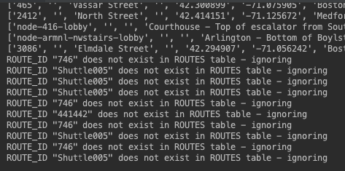
Ingesting Data
Sample data scraped from the API endpoints
Python cx_Oracle library used to insert data accordingly into normalized database design
Ingesting well-formed and known data vs. unstructured data on the fly
Normalizing and ingesting unstructured data is not easy
Hybrid approach taken
Ingest a snapshot of data to populate tables and maintain constraints
Future data ingested data based on existing references/constraints
Poorly-formed data logged for review
Notes:
Overall workflow:
Python was used to fetch and extract the data from the API endpoints
Python used with oracle python library to LOAD AND NORMALIZE data into oracle database
Data can be dumped from the database into a csv file
The extract and load process and be run repeatedly to collect more and more data
I learned that normalizing and cleaning data is NOT easy. For example, single quotes in the data needed to be escaped to be handled properly by the database. Other issues encountered include formatting datetimes, understanding the idiosyncrasies of embedded sql for python, etc.
An interesting scenario came up when trying to ingest data on the fly. If one is ingesting data on the fly, then it’s quite possible that the proper table references are not in place to ingest it properly.
For example, ingesting a STOP location with a STREET foreign key and that STREET has not been ingested in the STREET table.
There are a number of approaches, like ingesting non conforming data to a temporary table to be handled later and ingesting data that has correct references.
I took the hybrid approach of taking a snapshot of data to initially populate tables. Future ingested will be compared against those constraints. If they do not fit, then they’re logged and handled later.

Slide 14
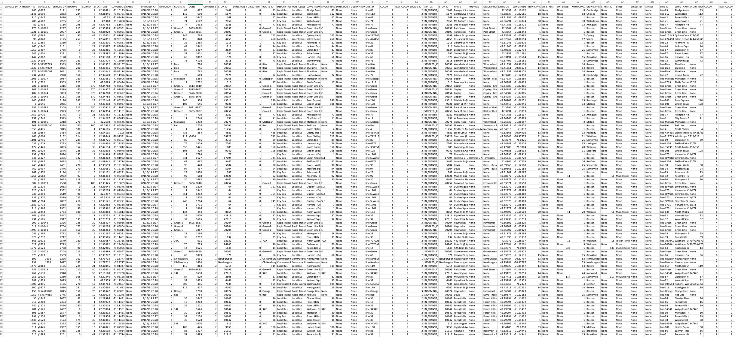
Dumping Data
Notes:
This is a screenshot of the dumped csv file data.
The extract script pulls and joins table data from the vehicles_data_history table.
As the vehicles data history table grows, so would this file.
This dumped file could eventually be pushed out to data aggregating sites such as Kaggle.

Slide 15
Future
Visualization Using Google Data Studio
Run ETL on a regular basis in cloud environment
Push dumped results to a Kaggle
Data Warehouse Tables
Stale vehicle updates (last_updated is stale)
Number of vehicles in transit
How long each vehicles stays at each stop
Geolocation analytics
Notes:
Here is a list of future enhancements that I think would be nice for the project.
The dumped CSV data could be imported into Google Data Studio for better visualization
The ETL could be run on a regular basis, versioned, and put online
The data could be pushed to data aggregator sites like Kaggle
Data warehouse tables could be used to analyze the large amount of data that can be collected
Interesting analytics include: stale vehicles that haven’t been updated or moving, # vehicles in transit, how long vehicles stay at each stop, geolocation (lat lon)

Slide 16
Questions?

Slide 17
Sources
https://en.wikipedia.org/wiki/MBTA_key_bus_routes
https://en.wikipedia.org/wiki/MBTA_Commuter_Rail
https://blog.mass.gov/transportation/mbta/south-station-please-review-the-enf/

