Slide 1
Healthcare Cybersecurity Risk Assessment & Mitigation Framework
MSIT 5910 Capstone Project
Supervised by: Professor Shabia Shabir
Submitted by: Diana Luna

Slide 2
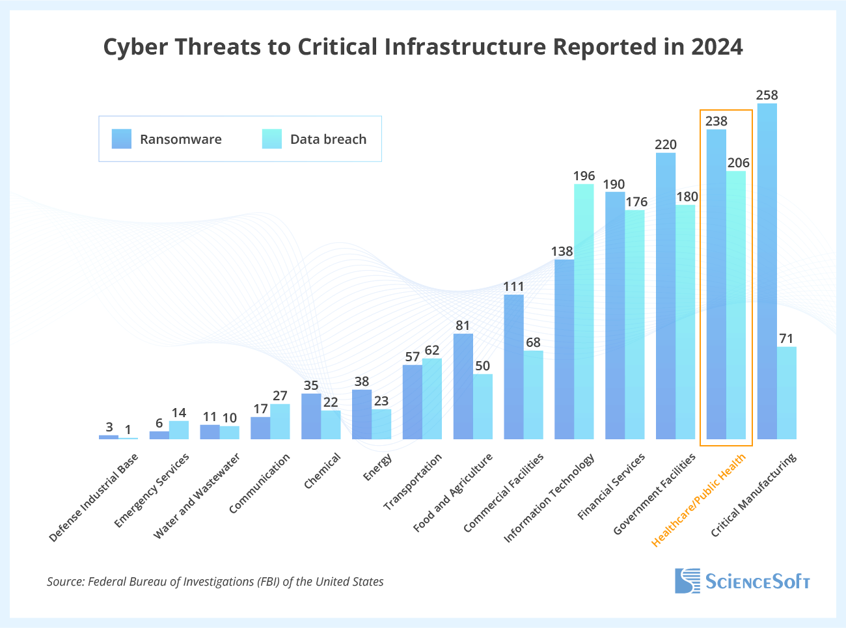
Introduction to Healthcare Cybersecurity Challenges
Growth of EHR and digital healthcare
Rise in ransomware/data breaches
Importance protecting ePHI
HIPAA
National Institute and Standards and Technology

Slide 3
Problem Statement
Healthcare organizations often lack
Formal risk registers
Integrated incident response
Threat modeling
Compliance mapping
Consequences
Data breaches
Downtime
Financial penalties
Patient safety risks

Slide 4
Project Objectives
Healthcare cybersecurity risk assessment and mitigation framework
Modular Architecture Objective
Risk Assessment
Threat Intelligence
Compliance Mapping
Incident Response
Reporting Dashboard
Assists mid-size healthcare organizations
Identify
Assess
Respond
Stakeholders
IT & Cybersecurity teams
Healthcare Providers
Compliance Officers

Slide 5
Project Scope
Scope
Python prototype
Modular architecture
Conceptual CI/CD integration
Healthcare cybersecurity focus

Slide 6
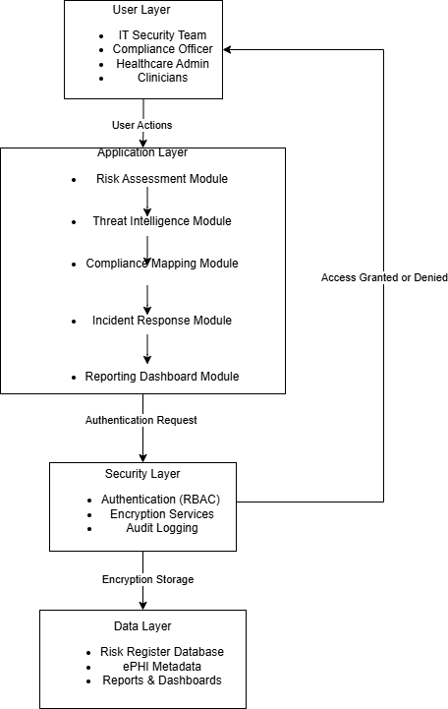
System Architecture
Layered & Modular Architecture
Data flows through
Each module is triggered by the previous

Slide 7
Core System Components
Risk Assessment
Threat Intelligence
Compliance Mapping
Incident Response
Reporting Dashboard

Slide 8
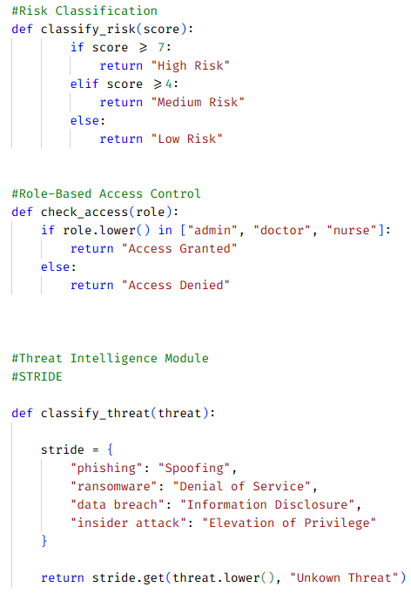
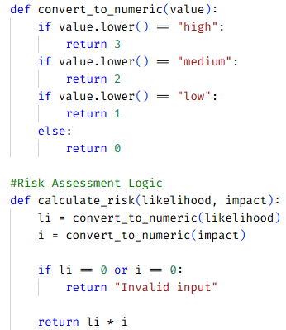
Risk Assessment & Security Logic
Inputs
Assets
Vulnerabilities
Output
Risk Score
Aligns
NIST Risk Assessment Principles
Prioritizes cyber security risks
Risk Score = Likelihood x Impact
High = 3
Medium =2
Low = 1
Example:
Asset | Vulnerability | Likelihood | Impact | Risk Score | Risk Level
Epic EHR System | Weak Passwords | High | High | 9 | High
Medical Device | Outdated Firmware | Medium | High | 6 | Medium

Slide 9
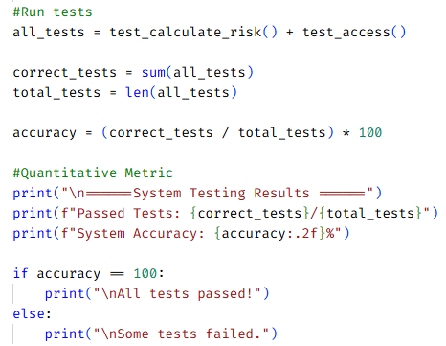
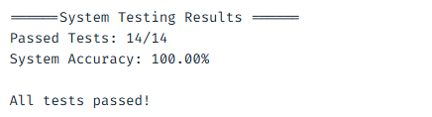
System Testing and Validation
Integration Testing
System testing
Black box and white box testing

Slide 10
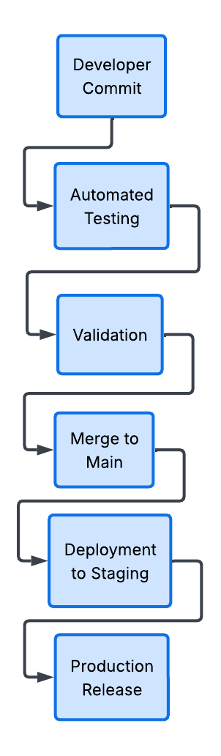
CI/CD and DevSecOps Integration
Workflow
GitHub Branches
Automated testing
Deployment validation
Healthcare deployment reliability

Slide 11
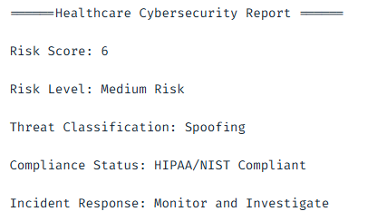
Results and Outputs
Risk Score
Threat classification
Compliance result
Incident response output

Slide 12
Challenges and Limitations
Aligning NIST & HIPAA
Balancing usability and technical depth
Lightweight prototype limitation
Not database/cloud integration
Limited threat intelligence feeds

Slide 13
Future Enhancements
Real time threat feeds
Cloud development
Database integration
Multi-factor authentication
AI threat detection
Expanded CI/CD automation

Slide 14
Conclusion
Framework improves health cybersecurity readiness
Modular architecture supports scalability
Testing validation reliability
CI/CD concepts improve future maintainability
Support HIPAA/NIST alignment

Slide 15
Resources
Allen-Addy, C. (2025 September 29). Threat Modeling STRIDE Methodology. IriusRisk. https://www.iriusrisk.com/resources-blog/threat-modeling-methodology-stride.
Davis, J. (2022, June 15). Ransomware Attack on Yuma Regional Medical Leads to Data Theft for 700K patients. SC Media. https://www.scworld.com/analysis/ransomware-attack-on-yuma-regional-medical-leads-to-data-theft-for-700k-patients
Kurskov, D. CyberAttacks on Healthcare to Affect Almost Half of Health Systems, Threaten PAtient Treatment, and Drive Up Breach Costs. Unless?. ScienceSoft. https://www.scnsoft.com/healthcare/cybersecurity-statistics
National Institute of Standards and Technology. (2018, April 16). Framework for Improving Critical Infrastructure Cybersecurity. (Version 1.1). https://nvlpubs.nist.gov/nistpubs/cswp/nist.cswp.04162018.pdf
Lindemulder, G. & Kosinski, M. (n.d.). What is Role-Based Access Control (RBAC)?. https://www.ibm.com/think/topics/rbac.
Marron J (2024) Implementing the Health Insurance Portability and Accountability Act (HIPAA) Security Rule: A Cybersecurity Resource Guide. (National Institute of Standards and Technology, Gaithersburg, MD), NIST Special Publication (SP) NIST SP 800-66r2. https://nvlpubs.nist.gov/nistpubs/SpecialPublications/NIST.SP.800-66r2.pdf
National Institute of Standards and Technology. (2012 September). Guide for Conducting Risk Assessments (NIST Special Publication 800-30 Rev. 1). U.S. Department of Commerce. https://nvlpubs.nist.gov/nistpubs/legacy/sp/nistspecialpublication800-30r1.pdf
National Institute of Standards and Technology. (2018, April 16). Framework for Improving Critical Infrastructure Cybersecurity. (Version 1.1). https://nvlpubs.nist.gov/nistpubs/cswp/nist.cswp.04162018.pdf
U.S. Department of Health and Human Services. (2023 December). Healthcare sector cybersecurity. Accessed April 30, 2024. https://aspr.hhs.gov/cyber/Documents/Health-Care-Sector-Cybersecurity-Dec2023-508.pdf

Slide 16
Demo Introduction

