Slide 1


Slide 2

AI-Powered Bug Detection Platform
Group Members: Zainab | Hamna |
Supervised By: [Supervisor Name]
Co-Supervisor: [Co-Supervisor Name]:

Slide 3
Table of Contents
1. Introduction — What is this project?
2. The Problem We Solve
3. How It Works — Step by Step
4. Datasets Used for Training the AI
5. AI Models Explained in Simple Language
6. Platform Walkthrough (Screenshots)
7. System Design Diagrams
8. How to Run the Project Locally
9. Future Plans
COLLEGE OF COMPUTING & SOFTWARE ENGINEERING- ZUFESTM

Slide 4
Introduction
COLLEGE OF COMPUTING & SOFTWARE ENGINEERING- ZUFESTM

Slide 5

What is this Project?
The Bug Detector is a smart AI system that automatically finds errors (bugs) in software code.
A developer or QA engineer uploads their code file or log file to the platform.
The AI instantly scans the file and tells you:
Type of bug (Crash / Logical / Performance / UI)
How serious it is (Critical / High / Medium / Low)
Which line of code has the problem
How to fix it
Who is responsible for fixing it
No manual code review needed — the AI does it all automatically.
COLLEGE OF COMPUTING & SOFTWARE ENGINEERING- ZUFESTM

Slide 6
The Problem We Solve
COLLEGE OF COMPUTING & SOFTWARE ENGINEERING- ZUFESTM

Slide 7
Old Way vs Our AI Solution
OLD WAY (Manual Review)
Developers manually read thousands of lines to find bugs.
Takes days or weeks — very expensive.
Human reviewers miss many bugs in large projects.
No clear record of bugs found and fixed.
OUR SOLUTION (AI-Powered)
Upload any code file — AI scans it in seconds.
87% accuracy in detecting if a file has bugs.
99% accuracy in classifying the type of bug.
Full history of all past analyses kept safely.
COLLEGE OF COMPUTING & SOFTWARE ENGINEERING- ZUFESTM

Slide 8
How It Works — Step by Step
COLLEGE OF COMPUTING & SOFTWARE ENGINEERING- ZUFESTM

Slide 9
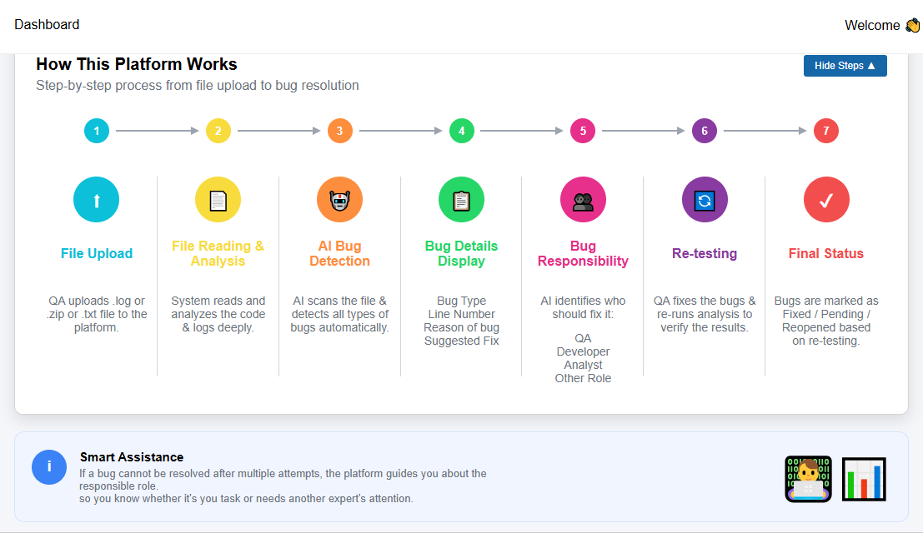
How It Works — 7 Simple Steps
COLLEGE OF COMPUTING & SOFTWARE ENGINEERING- ZUFESTM

Slide 10
Datasets Used to Train the AI
COLLEGE OF COMPUTING & SOFTWARE ENGINEERING- ZUFESTM

Slide 11
Datasets Used to Train the AI
Dataset 1: NASA Software Defect Dataset
File name: nasa_combined.csv
Source: NASA publicly released real project data
Contains data from real NASA space software
Tells the AI: Is this file buggy or clean? (Yes/No)
Total records used for training: ~17,000
Dataset 2: CK Metrics Dataset
File name: ck_combined.csv
CK = Chidamber & Kemerer (famous researchers)
Measures 20 qualities of code, for example:
WMC — How complex is this code?
LOC — How many lines of code?
CBO — How many other files does it depend on?
RFC — How many functions are called?
Teaches AI: What TYPE of bug is this?
COLLEGE OF COMPUTING & SOFTWARE ENGINEERING- ZUFESTM

Slide 12
AI Models — The Brain of the System
COLLEGE OF COMPUTING & SOFTWARE ENGINEERING- ZUFESTM

Slide 13
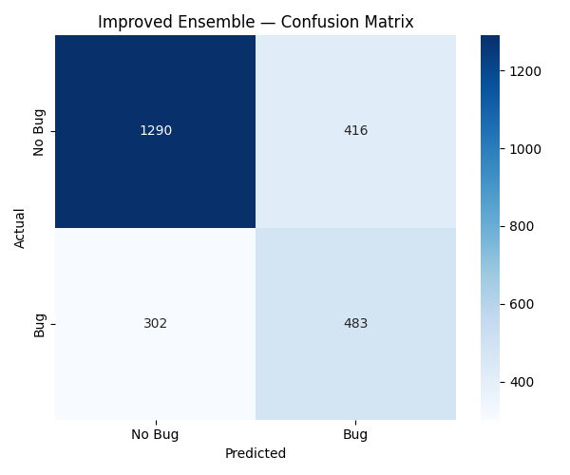
Model 1: Bug Detection Model
What does it do?
Reads the code file and decides: Does this file have a bug? (Yes or No)
How was it built?
We trained 3 AI algorithms together (called an 'Ensemble'):
XGBoost — A very powerful prediction algorithm (weight: 3)
Random Forest — Like a group of experts voting together (weight: 2)
Gradient Boosting — Learns from past mistakes step by step (weight: 2)
Combining all 3 gives much better accuracy than one alone.
How accurate is it?
AUC Score: 87% (AUC = how well it separates buggy vs clean code)
Trained on: 12,454 real software records
Uses 35 different code measurements to make its decision
COLLEGE OF COMPUTING & SOFTWARE ENGINEERING- ZUFESTM

Slide 14
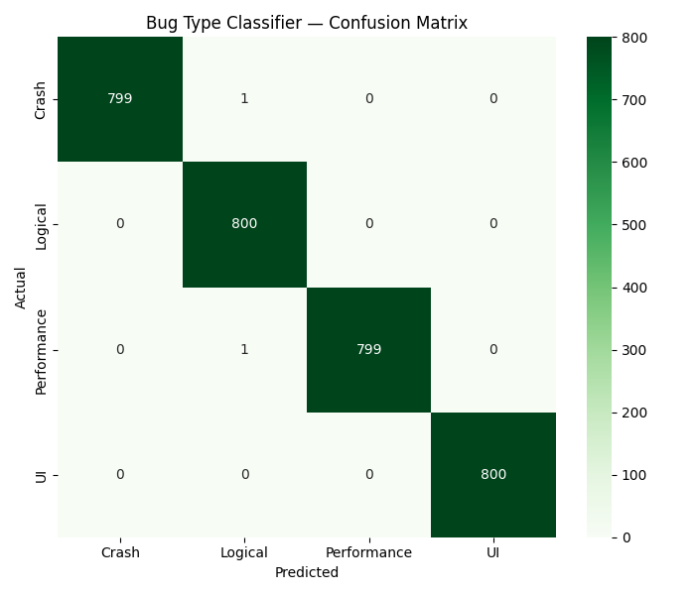
Model 2: Bug Type Classifier (99% Accurate)
What does it do?
Once a bug is found, it tells you WHAT TYPE of bug it is.
4 Bug Types it identifies:
Crash Bug The app will stop working / crash completely
Logical Bug Wrong answer, incorrect calculation, wrong output
Performance Bug App runs slowly or uses too much memory
UI Bug Something looks wrong on the screen
Algorithm used:
Random Forest Classifier — a group of decision trees voting together
Accuracy: 99.09% — nearly perfect!
Trained on 3,200 labeled examples
COLLEGE OF COMPUTING & SOFTWARE ENGINEERING- ZUFESTM

Slide 15
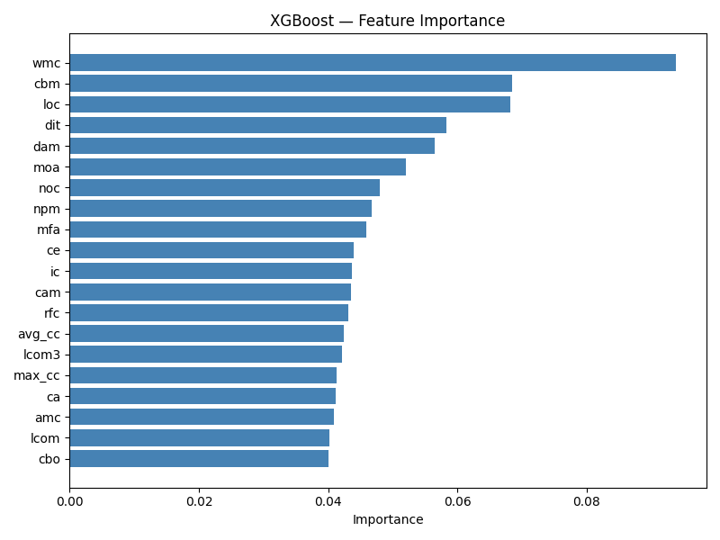
What the AI Looks At — Top Code Signals
The AI looks at 20 measurements of code quality.
These are the most important signals for bug detection:
WMC — Code complexity (most important!)
LOC — Total lines of code
CBO — Number of connections to other code files
DIT — Depth of class inheritance
RFC — How many different functions are called
Rule of thumb:
Higher values = more complex code = higher risk of bugs
COLLEGE OF COMPUTING & SOFTWARE ENGINEERING- ZUFESTM

Slide 16
Model 3: Claude AI Enhancement (Optional Feature)
What is Claude AI?
Claude is a powerful AI assistant made by Anthropic.
We use the Claude Haiku version — fast, smart, and affordable.
What does it add on top of our ML models?
Enhanced Description — A clear 2-sentence explanation of the bug
Technical Reason — Why the AI flagged this specific code
Corrected Code — The actual fixed version of the buggy line
Fix Explanation — What was changed and why
How to enable it?
Go to Settings > Enable Claude AI Mode > Upload your file
Analysis takes a bit longer but gives much richer reports.
Claude AI Output Example
Bug found: Null Pointer
at line 45
Fixed code:
if (obj != null) {
Reason: Object used
without null-check
COLLEGE OF COMPUTING & SOFTWARE ENGINEERING- ZUFESTM

Slide 17
Platform Walkthrough
COLLEGE OF COMPUTING & SOFTWARE ENGINEERING- ZUFESTM

Slide 18
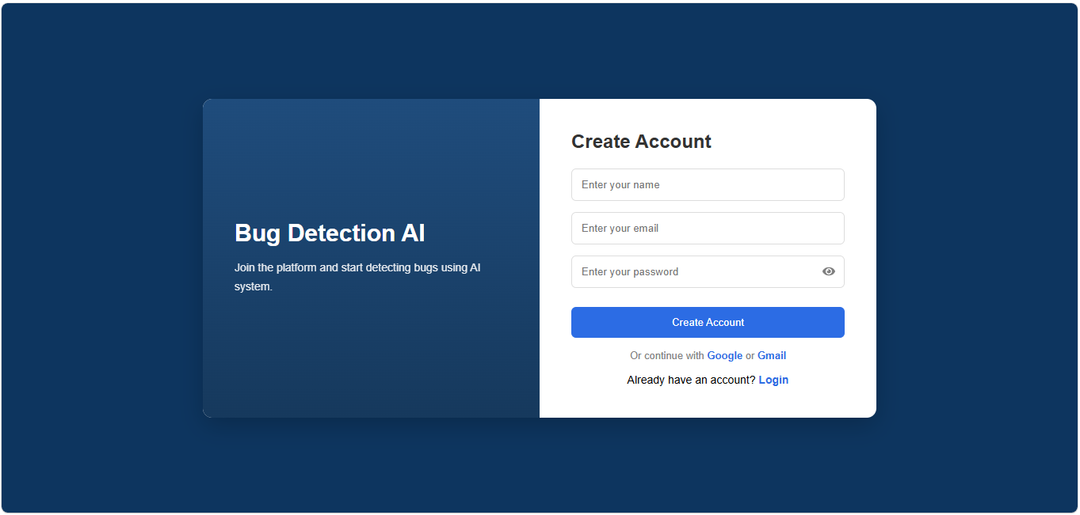
Login & Signup — Getting Started
Create an account with name, email, and password.
Login securely — passwords are encrypted.
Forgot password? Use the OTP email reset.
COLLEGE OF COMPUTING & SOFTWARE ENGINEERING- ZUFESTM

Slide 19
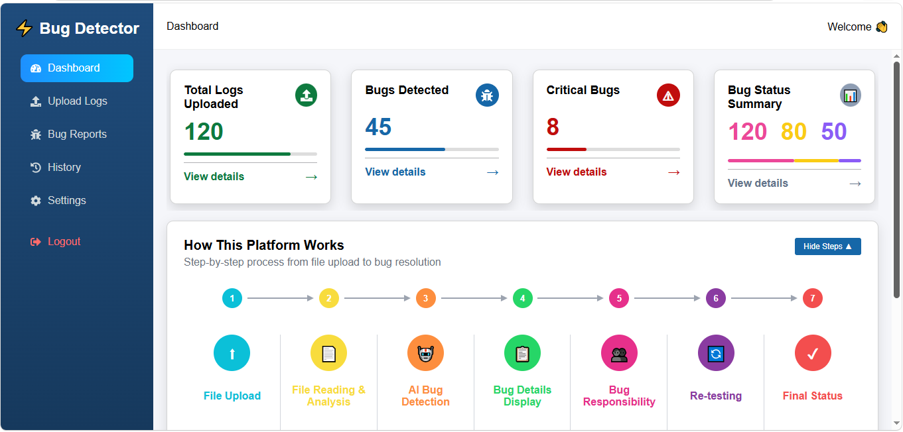
Dashboard — Your Command Center
See all key numbers at a glance:
Total files uploaded
Total bugs found
Critical bugs count
Fixed / In-Progress / Pending status
'How This Platform Works' guide always visible.
COLLEGE OF COMPUTING & SOFTWARE ENGINEERING- ZUFESTM

Slide 20
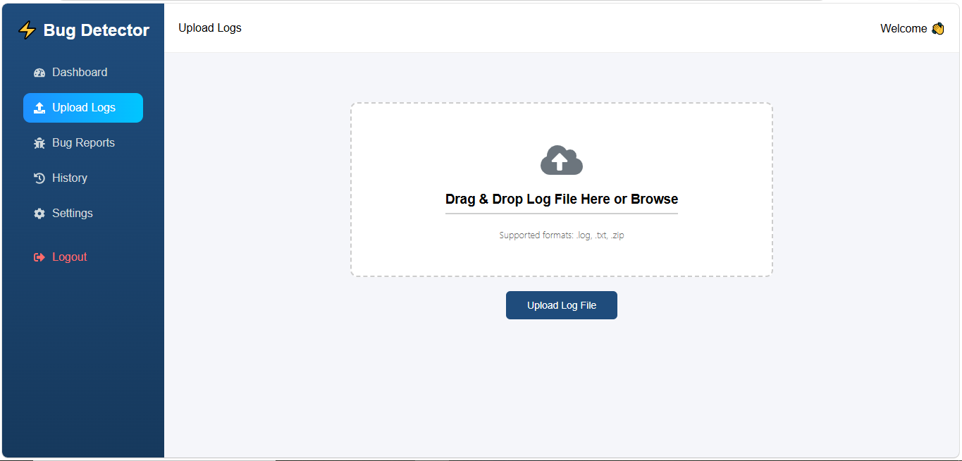
Upload Files — Start the Analysis
Supported File Types:
.py .java .js .ts .cpp .c .cs (source code)
.log .txt (error log files)
.zip (entire project folder)
Drag & drop or click to browse.
Enable Claude AI Mode for richer results.
Maximum file size: 50 MB.
COLLEGE OF COMPUTING & SOFTWARE ENGINEERING- ZUFESTM

Slide 21
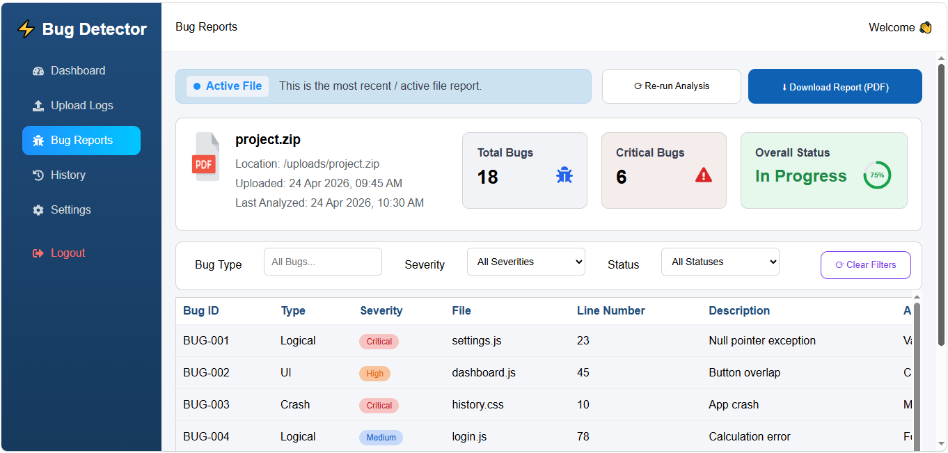
Bug Reports — See Every Bug in Detail
Each bug shows:
Bug ID, Type, Severity level
File name and exact line number
Why the AI flagged this code
Suggested fix
Assigned person: Developer / QA / Analyst
Filter bugs by: Severity | Type | Status
Update status: Open -> In Progress -> Fixed
Download the full report as a PDF.
COLLEGE OF COMPUTING & SOFTWARE ENGINEERING- ZUFESTM

Slide 22
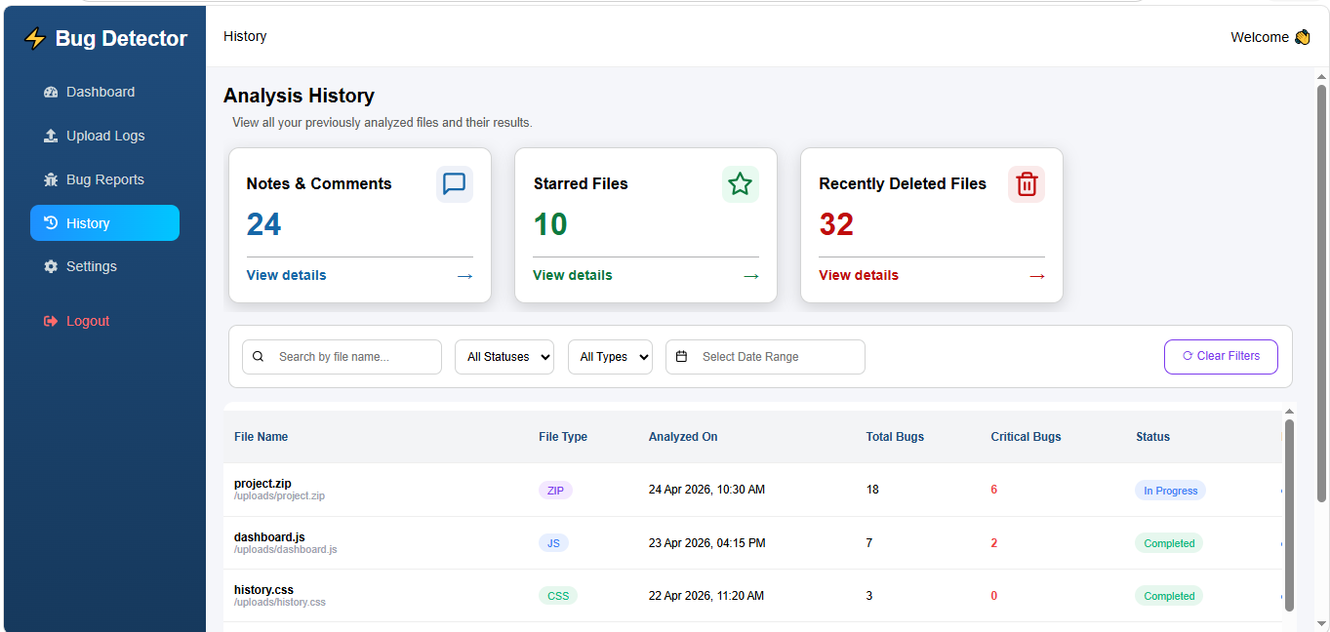
Analysis History — Track All Past Work
See every file analyzed before:
File name, date, bugs found, current status
Star important analyses for quick access.
Delete old records you no longer need.
Search by file name, status, or file type.
COLLEGE OF COMPUTING & SOFTWARE ENGINEERING- ZUFESTM

Slide 23
System Design
COLLEGE OF COMPUTING & SOFTWARE ENGINEERING- ZUFESTM

Slide 24
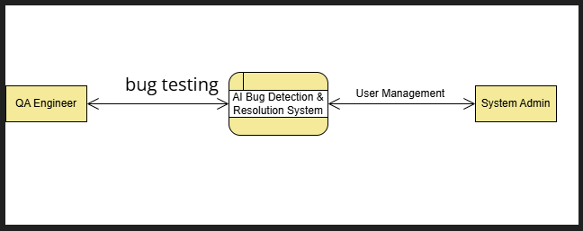
Use Case Diagram — Who Uses the System?
QA Engineer:
Uploads files, views reports, updates bug status
System Admin:
Manages user accounts and access
COLLEGE OF COMPUTING & SOFTWARE ENGINEERING- ZUFESTM

Slide 25
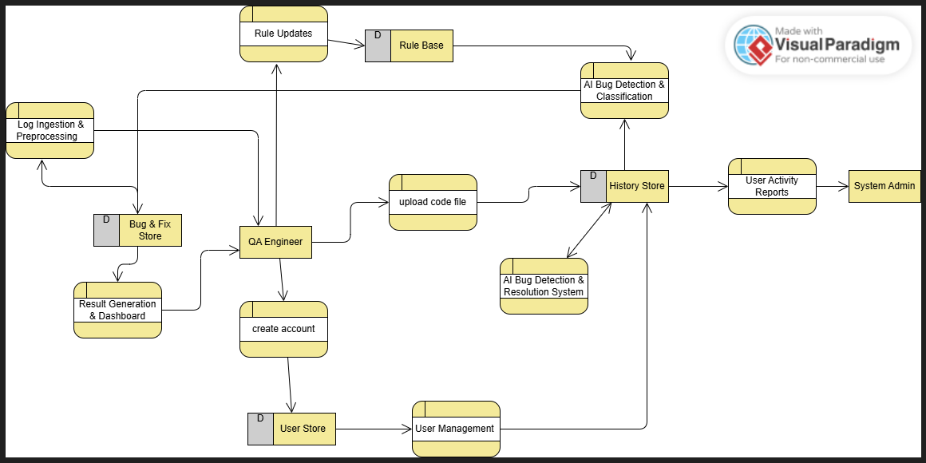
Data Flow Diagram — How Data Moves in the System
How data flows through our system:
1. QA Engineer uploads a code file
2. System reads and preprocesses the file
3. AI model analyzes and detects bugs
4. Results saved to the History Store
5. Dashboard shows results to the user
6. Admin can view activity reports
COLLEGE OF COMPUTING & SOFTWARE ENGINEERING- ZUFESTM

Slide 26
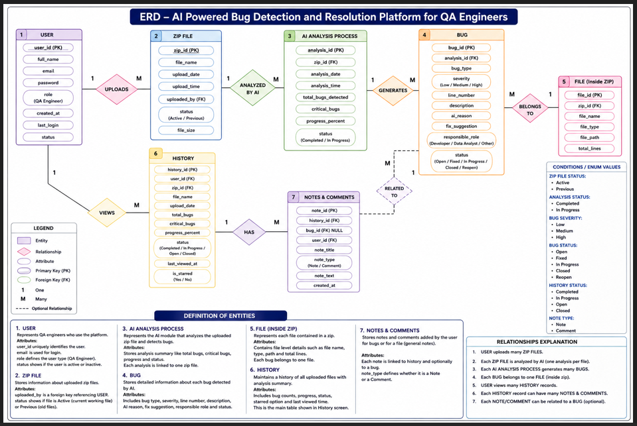
Database Design (ERD) — What We Store
Our database (MongoDB) has 5 main collections:
Users — name, email, password, role
Uploads — every file uploaded by users
Analysis — each analysis run (status, time)
Bugs — every bug found with full details
History — record of past analyses
COLLEGE OF COMPUTING & SOFTWARE ENGINEERING- ZUFESTM

Slide 27
How to Run the Project Locally
COLLEGE OF COMPUTING & SOFTWARE ENGINEERING- ZUFESTM

Slide 28
How to Run the Project — Step by Step
STEP 1: Install Requirements
Install Python 3.9+ and Node.js
Install MongoDB (free, local database)
STEP 2: Install Python Libraries
Open terminal inside the 'backend' folder
Run: pip install -r requirements.txt
STEP 3: Install Frontend Libraries
Open terminal in 'bug-detector' folder
Run: npm install
STEP 4: Start the Backend Server
In 'backend' folder terminal, run:
python app.py
Server starts at: http://localhost:5000
STEP 5: Start the Frontend Website
In 'bug-detector' folder terminal, run:
npm start
Opens at: http://localhost:3000
STEP 6: Use the Platform
Open browser at: http://localhost:3000
Sign up -> Login -> Upload file -> Done!
COLLEGE OF COMPUTING & SOFTWARE ENGINEERING- ZUFESTM

Slide 29
Future Plans
COLLEGE OF COMPUTING & SOFTWARE ENGINEERING- ZUFESTM

Slide 30
What We Plan to Build Next
Cloud Deployment Make the platform available online — no local setup needed
Email Notifications Automatically email developers when new bugs are found
GitHub Integration Connect directly to code repositories for automatic scanning
Mobile App Access bug reports from your phone anytime
More Languages PHP, Ruby, Swift, Kotlin support
Advanced Analytics Charts and trends showing bug patterns over time
COLLEGE OF COMPUTING & SOFTWARE ENGINEERING- ZUFESTM

Slide 31
Thank You
AI-Powered Bug Detection & Resolution Platform
College of Computing & Software Engineering — Ziauddin University
COLLEGE OF COMPUTING & SOFTWARE ENGINEERING- ZUFESTM

