Slide 1

JVM Basics
Load balance tomcat servers with httpd

Slide 2
What is JVM
JVM - Java virtual machine
Software on top of a real hardware
Can run the same application on different machines where the JVM is available

Slide 3
JDK vs JRE
JDK contains everything that will be required to develop and run Java application.
JRE contains everything required to run Java application which has already been compiled. It doesn’t contain the code library required to develop Java application.
JRE = JVM + Required Library to run Application.
JDK = JRE + Required Library to develop Java Application.

Slide 4
JVM concepts: JVM
Java code (.java)
Java compiler (javac)
Java byte code (.class)
JVM
JVM
JVM
Windows
Linux
Mac

Slide 5
Apache Tomcat Installation
Tomcat server is servlet container running on top of JVM (JRE is required)
JRE install: yum install java-1.8.0-openjdk
Installation is simple: yum install tomcat tomcat-webapps tomcat-admin-webapps
Enable: systemctl enable tomcat (enable for auto start)
Startup: systemctl start tomcat (http://localhost:8080)
Webapps folder in /usr/share/tomcat

Slide 6
Apache HTTPD installation
Simple install: yum install httpd
To start:
systemctl enable httpd
systemctl start httpd (http://localhost:80)
Home dir: /etc/httpd
Open firewall port:
firewall-cmd --zone=public --add-port=80/tcp --permanent
firewall-cmd –reload
systemctl stop firewalld (stop firewall)

Slide 7
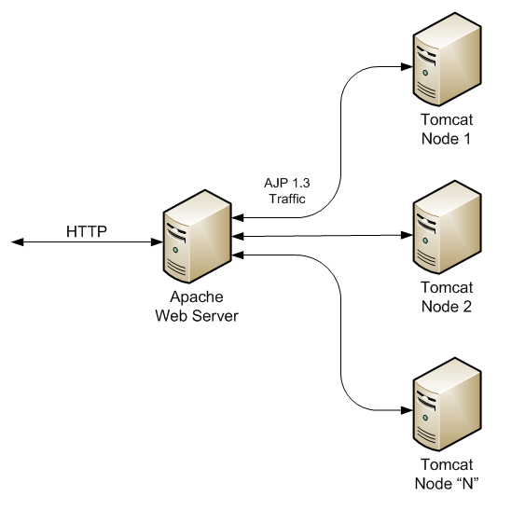
Apache HTTPD + Tomcat
Mostly used way to connect HTTPD with tomcat is mod_jk connector
Copy mod_jk connector
cp /vagrant/mod_jk.so /etc/httpd/modules/
Create /etc/httpd/conf/workers.properties with content
worker.list=lb
worker.lb.type=lb
worker.lb.balance_workers=myworker, other
worker.myworker.host=localhost
worker.myworker.port=8009
worker.myworker.type=ajp13

Slide 8
Apache HTTPD + Tomcat (Continuation)
Edit /etc/httpd/conf/httpd.conf
Add to the end of file
LoadModule jk_module modules/mod_jk.so
JkWorkersFile conf/workers.properties
JkShmFile /tmp/shm
JkLogFile logs/mod_jk.log
JkLogLevel info
JkMount /test* lb
Restart apache

Slide 9
Useful links
Protocols comparison:
http://www.wellho.net/mouth/1549_http-https-and-ajp-comparison-and-choice.html
JVM Basics:
https://www.cubrid.org/blog/understanding-jvm-internals/
JVM tuning:
https://crunchify.com/jvm-tuning-heapsize-stacksize-garbage-collection-fundamental/

Slide 10
Task for Module 3
1) Create Vagrantfile (in task3 branch)
2) Vagrantfile should bring up and provision 3 VMs:
One with Apache httpd
Two with Apache tomcat
Create index.html (in both tomcat VMs) in usr/share/tomcat/webapps/<some_folder>/index.html (content tomcatX)
Configure Apache httpd to load balance requests between 2 tomcat servers
Only Apache httpd port should be forwarded to host
Notes: mode_jk.so will be send with presentation
Email: vitali_zevako@epam.com

