Slide 1

Gradle build tool
Jenkins CI server

Slide 2
Core Gradle features
Build-By-Convention with Flexibility (build.gradle)
Groovy and DSL
Support for Ivy and Maven Dependencies
Multi-Project Builds (settings.gradle)
Easy to add custom logic
Large plugin ecosystem
Task UP-TO-DATE checking
https://docs.gradle.org/current/userguide/userguide.html
Groovy tutorial: https://www.youtube.com/watch?v=B98jc8hdu9g

Slide 3
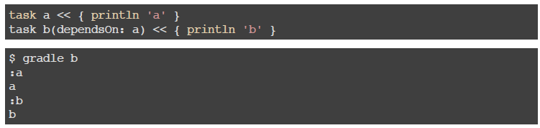
Tasks
dependsOn creates an execution dependency
finalizedBy creates a finalization dependency
shouldRunAfter defines execution order between several tasks

Slide 4
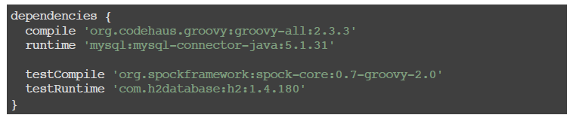
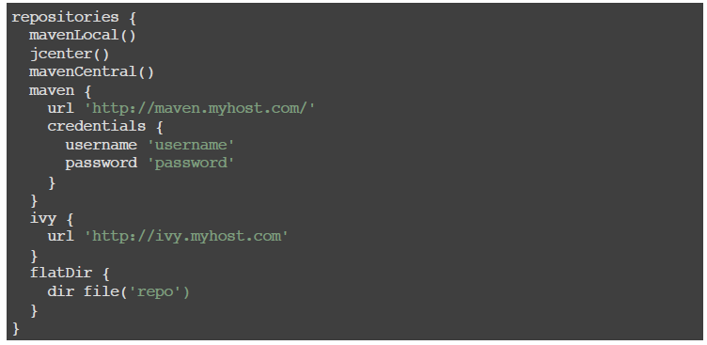
Dependencies & Repositories

Slide 5
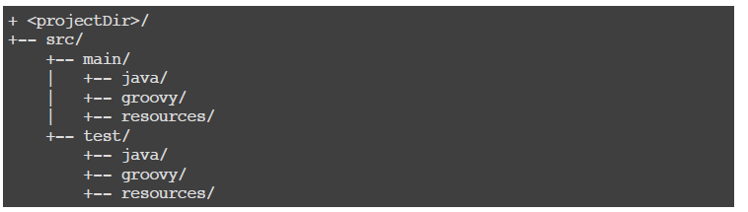
Project Structure
Follows maven convention, but can be configured

Slide 6
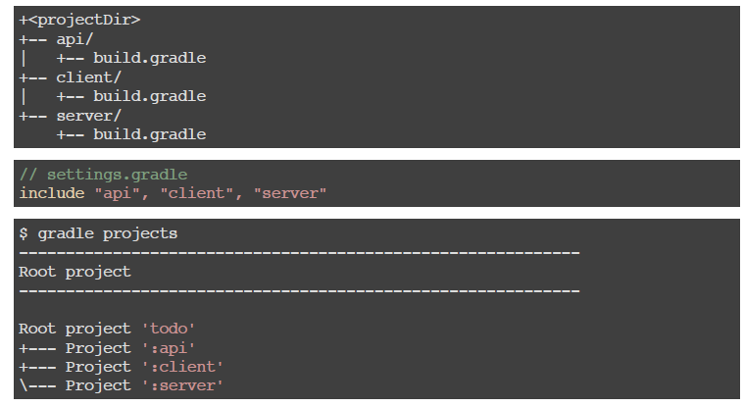

Multi projects

Slide 7
Build script main sections
allprojects { } | Configures this project and each of its sub-projects.
artifacts { } | Configures the published artifacts for this project.
dependencies { } | Configures the dependencies for this project.
repositories { } | Configures the repositories for this project.
sourceSets { } | Configures the source sets of this project.
subprojects { } | Configures the sub-projects of this project.

Slide 8
Jenkins
The leading open source automation server, Jenkins provides hundreds of plugins to support building, deploying and automating any project.
https://jenkins.io
Installation:
Add the Jenkins repository to the yum repos, and install Jenkins from here.
yum install java-1.8.0-openjdk-devel
wget -O /etc/yum.repos.d/jenkins.repo http://pkg.jenkins-ci.org/redhat/jenkins.repo
rpm --import https://jenkins-ci.org/redhat/jenkins-ci.org.key
yum install jenkins

Slide 9
Overview of Jenkins Features
Hosted internally
Free open source
Rich set of plugins with good documentation
Tons of integrations
Easy setup
Pipeline plugin (groovy based jobs)

Slide 10
Task for Module 4
1) Clone repository with sample project https://github.com/vitali-zevako/gradleSample.git and commit it into your task4 branch (do not commit .git, .gradle, build folders)
2) Create gradle build script for sample project (build.gradle)
1. Build produces war file, like app.war (without version in file name)
2. Version should be specified in gradle.properties (like version=1.0.5)
3. Create increment version task (should NOT be executed if we run gradlew build)
4. Increment task updates version in gradle.properties (1.0.5 -> 1.0.6)
5. Create task to update greetings.txt file with version from gradle.properties (in build folder, not in src folder, should be executed when we run gradlew build, in correct order)
email: vitali_zevako@epam.com

