Slide 1

*
Operator Control
ROBIL Workshop 3/20/13
IAI, Lahav

Slide 2
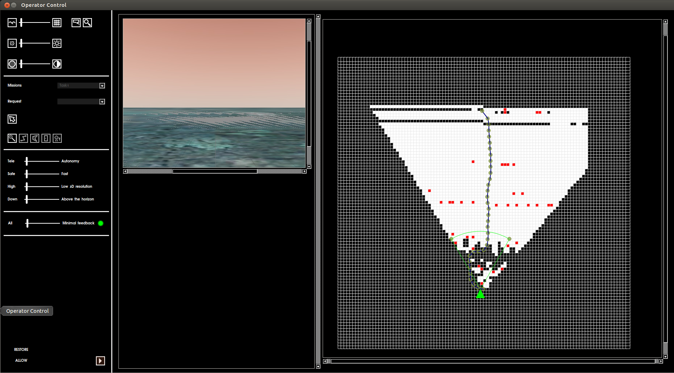
Operator Control HMI

Slide 3
Architecture
Robot
C21
C22
C34
ROS
ROS
ROS
C11 Agent
C11 Operator Control HMI
ROS
ROBIL – Operator Control

Slide 4
Implemented functionality
Task selection
Execution control (run, pause, resume)
Receiving images
Receiving occupancy grid
Receiving path
Path override (not completed)
ROBIL – Operator Control

Slide 5
Planned tasks
Receiving warnings from monitoring (C35)
Receiving recommendations from monitoring (C35)
Receiving detected objects (door, car equipment, …)
Overriding detected objects
Operator requests (panoramic image, ...)
ROBIL – Operator Control

Slide 6
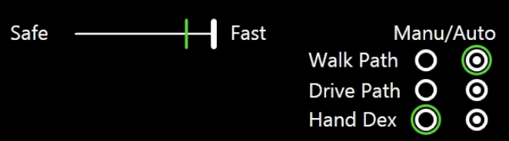
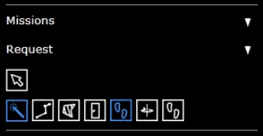
Priority tweaking
ROBIL – Operator Control

Slide 7

Health Monitoring
Level # | Added data TX from ROBIL | Assumed added bandwidth
Minimal | All-OK heartbeat every 5 seconds | ~0.001kbps
2 | Sensor data from main Joints (ankles, knees, hips, torso, shoulders, elbows, wrists, neck, head) and IMU every 0.1 seconds. Also displays the current decision tree and ROBIL's position within it. | ~1kbps
3 | Sensor data from LIDAR in resolution compliant to 3D res. slider (see ) | ~10-200kbps
4 | Sensor data from head cam in 15fps VGA video | ~900kbps
All | Sensor data from all cams in 30 FPS at full resolution | ?
ROBIL – Operator Control

Slide 8
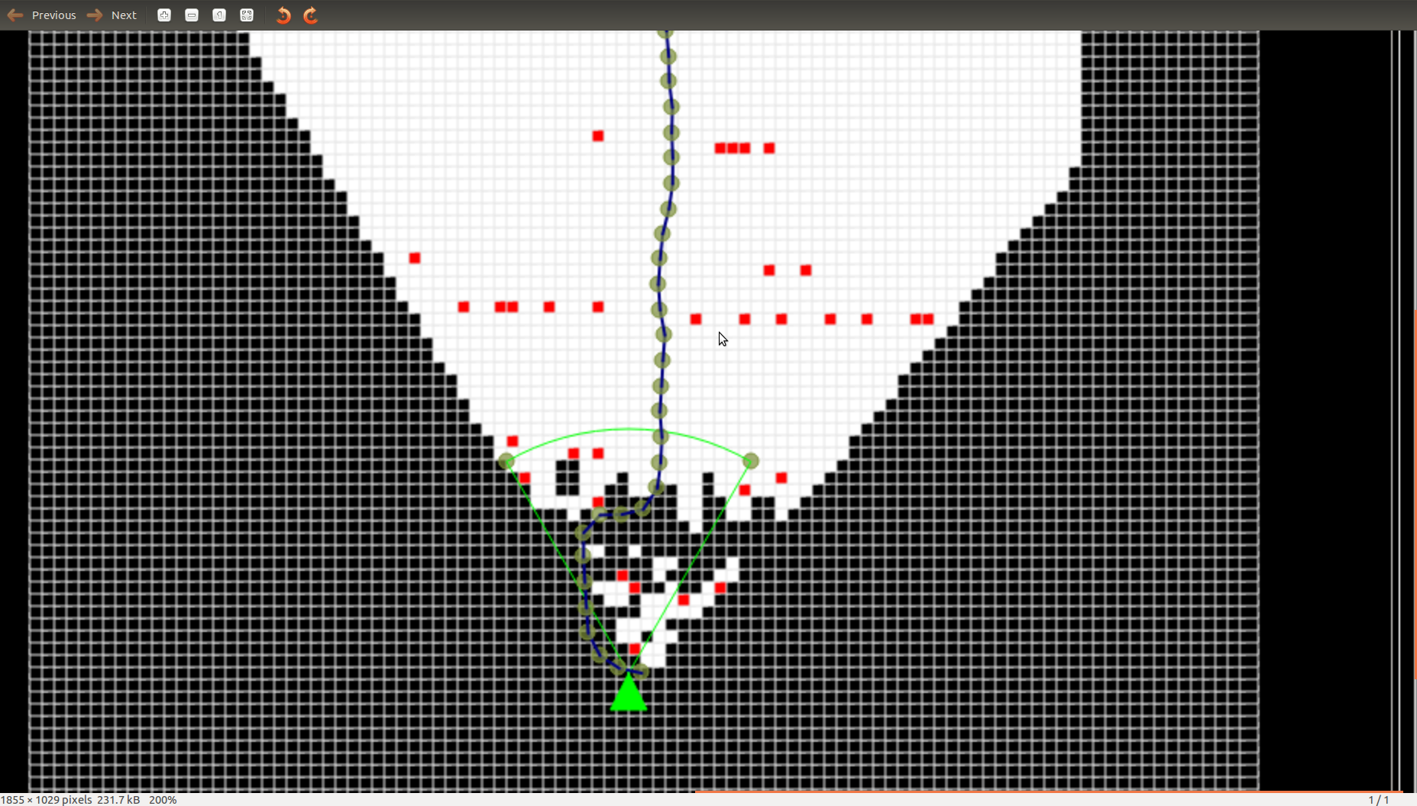
Occupancy grid
ROBIL – Operator Control

