Slide 1
GIT
The fast version control system

Slide 2





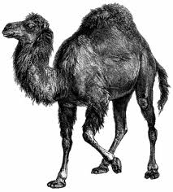


GIT - the fast version control system
Notes:
Replacing SVN as the De-facto standard in the open source world.
Written by Linus for the Linux kernel project.
Very very efficient.
Dvcs

Slide 3
DVCS key concepts
- Classic SCM operations are all local.
- Collaboration via repository sync.
- Peer-to-Peer approach (All repo are equal).
- Make (record) the changes and Share the changes are distinct operations.
- Fast and easy branching and merging.

Slide 4
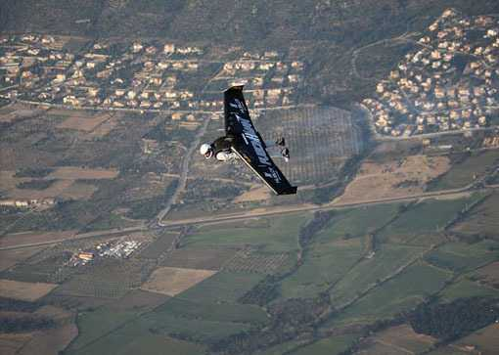

Agenda
Part one – solo
  Git terminology and concepts.
  Basic commands.
  Private branching.
Part two – collaboration
  Sharing your work.
  Central repo.
  Peer to peer.
  Methodologies and best practices.
Notes:
We will follow a use case of a developer being assigned a task that should take place on the main trunk.
First part will be focused on the local operations and the day-to-day usage of git.
At the second part we will complete the picture and see how to push the work into the teams server (for CI, tests integration etc.) We will also examine another use case of bug fix on a maintenance branch at the feature frees phase.

Slide 5

Getting GIT repository - init
Create new empty repository in the current directory using the init command:
$pwd
/home/mio/dev/prj
$git init
Initialized empty Git repository in /home/mio/dev/prj/.git/
Notes:
Can be create on a code tree top folder or an empty one.

Slide 6

Getting GIT repository - clone
Download a clone of an existing git repository using the clone command:
$git clone git@git.tikalk.com:project/project.git
Cloning into project...
remote: Counting objects: 1001, done.
remote: Compressing objects: 100% (307/307), done.
remote: Total 1001 (delta 294), reused 889 (delta 264)
Receiving objects: 100% (1001/1001), 105.16 KiB | 58 KiB/s, done.
Resolving deltas: 100% (294/294), done.
Notes:
Hooks
Master branch checked out.
Bare repo. (posh only. can not be pulled into)

Slide 7
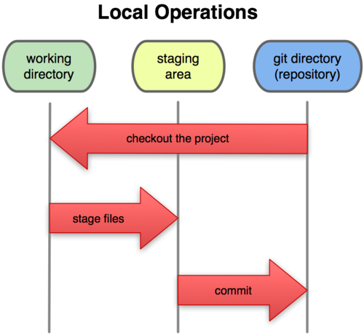
Where we work
Working directory
  Edit files...
Staging area (index)
  git add
The repository
  git commit
$ vim gitflow-common
$ git add gitflow-common
$ git commit
[develop 1dcfa9a] comment
1 files changed, 1 insertions(+), 0 deletions(-)
Notes:
Index was borne as cache for next commit.
Clean the index when merging.
Create commit sets.
Commit -a (delete files w/o git rm)
Git rm –cached, git mv
4th area – the remote. Will talk more of it later.

Slide 8
Work area status
$ git status
# On branch master
# Changes to be committed:
# (use "git reset HEAD <file>..." to unstage)
#
# modified: foo.txt
#
# Changes not staged for commit:
# (use "git add <file>..." to update what will be committed)
# (use "git checkout -- <file>..." to discard changes in working directory)
#
# modified: foo.txt
#
# Untracked files:
# (use "git add <file>..." to include in what will be committed)
#
# foo.txt~
See where you stand:
  git status
Remove from index:
  git reset
  git rm --cached

Slide 9
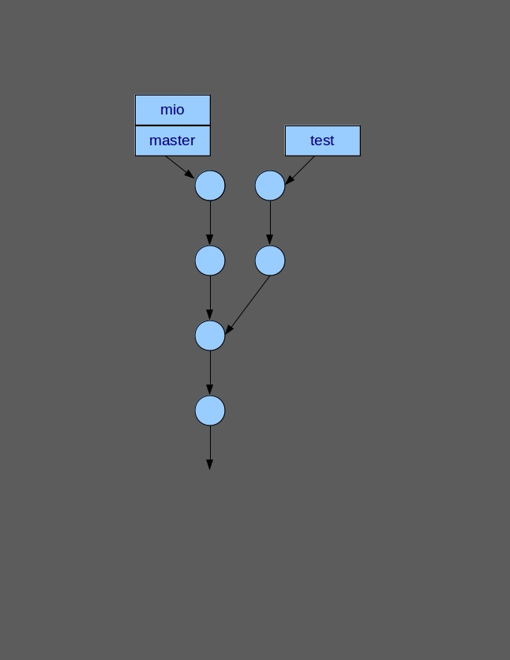
Develop in context - Branching
Branches are refs
Create branch:
  git branch
Switch branch:
  git checkout
$ git branch
* master
test
$ git branch mio
$ git branch
* master
mio
test
$ git checkout mio
Switched to branch 'mio'
$ git branch
master
* mio
test
Notes:
Team branches are created according to branch methodology and need to be tracked (2nd part).
Private branches can be used at will to create private context at your development envioronment.
Merges are done localy and are the same.
Checkout command can take any commit-ish argument.

Slide 10
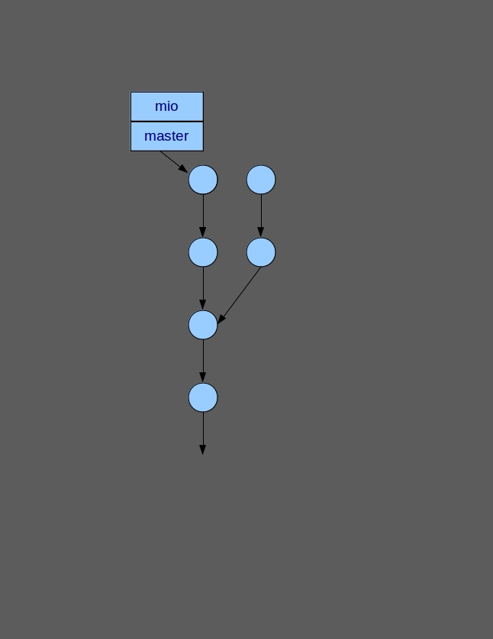
Branching – cont.
Remove branches:
  git branch -d/D
$ git branch -d test
error: The branch 'test' is not fully merged.
If you are sure you want to delete it, run 'git branch -D test'.

Slide 11
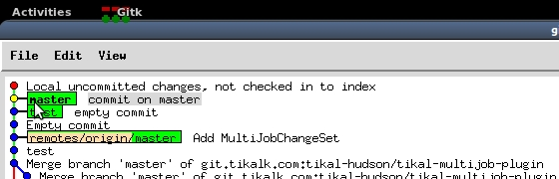
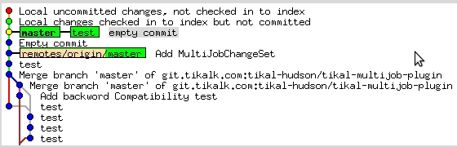
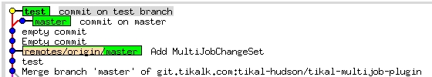
Branching cont.
$ git branch
* master
$ git branch test
$ git branch
* master
test
$ git commit -m "commit on master"
[master 8275b46] commit on master
1 files changed, 1 insertions(+), 0 deletions(-)
$ git checkout test
M src/main/java/com/tikal/jenkins/plugins/multijob/MultiJobProject.java
Switched to branch 'test'
$ vim pom.xml
$ git commit -a -m "commit on test branch”
[test 4bc8893] commit on test branch
2 files changed, 3 insertions(+), 1 deletions(-)
Notes:
Create private branch
Clean the index by commiting to master
Switch to private branch
Write your private code. Commit as meny times as you want.
When done you can merge to master or delete your private branch.

Slide 12
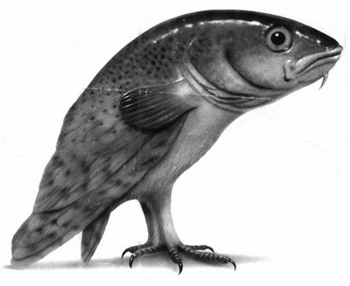
Merge
Merge 2 or more commits
git merge <branch>
git merge <commit>
Git merge <branch1> <branch2> (Octopus)
$ git merge test
Auto-merging pom.xml
Merge made by recursive.
pom.xml | 1 +
1 files changed, 1 insertions(+), 0 deletions(-)
Notes:
If there is no conflict GIT will merge automaticly and will generate comment.
--no-commit
--no-ff
-m
Merge strategies: Recursive, ff, Octopus

Slide 13
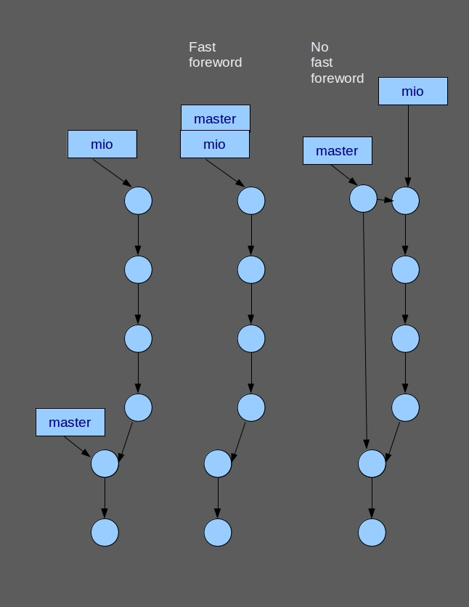
Fast forward merge
When the target (HEAD) is ancestor of the merged commit we can simply move the label.
$ git merge mio
Updating 7303eee..82229e4
Fast-forward
pom.xml | 1 +
1 files changed, 1 insertions(+), 0 deletions(-)

Slide 14
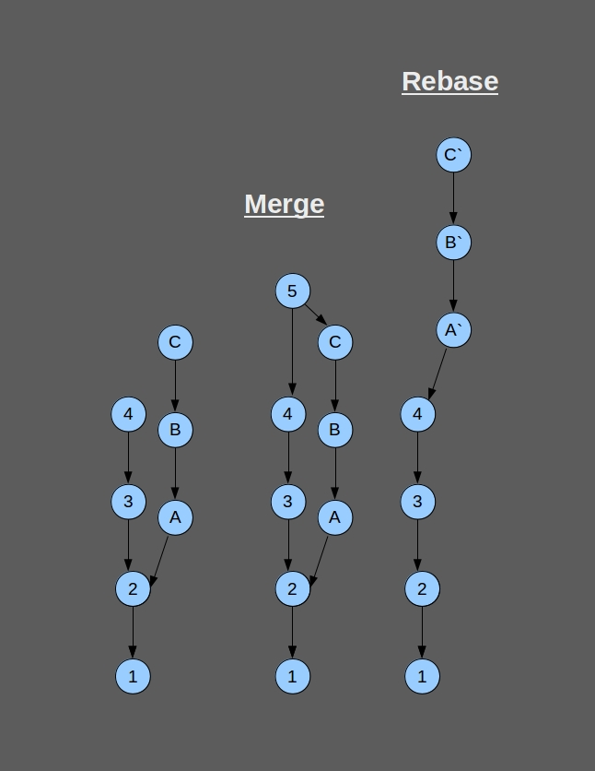
Rebase
git merge
Merge – create new commit with 2 parents.
git rebase
Rebase – rewrite the commits to get linear history.

Slide 15

Merge – conflict resolution
$ git merge test
Auto-merging pom.xml
CONFLICT (content): Merge conflict in pom.xml
Automatic merge failed; fix conflicts and then commit the result.
$ git status
# On branch master
# Your branch is ahead of 'origin/master' by 4 commits.
#
# Unmerged paths:
# (use "git add/rm <file>..." as appropriate to mark resolution)
#
# both modified: pom.xm
…
</properties>
<<<<<<< HEAD
<!-- Master branch -->
=======
<!-- test branch -->
>>>>>>> test
<repositories>
...

Slide 16
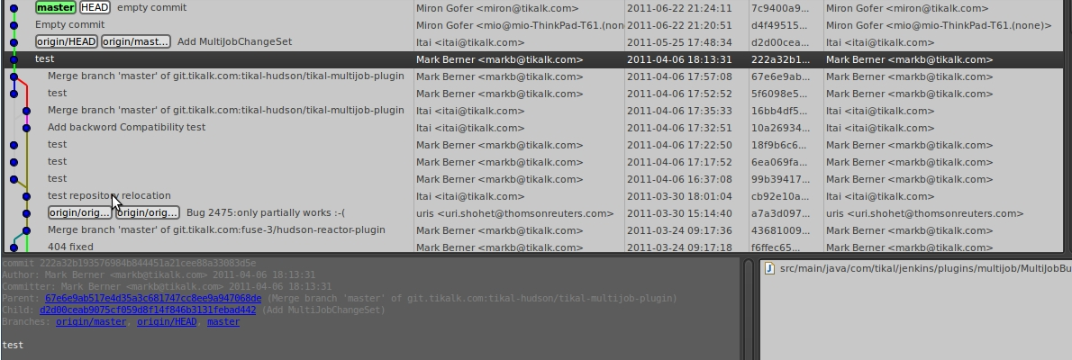
Review the history
git log
git show
git bisect
git blame
gitk
$git help show
...
Shows one or more objects (blobs, trees, tags and commits).
For commits it shows the log message and textual diff.
For tags, it shows the tag message and the referenced objects.
For trees, it shows the names (equivalent to git ls-tree with --name-only).
For plain blobs, it shows the plain contents.
...
Notes:
Diff

Slide 17
Private branching - DIY
Create git repo.
Add content
Edit-Add-Status-commit
Create private branch
Edit-commit
Switch to the branch
Edit-Add-Commit
Switch back to master
Merge
init
add
commit
branch [new-branch]
checkout
merge

Slide 18
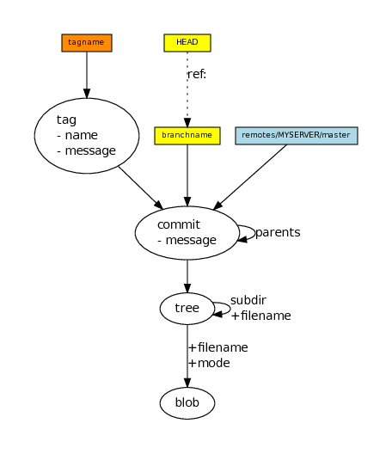
GIT repo internals
DAG
Blob – file content
Tree – represent directory
Commit – a snapshot in time
Tag – hard tag
Ref – soft tag (branch)
Notes:
Directed Acyclic Graph
Every repo has at least one orphan commit.
Commit can have 0 or more parent.
No one points at the HEADs (tip's)
Trees can nest (as deep as needed)
Refs are not objects.
GarCol
Pack

Slide 19
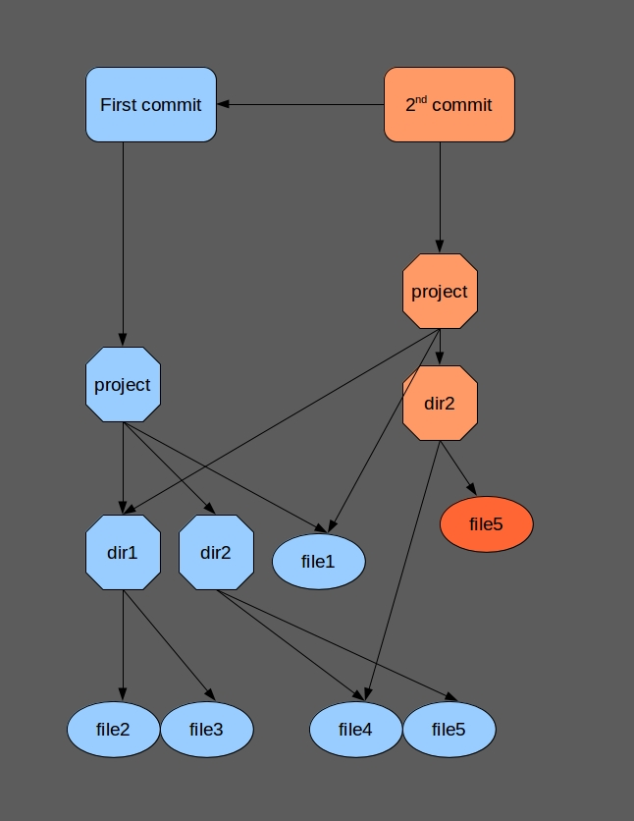
GIT repo internals
Commit example
Changing file5
$git log -p
commit 59c3fb46b7538c415b8d5fc29f625e2111bece4d
Author: Miron Gofer <miron@tikalk.com>
Date: Tue Jul 12 08:47:59 2011 +0300
2nd commit
diff --git a/dir2/file5 b/dir2/file5
index 4806cb9..f6b0f24 100644
--- a/dir2/file5
+++ b/dir2/file5
@@ -1 +1,2 @@
file5
+change file5
commit 7cd43ed023db9804389e3aafc6c4b08ea64cef02
Author: Miron Gofer <miron@tikalk.com>
Date: Tue Jul 12 08:46:29 2011 +0300
first commit
...

Slide 20
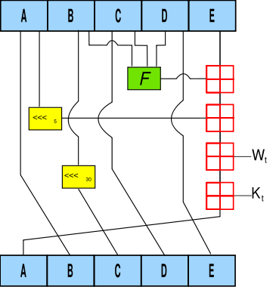
GIT repo internals
Sha1 - Content based Globally unique object id.
$ git cat-file commit b858dd96e36718b7ce
tree 98b1a2ee70edd79102ae5d79671abb67fe79f089
parent 2b17a599462df07735c42d510316fa273edd7d
author Itai <itai@tika...> 1300600429 +0200
committer Itai <itai@ti...> 1300600429 +0200
$ git cat-file -p 98b1a2ee70edd79102
100644 blob 8322a83f575bfdd33a24cf35a8963d151b31c1db .classpath
100644 blob c35a4ed2e2f53c427b035d9efde2c02f9ab64ecb .gitignore
100644 blob a86af1fb3dddcdd984f7643d9b28fa159749ce4b .project
040000 tree 66a0ce093621f284518959a08e034a04c890c117 .settings
100644 blob 488a99b954ec307c156f9d8ef95b5aff40263563 pom.xml
040000 tree f816c0be9e6ed2ca365992249539b1241c6a5837 src

Slide 21

Remote tracking branches
- Managing ”remotes”
- Remote branches
$ git remote
origin
$ git branch -avv
* master 85d4685 [origin/master: ahead 7] commit on branch master
mio ddc86b3 Merge branch 'test'
test 4bc8893 commit on test branch
remotes/origin/HEAD -> origin/master
remotes/origin/alexn 117cf1d build issues
remotes/origin/master d2d00ce Add MultiJobChangeSet
remotes/origin/origin/HEAD a7a3d09 Bug 2475:only partially works :-(
remotes/origin/origin/master a7a3d09 Bug 2475:only partially works :-(
Notes:
By default we clone remote tracking branches from the orig clone.
Remote tracking branches are read only.
Track and Upstream.

Slide 22
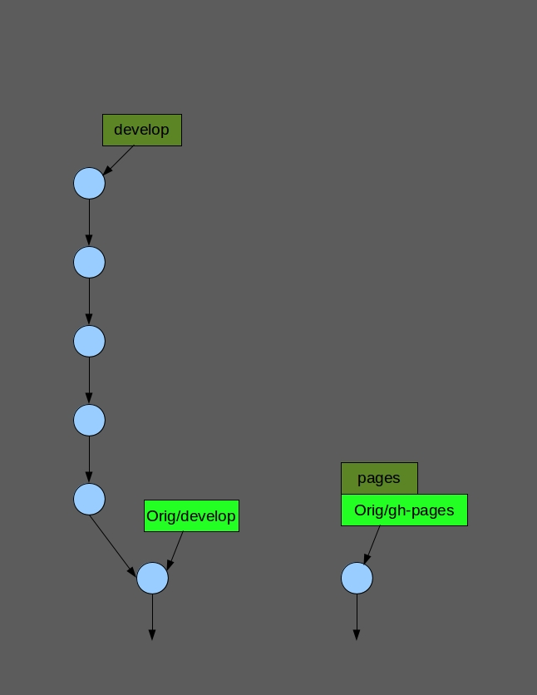
Remote tracking
- Local branch tracking remote branch (upstream)
$ git branch -a
* develop
remotes/origin/HEAD -> origin/develop
remotes/origin/develop
remotes/origin/feature/python-rewrite
remotes/origin/gh-pages
remotes/origin/master
$ git branch pages origin/gh-pages
Branch pages set up to track remote branch gh-pages from origin.
$ git branch -avv
* develop 3b2e644 [origin/develop] commit
pages 9975a12 [origin/gh-pages] Added GA-enabled weblink.
remotes/origin/HEAD -> origin/develop
remotes/origin/develop 3b2e644 commit
remotes/origin/feature/python-rewrite b88d4ed Move up a year.
remotes/origin/gh-pages 9975a12 Added GA-enabled weblink.
remotes/origin/master 1ffb6b1 Merge branch 'release/0.4.1'

Slide 23
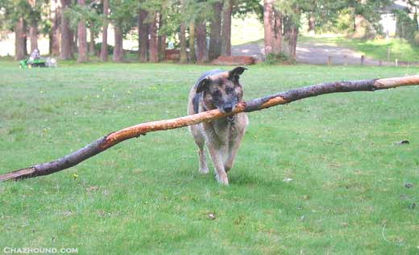
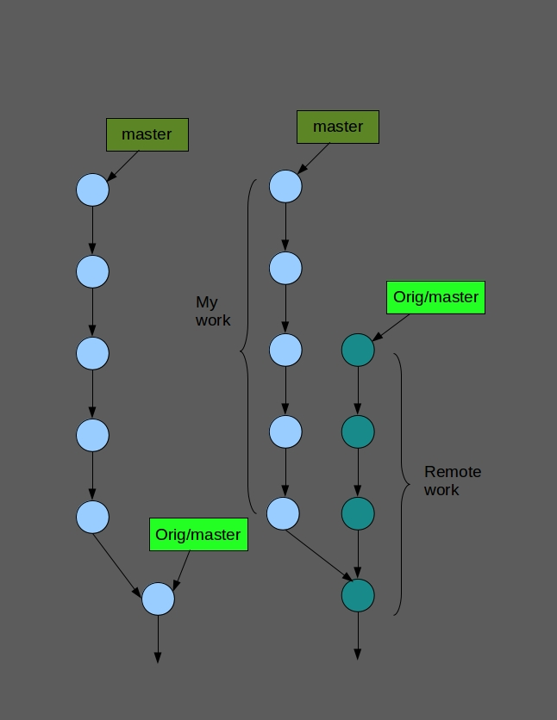
GIT fetch
-Update remote tracking branches with git fetch
-Merge your work with git merge
$ git fetch
remote: Counting objects: 5, done.
remote: Compressing objects: 100% (3/3), done.
remote: Total 3 (delta 2), reused 0 (delta 0)
Unpacking objects: 100% (3/3), done.
From file:///home/mio/dev/gitflow/gitflow2/gitflow
3b2e644..d0364a7 master -> origin/master
Notes:
All, remote, branch
Pull will merge to current branch only.

Slide 24

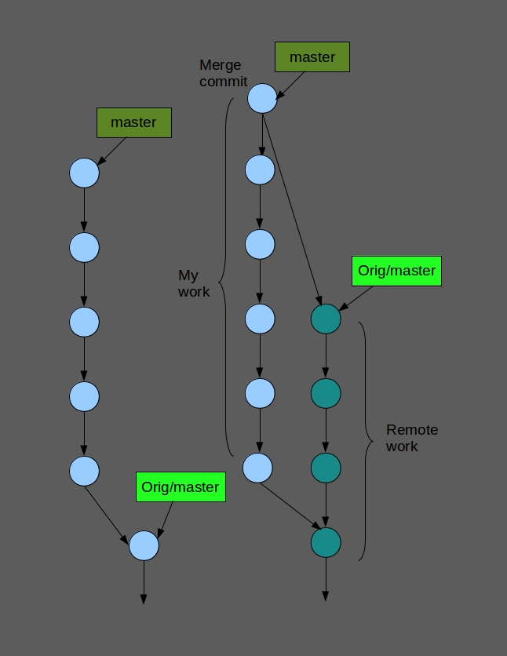
GIT pull
Fetch and merge in one command with git pull
$ git pull
Updating 3b2e644..d0364a7
Fast-forward
gitflow-common | 4 ++--
1 files changed, 2 insertions(+), 2 deletions(-)

Slide 25
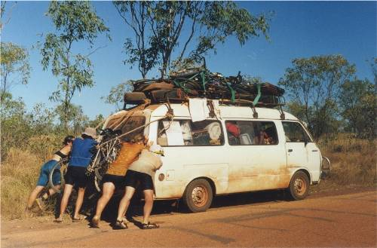
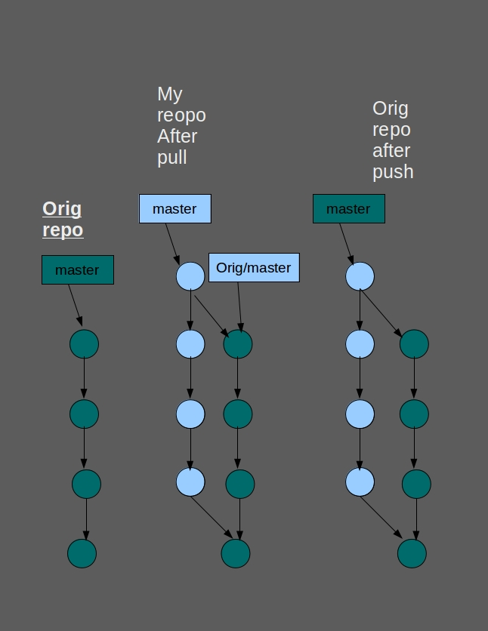
Share your work
-Send your work to the remote repo using: git push
-Push merge must be ff
$ git push
Counting objects: 5, done.
Delta compression using up to 2 threads.
Compressing objects: 100% (3/3), done.
Writing objects: 100% (3/3), 322 bytes, done.
Total 3 (delta 2), reused 0 (delta 0)
Unpacking objects: 100% (3/3), done.
To /home/mio/dev/gitflow/gitflow2/gitflow.git/
3b2e644..d0364a7 develop -> develop

Slide 26
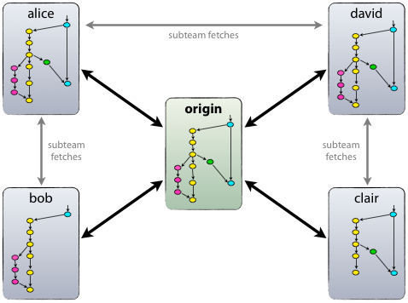
Collaboration
- Sync and deliver to/from the central master repo.
- Peer to peer sync
Notes:
We will go over a scenario of team that has a task to be develop on a team branch.
A simple topology of 1 central server with bare git repo. That is the orig of everyone.
Same toolbox will do the trick on more complicate topologies.
Bare repo.

Slide 27
Colaboration DIY
Clone a repository
Make some changes and commit. (you can work on master or private branch)
Pull (or fetch – merge) to sync with central repo.
Push
clone
branch
checkout
add
commit
fetch
merge
pull
push

Slide 28
Thank you!
miron@tikalk.com

