Slide 1
a tutorial on
Markov Chain Monte Carlo (MCMC)
Dima Damen
Maths Club
December 2nd 2008

Slide 2
Plan
Monte Carlo Integration
Markov Chains
Markov Chain Monte Carlo (MCMC)
Metropolis-Hastings Algorithm
Gibbs Sampling
Reversible Jump MCMC (RJMCMC)
Applications
  MAP estimation – Simulated MCMC

Slide 3
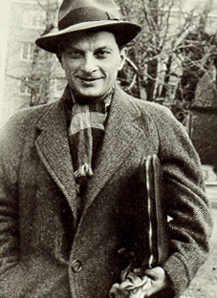
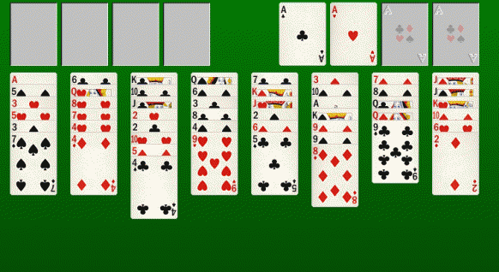
Monte Carlo Integration
Stan Ulam (1946) [1]

Slide 4

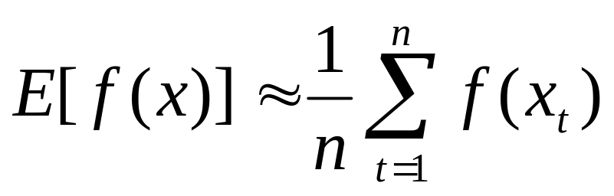
Monte Carlo Integration
Any distribution π can be approximated by a set of samples of size n where the distribution of the samples π ⋆
Monte Carlo simulation assumes independent and identically-distributed (i.i.d.) samples.

Slide 5
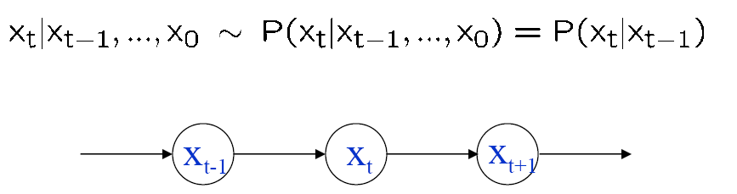
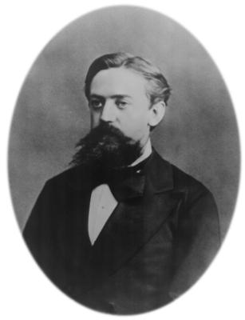
Markov Chains
Andrey Markov (1885)

Slide 6
Markov Chains
To define a Markov chain you need
  Set of states (D) / domain (C)
  Transition matrix (D) / transition probability (C)
  Length of the Markov chain – n
  Starting state (s₀)

Slide 7
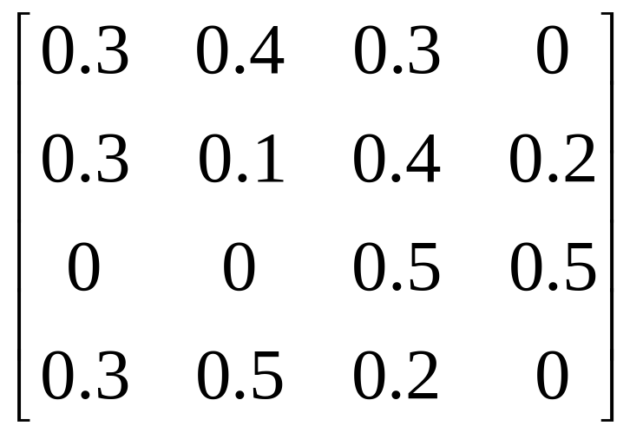
Markov Chains
0.4
A
0.3
B
0.3
0.1
0.3
0.3
0.2
0.2
0.4
C
D
0.5
0.5
0.5
C
C
D
B
B
A
C
D
A

Slide 8
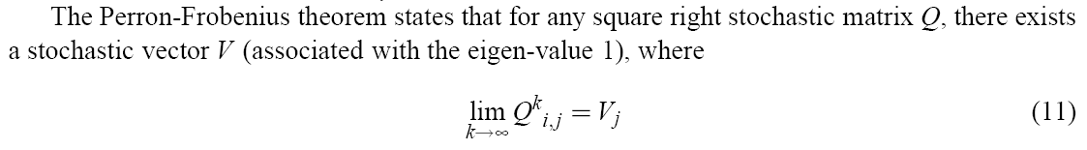
Markov Chain - proof
A right stochastic matrix A is a matrix where A(i, j) ≥ 0 and the sum of each row = 1
Exists but not guaranteed to be unique.
if the Markov chain is irreducible and aperiodic, the stationary distribution is unique
Matlab

Slide 9
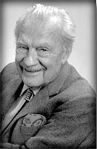
Markov Chain Monte Carlo (MCMC)
Used for realistic statistical modelling
1953 – Metropolis
1970 – Hastings et. al.

Slide 10
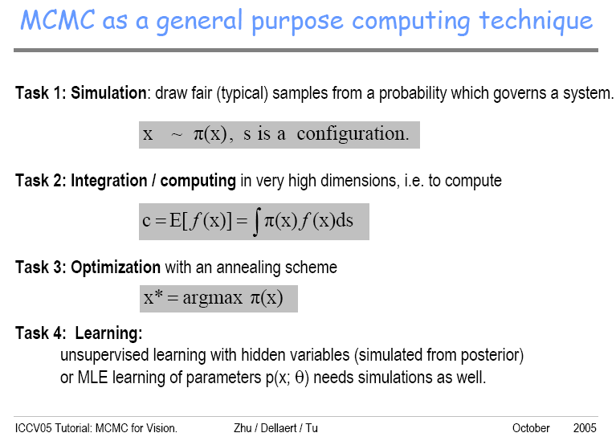
Markov Chain Monte Carlo (MCMC)
[2]

Slide 11
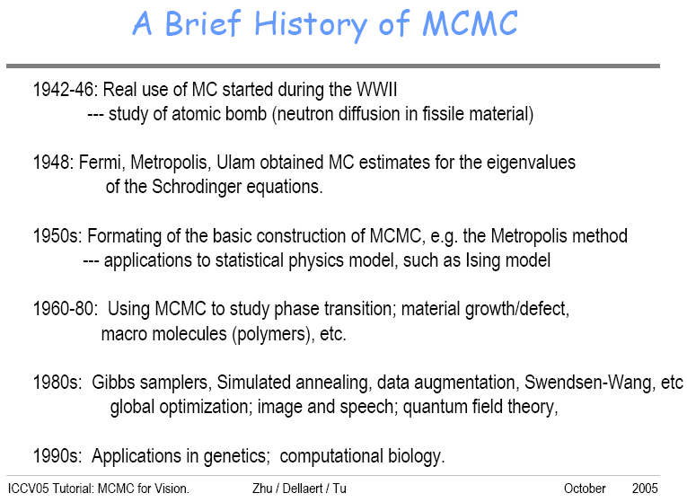
Markov Chain Monte Carlo (MCMC)
[2]

Slide 12

Markov Chain - proof
Detailed balance
then the invariant distribution is guaranteed to be unique and equals π.
proof
[3]

Slide 13
Markov Chain - proof
0.45
0.6
0.55
A
B
0.7
0.4
0.3
A
B
Q(B|A) π(A)=Q(A|B)π(B)
? (0.6) = ?? (0.4)
Q(A|B) = 3/2 Q(B|A)

Slide 14


Markov Chain Monte Carlo (MCMC)
For a selected proposal distribution Q(y|x), where , most likely Q will not satisfy the detailed balance for all (x, y) pairs. We might find that for some x and y choices
The process would then move from x to y too often and from y to x too rarely

Slide 15

Markov Chain Monte Carlo (MCMC)
A convenient way to correct this condition is to reduce the number of moves from x to y by introducing an acceptance probability
[4]

Slide 16
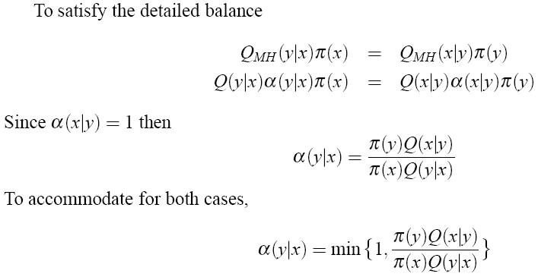
Markov Chain Monte Carlo (MCMC)

Slide 17

Metropolis-Hastings algorithm
Accepting the moves with a probability guarantees convergence.
But the performance can not be known in advance.
It might take too long to converge depending on the choice of the transition matrix Q
A transition matrix where the majority of the moves are rejected converges slower.
The acceptance rate along the chain is usually used to assess the performance

Slide 18
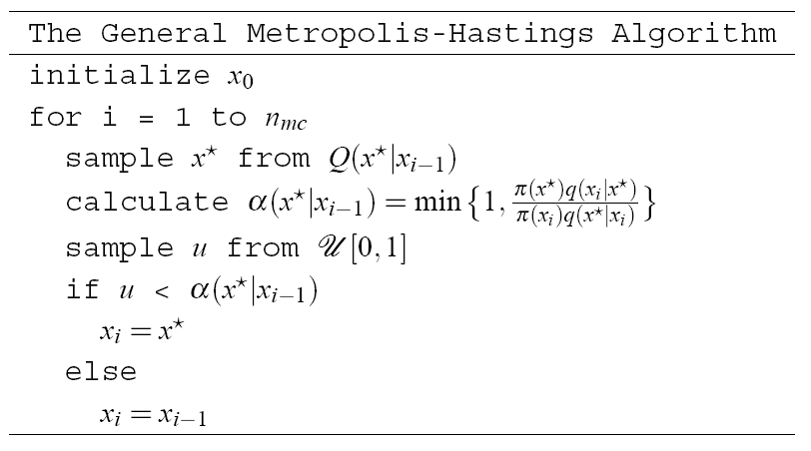
The general MH algorithm

Slide 19
Introduction to MCMC
MCMC – Markov Chain Monte Carlo
When?
  You can’t sample from the distribution itself
  Can evaluate it at any point
  Ex: Metropolis Algorithm
5
2
1
3
4
1
1
2
3
4
4
5
…

Slide 20
Metropolis-Hastings algorithm
When implementing MCMC, the most immediate issue is the choice of the proposal distribution Q.
Any proposal distribution will ultimately deliver (detailed balance), but the rate of convergence will depend crucially on the relationship between Q and π

Slide 21
Metropolis-Hastings algorithm
Example
f(x) = 0.4 normpdf(x,2,0.5) + 0.6 betapdf (x,4,2)
???
proposal distribution
uniform distribution |y-x| <= 1

Slide 22
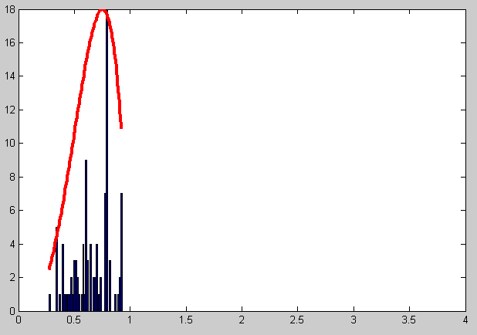
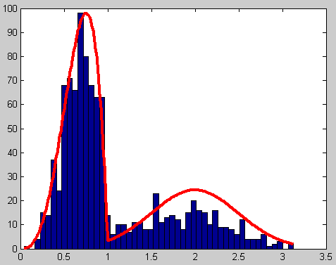
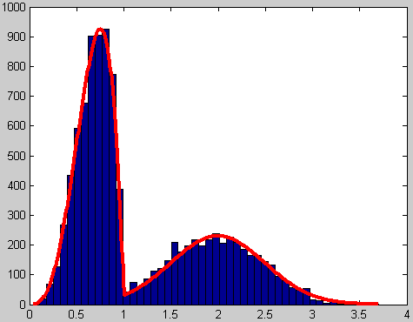
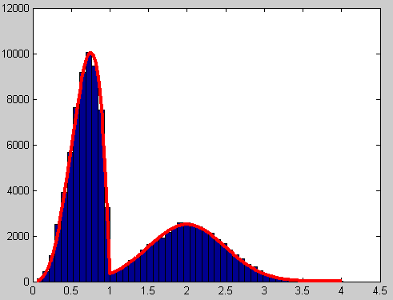
Metropolis-Hastings algorithm
n_{mc} = 100 | n_{mc} = 1,000
n_{mc} = 10,000 | n_{mc} = 100,000

Slide 23
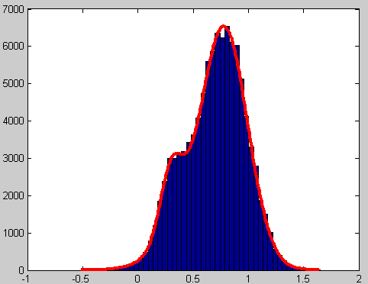
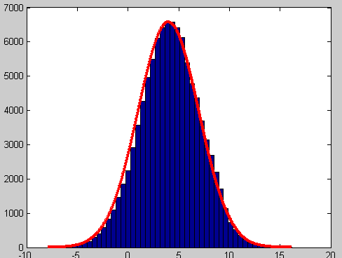
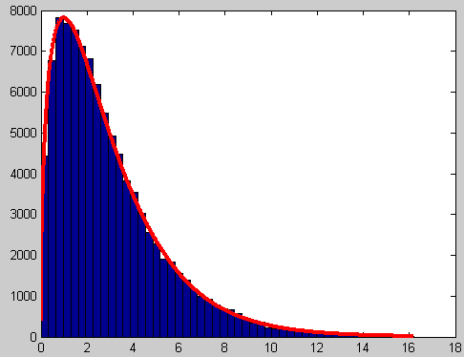
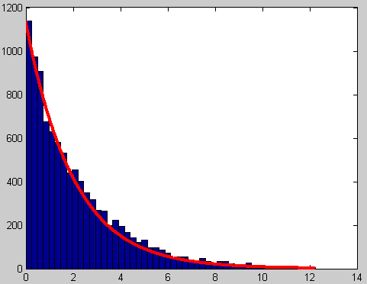
Matlab Code
Examples…

Slide 24
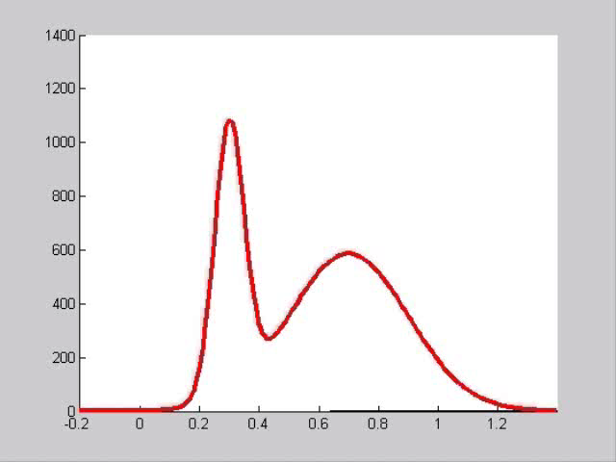
Matlab Code

Slide 25
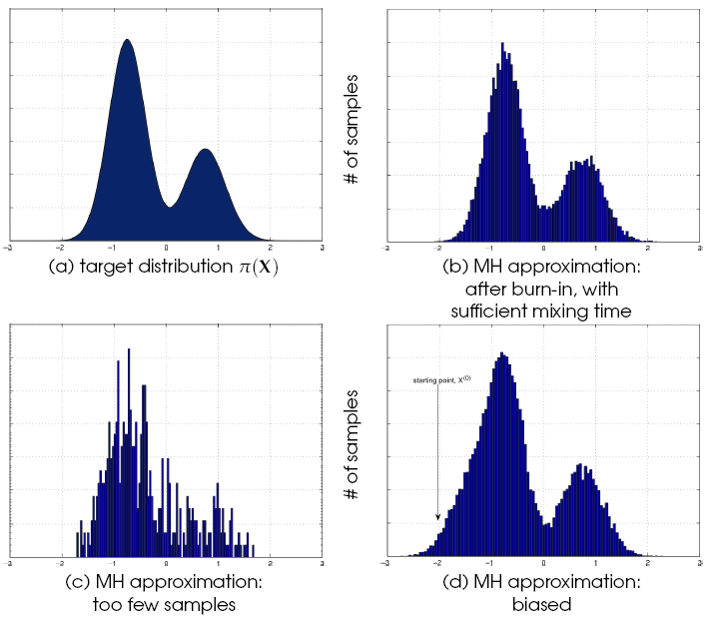
Metropolis-Hastings Algorithm
Burn-in time
Mixing time
Figure from [5]

Slide 26
Running multiple chains
Assists convergence
  Check convergence by different starting points run until they are indistinguishable.
Two schools – single long chain, multiple shorter chains

Slide 27
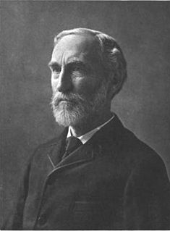

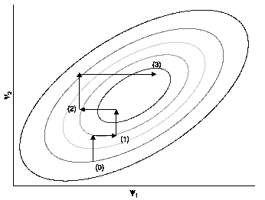
Gibbs Sampling
Special case of MH algo
α = 1 always (we accept all moves
Divide the space into a set of dimensions
X = (X₁, X₂, X₃, … , X_{d})
Each scan i,
X_{i} = π (X_{i} | X_{≠i})
Figure from [1]

Slide 28
Trans-dimensional MCMC
Choosing model size and parameters
  Ex. # of Gaussians (k) and Gaussian parameters (θ)
Within model vs. across model
Trans-dimensional MCMC
Ex. RJMCMC (Green)

Slide 29
Reversible Jump MCMC (RJMCMC)
Green (1995) [6]
joint distribution of model dimension and model parameters needs to be optimized to find the best pair of dimension and parameters that suits the observations.
Design moves for jumping between dimensions
Difficulty: designing moves

Slide 30
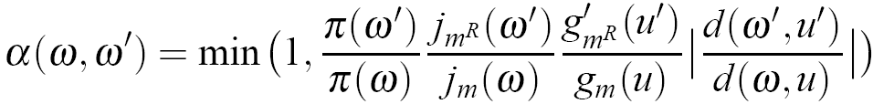
Reversible Jump MCMC (RJMCMC)

Slide 31
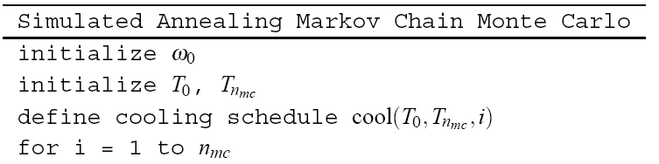
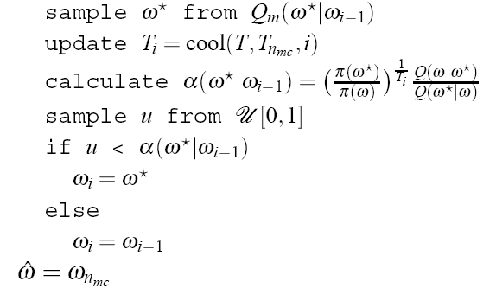
Application – MAP estimation
Maximum a Posteriori (MAP)
Adding simulated annealing

Slide 32
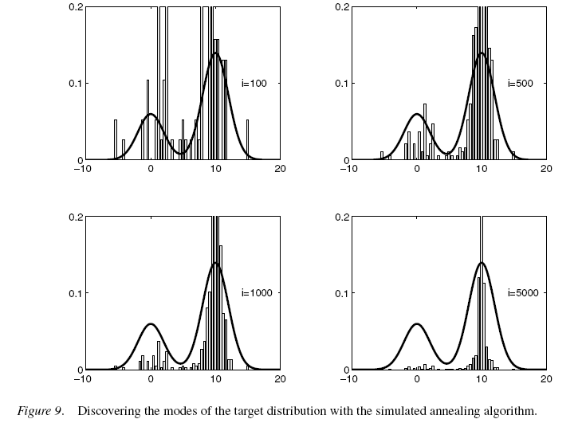
Application – MAP estimation
Figure from [1]

Slide 33
Thank you ☺

Slide 34
References
[1] Andrieu, C., N. de Freitas, et al. (2003). An introduction to MCMC for machine learning. Machine Learning 50: 5-43
[2] Zhu, Dalleart and Tu (2005). Tutorial: Markov Chain Monte Carlo for Computer Vision. Int. Conf on Computer Vision (ICCV) http://civs.stat.ucla.edu/MCMC/MCMC_tutorial.htm
[3] Chib, S. and E. Greenberg (1995). "Understanding the Metropolis-Hastings Algorithm." The American Statistician 49(4): 327-335.
[4] Hastings, W. K. (1970). "Monte Carlo sampling methods using Markov chains and their applications." Biometrika 57(1): 97-109.
[5] Smith, K. (2007). Bayesian Methods for Visual Multi-object Tracking with Applications to Human Activity Recognition. Lausanne, Switzerland, Ecole Polytechnique Federale de Lausanne (EPFL). PhD: 272
[6] Green, P. (2003). Trans-dimensional Markov chain Monte Carlo. Highly structured stochastic systems. P. Green, N. Lid Hjort and S. Richardson. Oxford, Oxford University Press.

