Slide 1
Movie Recommender System from IMDb Dataset
Dimas M. Adnan
JCDS0804

Slide 2

Presentation Outline
Overview
Model
Conclusion
Dashboard

Slide 3
Overview

Slide 4
Overview
In a very general way, recommender systems are algorithms aimed at suggesting relevant items to users (items being movies to watch, text to read, products to buy or anything else depending on industries) (Rocca, 2019).
Recommender Systems (RS) have emerged as a popular paradigm and often as an alternative to search, for enabling customers to quickly discover needed items (Lu, et al, 2014).
Personalized Product Recommendations Drive Just 7% of Visits but 26% of Revenue (Salesforce.com, 2017).
35% of Amazon.com’s revenue is generated by its recommendation engine (McKinsey, 2013).

Slide 5
Overview
IMDb is the world's most popular and authoritative source for movie, TV and celebrity content, designed to help fans explore the world of movies and shows and decide what to watch.
The dataset is taken from https://www.kaggle.com/danielgrijalvas/movies
There are 6820 movies in the dataset (220 movies per year, 1986-2016).

Slide 6
Feature Description
Name | Description
budget | the budget of the movie
company | movie production company
country | movie country of origin
director | director of the movie
genre | main genre of the movie
gross | revenue of the movie
name | name of the movie
rating | rating of the movie (R, PG, etc.)
released | release date (YYYY-MM-DD)
runtime | duration of the movie
score | IMDb user rating
star | main actor/actress
votes | number of user votes
writer | writer of the movie
year | year of release

Slide 7
Goal(s)
“Build a simple movie recommender system”

Slide 8
modelling

Slide 9
Modelling Process
Data Preprocessing and Cleaning
Exploratory Data Analysis
Modelling

Slide 10
Selecting A Great Movie To Watch
Select by themes
Choose by genre
Select by favourite actors
Select by audience
Select by the director
Select by the producer
Year of released
Use popularity rankings (score)
http://www.gacds.org/entertainment/tips-to-selecting-a-great-movie-to-watch/
taken from https://medium.com/fnplus/content-based-recommendations-ffb221931485

Slide 11
Model Used
Natural Language Processing
Bag of Words
‘company’, ’director’, 'genre’, 'star’, 'rating’, and 'year’
Content-based Filtering
CountVectorizer
Cosine Similarity

Slide 12
Dashboard

Slide 13
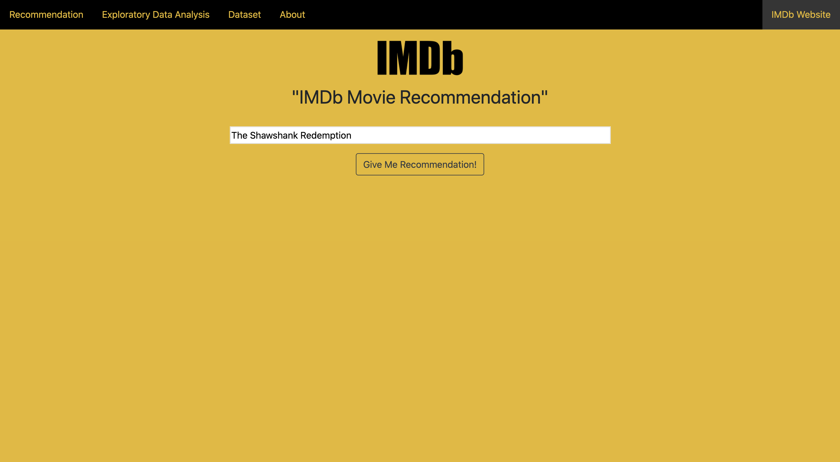
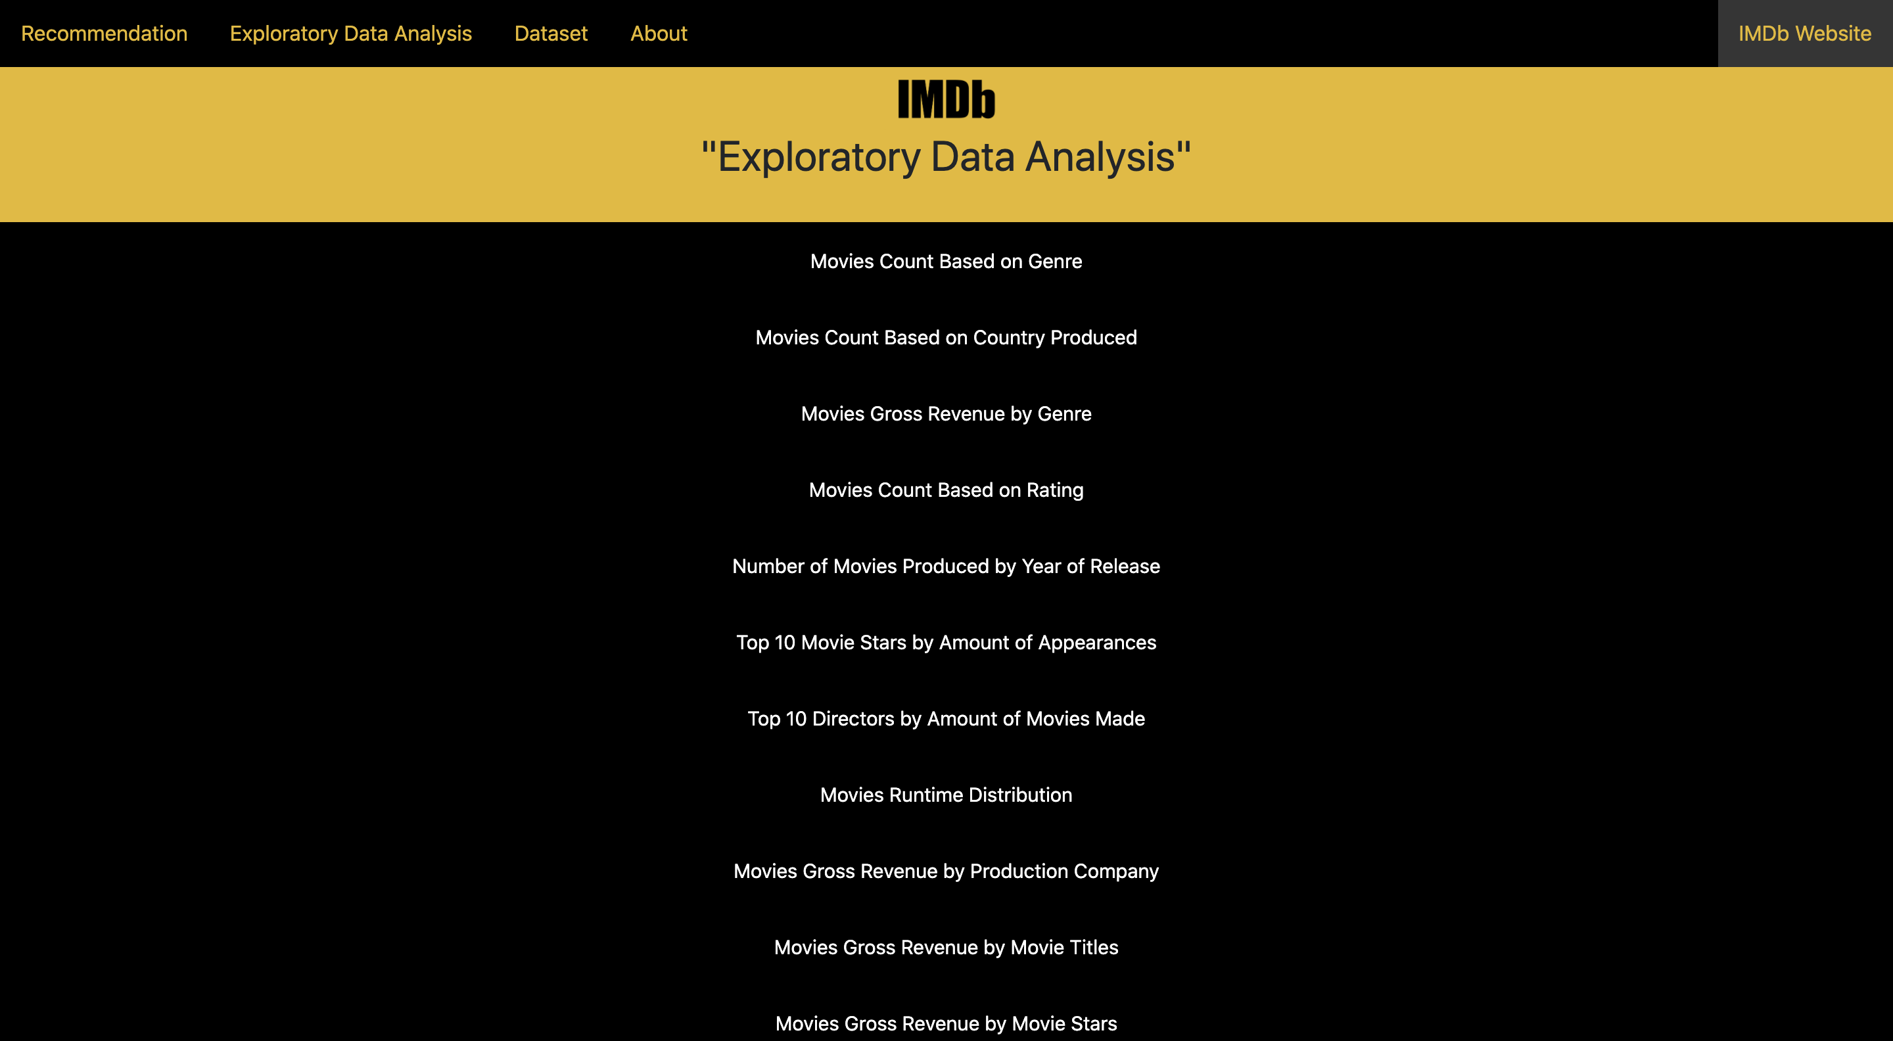
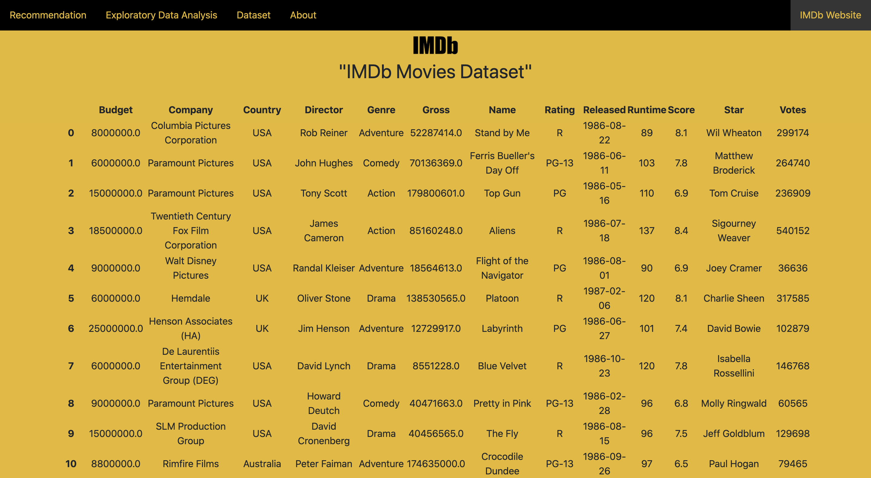
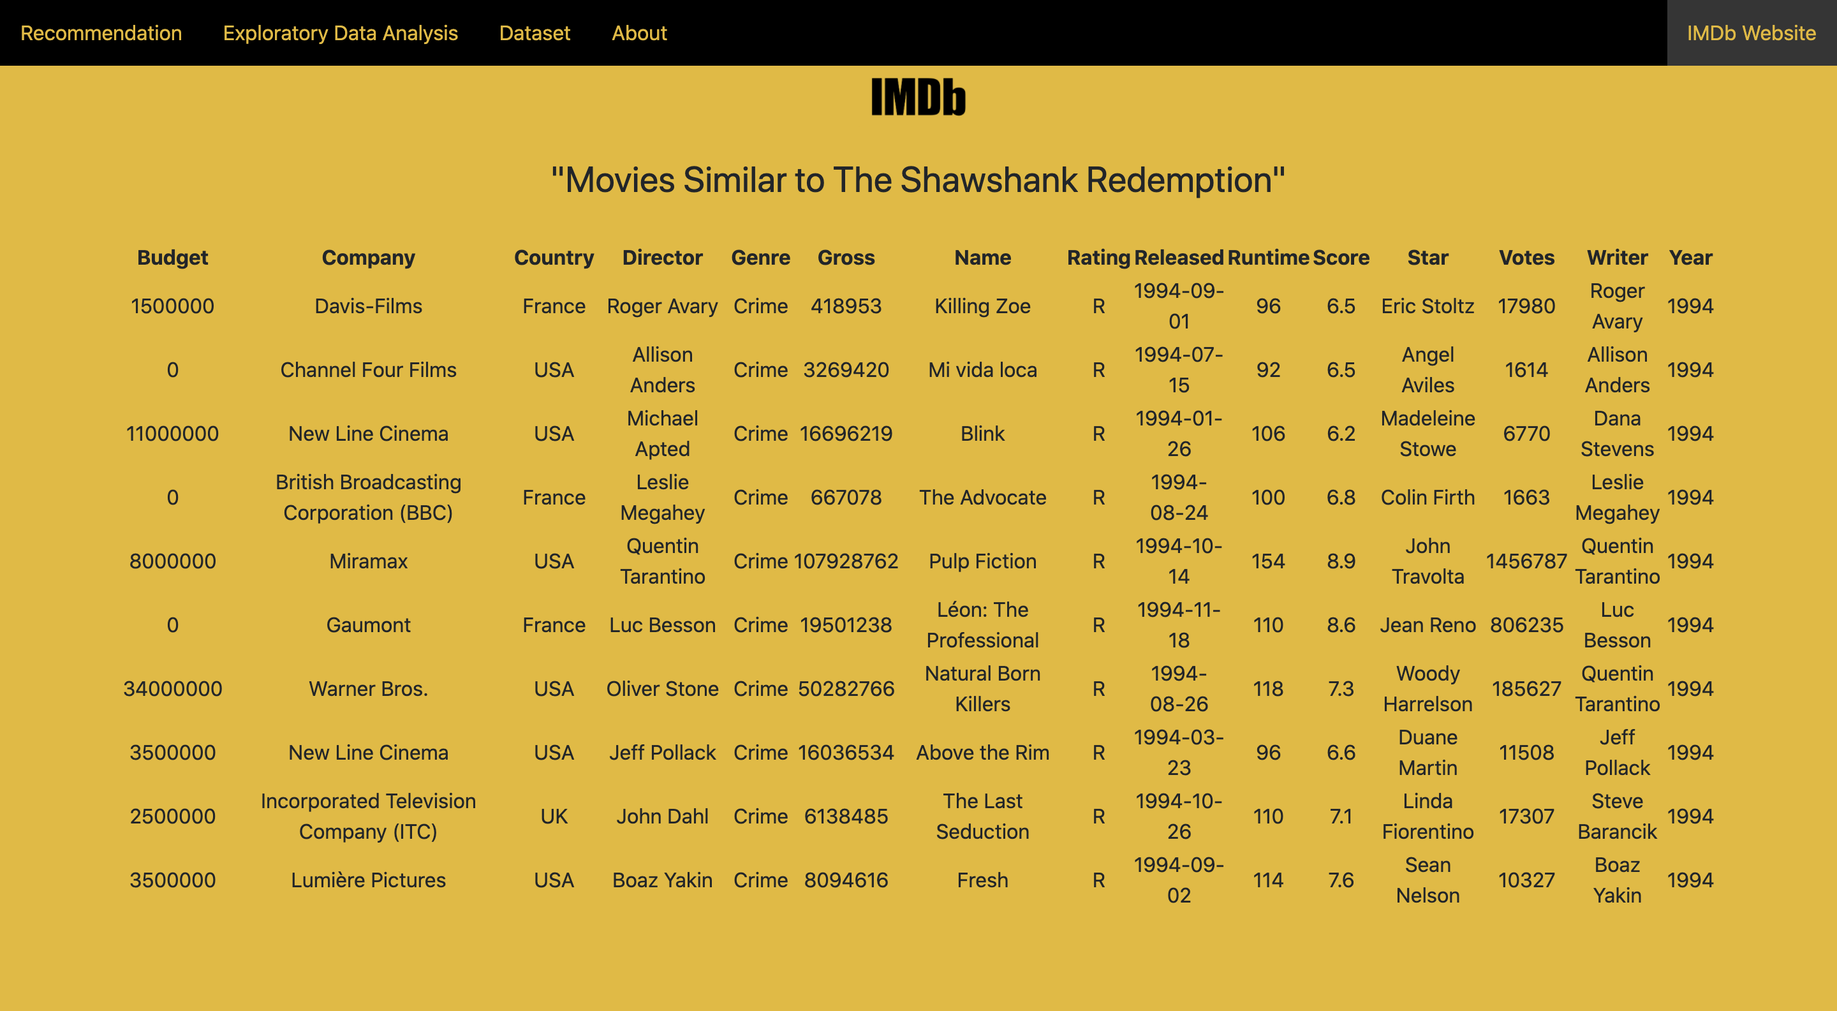

Slide 14
Conclusion

Slide 15
Conclusion
The model can give you movies recommendation based on the bag of words which contained multiple features mentioned before. The recommendations are ranked/sorted by their cosine similarity score.

Slide 16
Thank you!

