Slide 1
Text-To-SQL App with feedback loop
Natural Language to SQL Query Generation using LangChain & Ollama
BDNSV - Dima Florin-Alexandru (462)
FMI Unibuc - 2026

Slide 2
Project Overview
What is project’s purpose?
Goal: Convert natural language questions into SQL queries
Multi-step chain:
  Accept NLP question
  Generate SQL query using feedback loop for learning from user interactions
  Execute query
  Summarize results in natural language
Tech Stack: LangChain, Ollama (Local LLMs), SQLite, Gradio (and more)

Slide 3
Core Features
Meeting project requirements
1. Ambiguous Input Handling:
  Schema-aware prompt engineering
  Database context inclusion
  Clarification requests for vague questions
3. Error Handling & Feedback:
  SQL validation and auto-correction
  User feedback loop (1-5 rating + corrections)
  Few-shot and chain-of-thought prompting
2. LLM Comparison:
  Llama3, Mistral, CodeLlama support
  Side-by-side accuracy evaluation
  Syntax and logic comparison
4. Benchmark Testing:
  Spider benchmark: measure exact match, execution accuracy

Slide 4
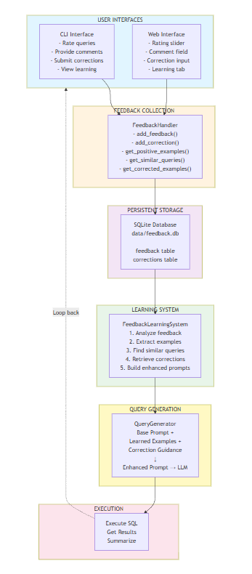
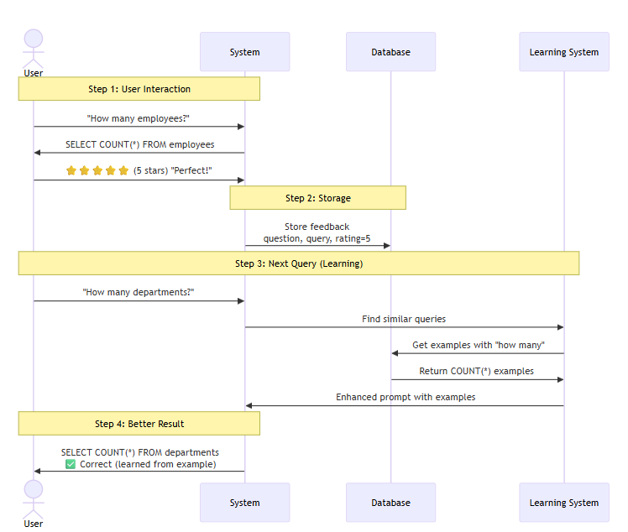
System Architecture
Multi-step pipeline & Data flow

Slide 5
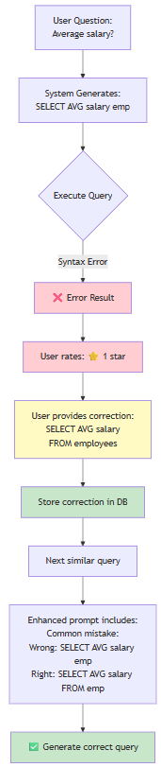
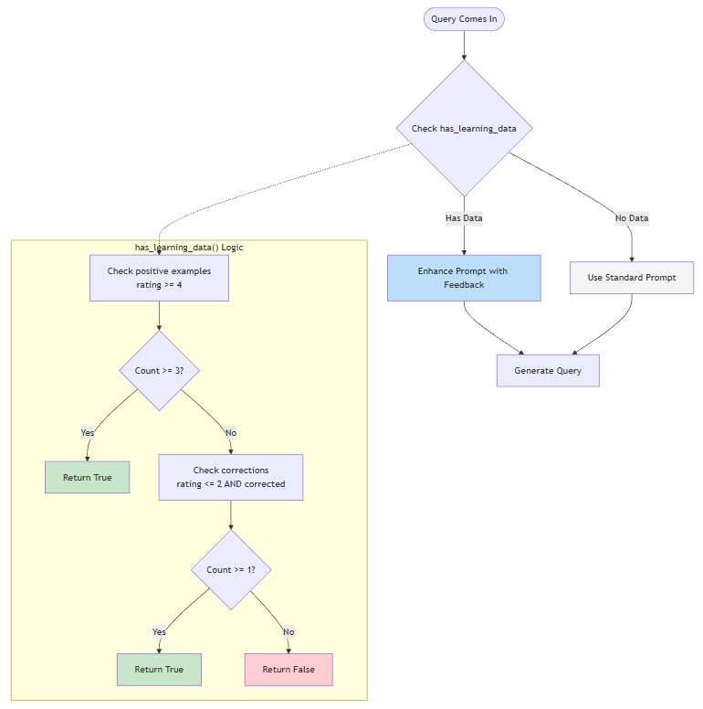
System Architecture
Correction & Learning activation

Slide 6
Feedback loop for self-improving
How does it work?
Step 1: Collect Feedback
  User rates query (1-5 stars)
  Optional: provide corrected SQL
Step 2: Learn
  Extract positive examples (rating ≥4)
  Store user corrections
  Find similar past queries
Step 3: Improve
  Enhance prompts with learned examples
  Add correction guidance
  Better results → More positive feedback
Result: System improves automatically with usage

Slide 7
LLM Comparison
Multi-Model evaluation
Models Tested: Llama3:latest, Mistral:7b, CodeLlama:latest
Metrics:
  Query accuracy
  Syntax correctness
  Logical structure
  Execution success rate
  Response time
Finding:
  CodeLlama performs best for complex queries
  Llama3 performs best for natural language understanding

Slide 8
Benchmark results
Spider benchmark performance
Dataset: Spider
Initial results (no learning): Exact match: 20%, Execution accuracy: 35%
After normalization & Learning: Exact match: 75%, Execution accuracy: 75%
Key Improvements:
  SQL normalization (aliases, whitespace, case)
  Few-shot learning from positive examples
  Error correction from user feedback
Test set: 5-20 random queries across multiple databases

Slide 9
User Interface
Dual interface: CLI & Web
1. CLI Interface:
  Interactive command-line
  Commands: stats, learning, compare, quit
  Real-time feedback collection
  Correction submission for failed queries
2. Web Interface (Gradio):
  User-friendly visual interface
  Tabs: Query Generation, Model Comparison, Learning System
  Real-time feedback collection
  Correction submission for failed queries
Accessibility: Both interfaces suitable for different user preferences

Slide 10
Conclusion
Summary & Next steps
Achievements:
  Text-to-SQL pipeline meeting the requirements
  Feedback loop with automatic learning
  Fair results achieved on Spider benchmark
  Multi-LLM comparison framework
  Dual interface (CLI + Web)
  Error handling
Possible future enhancements:
  Support for more complex SQL (subqueries, CTEs)
  Multi-database support (PostgreSQL, MySQL)
  Advanced learning algorithms/fine-tuning
  Query optimization suggestions
  More benchmarks (BIRD, WikiSQL)
Documentation: Comprehensive README, guides, diagrams, code comments

Slide 11
References
References & Resources
AI Tools Used:
[1] GitHub Copilot (Claude Sonnet 4.5), https://github.com/features/copilot, Date generated: January 2026
Frameworks & Libraries:
[2] LangChain Documentation, https://python.langchain.com/, Last accessed: January 2026
[3] Ollama, https://ollama.ai, Last accessed: January 2026
Benchmarks:
[4] Yu, T., et al., "Spider: A Large-Scale Human-Labeled Dataset for Complex and Cross-Domain Semantic Parsing and Text-to-SQL Task", EMNLP 2018
Database:
[5] SQLite, https://www.sqlite.org, Last accessed: January 2026
Code Repository:
[6] GitHub Repository, https://github.com/dimaflorinalex/ProiectBDNSV

