Slide 1
Terasology
Análise do projeto de open source em relação à engenharia de software
Diogo Moura – up2013 Filipa Ramos – up201305378 Inês Santos – up2013 Sérgio Domingues – up2013
Turma 6 – Engenharia de Software
Faculdade de Engenharia da Universidade do Porto

Slide 2
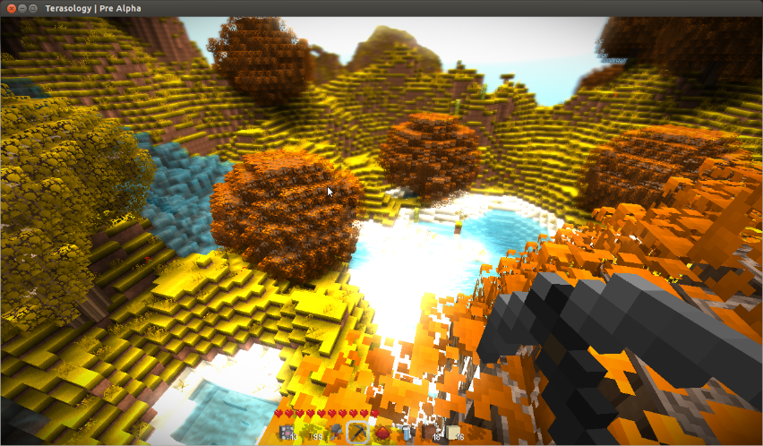
Terasology
Software developing process
Aspired Model
BDD (Behaviour Driven-Development)
Process:
Fork the project
Issue a pull request
Important tools:
Jenkins
Issue tracking
Pull request
Terasology is a game that pays tribute to Minecraft.
Objectives:
- studying the procedures involved in creating 3D terrain;
- deepen the knowledge of the rendering techniques in Java using the game development library LWJGL .

