Slide 1
Distributed AMQP Messaging Cluster
INFT6000 Principles of Distributed Systems | HW2 | Group 4 | Mr. Islam Elgedawy
Goal: a RabbitMQ cluster that never loses a confirmed message when a node fails, and test clients that prove it
RabbitMQ 3.13.7 quorum queues | Docker Compose | Python 3 + pika clients | Prometheus + Grafana (bonus)
Cluster & infrastructure
Docker, quorum queues, failure injection
Monitoring & performance
Prometheus, Grafana, alerts, benchmarks
Producer
Publisher confirms, retries, failover
Consumer & validation
Manual acks, idempotency, persistence
Notes:
About 0:30
Good morning. We are Group 4, and our project is a distributed AMQP messaging cluster built on RabbitMQ.
Our goal: when a broker node fails, no message that the broker has confirmed may be lost. [point at the orange line] We built a three-node cluster with Docker Compose, our own Python producer and consumer, Prometheus and Grafana monitoring, which is the bonus, and tests that check every message.

Slide 2
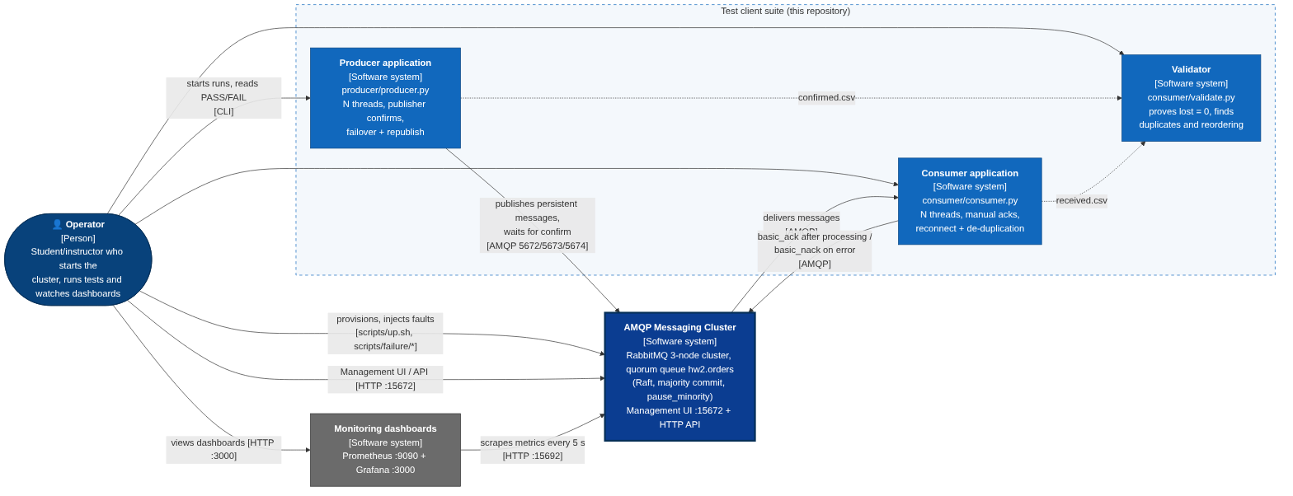
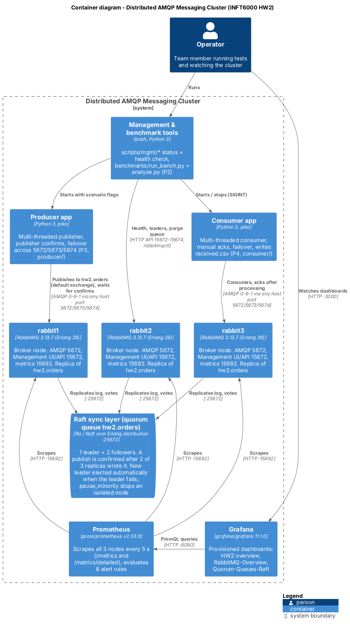
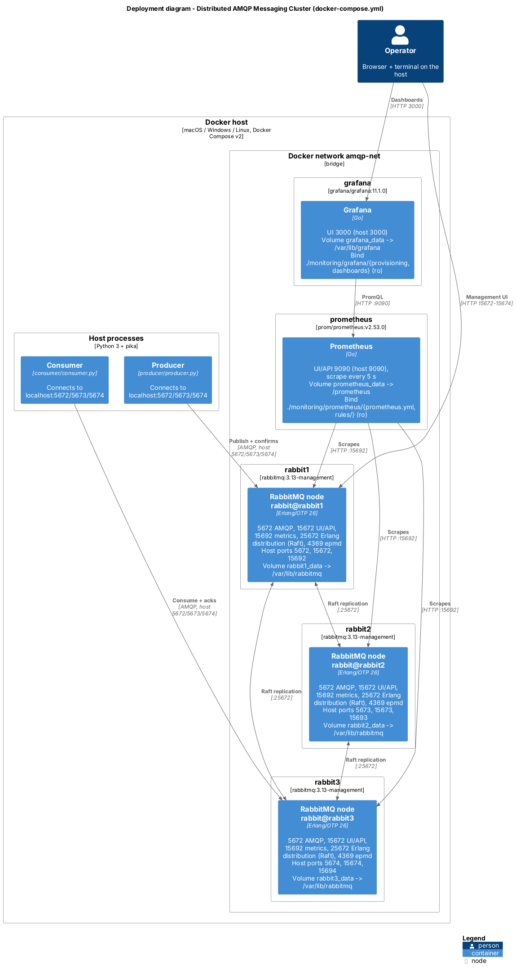
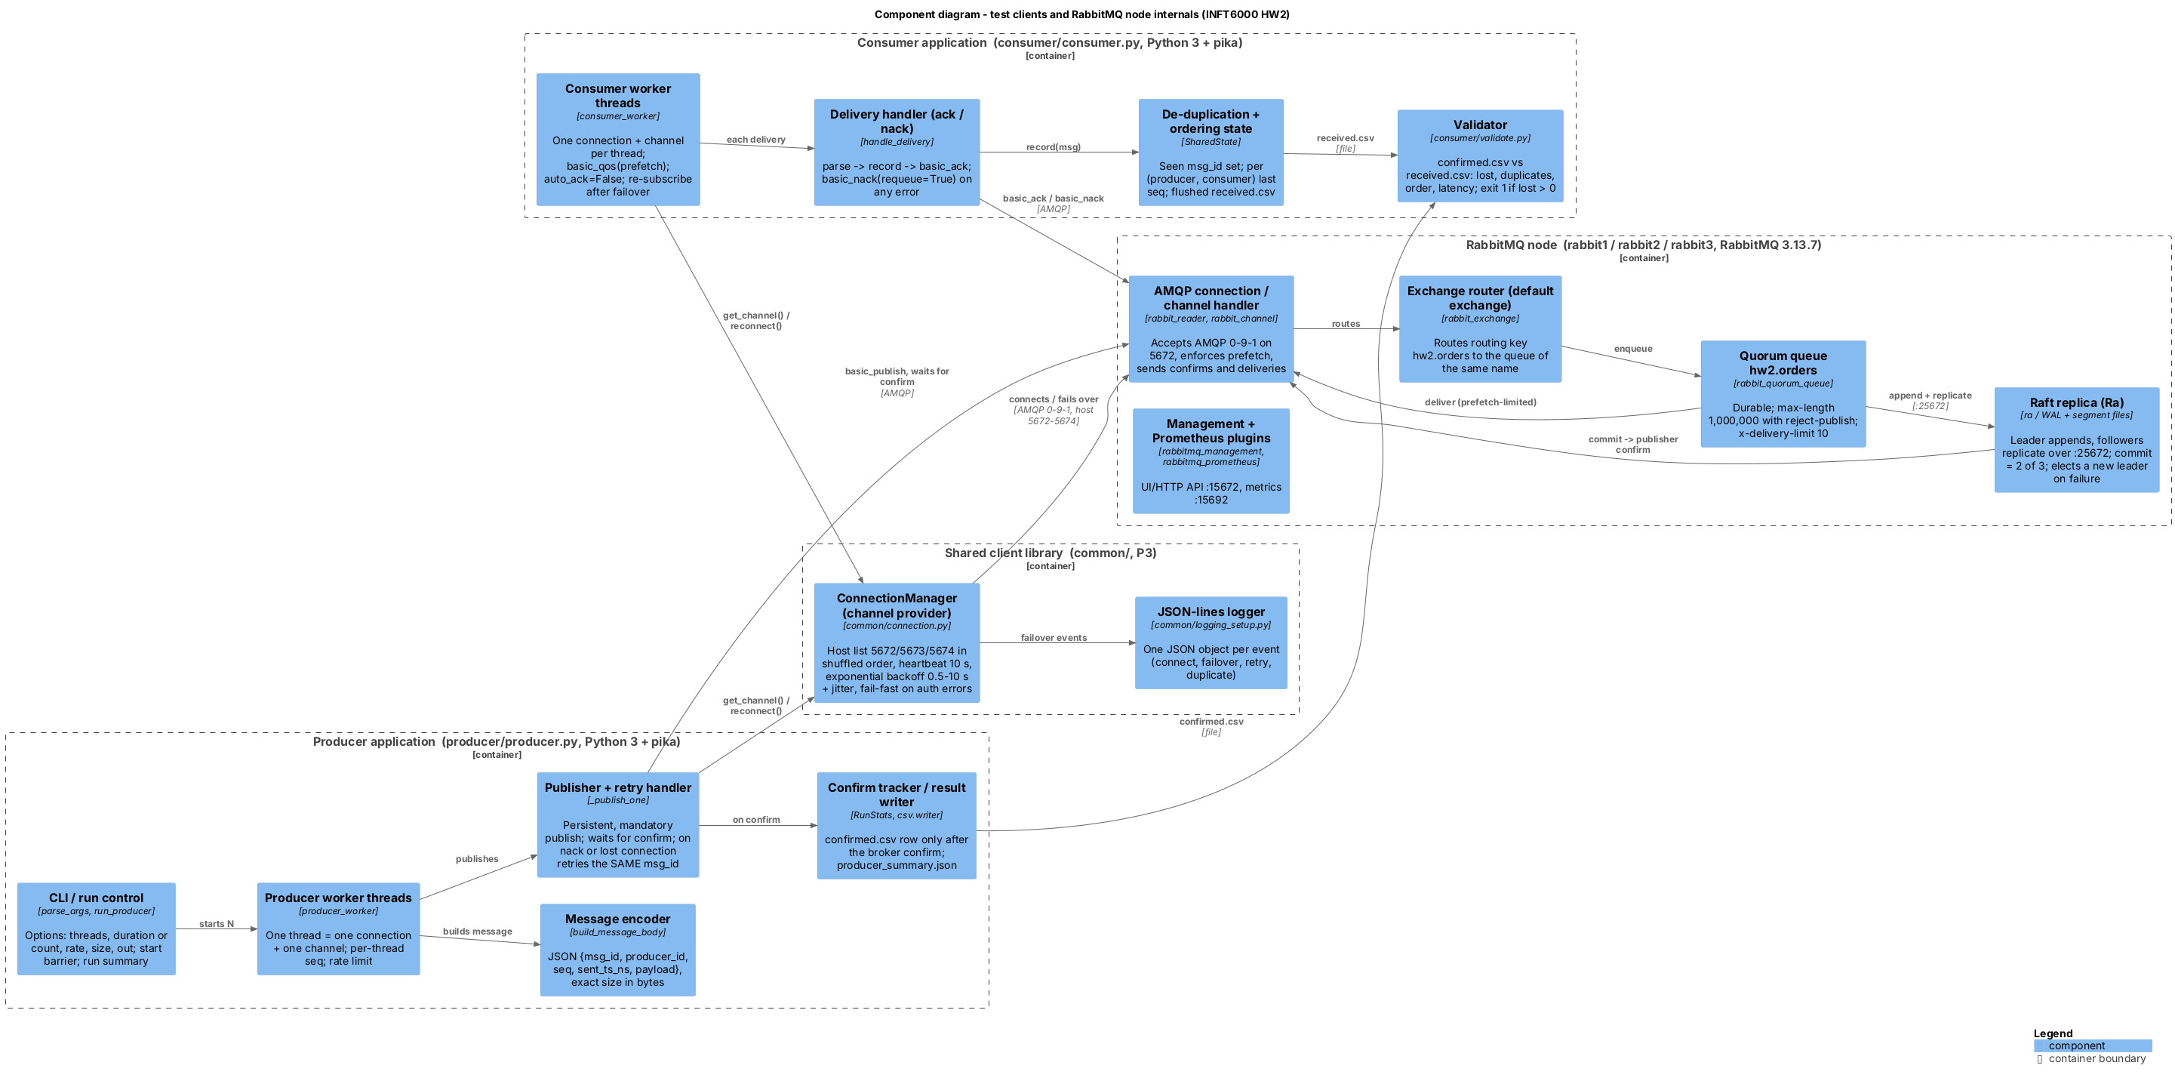
Architecture: the four C4 diagrams
1 Context
2 Container
4 Deployment
3 Component
Full size in the report (sections 1, 4, 5 and 6); Component and Deployment also on backup slides 11-12. Every box, port and volume matches docker-compose.yml and the code.
Notes:
About 0:45
We modelled the system with all four levels of the C4 model.
[point at 1] The context: our cluster with the producer, the consumer, the validator, the operator and the dashboards around it.
[point at 2] The containers: three RabbitMQ 3.13.7 nodes sharing the Raft layer of our queue, plus Prometheus and Grafana.
[point at 3] The components: retry and failover, confirm tracking, acknowledgements and de-duplication in our clients, and the quorum queue with its Raft replica inside a node.
[point at 4] And the deployment: one Docker host, the ports, and a persistent volume per node.

Slide 3
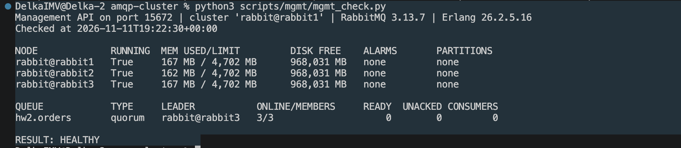
Three nodes, one replicated quorum queue
Leader
writes the log, replicates
Follower
votes, stores a copy
Follower
votes, stores a copy
hw2.orders: quorum queue, 3 replicas, delivery limit 10
pause_minority: an isolated node stops serving - no split brain
reject-publish at 1,000,000: a full queue nacks, never drops
Volumes rabbitN_data: the Raft log survives restarts
Health: Docker healthcheck per node; up.sh waits for 3 members; mgmt_check.py
Commit rule: a message is confirmed to the producer only after 2 of 3 nodes have written it to disk. Three nodes is the smallest cluster that keeps that majority after one failure.
Docker evidence: python3 scripts/mgmt/mgmt_check.py on our Mac (11 Nov 2026)
Notes:
About 1:05
Our queue, hw2.orders, is a quorum queue, copied to all three nodes with Raft: one leader and two followers.
The leader writes each message to its log and sends it to the followers. When two of the three have it on disk, it is committed, and only then is the producer's confirm sent. Three is the smallest cluster that keeps a majority after one failure.
[point at the list] pause_minority prevents a second leader, a full queue rejects instead of dropping, and each node keeps its Raft log on a volume.
[point at the screenshot] And here is our health check on Docker: three nodes running, no alarms, no partitions; the queue is quorum, its leader at that moment was rabbit3, and three of three members are online. Result: HEALTHY.

Slide 4
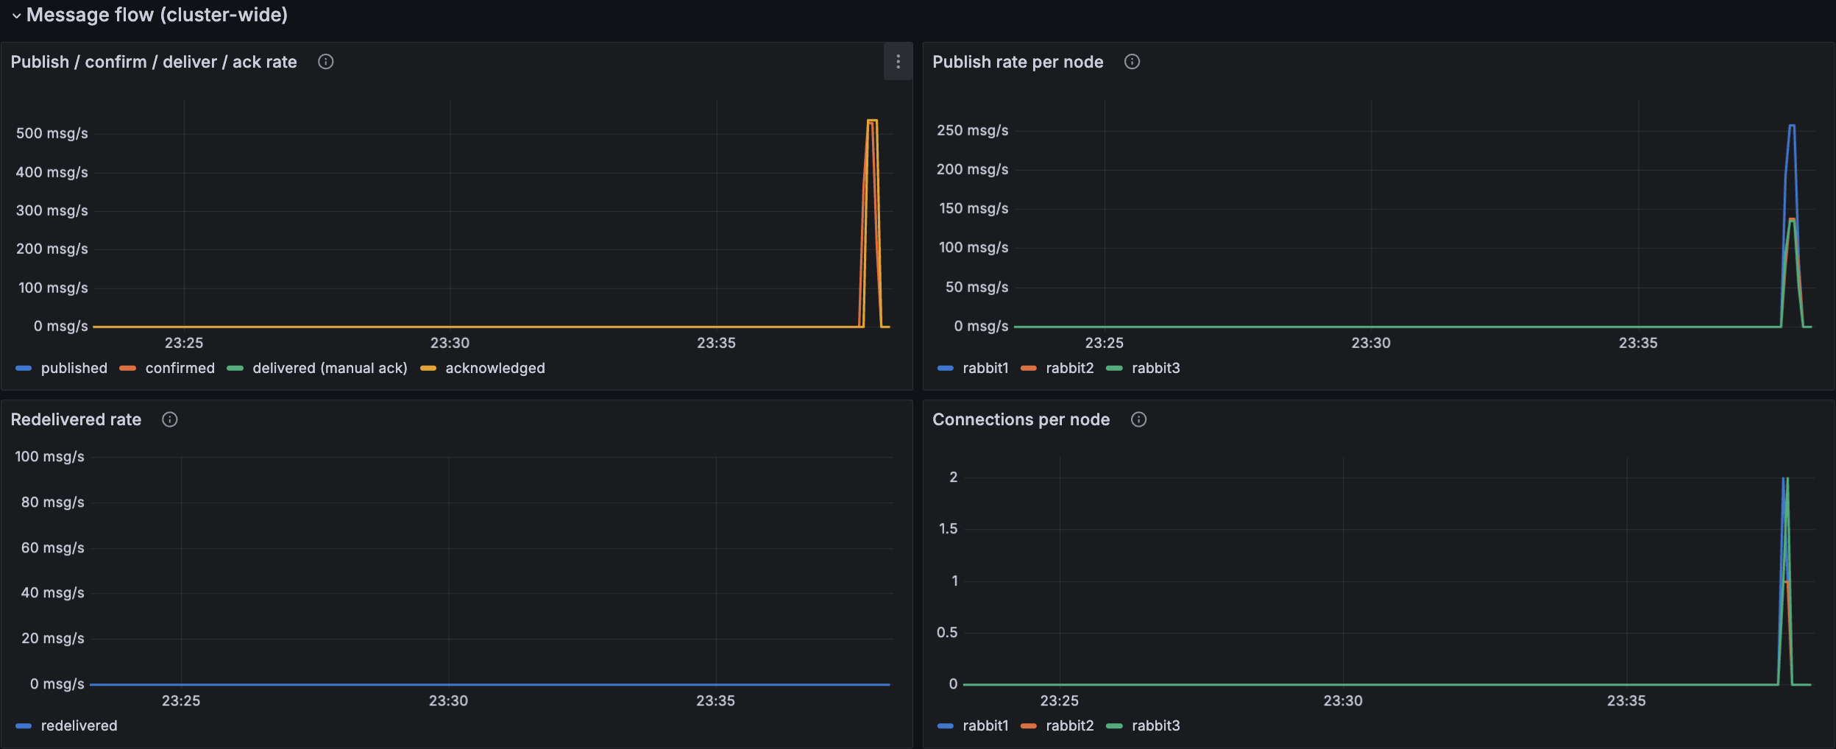
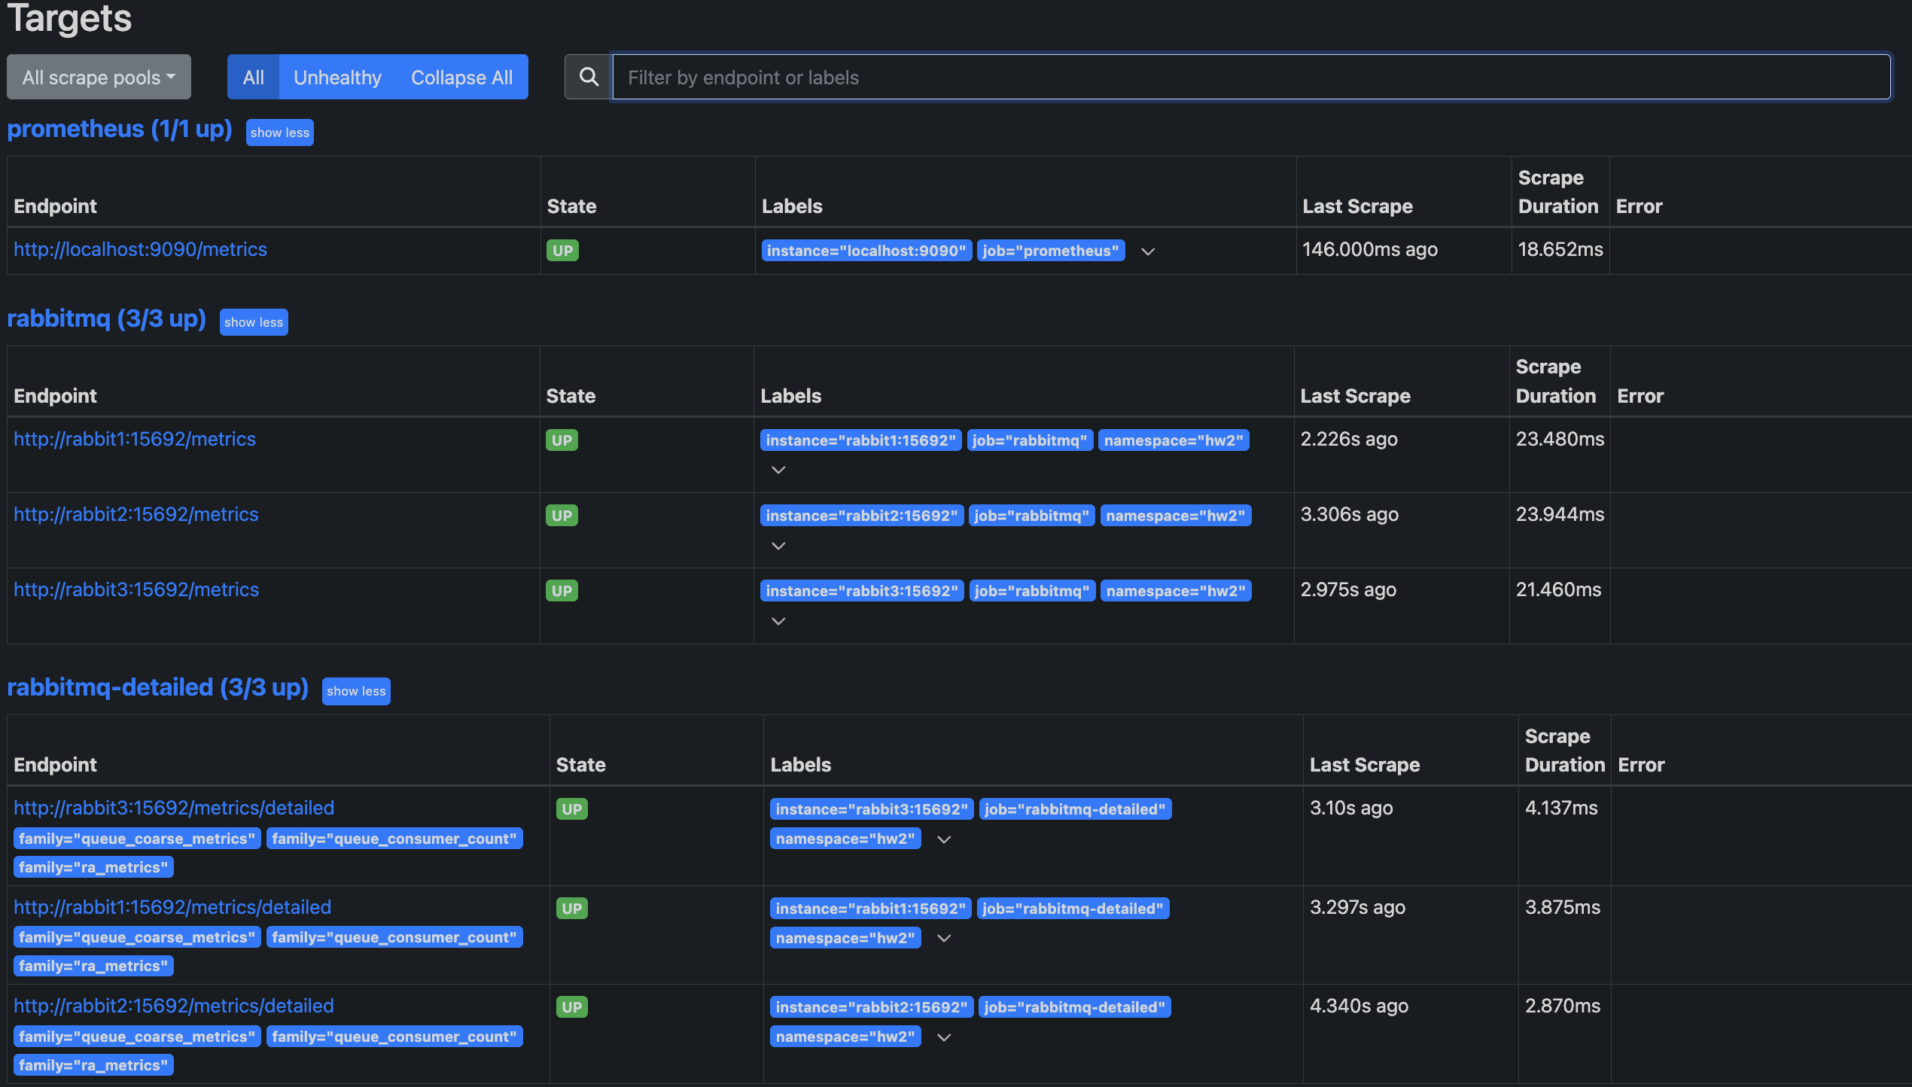
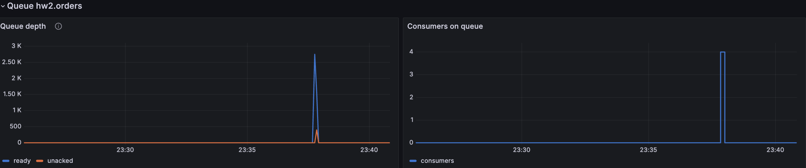
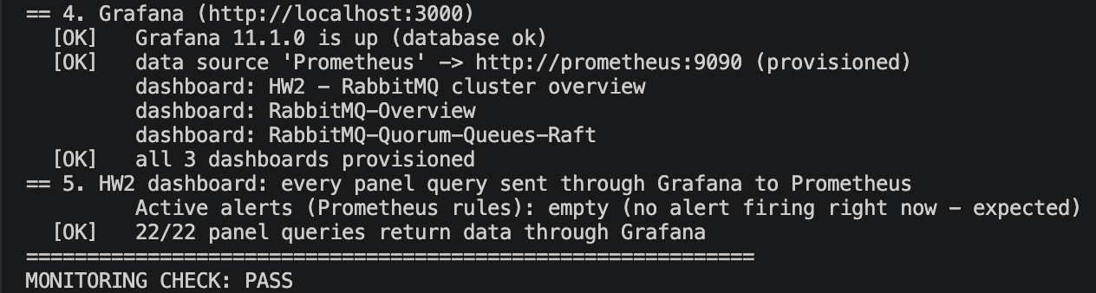
Bonus: Prometheus + Grafana, verified on Docker
Prometheus targets: 7 of 7 UP
Grafana, HW2 dashboard: message rates and queue depth during a message-processing run
Required by the bonus | Grafana panel / Prometheus metric
Queue depth | Queue depth / rabbitmq_detailed_queue_messages
Message rates | Publish / confirm / deliver / ack / rabbitmq_global_messages_*
Node health | Nodes up, memory, disk / up, rabbitmq_alarms_*
check_monitoring.py also reported: 8 alert rules loaded with health ok; node health, queue depth, message and confirm rates present.
Notes:
About 1:20
Thank you. The bonus asks for Prometheus and Grafana collecting queue depth, message rates and node health.
[point at the targets screenshot] Every RabbitMQ node exports metrics on port 15692. Prometheus scrapes them every five seconds, and here you can see all seven targets are UP: Prometheus itself, and two jobs on each of the three nodes.
[point at the large Grafana screenshot] This is our Grafana dashboard on Docker during a message-processing run. The publish, confirm, deliver and acknowledge rates rise together to about 500 messages per second, and the traffic is spread over all three nodes. The redelivered rate stays at zero.
[point at the queue panel] Below, the queue depth climbs to about 2,700 messages and drops back to zero as soon as the four consumers attach.
[point at the terminal] Finally, our script check_monitoring.py proves that this is more than running containers. It found Grafana up, the Prometheus data source and all three dashboards provisioned, and all 22 dashboard queries returning data through Grafana. Result: MONITORING CHECK PASS. We also wrote eight alert rules, all evaluating without errors.

Slide 5
Producer: publisher confirms and failover
producer/producer.py, _publish_one() (abridged)
1
Each thread: own connection + channel
pika objects are not thread-safe
channel.confirm_delivery() # once per channel
channel.basic_publish(
exchange="", routing_key="hw2.orders", body=body,
properties=pika.BasicProperties(
delivery_mode=2, message_id=msg_id),
mandatory=True) # returns only after the confirm
except pika.exceptions.NackError:
retries += 1 # up to --nack-retry-limit (5)
manager.reconnect(); continue
except (AMQPConnectionError, OSError):
manager.reconnect(); continue
# same msg_id and seq are sent again
writer.writerow([msg_id, ..., sent_ts, confirm_ts])
2
Wait for the broker's confirm
the confirm means 2 of 3 disks have it
3
Connection lost? Next node, same msg_id
backoff 0.5 s doubling to 10 s, with jitter
4
confirmed.csv only after the confirm
the list of messages that must arrive
Shared library common/connection.py: host list 5672/5673/5674 in random order, heartbeat 10 s, wrong password fails at once
Notes:
About 1:05
Thanks. [point at step 1] In our producer each thread has its own connection and channel, because pika objects are not thread-safe.
[point at the code] We turn on publisher confirms. Every message is persistent and has a unique message ID. With confirms on, basic_publish returns only after the broker has confirmed the message, and for a quorum queue that means it is on two of the three disks.
If the broker answers with a nack, for example because the queue is full, we retry up to five times. If the connection breaks before the confirm arrives, we cannot know whether the message was stored, so we send it again with the same ID. That can create a duplicate, but never a loss.
[point at the bottom line] Reconnection goes to the next node, waiting half a second and doubling up to ten seconds, with random jitter. [point at step 4] Only confirmed messages are written to confirmed.csv, which is the list the validator checks later.

Slide 6
Consumer: manual acks, redelivery and idempotency
Deliver
prefetch 100
Parse
JSON message
Seen msg_id?
de-duplicate
Write + flush
received.csv
basic_ack
only now
Any error -> basic_nack(requeue=True); x-delivery-limit 10 stops a poison message
Why duplicates can happen
Validator: zero loss is a test, not a claim
A consumer dies after processing but before its ack arrives -> the broker redelivers (redelivered = true)
A producer loses a confirm in a crash -> it sends the same msg_id again
Delivery is at-least-once; processing once per msg_id makes it idempotent
lost = confirmed.csv - received.csv
Exit code 1 if lost > 0 or nothing was confirmed. Also reports duplicates, order per consumer and latency. Tested with planted errors: finds exactly 2 lost, 3 duplicated, 1 reordered.
Notes:
About 0:55
Thank you. Our consumer uses manual acknowledgements. [follow the flow] A message is delivered, parsed, checked against the IDs we have already seen, written to received.csv and flushed, and only then acknowledged.
If the consumer crashes before the ack, the broker gives the message to another consumer and marks it as redelivered. On an error we nack it back to the queue, and a delivery limit of ten stops a broken message from looping forever.
[point at the left box] Duplicates are normal with at-least-once delivery. Because we remember the IDs we have processed, a duplicate is acknowledged but not processed again. That makes the consumer idempotent.
[point at the right box] The validator subtracts received from confirmed. Anything left is lost, and the run fails.

Slide 7
Integration test on Docker: zero lost messages
Run by us on a Mac with Docker Desktop: 3 healthy RabbitMQ containers, Prometheus and Grafana running
Smoke test
Leader crash under load
./scripts/p4/smoke.sh
./scripts/p4/chaos_run.sh leader-crash
10,000 / 10,000
23,680 / 23,680
confirmed by the broker / received (unique)
confirmed by the broker / received (unique)
0 lost 0 duplicates
RESULT: PASS
0 lost 2 duplicates (detected, not reprocessed)
0 ordering violations per consumer; p95 2.96 ms, max 513.79 ms
RESULT: PASS - producer and consumer exited cleanly
NOT Docker - wider coverage on a native RabbitMQ 3.13.7 test cluster, same code and configuration
24
failure runs under load (5 fault types)
467,287
confirmed messages
0
lost
50,000 -> 50,000
messages through a full restart
Notes:
About 1:00
We ran these tests ourselves on a Mac with Docker Desktop, with all three RabbitMQ containers healthy and Prometheus and Grafana running.
[point at the first card] The smoke test sent 10,000 messages: 10,000 confirmed by the broker, 10,000 received, nothing lost and no duplicates.
[point at the second card] Then we killed the queue leader while the producer and consumer were running. All 23,680 confirmed messages were received with zero loss. Two duplicates were delivered because of the crash, and our consumer did not process them twice. There were no ordering errors per consumer, and 95 percent of messages arrived within three milliseconds.
[point at the bottom row] To test more failure types we also ran a larger campaign on a native RabbitMQ test cluster with the same code: 24 failure runs, 467,287 messages, zero lost.

Slide 8
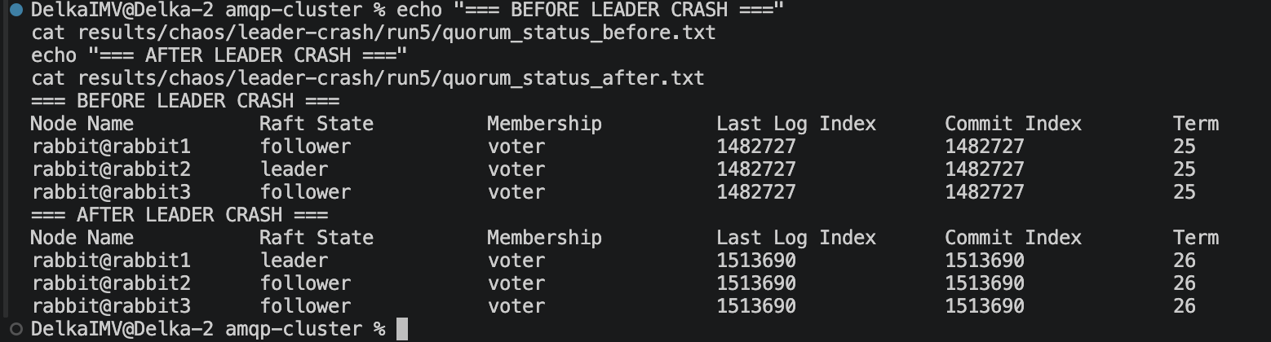
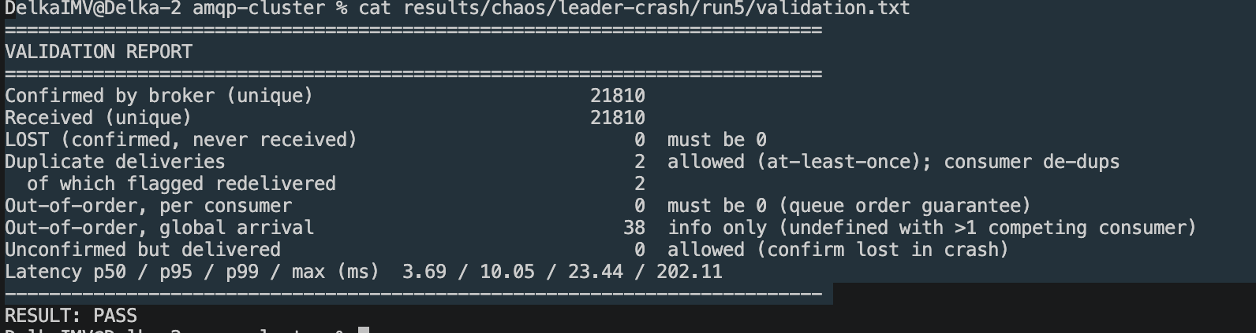
Fault tolerance: automatic leader election, no loss
Native test cluster - leader crash run 5, all clients on the leader
All failure scenarios, native test cluster (24 runs)
Fault (runs) | Election | Confirms paused | Lost
Follower crash (6) | none needed | 0.3 s | 0
Leader crash (6) | 447-964 ms | 0.2-0.3 s | 0
Partition (6) | majority side | up to 28 s | 0
Rolling restart (3) | automatic | - | 0
Two nodes down (3) | after recovery | 31-38 s | 0
results/chaos/leader-crash/run5/quorum_status_before.txt and _after.txt
Crashes: a new leader in about half a second; all producer and consumer threads reconnected
Partition: slowest - clients only notice through missed heartbeats
Two nodes down: writes stop until a majority returns (consistency over availability)
results/chaos/leader-crash/run5/validation.txt
rabbit2 -> rabbit1, term 25 -> 26, election 521 ms. 21,810 / 21,810 received, 0 lost, 2 redelivered duplicates handled.
Notes:
About 1:10
This is one leader crash from our native test cluster, run 5, where every client was connected to the leader on purpose.
[point at the top screenshot] Before the crash, rabbit2 is the leader in Raft term 25. After it, rabbit1 is the leader in term 26: exactly one election, which took 521 milliseconds. All three nodes end with the same commit index, so the restarted node caught up from the log.
[point at the lower screenshot] The validator for the same run: 21,810 confirmed, 21,810 received, zero lost, and two redelivered duplicates handled.
[point at the table] Across all failure types, nothing was lost. Leader elections took about half a second, a partition was the slowest case at up to 28 seconds, and with two nodes down, writes stopped until a node returned. We chose consistency over availability.

Slide 9
Performance: 33 benchmark runs, analysed
What it shows
1 thread: ~3.1 ms per message, 2.1 ms of it waiting for the Raft commit + confirm
16 threads: 2.5x the throughput - CPU-bound on 2 vCPUs
64 KB messages: 302 msg/s but 19.8 MB/s
Prefetch 10/100/500: no difference
Source: benchmarks/results/summary.md, generated by benchmarks/analyze.py from 33 runs in benchmarks/results/raw/ (native test cluster)
Limitations
Measured on a 2-vCPU native test cluster (same config, not Docker); absolute numbers will differ on our Macs. Broker's own Prometheus count matched the clients within 0.4 %. Synchronous confirms cap one thread at ~320 msg/s. Partitions are slow to resolve (60 s Erlang net_ticktime).
Notes:
About 1:05
We ran 33 benchmark runs: eleven configurations, three times each, with the same safety settings as before.
[point at the bar chart] One producer thread sends about 315 messages per second, because it waits about 2 milliseconds for each Raft commit and confirm. Sixteen threads reach 774, limited by the two CPUs of the test machine.
[point at the line chart] Latency grows with load: the median from 2.3 to 13.3 milliseconds, and the 99th percentile to 74 at sixteen threads.
[point at the box] Large 64-kilobyte messages reached almost 20 megabytes per second, prefetch made no difference because the consumers were never the bottleneck, and the broker's own counters matched ours within 0.4 percent.
[point at Limitations] These numbers come from the native test cluster, not from our Docker Macs, so absolute values will differ there.

Slide 10
What we proved, and what we learned
Proved
No confirmed message lost: 0 of 10,000 and 0 of 23,680 (leader crash) on Docker; 0 of 467,287 in 24 native failure runs. Leaders replaced automatically in about half a second.
Learned
Confirms + manual acks give at-least-once, so the consumer must be idempotent. A partition hurts more than a crash. Make the clients fail over in every test, or the test proves nothing.
Next
Asynchronous confirms for throughput, a lower net_ticktime for faster partition detection, TLS and real secrets, nodes on separate machines.
Questions?
Notes:
About 0:30
To sum up. [point at Proved] No confirmed message was lost: not on Docker, and not in 24 native failure runs. Leaders were replaced automatically in about half a second.
[point at Learned] We learned that at-least-once delivery needs an idempotent consumer, that a partition is harder than a crash, and that a failover test only counts if the clients are on the node you kill.
Thank you. We are happy to take your questions.

Slide 11
Backup: C4 Component diagram
Notes:
Backup slide - show only if asked. Producer components, the shared ConnectionManager (our channel provider with retry and failover), consumer components, and inside one RabbitMQ node: connection handler, default exchange, quorum queue and Raft replica. Names match the functions in the code.

Slide 12
Backup: C4 Deployment diagram
One Docker host, network amqp-net. Host ports: AMQP 5672-5674, management 15672-15674, metrics 15692-15694, Prometheus 9090, Grafana 3000. Volumes rabbit1_data..rabbit3_data at /var/lib/rabbitmq.
Notes:
Backup slide - show if asked about ports, volumes or how the containers are deployed.

Slide 13
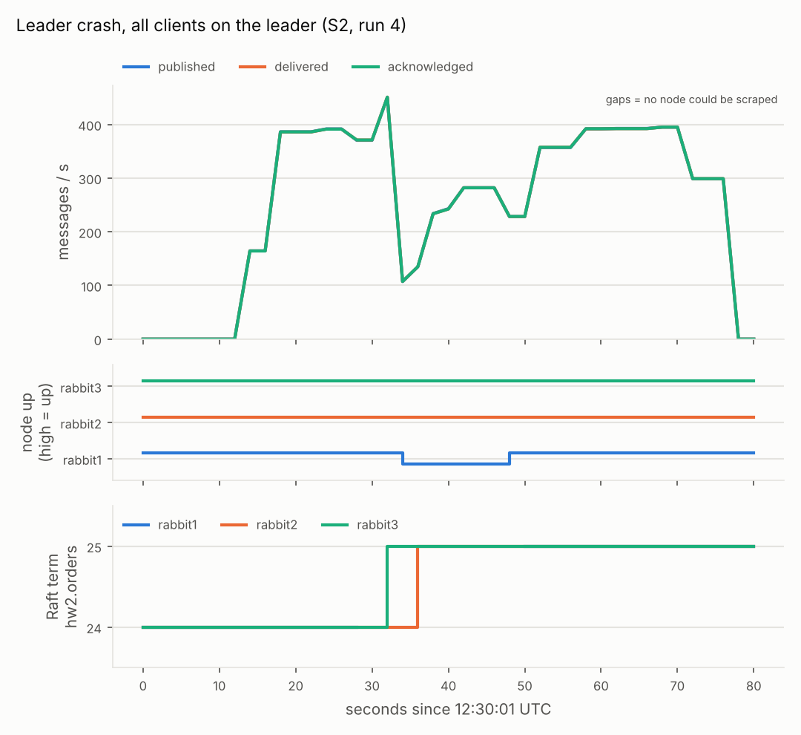
Backup: Prometheus view of a leader crash (native, run 4)
Native test cluster, results/chaos/leader-crash/run4, all clients on the leader (rabbit1)
Drawn by scripts/mgmt/plot_prometheus.py from Prometheus query_range over the run window
Top: broker message rates dip and recover. Middle: rabbit1 not scraped while down. Bottom: Raft term steps up = election (461 ms in scenario.log)
Notes:
Backup slide - show if asked how failover looks in the metrics. Native test cluster, not Docker.

Slide 14
Backup: where every result comes from
Result | Environment | Evidence in the repository
Smoke 10,000 / 10,000; leader crash 23,680 / 23,680 | Our Mac, Docker Desktop | results/ folders on our Mac (terminal output)
mgmt_check HEALTHY; 7/7 targets; Grafana; check_monitoring PASS | Our Mac, Docker Desktop | docs/evidence/docker/*.png
Idle failure runs S1-S3 (55 ms election) | Docker, 2026-10-23 (P1) | results/failure_S*.log
24 failure runs, 467,287 confirmed, 0 lost (incl. run 5 on slide 8) | Native RabbitMQ 3.13.7 test cluster, same config | results/chaos/, docs/evidence/p4-data-integrity.md
Persistence 50,000 -> 50,000 | Native test cluster | results/persistence/
33 benchmark runs | Native test cluster, 2 vCPU | benchmarks/results/
Code exactly as submitted: 12 runs, 0 lost | Native test cluster | results/as-submitted/
Benchmark self-test output (fake clients) is never reported as a result.
Notes:
Backup slide - use it if the professor asks where a number was measured.

