Slide 1
Homework 2: Distributed AMQP Messaging Cluster, Management, & Validation
INFT6000 Principles of Distributed Systems
Vusat Ahmadzada
ID 14086
Ali Pashayev
ID 14102
Dilara Imamverdiyeva
ID 15764
Habib Hasanov
ID 11621
Project team: Group 04
Instructor: Mr. Islam Elgedawy

Slide 2
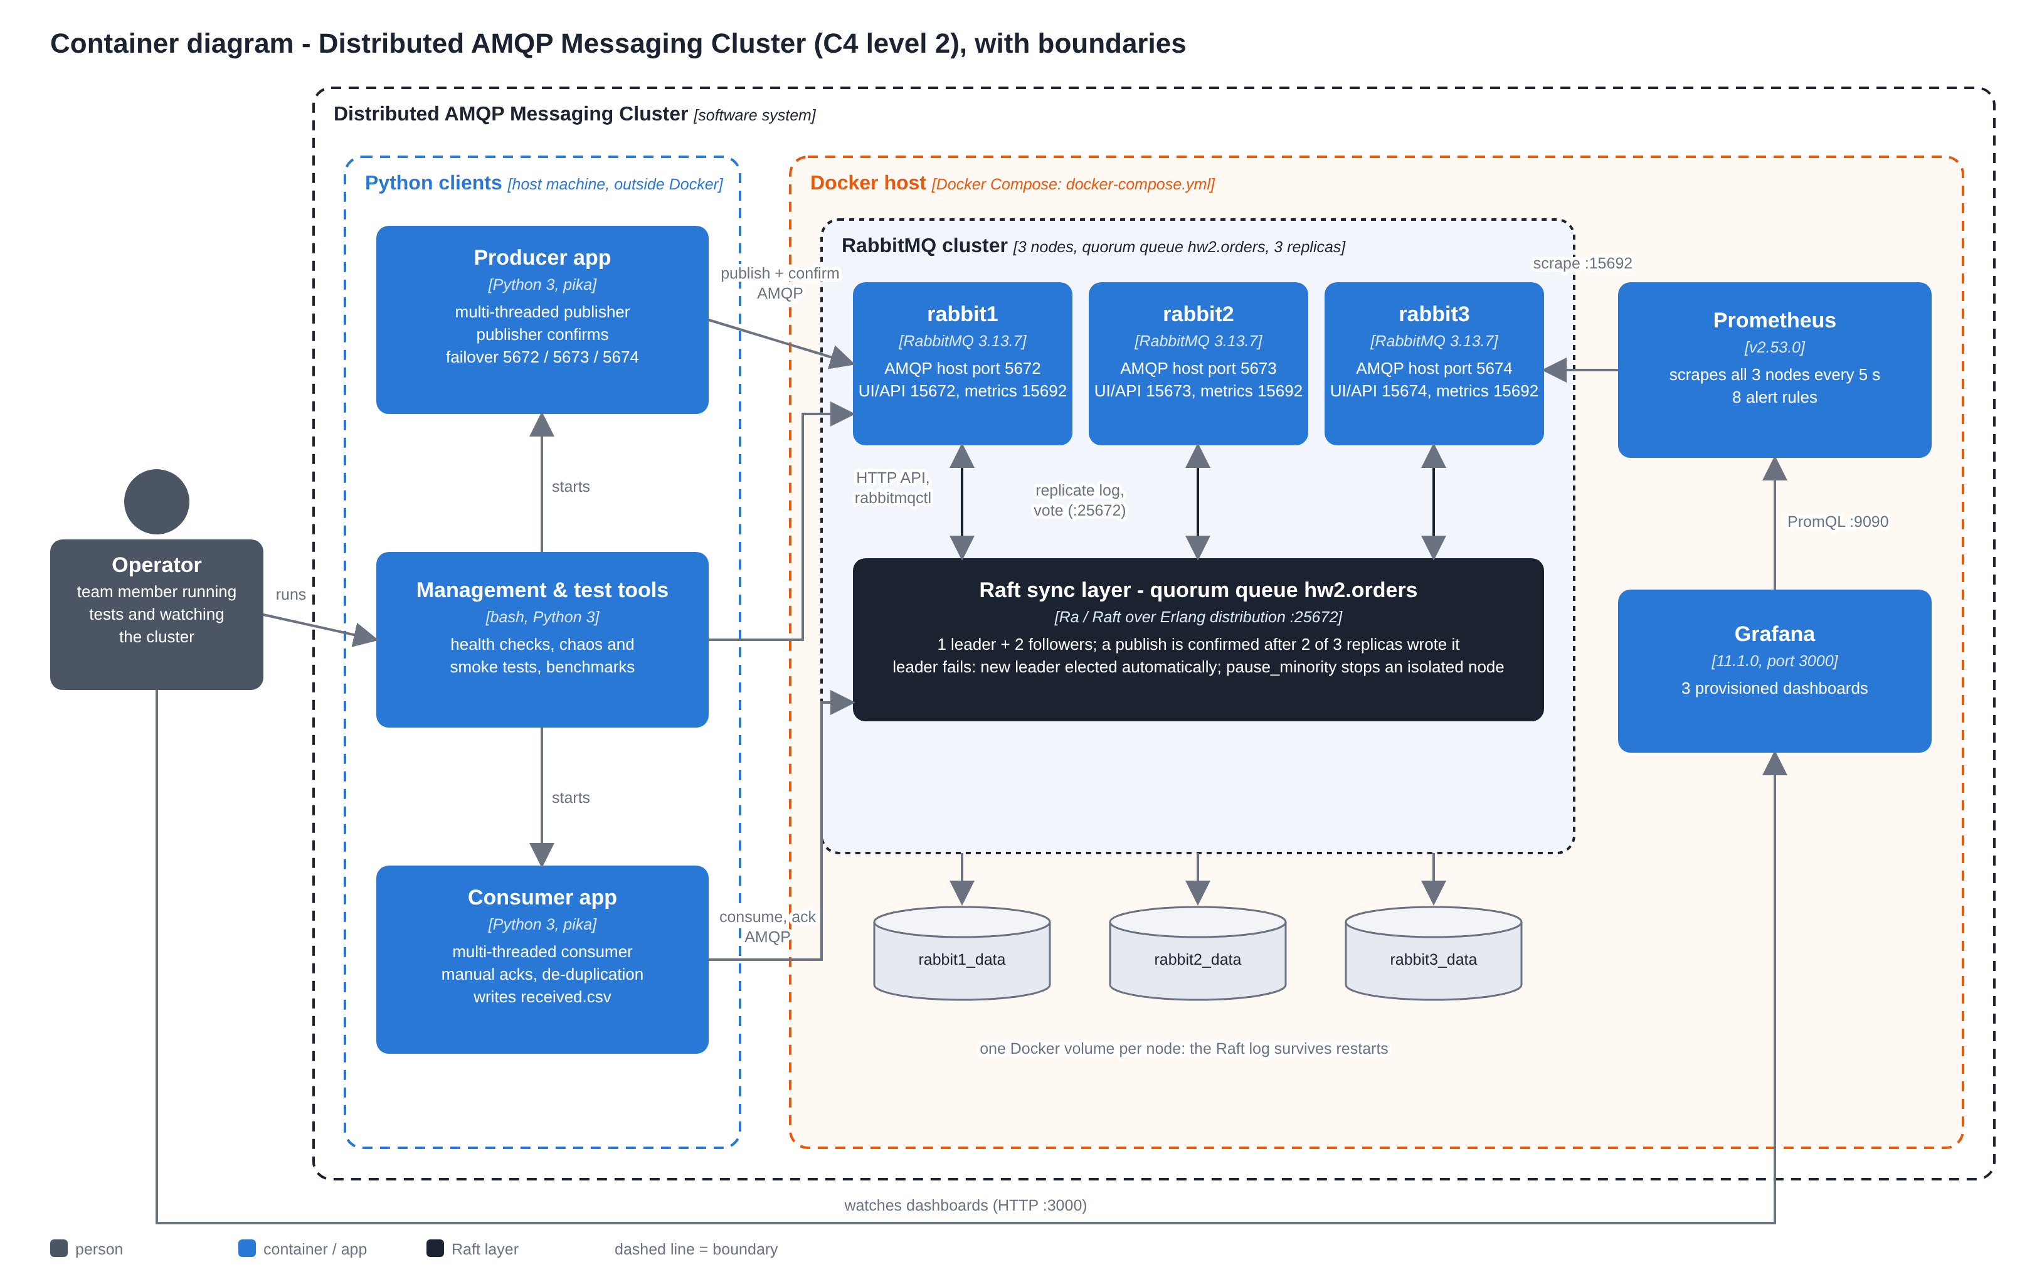
Architecture: what runs, and how it connects
C4 level 2 - Container diagram (docs/c4/container-diagram.puml)

Slide 3
Producer: publisher confirms and failover
producer/producer.py + common/connection.py (abridged)
1
Each thread: own connection + channel
pika objects are not thread-safe
channel.confirm_delivery() # once per channel
channel.basic_publish(
exchange="", routing_key="hw2.orders", body=body,
properties=pika.BasicProperties(
delivery_mode=2, message_id=msg_id),
mandatory=True) # returns only after the confirm
except pika.exceptions.NackError:
retries += 1 # up to --nack-retry-limit (5)
manager.reconnect(); continue
except (AMQPConnectionError, OSError):
manager.reconnect(); continue
# same msg_id and seq are sent again
writer.writerow([msg_id, ..., sent_ts, confirm_ts])
2
Wait for the broker's confirm
the confirm means 2 of 3 disks have it
3
Connection lost? Next node, same msg_id
backoff 0.5 s doubling to 10 s, with jitter
4
confirmed.csv only after the confirm
the list of messages that must arrive
Shared library common/connection.py: host list 5672/5673/5674 in random order, heartbeat 10 s, wrong password fails at once

Slide 4
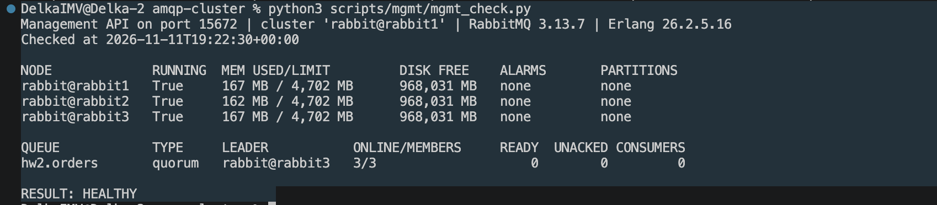
Three nodes, one replicated quorum queue
Leader
writes the log, replicates
Follower
votes, stores a copy
Follower
votes, stores a copy
hw2.orders: quorum queue, 3 replicas, delivery limit 10
pause_minority: an isolated node stops serving - no split brain
reject-publish at 1,000,000: a full queue nacks, never drops
Volumes rabbitN_data: the Raft log survives restarts
Health: Docker healthcheck per node; up.sh waits for 3 members; mgmt_check.py
Commit rule: a message is confirmed to the producer only after 2 of 3 nodes have written it to disk. Three nodes is the smallest cluster that keeps that majority after one failure.
Docker evidence: python3 scripts/mgmt/mgmt_check.py

Slide 5
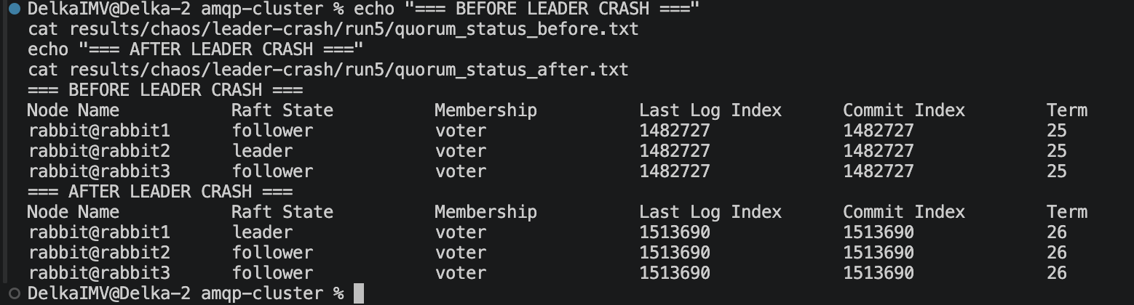
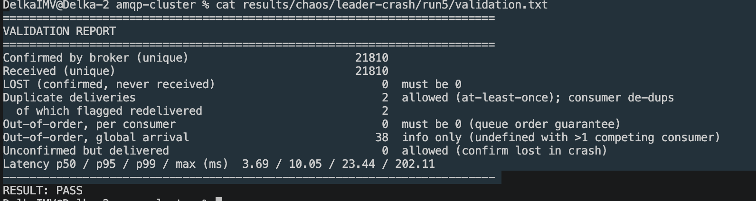
Fault tolerance: automatic leader election, no loss
Native test cluster - leader crash run 5, all clients on the leader
All failure scenarios, native test cluster (24 runs)
Fault (runs) | Election | Confirms paused | Lost
Follower crash (6) | none needed | 0.3 s | 0
Leader crash (6) | 447-964 ms | 0.2-0.3 s | 0
Partition (6) | majority side | up to 28 s | 0
Rolling restart (3) | automatic | - | 0
Two nodes down (3) | after recovery | 31-38 s | 0
results/chaos/leader-crash/run5/quorum_status_before.txt and _after.txt
Crashes: a new leader in about half a second; all producer and consumer threads reconnected
Partition: slowest - clients only notice through missed heartbeats
Two nodes down: writes stop until a majority returns (consistency over availability)
results/chaos/leader-crash/run5/validation.txt
rabbit2 -> rabbit1, term 25 -> 26, election 521 ms. 21,810 / 21,810 received, 0 lost, 2 redelivered duplicates handled.

Slide 6
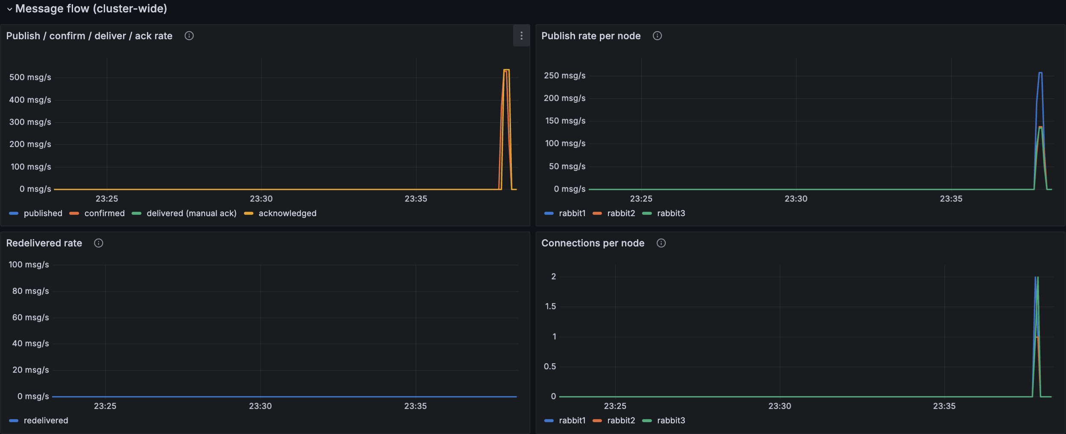
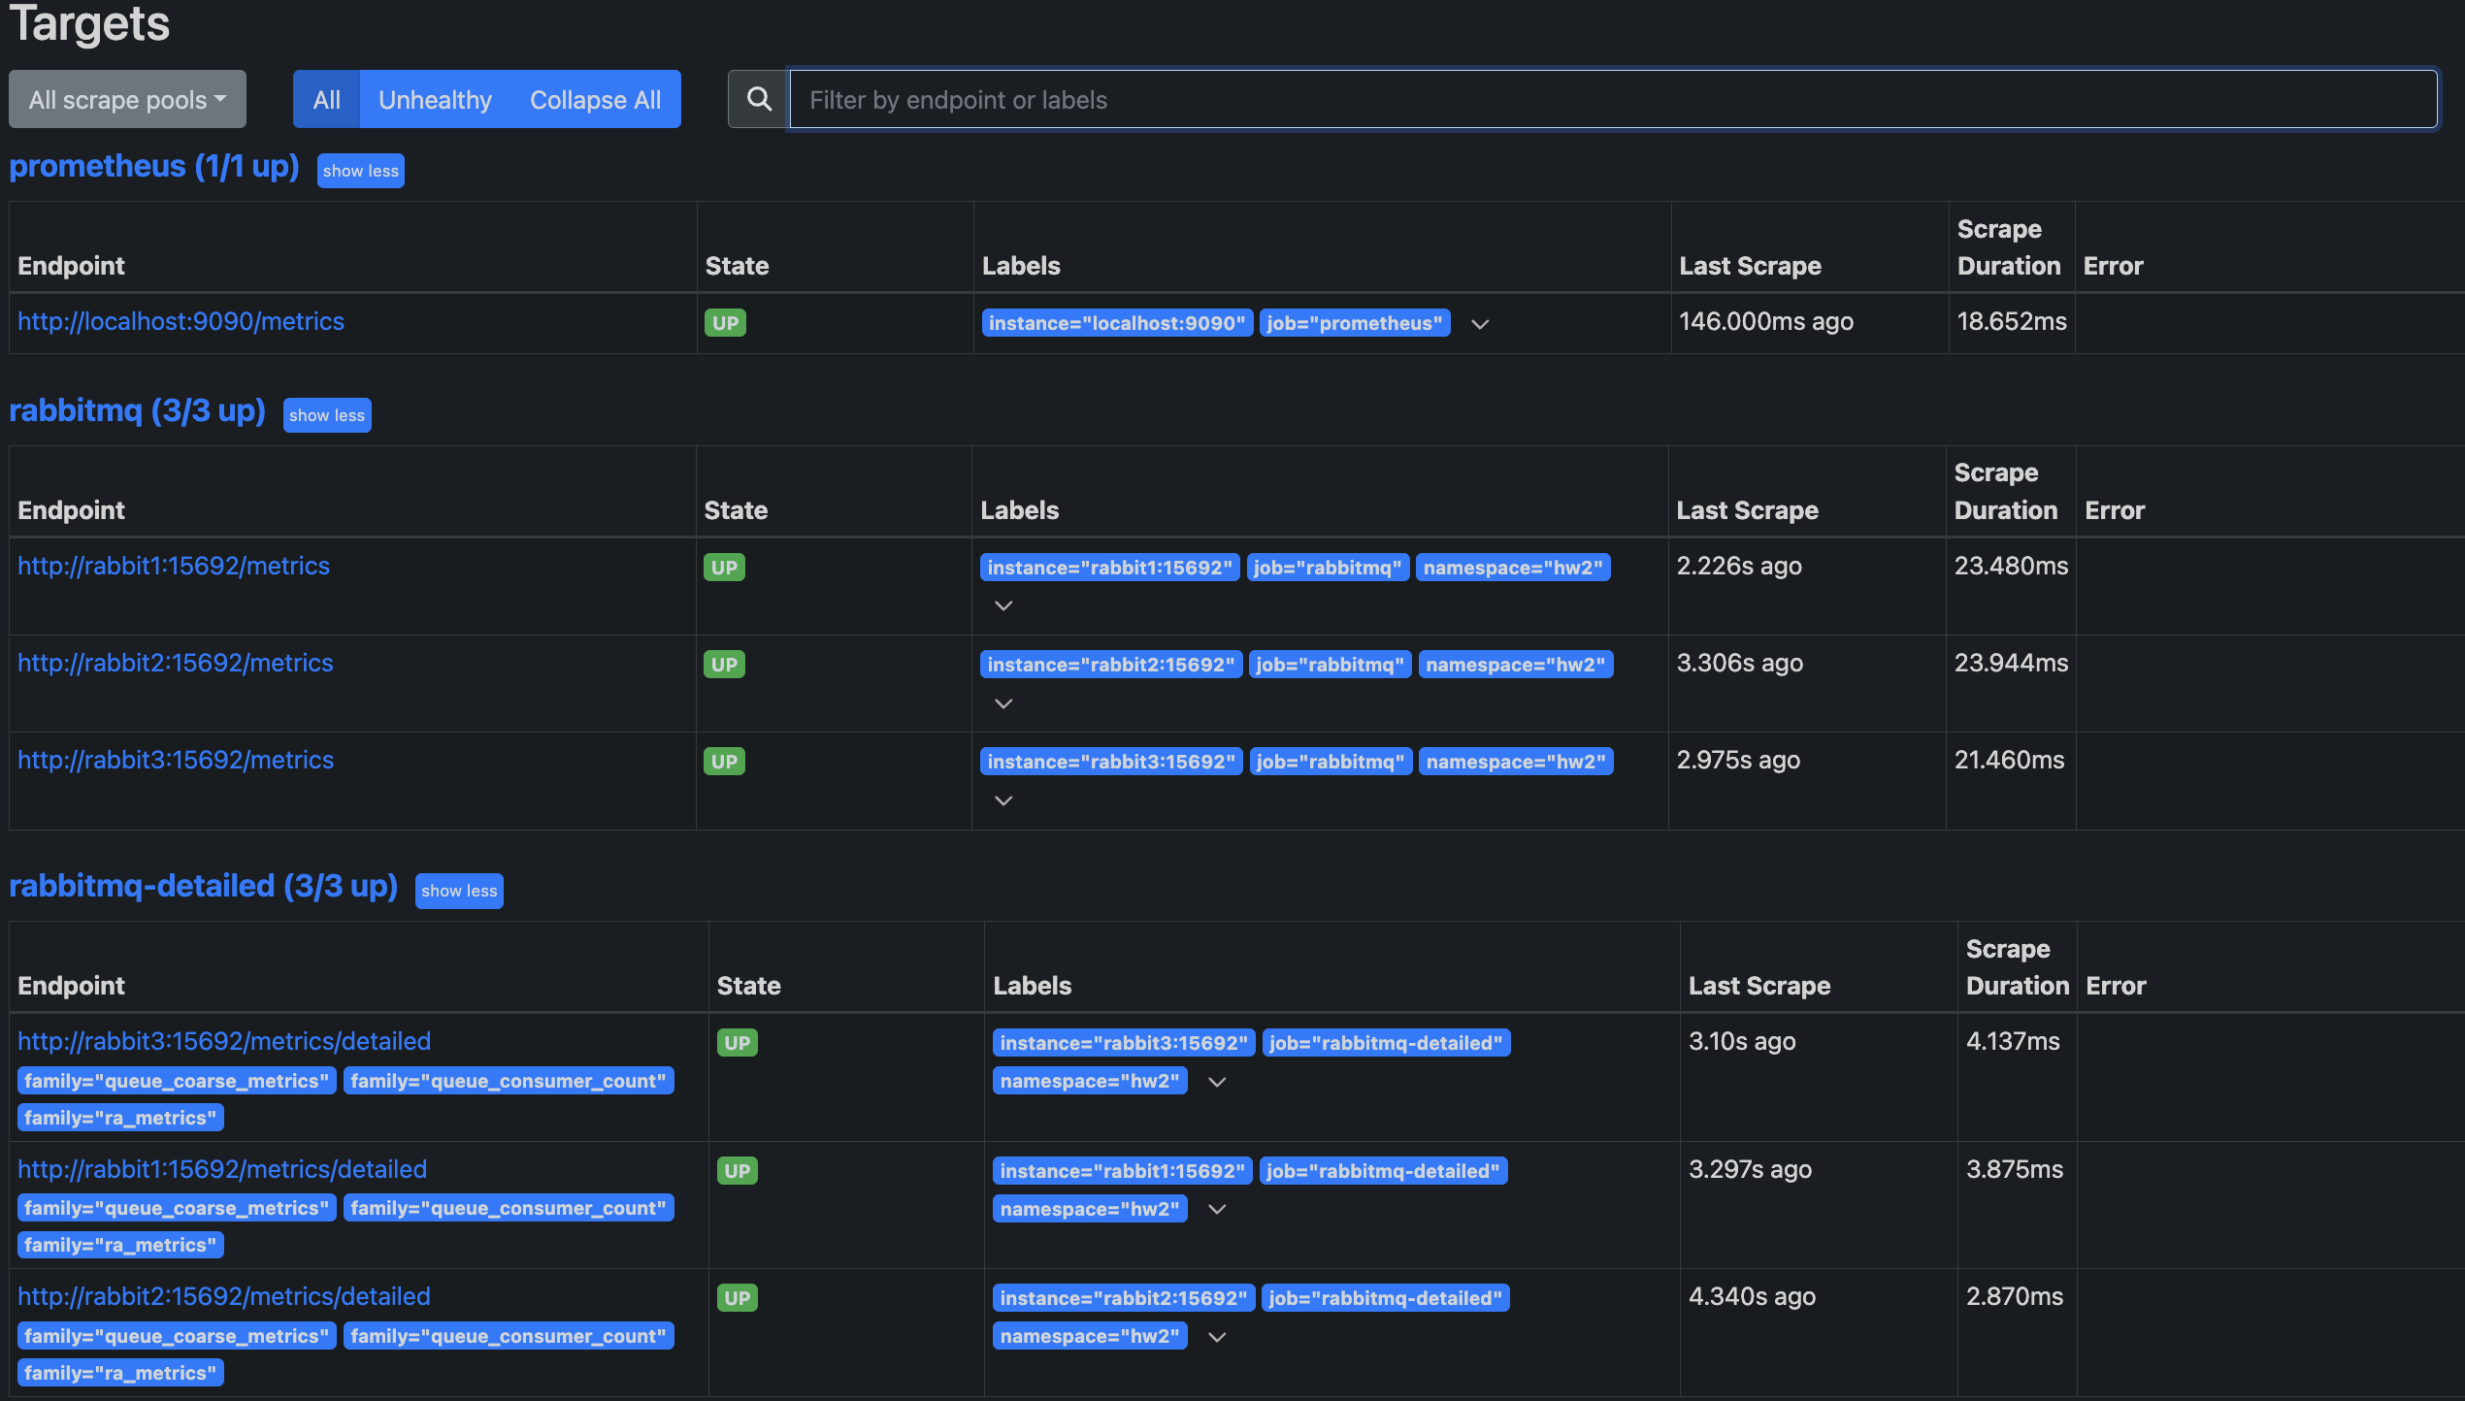
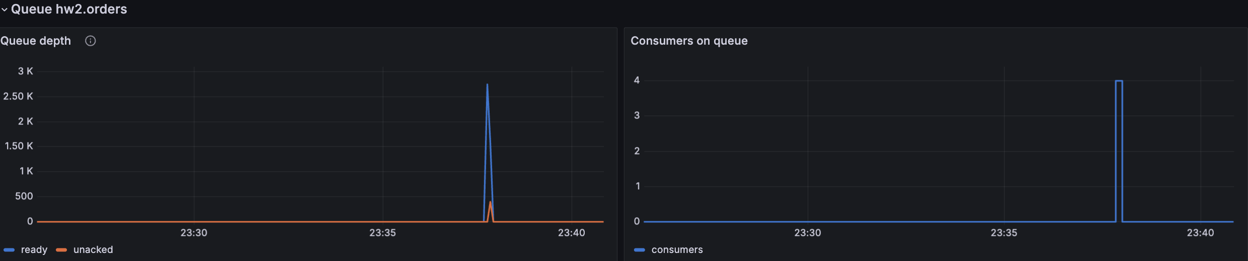
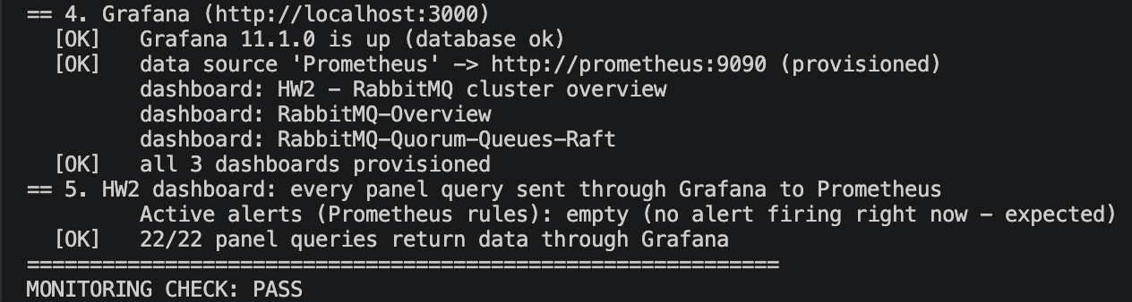
Bonus: Prometheus + Grafana, verified on Docker
Prometheus targets: 7 of 7 UP
Grafana, HW2 dashboard: message rates and queue depth during a message-processing run
Required by the bonus | Grafana panel / Prometheus metric
Queue depth | Queue depth / rabbitmq_detailed_queue_messages
Message rates | Publish / confirm / deliver / ack / rabbitmq_global_messages_*
Node health | Nodes up, memory, disk / up, rabbitmq_alarms_*
check_monitoring.py also reported: 8 alert rules loaded with health ok; node health, queue depth, message and confirm rates present.

Slide 7
Performance: 33 benchmark runs, analysed
What it shows
1 thread: ~3.1 ms per message, 2.1 ms of it waiting for the Raft commit + confirm
16 threads: 2.5x the throughput - CPU-bound on 2 vCPUs
64 KB messages: 302 msg/s but 19.8 MB/s
Prefetch 10/100/500: no difference
Source: benchmarks/results/summary.md, generated by benchmarks/analyze.py from 33 runs in benchmarks/results/raw/ (native test cluster)
Limitations
Measured on a 2-vCPU native test cluster (same config, not Docker); absolute numbers will differ. Broker's own Prometheus count matched the clients within 0.4 %. Synchronous confirms cap one thread at ~320 msg/s. Partitions are slow to resolve (60 s Erlang net_ticktime).

Slide 8
Consumer: manual acks, redelivery and idempotency
Deliver
prefetch 100
Parse
JSON message
Seen msg_id?
de-duplicate
Write + flush
received.csv
basic_ack
only now
Any error -> basic_nack(requeue=True); x-delivery-limit 10 stops a poison message
Why duplicates can happen
Validator: zero loss is a test, not a claim
A consumer dies after processing but before its ack arrives -> the broker redelivers (redelivered = true)
A producer loses a confirm in a crash -> it sends the same msg_id again
Delivery is at-least-once; processing once per msg_id makes it idempotent
lost = confirmed.csv - received.csv
Exit code 1 if lost > 0 or nothing was confirmed. Also reports duplicates, order per consumer and latency. Tested with planted errors: finds exactly 2 lost, 3 duplicated, 1 reordered.

Slide 9
Integration test on Docker: zero lost messages
Run by us on the Docker Compose deployment: 3 healthy RabbitMQ containers, Prometheus and Grafana running
Smoke test
Leader crash under load
./scripts/p4/smoke.sh
./scripts/p4/chaos_run.sh leader-crash
10,000 / 10,000
23,680 / 23,680
confirmed by the broker / received (unique)
confirmed by the broker / received (unique)
0 lost 0 duplicates
RESULT: PASS
0 lost 2 duplicates (detected, not reprocessed)
0 ordering violations per consumer; p95 2.96 ms, max 513.79 ms
RESULT: PASS - producer and consumer exited cleanly
Repeated on Docker: leader crash, follower crash and partition, 3 runs each, plus a full-restart persistence test
9
failure runs under load (3 fault types)
190,405
confirmed messages
0
lost
50,000 -> 50,000
messages through a full restart of all 3 nodes

Slide 10
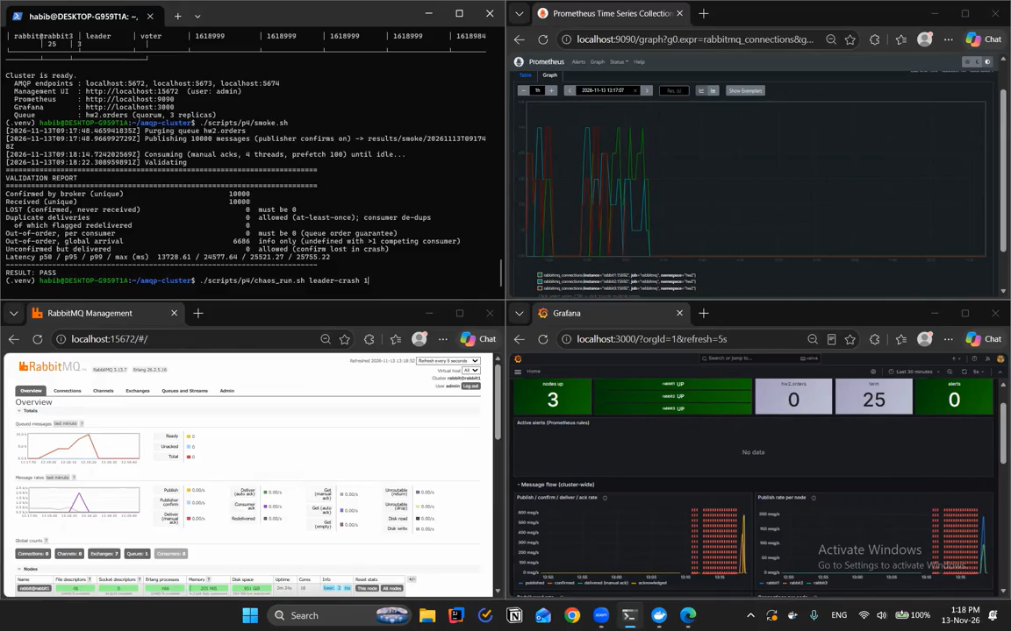
Recorded demo: leader crash under load on Docker
Insert the demo video here
PowerPoint: Insert > Video > Movie from File (Mac) / This Device (Windows)
Resize the video to this frame, then delete this box
What to watch
1 Before: one leader, two followers, 3/3 online
2 All clients start on the leader
3 At 15 s the leader container is killed
4 New leader elected, clients fail over
5 Validator: confirmed = received, LOST 0
6 RESULT: PASS, new leader in a higher term
$ ./scripts/p4/chaos_run.sh leader-crash demo1
Waiting time sped up; nothing else edited
Notes:
Habib - 1:35 (about 1:25 of video)
[before you click play] This is a recording of the leader-crash test on our Docker cluster. The waiting parts are sped up. Nothing else is edited.
[0:00, first quorum status] First, we check the queue. rabbit[X] is the leader, the other two are followers, and all three members are online.
[0:12, test starts] Now we start the test: four producer threads and four consumer threads. All clients start on the leader, so they must fail over.
[0:30, "Injecting fault"] After fifteen seconds, the script kills the leader container. The other two nodes still have a majority, so they elect a new leader, and the clients reconnect to them. The killed node is then started again and rejoins as a follower.
[0:45, sped-up part] The producer finishes, and the consumer empties the queue.
[0:55, validation report] Now the validator. Confirmed and received are the same number: [N]. LOST is zero. Out-of-order per consumer is zero. If there are duplicate deliveries, they are messages delivered again after the crash, and our consumer ignored them. RESULT: PASS.
[1:15, second quorum status] Finally, the queue has a new leader, rabbit[Y], in a higher Raft term, and all three members are online again.

Slide 11
What we proved, and what we learned
Proved
No confirmed message lost. Docker: 0 of 10,000 (smoke), 0 of 23,680 (leader crash), 0 of 190,405 in 9 more failure runs. Native cluster: 0 of 467,287 in 24 failure runs. New leaders elected automatically in about half a second (native).
Learned
Confirms + manual acks give at-least-once, so the consumer must be idempotent. A partition hurts more than a crash. Make the clients fail over in every test, or the test proves nothing.
Next
Asynchronous confirms for throughput, a lower net_ticktime for faster partition detection, TLS and real secrets, nodes on separate machines.
Thank you for your attention!

