Slide 1
TURKISH SENTIMENT ANALYSIS BIM 488 - INTRODUCTION TO PATTERN RECOGNITION
KAAN TAŞ & CAN CANBAY

Slide 2
INTRODUCTION
Sentiment Analysis is the most prominent branch of natural language processing.
It deals with the text classification.
Sentiment Analysis allows to classify movie comments of users to get faster and more accurate results.
The intention can be of positive or negative type.

Slide 3
RELATED WORK
Sentiment analysis concept has been more important day after day.
So that, there have been lots of works about this concept.
Big companies use sentiment analysis to analyze the user comments, searching for products by user sentiments’ etc.
Several companies which works with this topic are Twitter, Bing, IMDB, Google and Amazon.

Slide 4
METHODOLOGY
We use the holdout method (70% for training and 30% for testing) for the evaluation.
Firstly, we obtained training and testing files using given positive and negative text files which have 730 comments.

Slide 5
A. TEXT PREPROCESSING
A.1. Tokenization
Each sentence was separated into words by using each comment. These words are expressed as tokens.
A.2. Stop-Word Removal
Stop-words are words that pass through almost every sentence and are not worthy of classification. Stop-words are usually shorter than 3 letters in Turkish. At this stage, words shorter than 3 letters in length are not considered.
A.3. Stemming
Stemming is the process of reducing inflected (or sometimes derived) words to their word stem, base or root form in linguistic morphology.
We used fixed-prefix as the stemming method. When using fixed-prefix we only got the first 5 letters of words that are more than 5 letters because words are generally 5 letters in Turkish.

Slide 6
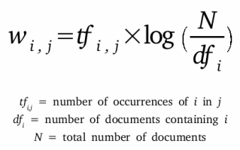
b. Text transformatıon
We calculated the TF-IDF values ​​of each word to measure the importance of these words.
Every comment is considered as a document.
All tf-idf values ​​of each word were added and obtained a weighted score w. Then, these scores were sorted as descending and the first 3000 words were taken.

Slide 7
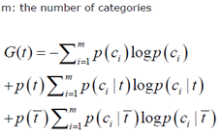
c. Feature selectıon
Given text documents contain billions of words and document vectors would contain billions of dimensions.
As a result, many algorithms cannot handle huge number of terms. So, we use a feature selection method to reduce these terms and to obtain precious terms for classification of comments.
Information gain measures the information obtained for category prediction by knowing the presence or absence of a term in a document.
Information gain is calculated for each term and the best n terms are selected.

Slide 8
c. Feature selectıon
We need to calculate estimating probabilities of some variables to calculate information gain for each term.
P(ci) is the probability of category i. In this project, there are two categories as positive and negative. P(positive) and P(negative) are 0.5 because there are equal number of comments for each category.
P(t) is the probability of a term t. In this project, terms are fetched from comments and it calculated by document frequency of the term over total comment size.
P(~t) is the probability of the absence of t. That value are calculated by using 1-P(t).
P(ci | t) is the probability of category i if term t is in the document which is in category i.
P(positive | term) = How many positive comments have this term / Document frequency of term
P(ci | ~t) is the probability of category i if term t is not in the document which is in category i.
P(positive | ~term) = How many positive comments do not have this term / (Total Document Size - Document frequency of term)

Slide 9
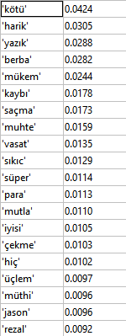
c. Feature selectıon
First 20 features that have the highest information gain values are shown.

Slide 10
d. classıfıcatıon
The task is to assign a comment (document) to one category (positive or negative), based on its contents (words) in this sentiment analysis project.
We use features that came from information gain calculations.
We calculate probability of being positive and negative for each feature.
Then, we use comments that in testing set.
Each word of these comments compare features and if there are features in these comment, each feature probability value multiply with each other.
If positive probability multiplication bigger than negative probability multiplication of a testing comment, this comment’s class is positive and vice versa.

Slide 11
d. classıfıcatıon
Naive Bayes Classifier Formula;
P(word | positive)
= (How many times word in positive comments + 1) / (How many total words in positive comments + How many total words in training feature set (500))

Slide 12
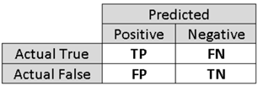
e. evolutıon
Precision = TP / (TP + FP)
Recall = TP / (TP + FP)
Accuracy = (TP + TN) / (TP + TN + FP + FN)
F-Score = (2 * Precision * Recall) / (Precision + Recall)

Slide 13

e. evolutıon
TP, FP, TN and FN values are shown above.
Accuracy is 83.37%
F-Score is 83.13%

Slide 14
THE END

