Slide 1
Final Project
EE P 596 Computer Vision: Classic and Deep Methods
Diman Todorov

Slide 2
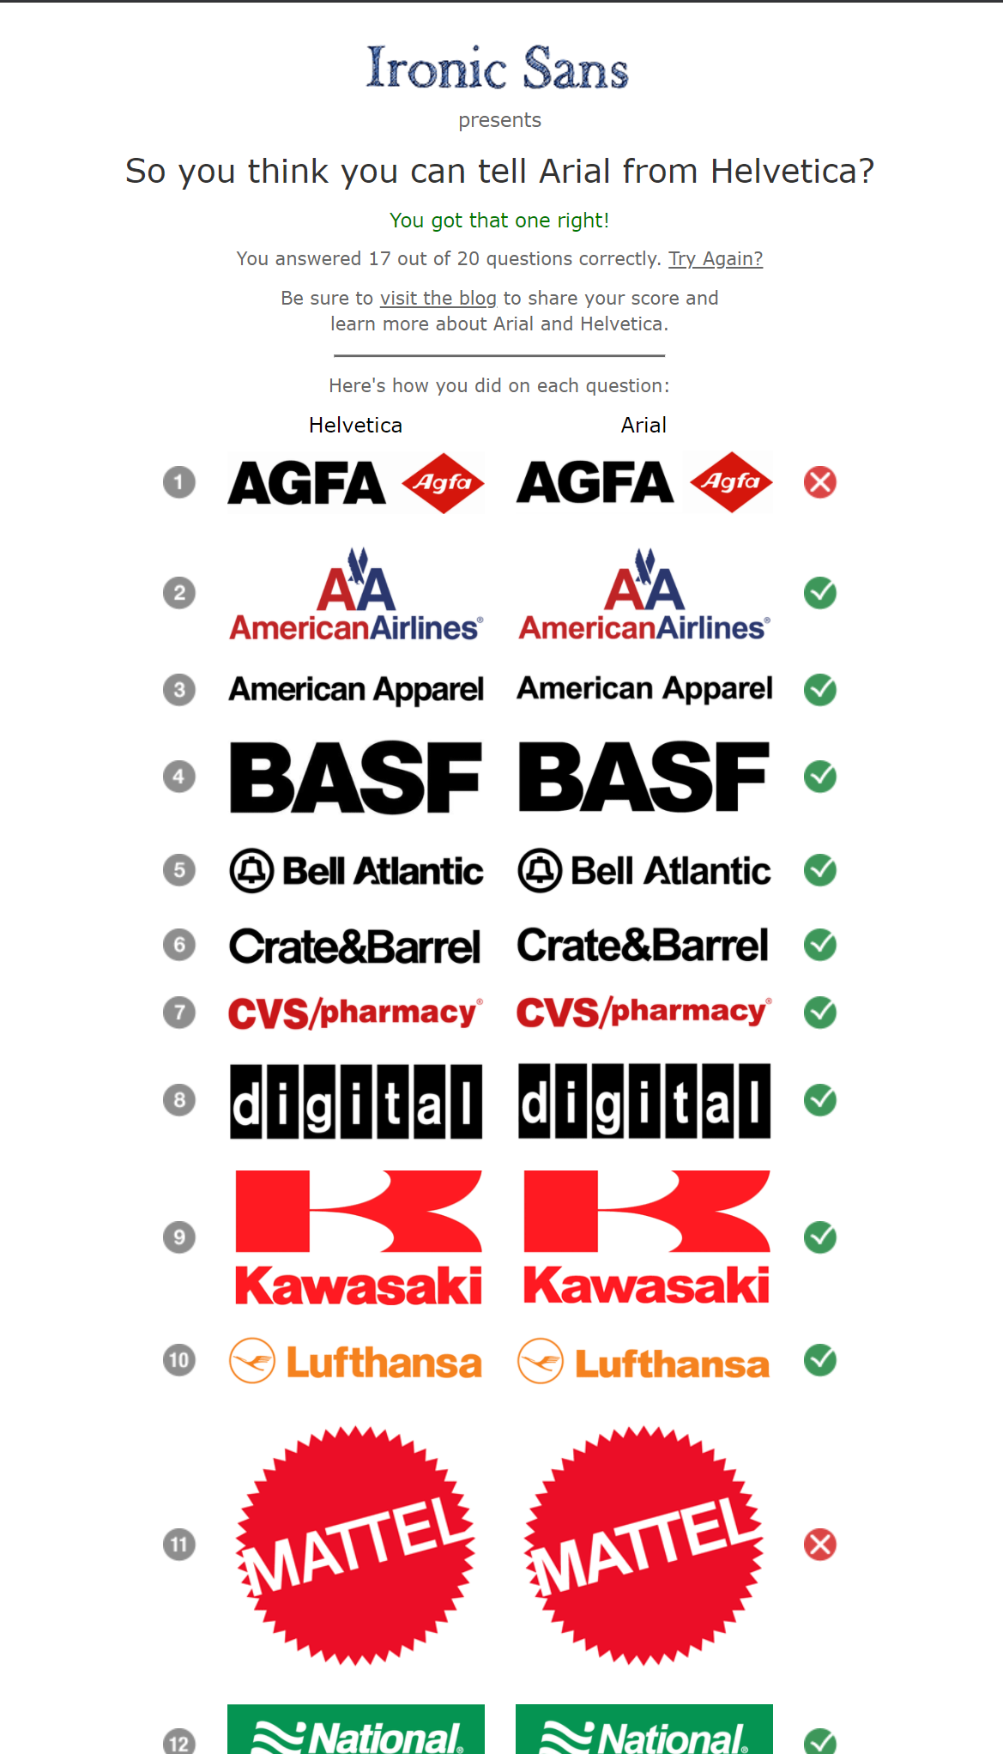
Topic
http://www.ironicsans.com/helvarialquiz/
85% accuracy

Slide 3





Data
~5.5 million abstracts
Examples:
~40k training data
Arial
Times New Roman
Courier New
Calibri
Candara
Georgia
Corbel
Helvetica
Comic Sans MS
Garamond
…
~10k test data

Slide 4
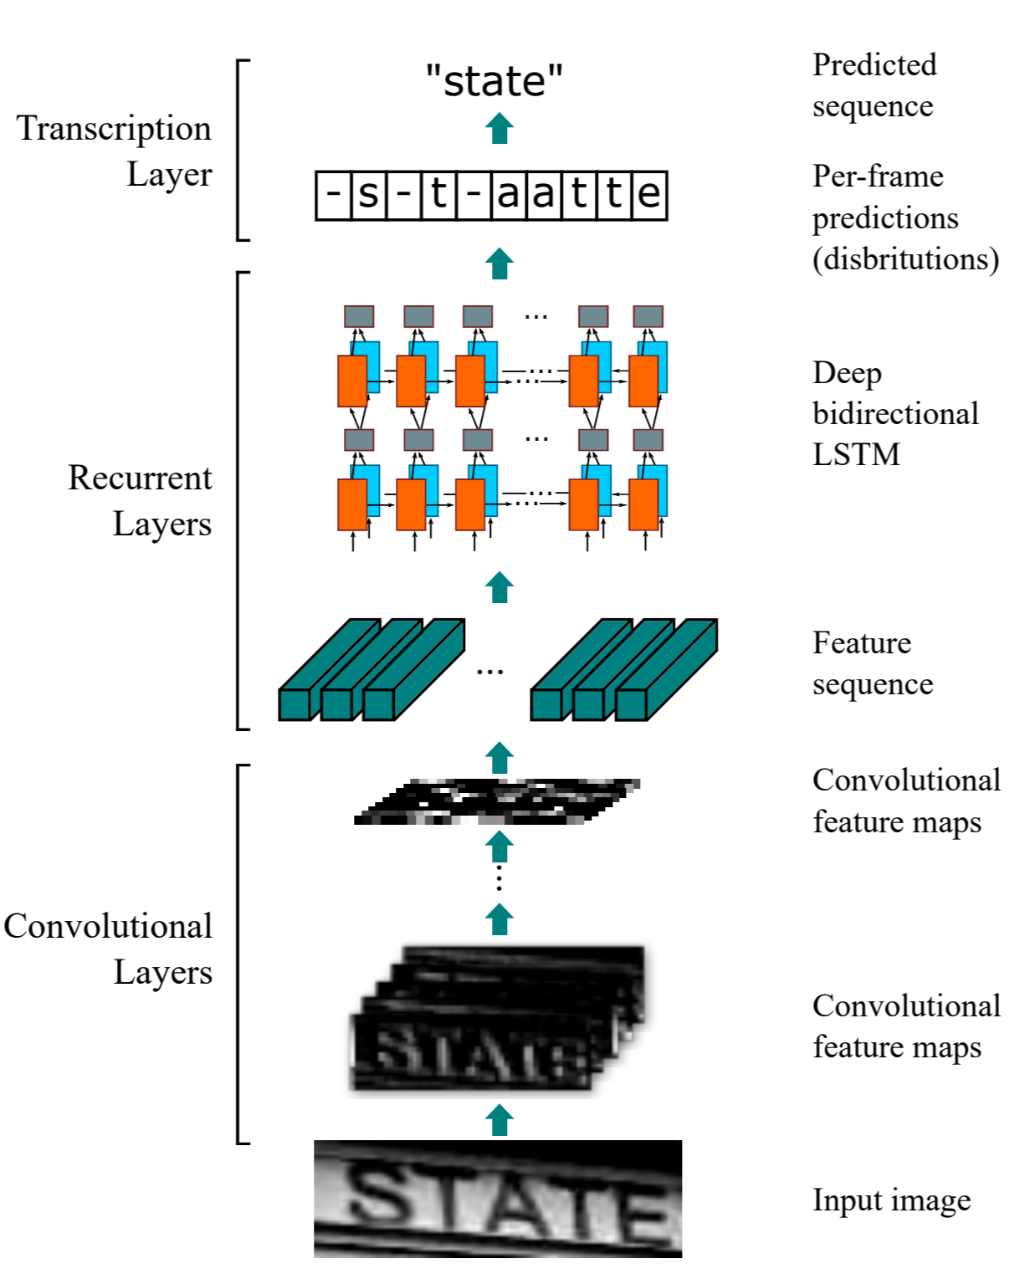
Method
Inspiration: https://github.com/bes-dev/crnn-pytorch
Convolutional Recurrent Neural Network – successful in OCR
Source 32x128
Random Crop 32x32 (crop must be interesting)
Normalize around (0.5, 0.5, 0.5), (0.5, 0.5, 0.5)
Mini Batch size 100 (matters!)
3 epochs
Print loss, accuracy, class accuracy every 100 mini-batches

Slide 5
Results & Future Work
[3, 400] loss: 0.069 accuracy: 98.429
class accuracy: Arial 98.6% Times New Roman 98.6% Courier New 98.6% Calibri 97.1% Candara 100% Georgia 100% Corbel 98.6% Helvetica 92.9% Comic Sans MS 100% Garamond 100%
Finished Training
Irrelevant problem.
But:
more fonts
more backgrounds
more random transforms
real images (e.g. adverts, magazine covers…)

