Slide 1
Operating Systems
CMPSC 473
CPU Management/Memory Virtualization
CPU Scheduling (2), Process Synchronization
September 28, 2015 – Lecture 11
Instructor: Diman Zad Tootaghaj
Adapted from slides by Dr. Bhuvan Urgaonkar
http://www.cse.psu.edu/~buu1/

Slide 2
Implementing User-level Threads
It should be clear that we would need the following:
  UT.1: Scheduling and context switching code as part of process code
    E.g., a library that we link against our process
  UT.2: Room to store hardware context and stack for each thread in process’s own address space
  UT.3: Facility for this code to intervene execution of threads from time to time and run itself (analogous to timer interrupt handling by OS)
  UT.4: Ability to save/restore hw context (in user space)

Slide 3
User-level Threads Implementation: Putting it all Together
Use “alarm” facility provided by the OS to ensure the user-level scheduling/context switching code gets to run from time to time
Implement this code as part of (or called from within) the signal handler
Define your own thread control block data structure to maintain the hardware context and scheduling state for each thread
Use sigsetjmp and siglongjmp for saving/restoring hardware context and for context switching in the thread chosen by your CPU scheduler

Slide 4
Quiz
Q1: Name two optimization goals (metrics) in designing a CPU scheduler and compare FCFS and SRTF with respect to these metrics.
Q2: Processes may be in one of 5 different states, can you name these states?
Q3: A process on an average runs for time T before blocking for I/O. A context switch takes time S which is effectively a waste (overhead). For round robin scheduling with quantum Q (S is not included in Q), give a formula for CPU efficiency for each of the following:
1) Q = S
2) Q >T
3) Q is nearly 0
Hint: CPU efficiency = (Useful CPU time)/(Total CPU time) =(Useful CPU time)/(Sum of CPU useful time and CPU overhead in switching processes).
Notes:
Q1. Throughput: same.
Waiting time smaller in SRTF
Q.2 new, ready, running, waiting, terminated
Q3. a) Q=infinity (b) Q>T (c) S<Q<T (d) Q=S (e) Q nearly 0
For (a) and (b) a process runs for T and a switch occurs when it gets blocked. Efficiency is T/(T+S) In (c), since Q<T, each run of T requires T/Q process switches, resulting in overhead of ST/Q and therefore, the efficiency is T/(T+(ST/Q)) which is Q/(Q+S).
For (d), take Q for S in (c) and we get Q/(Q+Q) which is 50% For (e), the efficiency goes to 0 as Q goes to 0

Slide 5
Process v K thread v U thread
Context switch
  Compare direct overheads
    Saving/restoring registers, executing the scheduler
  Compare indirect overheads
    TLB flush, Cache pollution
    Kernel/User mode transitions
Memory needs
  Compare
    User space memory
    Kernel memory
Parallelism and scheduling
  What happens on a multi-CPU system?
  What happens upon blocking I/O?

Slide 6
Round Robin (RR)
Each process gets a small unit of CPU time (time quantum), usually 10-100 milliseconds. After this time has elapsed, the process is preempted and added to the end of the ready queue.
If there are n processes in the ready queue and the time quantum is q, then each process gets 1/n of the CPU time in chunks of at most q time units at once. No process waits more than (n-1)q time units.
Performance
  q large => FCFS
  q small => q must be large with respect to context switch, otherwise overhead is too high

Slide 7
Example of RR with Time Quantum = 20
Process CPU Time
P₁ 53
P₂ 17
P₃ 68
P₄ 24
The Gantt chart is:
Typically, higher average turnaround than SJF, but better response
P₁
P₂
P₃
P₄
P₁
P₃
P₄
P₁
P₃
P₃
0
20
37
57
77
97
117
121
134
154
162

Slide 8

Time Quantum and Context Switch Time

Slide 9

Turnaround Time Varies With Time Quantum

Slide 10
Proportional-Share Schedulers
A generalization of round robin
Process P_{i} given a CPU weight w_{i} > 0
The scheduler needs to ensure the following
  forall i, j, |T_{i}(t₁, t₂)/T_{j}(t₁,t₂) - w_{i}/w_{j}| ≤ e
  Given P_{i} and P_{j} were backlogged during [t₁,t₂]
Que: Who chooses the weights and how?

Slide 11
Lottery Scheduling
Perhaps the simplest proportional-share scheduler
Create lottery tickets equal to the sum of the weights of all processes
Draw a lottery ticket and schedule the process that owns that ticket

Slide 12

Lottery Scheduling Example
P1=6
P2=9
1
4
7
10
13
2
5
8
11
14
3
6
9
12
15
9
Schedule P2

Slide 13
Lottery Scheduling Example
P1=6
P2=9
1
4
7
10
13
2
5
8
11
14
3
6
9
12
15
3
Schedule P1

Slide 14
Lottery Scheduling Example
P1=6
P2=9
1
4
7
10
13
2
5
8
11
14
3
6
9
12
15
11
As t ∞, processes will get their share (unless they were blocked a lot)
Problem with Lottery scheduling: Only probabilistic guarantee
What does the scheduler have to do
  When a new process arrives?
  When a process terminates?
Schedule P2

Slide 15
Lottery Scheduling
Exercise: Calculate the time complexity of the operations Lottery scheduling will involve

Slide 16
Priority-based Scheduling
Associate with each process a quantity called its CPU priority
At each scheduling instant
  Pick the ready process with the highest CPU priority
  Update (usually decrement) the priority of the process last running
    Priority = Time since arrival => FCFS
    Priority = 1/Size => SJF
    Priority = 1/Remaining Time => SRPT
    Priority = Time since last run => Round-robin (RR)
UNIX variants
  Priority values are positive integers with upper bounds
  Decreased every quantum
    Fairness, avoid starvation
  Increased if the process was waiting, more wait => larger increase
    To make interactive processes more responsive
  Problems
    Hard to analyze theoretically, so hard to give any guarantees
    May unfairly reward blocking processes

Slide 17
Multilevel Queue
Ready queue is partitioned into separate queues:
foreground (interactive)
background (batch)
Each queue has its own scheduling algorithm
  foreground – RR
  background – FCFS
Scheduling must be done between the queues
  Fixed priority scheduling; (i.e., serve all from foreground then from background). Possibility of starvation.
  Time slice – each queue gets a certain amount of CPU time which it can schedule amongst its processes; i.e., 80% to foreground in RR
  20% to background in FCFS

Slide 18

Multilevel Queue Scheduling

Slide 19
Multilevel Feedback Queue
A process can move between the various queues; aging can be implemented this way
Multilevel-feedback-queue scheduler defined by the following parameters:
  number of queues
  scheduling algorithms for each queue
  method used to determine when to upgrade a process
  method used to determine when to demote a process
  method used to determine which queue a process will enter when that process needs service

Slide 20
Example of Multilevel Feedback Queue
Three queues:
  Q₀ – RR with time quantum 8 milliseconds
  Q₁ – RR time quantum 16 milliseconds
  Q₂ – FCFS
Scheduling
  A new job enters queue Q₀ which is served FCFS. When it gains CPU, job receives 8 milliseconds. If it does not finish in 8 milliseconds, job is moved to queue Q₁.
  At Q₁ job is again served FCFS and receives 16 additional milliseconds. If it still does not complete, it is preempted and moved to queue Q₂.

Slide 21

Multilevel Feedback Queues

Slide 22
Work Conservation
Examples of work-conserving schedulers: All schedulers we have studied so far
  Work conservation: The resource (e.g., CPU) can not be idle if there is some work to be done (e.g., at least one ready process)
Example of a non-work-conserving scheduler:
  Reservation-based (coming up)

Slide 23
Reservation-based Schedulers
Each process has a pair (x, y)
  Divide time into periods of length y each
  Guaranteed to get x time units every period
Why is this NWC?
Why design a NWC scheduler?

Slide 24
Hierarchical Schedulers
Reservation-based
(4, 10)
(6, 10)
Round-robin
Lottery
w=1
w=2
UNIX
UNIX
Processes
A way to compose a variety of schedulers
Sets of processes with different scheduling needs
Exercise: Think of conditions under which a tree of schedulers becomes NWC

Slide 25
Address Spaces: A Refinement
OS
OS
P1
P2
OS
P1
P2
The OS is made part of the address space of every process
Why?
  User/kernel transitions are not context switches anymore!
  Need to disallow virtual address range of OS from being accessed by processes -> MMU helps with this

Slide 26
Virtual memory

Slide 27
Background
Program must be brought (from disk) into memory and placed within a process for it to be run
Main memory and registers are only storage CPU can access directly
Protection of address spaces required to ensure correct operation

Slide 28
Recap: Logical vs. Physical Address Space
The concept of a logical address space that is bound to a separate physical address space is central to proper memory management
  Logical address – generated by the CPU; also referred to as virtual address
  Physical address – address seen by the memory unit
Logical and physical addresses are the same in compile-time and load-time address-binding schemes; logical (virtual) and physical addresses differ in execution-time address-binding scheme

Slide 29
What We Will Study
Recap: How do caches help bridge CPU/memory gap?
  The “memory wall”
How do the hardware and the OS fit many processes into limited DRAM?
  Memory Management Unit (MMU)
  Virtual memory
How can virtual memory be made to perform efficiently?

Slide 30
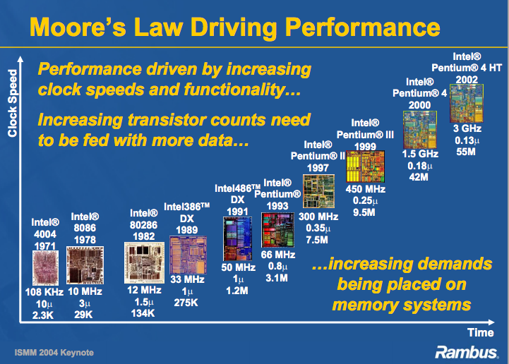

Slide 31
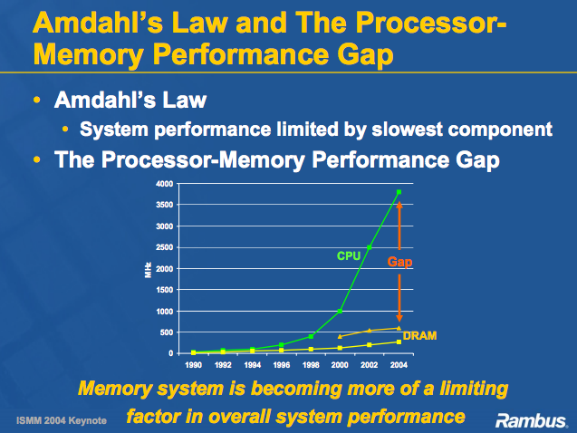

Slide 32
Reducing CPU/Memory Gap
Approach #1: Design faster DRAMs
  Double Data Rate: Transfer data at both the rising and the falling edge of a clock
  DDR1
    100 Mhz memory clock: upto 1600 MB/sec
  DDR2: DDR1+faster data bus
    100 MHz memory clock: upto 3200 MB/sec
  DDR3: Even faster data bus
    100 MHz memory clock: upto 6400 MB/sec
  DDR4: Further doubling of max BW

Slide 33
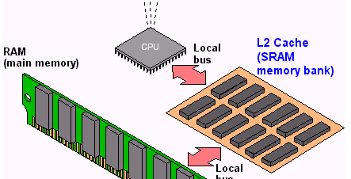
Reducing CPU/Memory Gap
Approach #2: Use hardware caches

Slide 34
Access Latencies
SECONDARY STORAGE
FLASH HDD
MAIN MEMORY
DRAM PCM
LAST-LEVEL
CACHE
EDRAM
L1 CACHE
SRAM
2¹
2³
2⁵
2⁷
2⁹
2¹¹
2¹³
2¹⁵
2¹⁷
2¹⁹
2²¹
2²³

Slide 35
Memory-Management Unit (MMU)
Hardware device that maps virtual to physical address
In MMU scheme, the value in the relocation register is added to every address generated by a user process at the time it is sent to memory
The user program deals with logical addresses; it never sees the real physical addresses

Slide 36

Dynamic relocation using a relocation register

