Slide 1
Operating Systems
CMPSC 473
Memory Virtualization
October 1, 2015 – Lecture 12
Instructor: Diman Zad Tootaghaj
Adapted from slides by Dr. Bhuvan Urgaonkar
http://www.cse.psu.edu/~buu1/

Slide 2
Announcements
Practice set question #1 is posted on Angel.
  won’t be graded, but useful to practice for exam.
No Class next week (Tuesday and Thursday)

Slide 3
Virtual memory

Slide 4
Background
Program must be brought (from disk) into memory and placed within a process for it to be run
Main memory and registers are only storage CPU can access directly
Protection of address spaces required to ensure correct operation

Slide 5
Recap: Logical vs. Physical Address Space
The concept of a logical address space that is bound to a separate physical address space is central to proper memory management
  Logical address – generated by the CPU; also referred to as virtual address
  Physical address – address seen by the memory unit
Logical and physical addresses are the same in compile-time and load-time address-binding schemes; logical (virtual) and physical addresses differ in execution-time address-binding scheme

Slide 6
What We Will Study
Recap: How do caches help bridge CPU/memory gap?
  The “memory wall”
How do the hardware and the OS fit many processes into limited DRAM?
  Memory Management Unit (MMU)
  Virtual memory
How can virtual memory be made to perform efficiently?

Slide 7
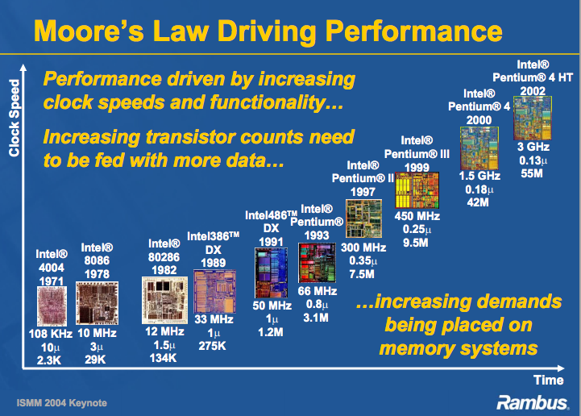

Slide 8
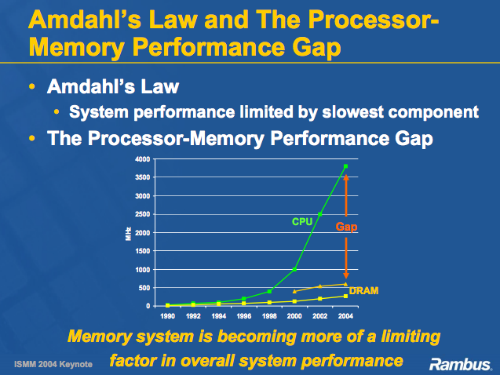

Slide 9
Reducing CPU/Memory Gap
Approach #1: Design faster DRAMs
  Double Data Rate: Transfer data at both the rising and the falling edge of a clock
  DDR1
    100 Mhz memory clock: upto 1600 MB/sec
  DDR2: DDR1+faster data bus
    100 MHz memory clock: upto 3200 MB/sec
  DDR3: Even faster data bus
    100 MHz memory clock: upto 6400 MB/sec
  DDR4: Further doubling of max BW

Slide 10
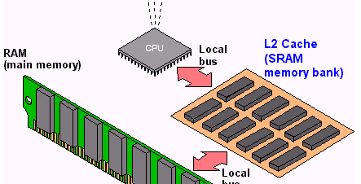
Reducing CPU/Memory Gap
Approach #2: Use hardware caches

Slide 11
Access Latencies
SECONDARY STORAGE
FLASH HDD
MAIN MEMORY
DRAM PCM
LAST-LEVEL
CACHE
EDRAM
L1 CACHE
SRAM
2¹
2³
2⁵
2⁷
2⁹
2¹¹
2¹³
2¹⁵
2¹⁷
2¹⁹
2²¹
2²³

Slide 12
Memory-Management Unit (MMU)
Hardware device that maps virtual to physical address
In MMU scheme, the value in the relocation register is added to every address generated by a user process at the time it is sent to memory
The user program deals with logical addresses; it never sees the real physical addresses

Slide 13

Dynamic relocation using a relocation register

Slide 14

HW address protection with base and limit registers

Slide 15
Swapping
A process can be swapped temporarily out of memory to a backing store, and then brought back into memory for continued execution
Backing store – fast disk large enough to accommodate copies of all memory images for all users; must provide direct access to these memory images

Slide 16

Schematic View of Swapping

Slide 17
Swapping
 | memory
 | OS
2K | P1
6K | P2
12K | empty
P3
Secondary
storage
P4
P5
empty

Slide 18
Swapping
 | memory
 | OS
2K
6K | P2
12K | empty
Swap out
P1
P3
P1
Secondary
storage
P4
P5
empty

Slide 19
Swapping
 | memory
 | OS
2K | P3
6K | P2
12K | empty
Swap in
P3
P1
Secondary
storage
P4
P5
empty

Slide 20
Swapping
 | memory
 | OS
2K | P3
6K | P2
12K | empty
P1
Secondary
storage
P4
P5
empty

Slide 21
Swapping
 | memory
 | OS
2K
6K | P2
12K | empty
Swap out
P3
P1
P3
Secondary
storage
P4
P5
empty

Slide 22
Swapping
 | memory
 | OS
2K | P1
6K | P2
12K | empty
Swap in
P1
P3
Secondary
storage
P4
P5
empty

Slide 23
Swapping
 | memory
 | OS
2K | P1
6K | P2
12K | empty
P3
Secondary
storage
P4
P5
empty

Slide 24
Recall: Contiguous Allocation
Relocation registers used to protect user processes from each other, and from changing operating-system code and data
  Base register contains value of smallest physical address
  Limit register contains range of logical addresses – each logical address must be less than the limit register
  MMU maps logical address dynamically

Slide 25
Contiguous Allocation (Cont.)
Multiple-partition allocation
  Hole – block of available memory; holes of various size are scattered throughout memory
  When a process arrives, it is allocated memory from a hole large enough to accommodate it
  Operating system maintains information about:
  a) allocated partitions b) free partitions (hole)
OS
OS
OS
OS
process 5
process 5
process 5
process 5
process 9
process 9
process 8
process 10
process 2
process 2
process 2
process 2

Slide 26
Dynamic Storage-Allocation Problem
How to satisfy a request of size n from a list of free holes
First-fit: Allocate the first hole that is big enough
Best-fit: Allocate the smallest hole that is big enough; must search entire list, unless ordered by size
  Produces the smallest leftover hole
Worst-fit: Allocate the largest hole; must also search entire list
  Produces the largest leftover hole
First-fit and best-fit better than worst-fit in terms of speed and storage utilization

Slide 27
Fragmentation
External Fragmentation – total memory space exists to satisfy a request, but it is not contiguous
  Consider some simple examples <on board>
Reduce external fragmentation by compaction
  Shuffle memory contents to place all free memory together in one large block
  Note: will encounter a similar problem with file systems
Many shortcomings:
  Compaction overheads may be high
  Restrictive in handling dynamic growth/reduction in address spaces
  I/O problem (will understand later)
    Latch job in memory while it is involved in I/O
    Do I/O only into OS buffers

Slide 28
Key Lesson
Allow address space of a process to be non contiguous in main memory
Two classic solutions:
  Paging
  Segmentation (on your own, not on syllabus, Chapter 16)

Slide 29

Paging

Slide 30
Paging
Set up a “page table” to translate logical to physical addresses

Slide 31
Paging vs. Contiguous Allocation
What we gain:
  No external fragmentation!
  No compaction (and associated overheads)
  “All pages are equal” => better handling of uncertainty
What we lose:
  Internal fragmentation
  Higher translation overheads (coming up)

Slide 32
Fragmentation
 | memory
 | OS
2K
6K | Empty (6K)
12K | empty Empty (3K)
If a whole partition is currently not being used, then it is called an external fragmentation.
P1 (2K)
If a partition is being used by a process requiring some memory smaller than the partition size, then it is called an internal fragmentation.
P2 (9K)

Slide 33
Address Translation Scheme
Address generated by CPU is divided into:
  Page number (p) – used as an index into a page table which contains base address of each page in physical memory
  Page offset (d) – combined with base address to define the physical memory address that is sent to the memory unit
  For given logical address space 2^{m} and page size 2^{n}
p
d
page number
page offset
m - n
n

Slide 34

Paging Address Translation

Slide 35

Paging Example
32-byte memory and 4-byte pages

Slide 36

Free Frames
Before allocation
After allocation

Slide 37
Paging: Translation Overheads
Note page table itself kept in main memory
Every data/instruction access requires two memory accesses!!
  One for the page table and one for the data/instruction.
The two memory access problem can be solved by the use of a special fast-lookup hardware cache called translation look-aside buffers (TLBs)

Slide 38

Paging Hardware With TLB

