Slide 1
Operating Systems
CMPSC 473
Process Synchronization
November 3, 2015 – Lecture 18
Instructor: Diman Zad Tootaghaj
Adapted from slides by Dr. Bhuvan Urgaonkar
http://www.cse.psu.edu/~buu1/

Slide 2
Process Synchronization

Slide 3
Recap
The mutual exclusion approach to addressing data races
Important to also ensure certain liveness conditions
“Mutex lock” or simply “lock”
  How to implement it?
  How to use it?

Slide 4
Mutual Exclusion/Critical Section Problem (Mutex)
Each process's code is divided into four sections:
  entry: synchronize with others to ensure mutually exclusive access to the …
  critical: use some resource; when done, enter the…
  exit: clean up; when done, enter the…
  remainder: not interested in using the resource
entry
remainder
critical
exit

Slide 5
Mutual Exclusion Algorithms
A mutual exclusion algorithm specifies code for entry and exit sections to ensure:
  mutual exclusion: at most one process is in its critical section at any time, and
  some kind of "liveness" condition. There are three commonly considered ones…
Mutex = Mutual Exclusion + Liveness

Slide 6
Mutex Liveness Conditions
1. no deadlock (not considered in your text): if a process is in its entry section at some time, then later some process is in its critical section
2. progress/no lockout/no starvation: if a process is in its entry section at some time, then later the same process is in its critical section
3. bounded waiting: no lockout + while a process is in its entry section, other processes enter the critical section no more than a certain number of times.
These conditions are increasingly strong (each implies the previous ones)
  Exercise: Prove this
Note: Slightly different terminology than your text

Slide 7
Mutex lock
Usage:
E.g., pthreads functions:
  pthread_mutex_t mymutex = PTHREAD_MUTEX_INITIALIZER; or
  pthread_mutex_init (mymutex, attr);
  pthreads_mutex_lock (mutex)
  pthreads_mutex_unlock (mutex)
Acquire the lock
Lock is locked
Critical Section
Lock is unlocked
Release the lock

Slide 8
P-C: Making count++, count– “atomic”
lock mutex;
while (true) {
while (count == 0); // do nothing
nextConsumed = buffer[out];
out = (out + 1) % BUFFER_SIZE;
lock(mutex);
count--;
unlock(mutex);
/* consume the item in nextConsumed */
}
while (true) {
/* produce an item and put in nextProduced */
while (count == BUFFER_SIZE); // do nothing
buffer [in] = nextProduced;
in = (in + 1) % BUFFER_SIZE;
lock(mutex);
count++;
unlock(mutex);
}
Shared variables: buffer, count, and mutex
  New shared variable mutex used only by entry/exit sections after being initialized
Local variables: in, out, nextProduced, nextConsumed

Slide 9
P-C: Deadlock!
lock mutex;
while (true) {
lock (mutex);
while (count == 0); // do nothing
unlock (mutex);
nextConsumed = buffer[out];
out = (out + 1) % BUFFER_SIZE;
lock (mutex);
count--;
unlock (mutex);
/* consume the item in nextConsumed */
}
while (true) {
/* produce an item and put in nextProduced */
lock (mutex);
while (count == BUFFER_SIZE); // do nothing
unlock (mutex);
buffer [in] = nextProduced;
in = (in + 1) % BUFFER_SIZE;
lock (mutex);
count++;
unlock (mutex);
}
Consumer consumes one item from a full buffer
Cannot decrement count since lock held by producer
Producer waiting on count to become less than BUFFER_SIZE
Consumer waiting for the producer to release the lock

Slide 10
Example to Show Mut. Excl. is Non-trivial
How about constructing a “lock” s.t. before getting into critical section, we acquire it and after leaving critical section, we release it?
Is there any trouble if we use a boolean flag as a lock? Consider P1 and P2
while (lock == 1) ; // Do nothing, just wait
//position 1
lock = 1;
.....
..... // Critical Section
.....
lock = 0;
If P1 interrupted at position 1, race condition might occur
P1 was waiting until lock == 0. Before it announces its turn (i.e., sets lock = 1), suppose P2 gets scheduled, sees that lock is 0, and enters its critical section
Before P2 leaves its critical section (i.e., sets lock = 0), suppose it gets descheduled
Since P1 was at position 1, it will set lock = 1 and also get into its critical section
Now, two processes are in the critical section at the same time!
Doesn’t work!

Slide 11
Mutex Via Disabling Interrupts
One way to achieve mutex is to disable interrupts when someone is in their critical section
  Why does this work? Extensively used inside the kernel
    Very efficient for small critical sections
  How would you adopt this to design a mutex lock in your threads library (P1)
    Hint: Disable signals
  Downsides:
    not generally useful
      What if a trap occurs with interrupts disabled?
      What if certain interrupts are non-maskable?
    efficient only for really small critical sections

Slide 12
Peterson’s Solution
Two process solution
Important: LOAD and STORE instructions are atomic; that is, cannot be interrupted.
The two processes share two variables:
  int turn;
  Boolean flag[2]
The variable turn indicates whose turn it is to enter its critical section.
The flag array is used to indicate if a process is ready to enter its critical section. flag[i] = true implies that process P_{i} is ready

Slide 13
Algorithm for Process P_{i}
while (true) {
flag[i] = TRUE;
turn = j;
while (flag[j] && turn == j);
CRITICAL SECTION
flag[i] = FALSE;
REMAINDER SECTION
}

Slide 14
while (true) {
flag[0] = TRUE;
turn = 1;
while(flag[1] && turn == 1);
CRITICAL SECTION
flag[0] = FALSE;
REMAINDER
}
while (true) {
flag[1] = TRUE;
turn = 0;
while(flag[0] && turn == 0);
CRITICAL SECTION
flag[1] = FALSE;
REMAINDER
}

Slide 15
Another look at Peterson’s Mutex Algorithm
while (true) {
flag[0] = TRUE;
turn = 1;
while ( flag[1] && turn == 1);
P0’s CRITICAL SECTION
flag[0] = FALSE;
P0’s REMAINDER SECTION
}
while (true) {
flag[1] = TRUE;
turn = 0;
while ( flag[0] && turn == 0);
P1’s CRITICAL SECTION
flag[1] = FALSE;
P1’s REMAINDER SECTION
}
Acquiring lock
Releasing lock

Slide 16
Proof: Mutex
P0 and P1 can never be in their critical sections together
When P0 is in its critical section, either
  flag[1] == FALSE
    i.e., P1 has left its CS
  Or turn == 0
    i.e., P1 in its entry section but has let P0 “go ahead at its own cost” and unable to proceed beyond its entry section till P0 comes out of its critical section

Slide 17
Proof: Bounded Wait
Consider P0 stuck in its entry section
  i.e., (flag[1] == TRUE) and (turn == 1)
Suppose P1 comes out of its CS and sets flag[1] = FALSE
Case 1: P0 gets to check flag[1] before P1 has a chance to set it back to TRUE
  P0 enters its CS
Case 2: P1 “races ahead” and does flag[1] = TRUE
  P0 will continue to be stuck in its while loop if it is context switched in
  Eventually, P1 will execute turn = 0
  Now, P1 will get stuck in its while loop
    Since flag[0] == TRUE and turn == 0)
  Eventually, P0 gets to run and finds the while condition false
    Since flag[1] == TRUE, but turn == 0

Slide 18
Algorithm (inventer, year) | Num. of processes/threads | Busy waiting? | Liveness guarantee | Other remarks
Dekker, pre-1965 | 2 | Yes | Bounded wait | First known solution to the mutex problem
Dijkstra, 1965 | n > 0 | Yes | No deadlock | Read this classic paper (only 1 page long) on ANGEL
Eisenberg and McGuire, 1972 | n > 0 | Yes | Bounded wait | Dekker’s generalization to any n
Bakery (Lamport, 1974) | n > 0 | Yes | Bounded Wait | Unbounded growth of variables poses practical limits
Peterson, 1981 | 2 | Yes | Bounded Wait | Easier to generalize to n than Dekker’s

Slide 19

Note on Edgar W. Dijkstra and his Solution
First to define phrases mutual exclusion, critical section, remainder section
Later invented semaphores (coming shortly)
Another famous contribution: Shortest Path Algorithm in graphs
Turning award in 1972
Prof. at Univ of Texas
Colorful person (combative, rarely used computers), read more online
Suggested paper #1: On ANGEL
  Only 1 page long

Slide 20
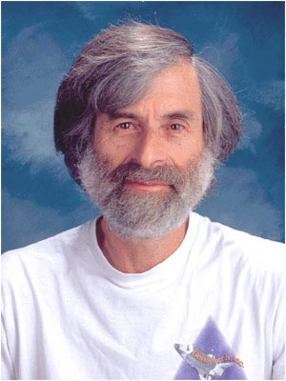
Leslie Lamport and his Solution
Bakery algorithm
  Has nice fault tolerance features in addition to bounded wait
Seminal work on fault tolerance
Invented LaTeX
Dijkstra prize in 2005
Worked at DEC, now at MSR
Turning award in 2013.

Slide 21
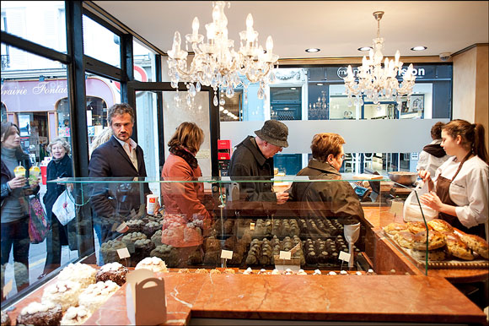
Bakery Algorithm

Slide 22
Bakery Algorithm
Suggested reading #2
Will put paper up on ANGEL
Read on your own
  Optional but highly recommended
  Classic paper
  Only 4 pages
  Understand proofs of mutex and bounded wait
  Understand problems due to integer overflow

Slide 23
Hardware Support for Mutex
Many systems provide hardware support for critical section code
Uniprocessors – could disable interrupts
  Currently running code would execute without preemption
  Generally too inefficient on multiprocessor systems
    Operating systems using this not broadly scalable
Modern machines provide special atomic hardware instructions
  Either test memory word and set value
  Or swap contents of two memory words

Slide 24
Mutex Via Disabling Interrupts
One way to achieve mutex is to disable interrupts when someone is in their critical section
  Why does this work? Extensively used inside the kernel
    Very efficient
  Downsides?
    What if a trap occurs with interrupts disabled?
    What if certain interrupts are non-maskable?
  How would you adopt this to design a mutex lock in your threads library
    Hint: Disable signals

Slide 25
TestAndndSet Instruction
Definition:
boolean TestAndSet (boolean *target)
{
boolean rv = *target;
*target = TRUE;
return rv:
}

Slide 26
Mutex lock using TestAndSet
Shared boolean variable lock, initialized to false
Solution:
while (true) {
while ( TestAndSet (&lock )); /* do nothing
// critical section
lock = FALSE;
// remainder section
}

Slide 27
Swap Instruction
Definition:
void Swap (boolean *a, boolean *b)
{
boolean temp = *a;
*a = *b;
*b = temp:
}

Slide 28
Mutex lock using Swap
Shared Boolean variable lock initialized to FALSE; Each process
has a local Boolean variable key.
Solution:
while (true) {
key = TRUE;
while ( key == TRUE)
Swap (&lock, &key );
// critical section
lock = FALSE;
// remainder section
}

Slide 29
Solving Synchronization Problems using Locks
Usage:
Acquire the lock
Lock is locked
Critical Section
Lock is unlocked
Release the lock

Slide 30
Mutex lock
Care to take when using locks (common mistakes to avoid)
  Do not attempt to release a lock that you haven’t acquired
  Do not attempt to acquire an already acquired lock
  Both can lead to race conditions
  A good implementation of locks would simply not allow these

Slide 31
E.g. #1: Shared Bank Account
lock mutex;
PROCESS 1 (wife’s transaction):
…
Withdraw (amt) {
Lock(mutex);
Bal -= amt;
Unlock(mutex);
return;
}_x001a_
PROCESS 2 (husband’s transaction):
…
Withdraw (amt) {
Lock(mutex);
Bal -= amt;
Unlock(mutex);
return;
}_x001a_

Slide 32
E.g. #2: Producer and Consumer
lock mutex;
while (true) {
while (count == 0); // do nothing
nextConsumed = buffer[out];
out = (out + 1) % BUFFER_SIZE;
lock(mutex);
count--;
unlock(mutex);
/* consume the item in nextConsumed
}
while (true) {
/* produce an item and put in nextProduced */
while (count == BUFFER_SIZE); // do nothing
buffer [in] = nextProduced;
in = (in + 1) % BUFFER_SIZE;
lock(mutex);
count++;
unlock(mutex);
}
Shared variables: buffer, count, and mutex
  New shared variable mutex used only by entry/exit sections after being initialized
Local variables: in, out, nextProduced, nextConsumed

Slide 33
E.g. #3: Signaling
PROCESS A:
A1 // one or more statements
a // single statement
A2 // one or more statements
PROCESS B:
B1 // one or more statements
b // single statement
B2 // one or more statements
Any interleaving is OK as long as “a” is executed before “b”
How to achieve this?

Slide 34
E.g. #3: Signaling (Lock using test&set)
BOOL m = FALSE;
PROCESS A:
A1 // one or more statements
a // single statement
m = false;
A2 // one or more statements
PROCESS B:
B1 // one or more statements
while(test&set(&m));
b // single statement
B2 // one or more statements
Lock(m);
Unlock(m);
Notice that how m is initialized of m is crucial

Slide 35
E.g. #3: Signaling (Lock using Peterson’s)
m = {turn, flag}
turn = A;
Flag[A] = TRUE;
Flag[B} = FALSE;
PROCESS A:
A1 // one or more statements
a // single statement
flag[A] = FALSE;
A2 // one or more statements
PROCESS B:
B1 // one or more statements
flag[B] = TRUE;
turn = A;
while (flag[A] && turn == A);
b // single statement
B2 // one or more statements
Lock(m);
Unlock(m);
Notice that how flag and turn are initialized is crucial

Slide 36
Problems with Locks
#1: For certain synchronization problems, using locks can be “clumsy”
#2: Can cause wastage (since they cause “busy wait” or “polling”)
#3: Can be harder to debug
We will focus mostly on #2, a bit on #1

Slide 37
Problems with Locks
#1: For certain synchronization problems, using locks can be “clumsy”
  E.g., how would you solve signaling using locks if you are not able to initialize it in ways shown in last two examples?

Slide 38
E.g. #3: Signaling (General Lock )
lock m;
PROCESS A:
A1 // one or more statements
a // single statement
Unlock(m);
A2 // one or more statements
PROCESS B:
B1 // one or more statements
Lock(m);
b // single statement
B2 // one or more statements
What happens here?? Depends. E.g., with pthreads:
  If the mutex type is PTHREAD_MUTEX_DEFAULT, attempting to recursively lock the mutex results in undefined behavior
  Attempting to unlock the mutex if it was not locked by the calling thread results in undefined behavior
  Attempting to unlock the mutex if it is not locked results in undefined behavior

Slide 39
Problems with Locks
#2: Mutex locks waste CPU cycles via busy wait
  If one thread has acquired the lock, others interested in acquiring keep “spinning” on the lock, i.e., polling its value
  Therefore, also called spin locks
Alternative to polling: event notification
  Related remarks:
    Polling vs. event notification is an important trade-off in other contexts as well (e.g., IO management)
    Interestingly, in uPs, polling may be preferable to event notification. Why? Hint: Compare context switch overhead with size of critical section; what is critical section is smaller?

Slide 40
Event Notification: Idea
Don’t make a thread (T1) poll the status of a lock if another (T2) is in its critical section
Instead,
  Allow T1 to indicate that it is interested in entering its critical section
  Allow T2 to indicate when it is done with its critical section
  Ensure that T2’s “signal” is conveyed to T1

Slide 41
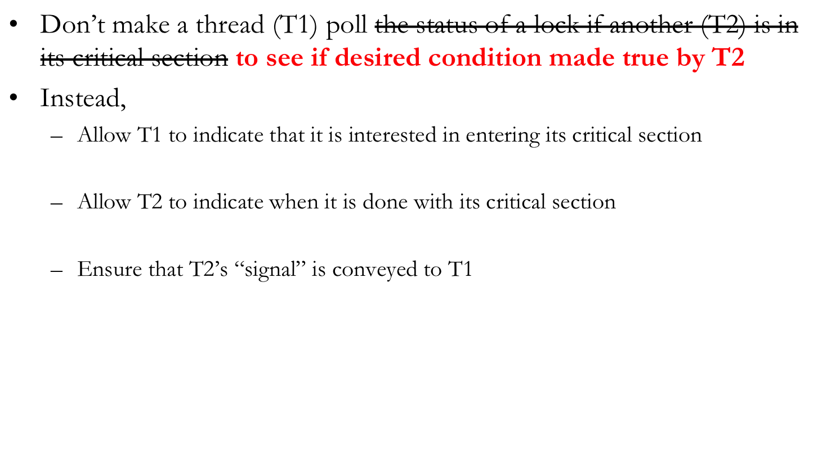
Event Notification: Idea

Slide 42
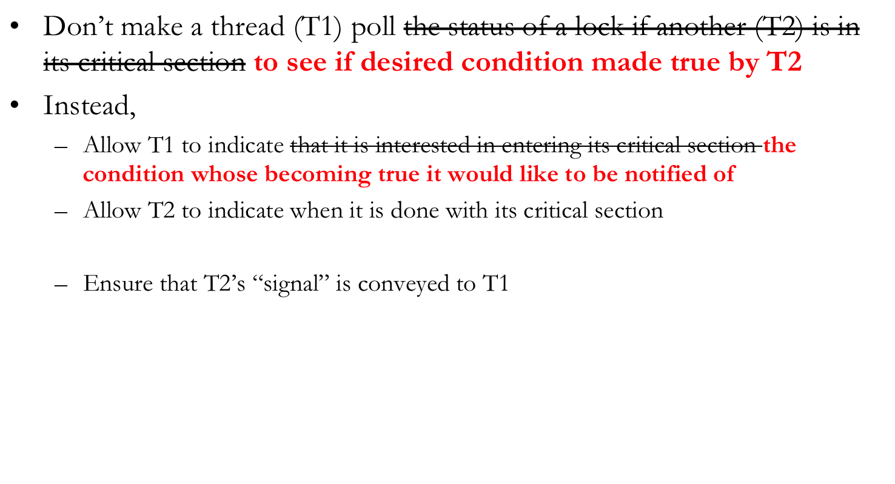
Event Notification: Idea

Slide 43
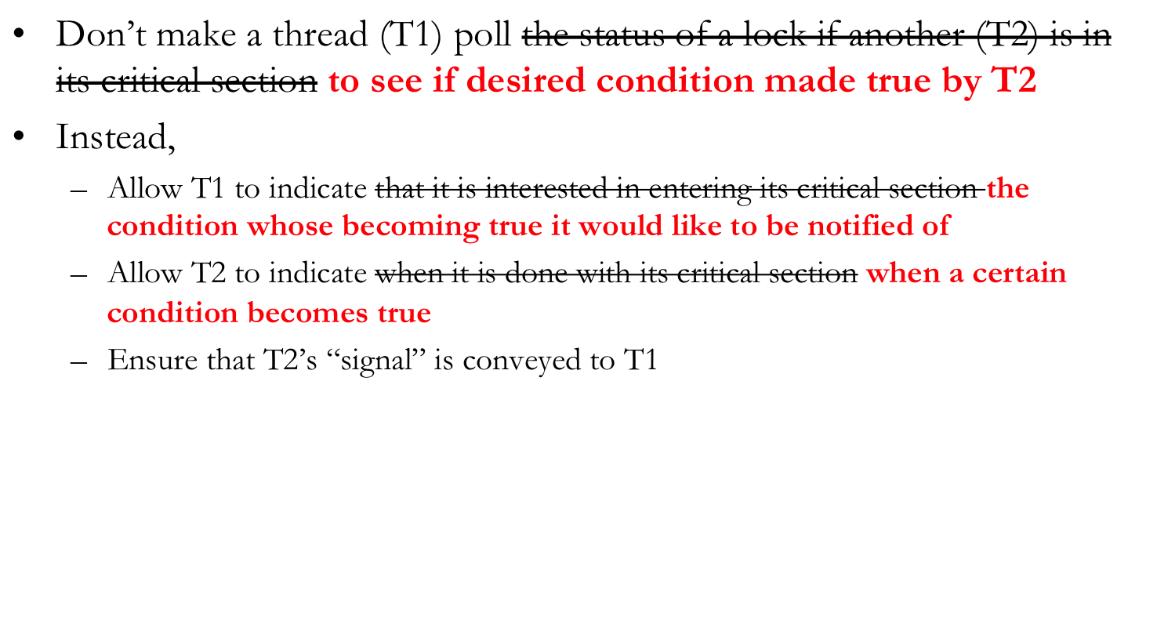
Event Notification: Idea

Slide 44
Condition Variables
Wait operation
  When a thread executes a wait call on a condition variable, it is immediately suspended
    It is now is waiting for the event that is represented by the condition variable to occur
Signal operation
  Eventually, a thread will cause the event to occur after which it will call the signal method on the corresponding condition variable
    If there are threads waiting on the signaled condition variable, the “monitor” will allow one of the waiting threads to resume its execution
    If there is no waiting thread on the signaled condition variable, this signal is lost as if it never occured

Slide 45
E.g. #3: Signaling (CVs )
cond_t a_done;
PROCESS A:
A1 // one or more statements
a // single statement
signal (a_done);
A2 // one or more statements
PROCESS B:
B1 // one or more statements
wait (a_done);
b // single statement
B2 // one or more statements

Slide 46
cond_t not_full, not_empty;
int count == 0;
Produce() {
if (count == N) wait (not_full);
… ADD TO BUFFER, count++ …
signal (not_empty);
}
Consume() {
if (count == 0) wait (not_empty);
… REMOVE FROM BUFFER, count-- …
signal (not_full);
}
What is wrong?
Notes:
The checking of a condition followed by a wait/signal should be done atomically. Note that signals can be lost. Q: Does this problem go away with semaphores?

Slide 47
cond_t not_full, not_empty;
mutex_lock m;
int count == 0;
Produce() {
mutex_lock (m);
if (count == N) wait (not_full,m);
… ADD TO BUFFER, count++ …
signal (not_empty);
mutex_unlock (m);
}
Consume() {
mutex_lock (m);
if (count == 0) wait (not_empty,m);
… REMOVE FROM BUFFER, count-- …
signal (not_full);
mutex_unlock (m);
}
NOTE: You can improve this code for more concurrency!

Slide 48
Busy Wait using Condition Variables
Have we completely eliminated the busy waiting that locks caused?

Slide 49
Busy waiting outside the critical section here, but could be inside a critical section also
Exercise: think of such a scenario on your own)
mutex_lock m;
int count == 0;
Produce() {
while (count == N);
… ADD TO BUFFER …
mutex_lock(m);
count++;
mutex_unlock (m);
}
Consume() {
while (count == 0);
… REMOVE FROM BUFFER …
mutex_lock(m);
count--;
mutex_unlock (m);
}
cond_t not_full, not_empty;
mutex_lock m;
int count == 0;
Produce() {
mutex_lock (m);
if (count == N) wait (not_full,m);
… ADD TO BUFFER, count++ …
signal (not_empty);
mutex_unlock (m);
}
Consume() {
mutex_lock (m);
if (count == 0) wait (not_empty,m);
… REMOVE FROM BUFFER, count-- …
signal (not_full);
mutex_unlock (m);
}

Slide 50
Condition Variables
pthreads functions/data struct
  pthread_cond_t condition = PTHREAD_COND_INITIALIZER; or
  pthread_cont_init (condition, attr)
  pthread_cond_wait (condition, mutex)
  pthread_cond_signal (condition)

Slide 51
When CVs are not adequate
Signal operations on CVs can be “lost”
  If there isn’t a thread doing a wait() when a thread calls signal(), the signal() is forgotten
Sometimes there is a need to remember all signal operations
Semaphores offer such “memory”
  Roughly: Semaphores = Integer + Signal/Wait, where the integer counts #signals - #waits

