Slide 1
Operating Systems
CMPSC 473
Process Synchronization
November 10, 2015 – Lecture 20
Instructor: Diman Zad Tootaghaj
Adapted from slides by Dr. Bhuvan Urgaonkar
http://www.cse.psu.edu/~buu1/

Slide 2
Process Synchronization

Slide 3
Topics
Today
  Semaphores
  Some important/interesting synchronization problems
    Non-solutions and solutions
Next
  Deadlocks
  Lots of practice with synchronization!

Slide 4
Busy waiting outside the critical section here, but could be inside a critical section also
Exercise: think of such a scenario on your own)
mutex_lock m;
int count == 0;
Produce() {
while (count == N);
… ADD TO BUFFER …
mutex_lock(m);
count++;
mutex_unlock (m);
}
Consume() {
while (count == 0);
… REMOVE FROM BUFFER …
mutex_lock(m);
count--;
mutex_unlock (m);
}
cond_t not_full, not_empty;
mutex_lock m;
int count == 0;
Produce() {
mutex_lock (m);
if (count == N) wait (not_full,m);
… ADD TO BUFFER, count++ …
signal (not_empty);
mutex_unlock (m);
}
Consume() {
mutex_lock (m);
if (count == 0) wait (not_empty,m);
… REMOVE FROM BUFFER, count-- …
signal (not_full);
mutex_unlock (m);
}

Slide 5
Condition Variables
pthreads functions/data struct
  pthread_cond_t condition = PTHREAD_COND_INITIALIZER; or
  pthread_cont_init (condition, attr)
  pthread_cond_wait (condition, mutex)
  pthread_cond_signal (condition)

Slide 6
When CVs are not adequate
Signal operations on CVs can be “lost”
  If there isn’t a thread doing a wait() when a thread calls signal(), the signal() is forgotten
Sometimes there is a need to remember all signal operations
Semaphores offer such “memory”
  Roughly: Semaphores = Integer + Signal/Wait, where the integer counts #signals - #waits

Slide 7
E.g. #3: Signaling (CVs )
cond_t a_done;
PROCESS A:
A1 // one or more statements
a // single statement
signal (a_done);
A2 // one or more statements
PROCESS B:
B1 // one or more statements
wait (a_done);
b // single statement
B2 // one or more statements
This solution actually isn’t correct. Can you spot a potential
problem due to a lost signal?
What happens if A executes signal (a_done) before B
executes wait (a_done)?

Slide 8
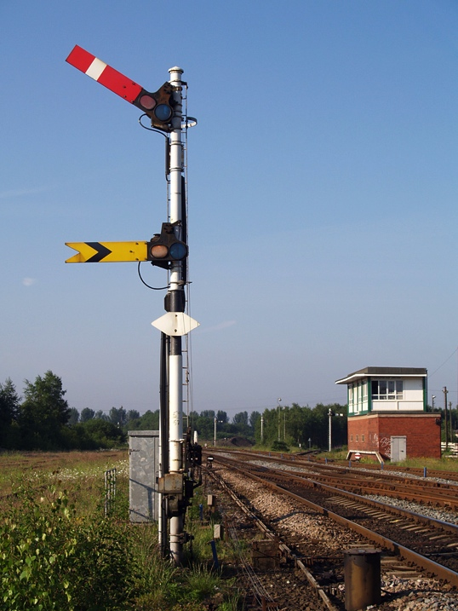
Semaphores (Dijkstra)
ACK: Lot of material borrowed from “The Little Book of Semaphores” by Allen B. Downey
  Available online (free) at:
  http://www.greenteapress.com/semaphores/

Slide 9
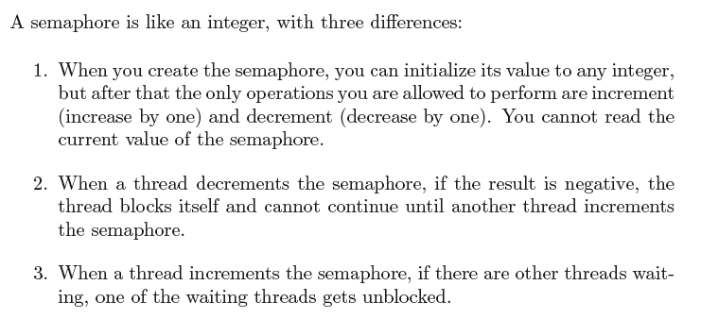
Semaphores Definition (Dijkstra)

Slide 10
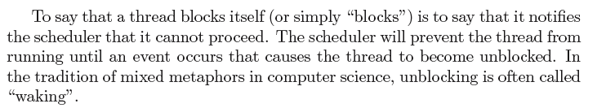
Semaphores Definition (contd.)
Can only be accessed via two indivisible (atomic) operations
  wait (S) { /* also called decrement */
  while S <= 0; // no-op
  S--;
  }
  signal (S) { /* also called increment */
  S++;
  }
Note: Busy waiting in these definitions, we will see how they can be improved to reduce busy waiting
Entry section
Exit section

Slide 11
Semaphore for Mutex
Can only be accessed via two indivisible (atomic) operations
  wait (S) { /* also called decrement */
  while S <= 0; // no-op
  S--;
  }
  signal (S) { /* also called increment */
  S++;
  }
Provides mutual exclusion
  Semaphore S; // initialized to 1
  wait (S);
  Critical Section
  signal (S);

Slide 12
Atomic. To think: how would you use locks to minimize busy wait?
wait (S) {
S--;
if (S < 0) {
add to queue of processes
blocked on this semaphore
block();
}
  }
  signal (S) {
  S++;
  if (S <= 0) {
  remove a process P from que
  add P to to ready queue
  }
wait (S) {
  while S <= 0;
  S--;
  }
  signal (S) {
  S++;
  }

Slide 13
Consequences of the definition
In general, there is no way to know before a thread decrements a semaphore whether it will block
After a thread increments a semaphore and another thread gets woken up, both threads continue running concurrently. There is no way to know which thread, if either, will continue immediately
When you signal a semaphore, you don’t necessarily know whether another thread is waiting, so the number of unblocked threads may be zero or one.

Slide 14
Meaning of Semaphore Values
If the value is +, it represents the number of threads that can decrement without blocking
If the value is -, it represents the number of threads that are blocked and are waiting
If the value is 0, it means there are no threads waiting, but if a thread tries to decrement, it will block

Slide 15
Counting and Binary Semaphores
Counting semaphore – integer value can range over an unrestricted domain
Binary semaphore – integer value can range only between 0 and 1; can be simpler to implement
  Same as mutex locks

Slide 16
Discussion Point
Liveness conditions provided by CVs and semaphores

Slide 17
Discussion Points
Common pitfalls
  Lock before you unlock; Don’t forget to unlock what you locked
  Be very careful when locking inside a while loop
    E.g., consider the producer from before doing
    Question: Why is it OK for the producer to not have the while loop as a critical section?
    mutex_lock(m);
    while (count == N);
    mutex_unlock(m);
    …

Slide 18
Discussion Points
Common pitfalls (2)
  If using multiple locks, acquire them in the same order
PROCESS A:
lock(m1);
lock(m2);
… Critical Section …
unlock(m2);
unlock(m1);
… Remainder Section …
PROCESS B:
lock(m2);
lock(m1);
… Critical Section …
unlock(m1);
unlock(m2);
… Remainder Section …
Possible deadlock here!

Slide 19
Semaphore Usage: Basic Synchronization Patterns
Not just for Mutex but many other purposes!
  Signaling
  Rendezvous
  Mutex
  Multiplex
  Barrier
  Re-usable barrier
  Queues
  FIFO Queue

Slide 20
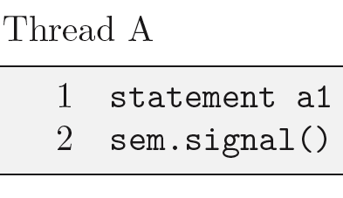
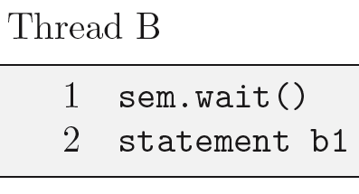
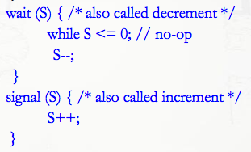
Signaling
Initial value of sem = 0
This ensures a1 executes before
b1
Why?

Slide 21
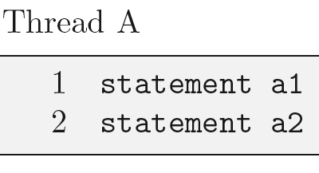
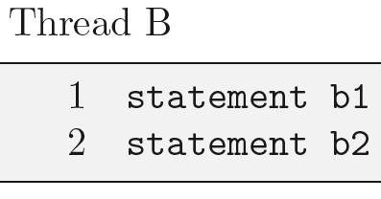
Rendezvous
We want a1 before b2 and b1
before a2
Hint: Create two semaphores
aArrived (indicating A has arrived
at the rendevous) and bArrived
both initialized to 0;

Slide 22
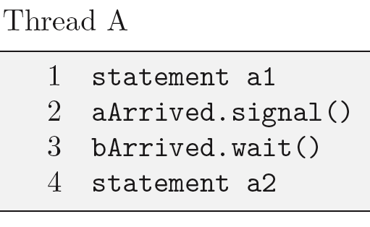
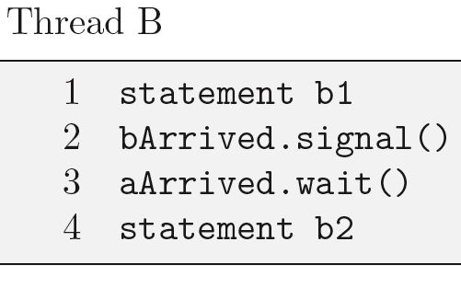
Rendezvous: Solution 1
Initialization:
  aArrived = 0;
  bArrived = 0;

Slide 23
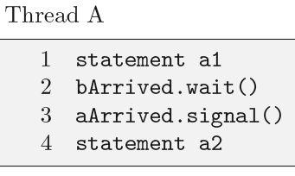
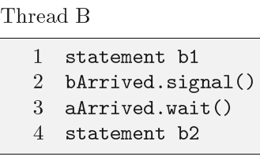
Rendezvous: Solution 2
Initialization:
  aArrived = 0;
  bArrived = 0;

Slide 24
Rendezvous: Solutions 1 and 2 Compared
Initialization:
  aArrived = 0;
  bArrived = 0;
Which is likely more efficient?
Hint: Solution 2 might require one
extra context switch

Slide 25
Multiplex
Initialize semaphore to N >= 1 to allow N threads to concurrently be in their critical sections
N=1 gives you Mutex, of course

Slide 26

Barrier
P1
P2
Pn

Slide 27
What’s wrong?
n = the number of threads
count = 0
mutex = Semaphore(1)
barrier = Semaphore(0)
rendezvous
mutex.wait()
count = count + 1
mutex.signal()
if (count == n)
barrier.signal()
barrier.wait()
critical point
Is this being non-atomic a problem?
Answer: No since count does not change after this!
Only one thread gets past this barrier, all others get stuck waiting

Slide 28
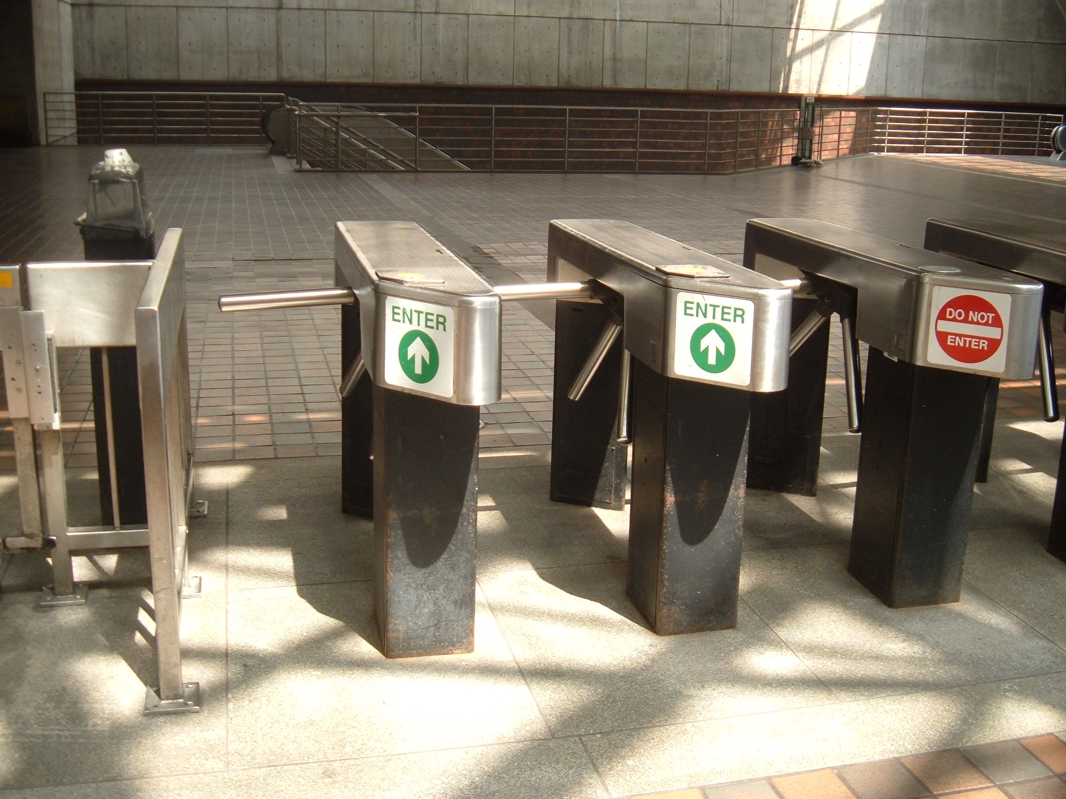
n = the number of threads
count = 0
mutex = Semaphore(1)
barrier = Semaphore(0)
rendezvous
mutex.wait()
count = count + 1
mutex.signal()
if (count == n)
barrier.signal()
barrier.wait()
barrier.signal()
critical point
This is a correct solution

Slide 29
Re-usable Barrier
Often a set of cooperating threads will perform a series of steps in a loop and synchronize at a barrier after each step
For this application we need a reusable barrier that locks itself after all the threads have passed through
Try on your own
  Find solution in “The Little Book of Semaphores”

Slide 30
Important/Classic Synchronization Problems
Please attempt to solve these problems on your own. Then lets discuss these together during the next class or two
  Producer Consumer
  Generalized Producer Consumer
  Readers Writers
  Dining Philosophers
  Dining Savages
  Dentist Clinic

Slide 31
Generalized Producer/Consumer
P >= 1 producers
C >=1 consumers
B slots in the buffer
Ensure no overflow, no underflow, no overwrites, no deadlock, no starvation
Can you ensure bounded wait?

Slide 32
Readers/Writers
R readers, W writers
Share some variables that the writers may update
OK for readers to concurrently read the shared variables. Why?
Not OK for a writer to concurrently update shared variables with another writer or when a reader is accessing
Solution without starvation?
Can we also get bounded wait?

Slide 33
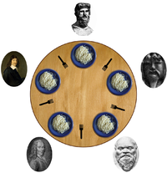
Dining Philosophers
N > 1 philosophers sitting on a circular dining table
N chopsticks, with a pair on either side of each phil.
Each phil. alternates between eating and thinking
When eating, needs both chopsticks
  Left and right chopsticks
Solution without deadlock?
Solution without starvation?
Solution with bounded wait?

Slide 34
Dentist’s Clinic
A dentist’s clinic has a waiting room with n seats and an OR which accommodates 1 patient
Patients that find waiting room full go away
Patients that find a vacant seat occupy it
Patients are served in FCFS order
Dentist goes off to sleep whenever there are no patients and is woken up by first arriving patient
Solve synchronization problem for dentist and patient processes. What liveness properties does your solution have?

