Slide 1
Operating Systems
CMPSC 473
Process Synchronization
November 17, 2015 – Lecture 22
Instructor: Diman Zad Tootaghaj
Adapted from slides by Dr. Bhuvan Urgaonkar
http://www.cse.psu.edu/~buu1/

Slide 2
Process Synchronization

Slide 3
Topics
Today
  Semaphores
  Some important/interesting synchronization problems
    Non-solutions and solutions
  Deadlocks
  Lots of practice with synchronization!

Slide 4
The barbershop problem
A barbershop consists of a waiting room with n chairs, and the barber room containing the barber chair.
If there are no customers to be served, the barber goes to sleep.
If a customer enters the barbershop and all chairs are occupied, then the customer leaves the shop.
If the barber is busy, but chairs are available, then the customer sits in one of the free chairs.
If the barber is asleep, the customer wakes up the barber.

Slide 5

Barbershop solution
Barber shop hint:
If there are n customers in the waiting room and one in the barber chair, then the shop is full and any customer that arrive immediately invoke balk. Otherwise each customer signals customer and waits on barber.

Slide 6
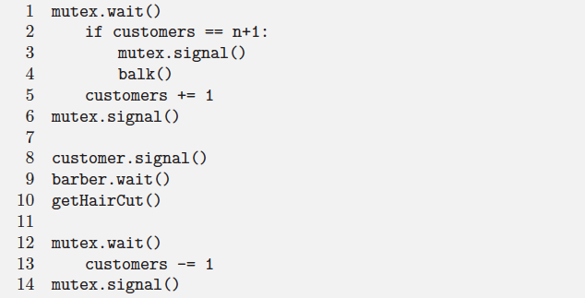
Barbershop solution (customer)

Slide 7

Barbershop solution (barber)
Each time a customer signals, the barber wakes, signals barber, and gives one hair cut.
If another customer arrives while the barber is busy, then in the next iteration the barber will pass the customer semaphore without sleeping

Slide 8
Building H₂O
There are two kinds of threads, oxygen and hydrogen. In order to assemble these threads into water molecules, we have to create a barrier that makes each thread wait until a complete molecule is ready to proceed.
  1: If an oxygen thread arrives at the barrier when no hydrogen threads are present, it has to wait for two hydrogen threads
  2: If a hydrogen thread arrives at the barrier when no other threads are present, it has to wait for an oxygen thread and another hydrogen thread.

Slide 9
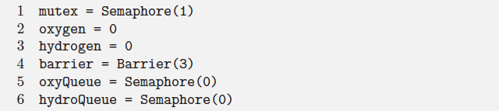
Building H₂O
Water building hint:
Oxyegen, hydrogen: Counters protected by mutex.
Barrier: where each set of 3 threads meet after invoking bond and before allowing the next set of threads to proceed.

Slide 10
Building H₂O
OxyQueue is the semaphore oxygen threads wait on.
HydroQueue is the semaphore hydrogen threads wait on.
OxyQueue.wait(): join the oxygen queue
OxyQueue.signal(): releases an oxygen thread from the queue.

Slide 11
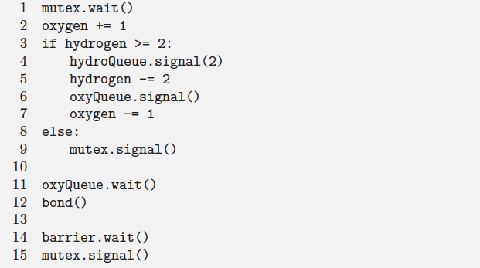
H₂O Solution(Oxygen code)

Slide 12
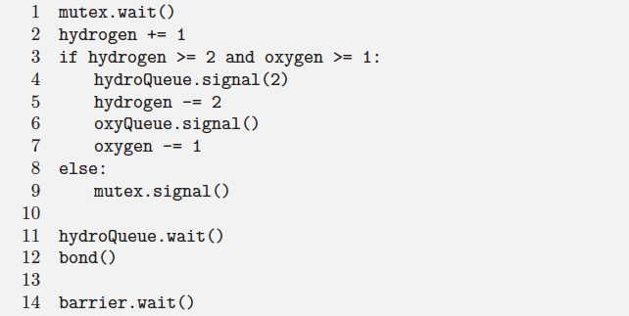
H₂O Solution(hydrogen code)

Slide 13
Deadlocks
A set of blocked processes each holding a resource and waiting to acquire a resource held by another process in the set
Example
  semaphores A and B, initialized to 1
  P₀ P₁
  wait (A); wait(B);
  wait (B); wait(A);
Example
  System has 2 disk drives
  P₁ and P₂ each hold one disk drive and each needs another one

Slide 14
System Model
Resource types R₁, R₂, . . ., R_{m}
    CPU cycles, memory space, I/O devices
Each resource type R_{i} has W_{i} instances.
Each process utilizes a resource as follows:
  request
  use
  release

Slide 15
Deadlock Characterization
Deadlock can arise if four conditions hold simultaneously:
Mutual exclusion: only one process at a time can use a resource
Hold and wait: a process holding at least one resource is waiting to acquire additional resources held by other processes
No preemption: a resource can be released only voluntarily by the process holding it, after that process has completed its task
Circular wait: there exists a set {P₀, P₁, …, P_{n}} of waiting processes such that P₀ is waiting for a resource that is held by P₁, P₁ is waiting for a resource that is held by P₂, …, P_{n–1} is waiting for a resource that is held by P_{n}, and P_{n} is waiting for a resource that is held by P₀.

Slide 16
Revisiting Dining Phil.
Consider a solution to DP which has deadlock and understand the four conditions that hold for this solution.

Slide 17
Resource-Allocation Graph
A set of vertices V and a set of edges E.
V is partitioned into two types:
  P = {P₁, P₂, …, P_{n}}, the set consisting of all the processes in the system
  R = {R₁, R₂, …, R_{m}}, the set consisting of all resource types in the system
request edge – directed edge P_{i} → R_{j}
assignment edge – directed edge R_{j} → P_{i}

Slide 18
Resource-Allocation Graph (Cont.)
Process
Resource Type with 4 instances
P_{i} requests instance of R_{j}
P_{i} is holding an instance of R_{j}
P_{i}
R_{j}
P_{i}
R_{j}

Slide 19

Example of a Resource Allocation Graph

Slide 20

Resource Allocation Graph With A Deadlock

