Slide 1
Operating Systems
CMPSC 473
IO Virtualization
November 19, 2015 – Lecture 23
Instructor: Diman Zad Tootaghaj
Adapted from slides by Dr. Bhuvan Urgaonkar
http://www.cse.psu.edu/~buu1/

Slide 2
Topics, Announcement
Today: IO devices and management: some basic concepts
1 lecture: Hard disk drives
2 lectures: File systems
Online Quiz 4: Will posted on Angel.

Slide 3
The requirements of IO
So far in this course:
  We have learned how to manage CPU, memory
What about I/O?
  Without I/O, computers are useless (disembodied brains?)
  But… thousands of devices, each slightly different
    How can we standardize the interfaces to these devices?
  Devices unreliable: media failures and transmission errors
    How can we make them reliable???
  Devices unpredictable and/or slow
    How can we manage them if we don’t know what they will do or how they will perform?

Slide 4
The requirements of IO
Some operational parameters:
  Byte/Block
    Some devices provide single byte at a time (e.g. keyboard)
    Others provide whole blocks (e.g. disks, networks, etc)
  Sequential/Random
    Some devices must be accessed sequentially (e.g. tape)
    Others can be accessed randomly (e.g. disk, cd, etc.)
  Polling/Interrupts
    Some devices require continual monitoring
    Others generate interrupts when they need service

Slide 5
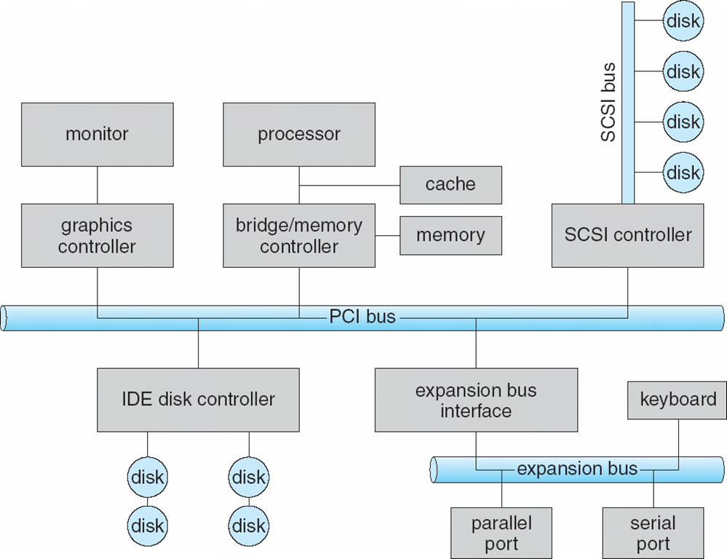
System Architecture
IO devices are diverse and numerous
Hierarchical bus structure connecting IO devices to CPU/memory
Devices span a wide range of “speeds” (relative to CPU/memory)
  Generally faster devices closer to CPU/memory

Slide 6


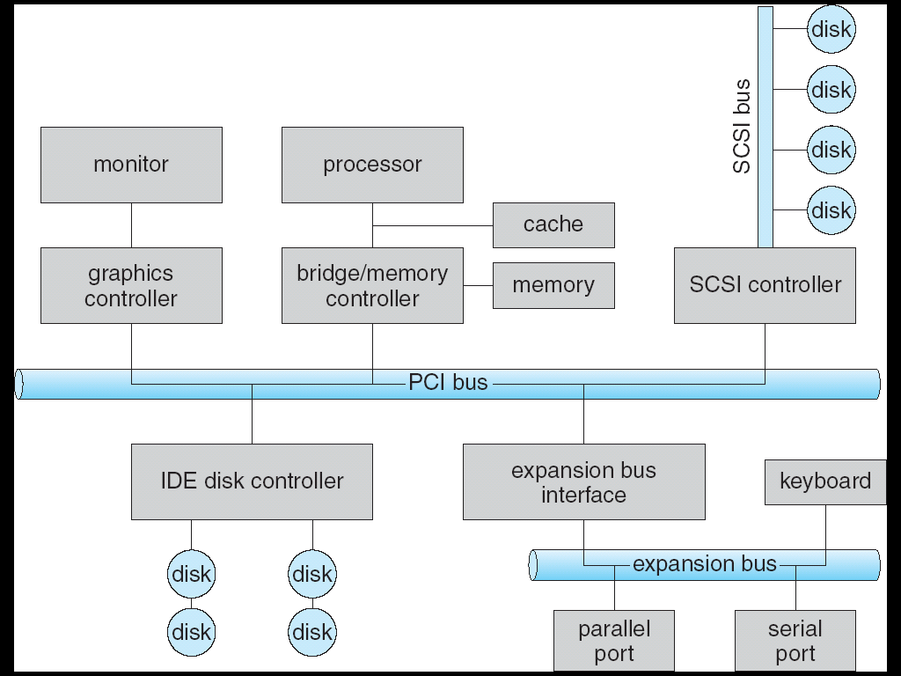
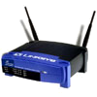
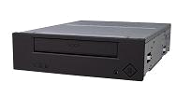
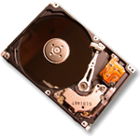

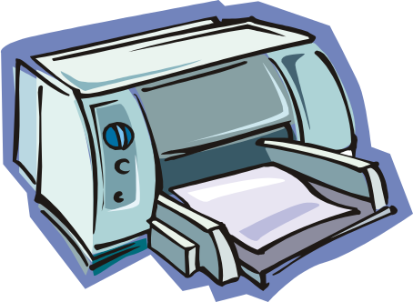


System Architecture

Slide 7
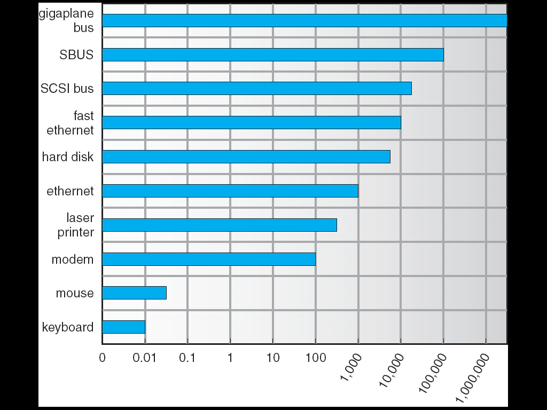
Example Device-Transfer Rates
Device Rates vary over many orders of magnitude
  System better be able to handle this wide range
  Better not have high overhead/byte for fast devices!
  Better not waste time waiting for slow devices

Slide 8
The Goal of the I/O Subsystem
Provide Uniform Interfaces, Despite Wide Range of Different Devices
  This code works on many different devices:
  int fd = open(“/dev/something”);
  for (int i = 0; i < 10; i++) {
  fprintf(fd,”Count %d\n”,i);
  }
  close(fd);
  Why? Because code that controls devices (“device driver”) implements standard interface.
We will try to get a flavor for what is involved in actually controlling devices in rest of lecture
  Can only scratch surface!

Slide 9
Want Standard Interfaces to Devices
Block Devices: e.g. disk drives, tape drives, Cdrom
  Access blocks of data
  Commands include open(), read(), write(), seek()
  Raw I/O or file-system access
  Memory-mapped file access possible
Character Devices: e.g. keyboards, mice, serial ports, some USB devices
  Single characters at a time
  Commands include get(), put()
  Libraries layered on top allow line editing
Network Devices: e.g. Ethernet, Wireless, Bluetooth
  different enough from block/character to have own interface
  Unix and Windows include socket interface
    Separates network protocol from network operation
    Includes select() functionality
  Usage: pipes, FIFOs, streams, queues, mailboxes

Slide 10
How Does User Deal with Timing?
Blocking Interface: “Wait”
  When request data (e.g. read() system call), put process to sleep until data is ready
  When write data (e.g. write() system call), put process to sleep until device is ready for data
Non-blocking Interface: “Don’t Wait”
  Returns quickly from read or write request with count of bytes successfully transferred
  Read may return nothing, write may write nothing
Asynchronous Interface: “Tell Me Later”
  When request data, take pointer to user’s buffer, return immediately; later kernel fills buffer and notifies user
  When send data, take pointer to user’s buffer, return immediately; later kernel takes data and notifies user

Slide 11
Recall: Process view of IO devices
Processes make use of IO devices via the system call interface
  “Advanced” ideas on “user-level” IO management requiring special support from IO devices
  We will focus on the popular design wherein access to IO devices is mediated by OS
Very commonly, a unified file (or similar) abstraction is offered even across disparate IO devices
  Most commonly in UNIX systems
  Alleged benefits in terms of ease of programming, usage, etc. – form your own opinion
It is useful to classify user’s view into:
  Synchronous or blocking – we will be concerned with this, e.g., file system operations
  Asynchronous or non-blocking – e.g., certain forms of networking such as select()
  Note that both are based on event notification by the OS (using signals), certain forms of non-blocking may also have some polling in combination with even notification

Slide 12
IO Devices
Differences
  Data transfer rates
    Range from 0,01 kbytes/sec (keyboard) till 30.000 kbytes/second (graphical screen)
    Disks typically have 500 kbytes/sec (optical) till 2000 kbytes/sec (magnetic)
  Application
    Disk for files or for virtual memory
    Influences disk scheduling and caching strategy
  Complexity
    OS is isolated from most of the complexity by an I/O module (controller)

Slide 13
IO Devices
  Unit of transfer
    Blocks of characters versus streams of characters
  Representation of data
    Coding conventions, parity,…
  Error states
    Kind of errors, reporting modes,…
Need a uniform approach to I/O as seen from the user and from the operating system point of view

Slide 14
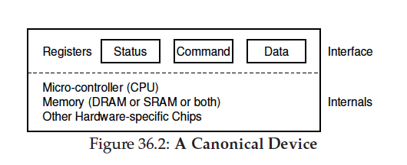
A Canonical Device
Internal structure
  Complex devices have a simple CPU, memory, other chips
    Software running within the device called “firmware”
Hardware interface
  E.g., STATUS, COMMAND, DATA registers that the (main) CPU can read/write

Slide 15
Methods of Device Interaction
Designated IO instructions
  E.g., in and out for the x86 ISA
  Generally privileged – why?
Memory-mapped IO
  Hardware makes device registers available as if they were memory locations
  Loads and stores to these memory locations are routed by hardware to these devices instead of main memory

Slide 16
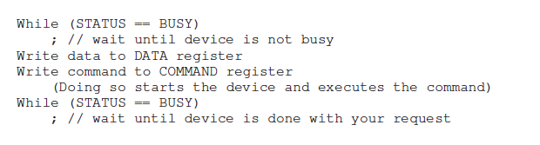
The Canonical Protocol
Programmed IO (PIO), based on “polling”
  Recall spinning used in the implementation of locks
Can be wasteful, two main approaches (possibly used together):
  Event notification (in the form of interrupts)
  Direct Memory Access (DMA) engine

Slide 17

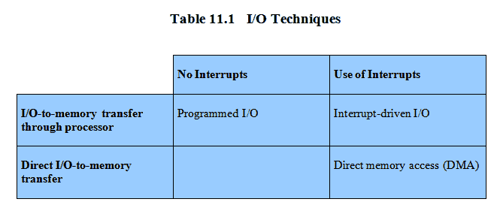
Techniques for Performing I/O

Slide 18
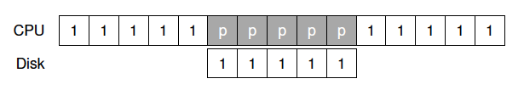
Interrupts
E.g., read some data from a device

Slide 19
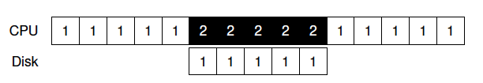
Interrupts
E.g., read some data from a device

Slide 20
Interrupts
E.g., read some data from a device
Improved overlap between IO and CPU => better CPU utilization
High interrupt processing overheads (e.g., in certain DoS attacks)
  Livelock
  Sometimes overheads can be reduced by coalescing interrupts
Sometimes polling IS the right thing to do!
  Recall similar discussion for locks

Slide 21

Direct Memory Access
E.g., writing some data to the disk

Slide 22
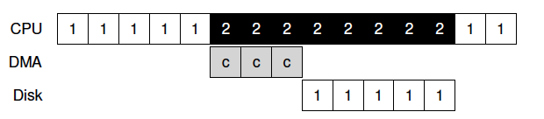
Direct Memory Access
E.g., writing some data to the disk
DMA engine takes care of issuing copying-related commands, and interrupts (main) CPU when finished
Single DMA in older systems, per-device DMA these days
FFT: role of MMU and virtual memory manager

