Slide 1
Operating Systems
CMPSC 473
IO Virtualization,
Magnetic (or Hard) Disk Drives
December 1, 2015 – Lecture 24
Instructor: Diman Zad Tootaghaj
Adapted from slides by Dr. Bhuvan Urgaonkar
http://www.cse.psu.edu/~buu1/

Slide 2
Disks and File Systems
We will focus on certain salient aspects of disk IO management as a case study of IO management
First, lets understand some basics of the IO device itself
Then, we will study an important OS part that manages disks – the file system
  We won’t get into the device driver in this course in any detail

Slide 3

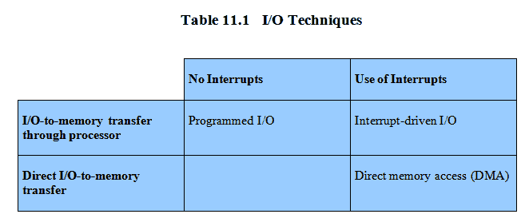
Techniques for Performing I/O

Slide 4
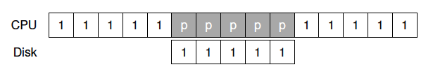
Interrupts
E.g., read some data from a device

Slide 5
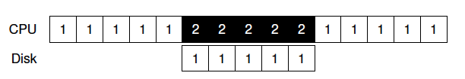
Interrupts
E.g., read some data from a device

Slide 6
Interrupts
E.g., read some data from a device
Improved overlap between IO and CPU => better CPU utilization
High interrupt processing overheads (e.g., in certain DoS attacks)
  Livelock
  Sometimes overheads can be reduced by coalescing interrupts
Sometimes polling IS the right thing to do!
  Recall similar discussion for locks

Slide 7

Direct Memory Access
E.g., writing some data to the disk

Slide 8
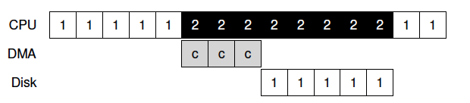
Direct Memory Access
E.g., writing some data to the disk
DMA engine takes care of issuing copying-related commands, and interrupts (main) CPU when finished
Single DMA in older systems, per-device DMA these days
FFT: role of MMU and virtual memory manager

Slide 9
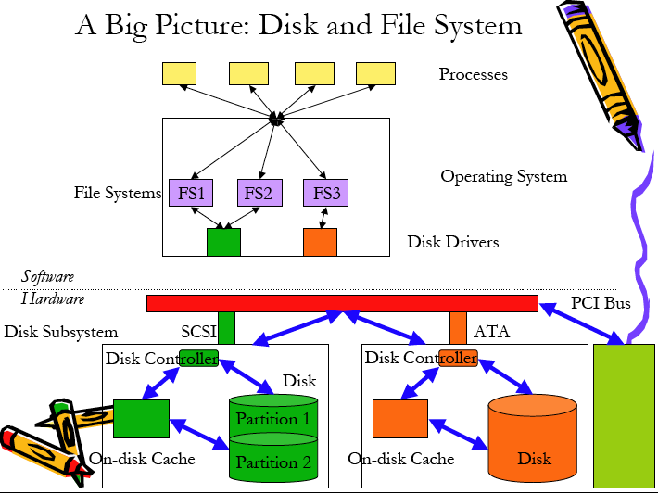
CPU/Memory
Sub-system

Slide 10
Interface
The disk consists of a large number of sectors
  Sector size: 512B
  Numbered 0 to n-1 on a disk with n sectors
  Read or written atomically
  Multi-sector operations need to be made atomic by OS
    File systems typically read/write in units of blocks; each block consists of multiple sectors
    “Torn write”: only a portion of a multi-sector write finishes due to an intervening failure (e.g., power loss)

Slide 11
Magnetic storage medium
Platters made of a hard material such as aluminum, coated with thin layer of ferromagnetic material
Data stored by magnetizing this material, direction of magnetization interpreted as 0 or 1
Persistent medium – data remains even when powered off
If interested in more details: https://www.youtube.com/watch?v=AfmTaOJMoUk

Slide 12

Moving-head Disk Mechanism

Slide 13
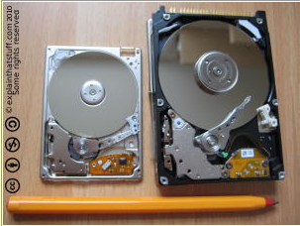

Slide 14
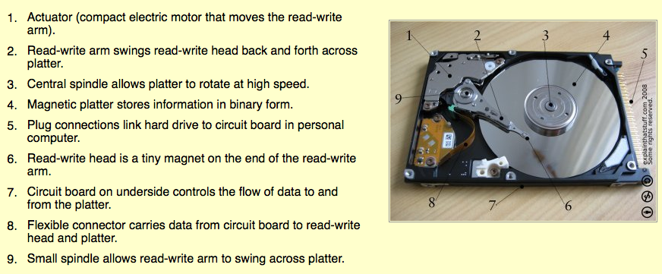

Slide 15
Overview of Mass Storage Structure
Magnetic disks provide bulk of secondary storage of modern computers
Drives rotate at 7200 to 15000 times per minute (RPM)
  120 to 240 times per second
Positioning Time (random-access time)
  Seek time: time to move disk arm to desired cylinder
  Rotational Latency: time for desired sector to rotate under the disk head
Transfer Time: Time to read data
Request service time = Positioning time + Data Transfer Time

Slide 16
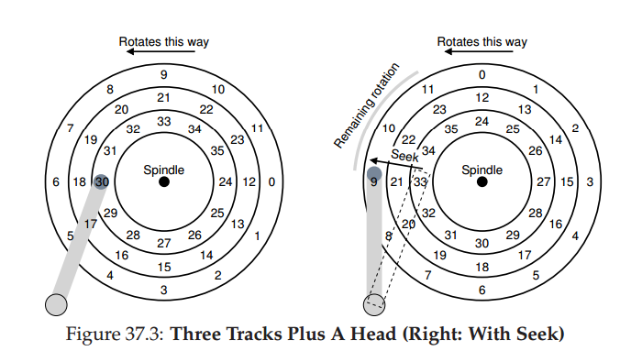
Basic Operation
Seek time
  Acceleration, coasting, deceleration
  Settling time (0.5 to 2 ms)
Rotational latency
Transfer time

Slide 17
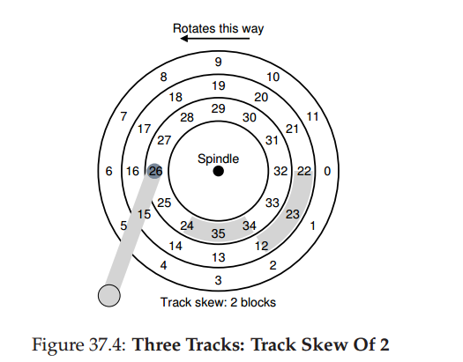
Some Other Details
Track skew
On-disk cache
  8-16 MB
  “Track buffer”
  Write-back vs. write-through
Outer tracks have more sectors than inner tracks
  Multi-zone drives wherein each zone has the same number of sectors/track

Slide 18
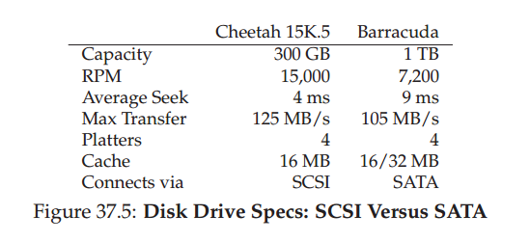
IO Time
A request service time has 3 components
  Seek time + Rotational latency + Transfer time
TTD: go over calculations in OS3 comparing performance for “random” vs “sequential” workloads
Key takeaway: Sequential workloads serviced much faster than random workloads

Slide 19
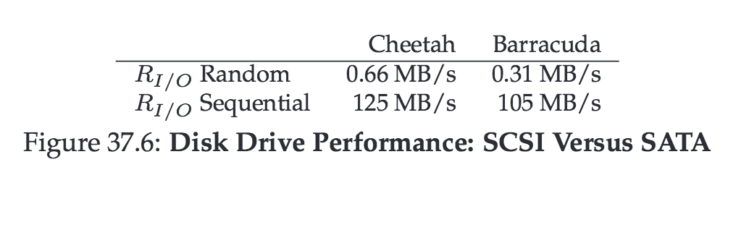
IO Time

Slide 20
Access Latencies
SECONDARY STORAGE
FLASH HDD
MAIN MEMORY
DRAM PCM
LAST-LEVEL
CACHE
EDRAM
L1 CACHE
SRAM
2¹
2³
2⁵
2⁷
2⁹
2¹¹
2¹³
2¹⁵
2¹⁷
2¹⁹
2²¹
2²³

Slide 21
Disk Scheduling
Ordering of requests issued to disk
  In controller: order requests executed by disk arm
  Important: Done at multiple places in s/w as well
    E.g., Device driver may order requests sent to controller
Typical goal: Minimize seek time (our focus)
  Seek time dependent on seek distance
More advanced
  Incorporate rotational latency as well
  Incorporate notions of fairness

Slide 22
Disk Scheduling (Cont.)
Several algorithms exist to schedule servicing of disk I/O requests.
We illustrate them with a request queue (0-199).
98, 183, 37, 122, 14, 124, 65, 67
Head pointer 53

Slide 23

FCFS
Illustration shows total head movement of 640 cylinders.

Slide 24
SSTF
Selects the request with the minimum seek time from the current head position.
SSTF scheduling is a form of SJF scheduling; may cause starvation of some requests.
Illustration shows total head movement of 236 cylinders.

Slide 25

SSTF (Cont.)

Slide 26
SCAN
The disk arm starts at one end of the disk, and moves toward the other end, servicing requests until it gets to the other end of the disk, where the head movement is reversed and servicing continues.
Sometimes called the elevator algorithm.
Illustration shows total head movement of 236 cylinders.

Slide 27

SCAN (Cont.)

Slide 28
C-SCAN
Provides a more uniform wait time than SCAN.
The head moves from one end of the disk to the other. servicing requests as it goes. When it reaches the other end, however, it immediately returns to the beginning of the disk, without servicing any requests on the return trip.
Treats the cylinders as a circular list that wraps around from the last cylinder to the first one.

Slide 29

C-SCAN (Cont.)

Slide 30
C-LOOK
Version of C-SCAN
Arm only goes as far as the last request in each direction, then reverses direction immediately, without first going all the way to the end of the disk.

Slide 31

C-LOOK (Cont.)

Slide 32
Disk properties and implications for file system design
Significantly slower than CPU/memory
  Caching crucial for read performance
  Buffering crucial for speed mismatch when writing
Large, contiguous data xfers preferable
  Use pre-fetching if it helps
  Coalesce requests in buffers
  Reorder them to improve “sequentiality”

