Slide 1
Operating Systems
CMPSC 473
I/O Management (3) – Disks and File Systems
December 3, 2015 – Lecture 25
Instructor: Diman Zad Tootaghaj
Adapted from slides by Dr. Bhuvan Urgaonkar
http://www.cse.psu.edu/~buu1/

Slide 2
Announcement
Friday: Office hours 10:00AM-12:00 is re-scheduled to Monday December 7, 10:00AM-12:00
Online Quiz 4: Due: Friday night (December 4).
Last Quiz: #5 (Disk scheduling) TBA

Slide 3
Disk Scheduling
Ordering of requests issued to disk
  In controller: order requests executed by disk arm
  Important: Done at multiple places in s/w as well
    E.g., Device driver may order requests sent to controller
Typical goal: Minimize seek time (our focus)
  Seek time dependent on seek distance
More advanced
  Incorporate rotational latency as well
  Incorporate notions of fairness

Slide 4
Disk Scheduling (Cont.)
Several algorithms exist to schedule servicing of disk I/O requests.
We illustrate them with a request queue (0-199).
98, 183, 37, 122, 14, 124, 65, 67
Head pointer 53

Slide 5

FCFS
Illustration shows total head movement of 640 cylinders.

Slide 6
SSTF
Selects the request with the minimum seek time from the current head position.
SSTF scheduling is a form of SJF scheduling; may cause starvation of some requests.
Illustration shows total head movement of 236 cylinders.

Slide 7

SSTF (Cont.)

Slide 8
SCAN
The disk arm starts at one end of the disk, and moves toward the other end, servicing requests until it gets to the other end of the disk, where the head movement is reversed and servicing continues.
Sometimes called the elevator algorithm.
Illustration shows total head movement of 236 cylinders.

Slide 9

SCAN (Cont.)

Slide 10
C-SCAN
Provides a more uniform wait time than SCAN.
The head moves from one end of the disk to the other. servicing requests as it goes. When it reaches the other end, however, it immediately returns to the beginning of the disk, without servicing any requests on the return trip.
Treats the cylinders as a circular list that wraps around from the last cylinder to the first one.

Slide 11

C-SCAN (Cont.)

Slide 12
C-LOOK
Version of C-SCAN
Arm only goes as far as the last request in each direction, then reverses direction immediately, without first going all the way to the end of the disk.

Slide 13

C-LOOK (Cont.)

Slide 14
Disk properties and implications for file system design
Significantly slower than CPU/memory
  Caching crucial for read performance
  Buffering crucial for speed mismatch when writing
Large, contiguous data xfers preferable
  Use pre-fetching if it helps
  Coalesce requests in buffers
  Reorder them to improve “sequentiality”

Slide 15
Disk properties and implications on Storage HW
Significantly slower than CPU/memory and seek latency high
  RAID: Array/Group of multiple disks
  A salient example of academic research leading to a billion dollar industry (many more!)

Slide 16
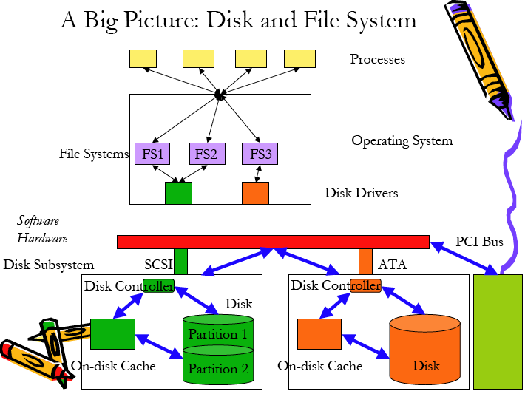
CPU/Memory
Sub-system

Slide 17
File and Directory
Virtualization of storage:
  File: simply a linear array of bytes, each of which you can read or write.
  Directory: contains a list of (user-readable name, low-level name) pairs.

Slide 18
File Attributes
Name: only information kept in human-readable form
Identifier: Unique tag (number) identifies file within file system.
Type: Needed for systems that support different types
Location: pointer to file location on device
Size: Current file size
Protection: Controls who can do reading, writing, executing
Time, data and user identification: data for protection, security and usage monitoring.
Information about files are kept in the directory structure.

Slide 19
File Naming
Motivation: Files abstract information stored on disk
  You do not need to remember block, sector, …
  We have human readable names
How does it work?
  Process creates a file, and gives it a name
    Other processes can access the file by that name
  Naming conventions are OS dependent
    Usually names as long as 255 characters is allowed
    Digits and special characters are sometimes allowed

Slide 20
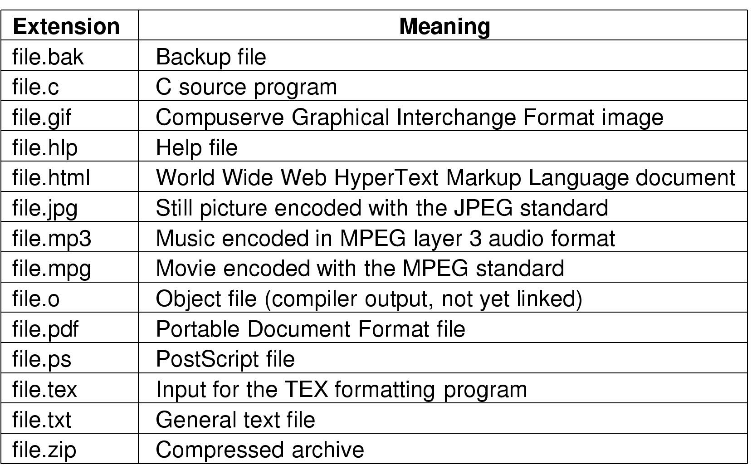
File Naming
Typical file extensions.

Slide 21
File Extensions
Name divided into 2 parts, second part is the extension
On UNIX, extensions are not enforced by OS
  However C compiler might insist on its extensions
    These extensions are very useful for C
Windows attaches meaning to extensions
  Tries to associate applications to file extensions

Slide 22
File-System Goals
Provide the useful abstraction of a file (a logical data store)
Provide fast access to stored data
Store data reliably (e.g., by replication or using error correction)
  Disk itself also uses internal error correction, RAID uses replication and or error correction

Slide 23
File-System Structure
File structure
  Logical storage unit
  Collection of related information
File system resides on secondary storage (disks)
File system organized into layers
File control block – storage structure consisting of information about a file

Slide 24
Basic File System Operations
Create a file
Write to a file
Read from a file
Seek to somewhere in a file
Delete a file
Truncate a file

Slide 25

FS on disk
Could use entire disk space for a FS, but
  A system could have multiple FSes
  Want to use some disk space for swap space
Disk divided into partitions, slices or minidisks
  Chunk of storage that holds a FS is a volume
  Directory structure maintains info of all files in the volume
    Name, location, size, type, …

Slide 26
Directories
Directories/folders keep track of files
  Is a symbol table that translates file names to directory entries
  Usually are themselves files
How to structure the directory to optimize all of the following:
  Search a file
  Create a file
  Delete a file
  List directory
  Rename a file
  Traversing the FS
Directory
Files
F 1
F 2
F 3
F 4
F n

Slide 27

Single-level Directory
One directory for all files in the volume
  Called root directory
  Used in early PCs, even the first supercomputer CDC 6600
Pros: simplicity, ability to quickly locate files
Cons: inconvenient naming (uniqueness, remembering all)

Slide 28

Two-level directory
Each user has a separate directory
Solves name collision, but what if user has lots of files
May not allow a user to access other users’ files

Slide 29

Tree-structured Directory
Directory is now a tree of arbitrary height
  Directory contains files and subdirectories
  A bit in directory entry differentiates files from subdirectories

Slide 30
Path Names
To access a file, the user should either:
  Go to the directory where file resides, or
  Specify the path where the file is
Path names are either absolute or relative
  Absolute: path of file from the root directory
  Relative: path from the current working directory
Most OSes have two special entries in each directory:
  “.” for current directory and “..” for parent

Slide 31
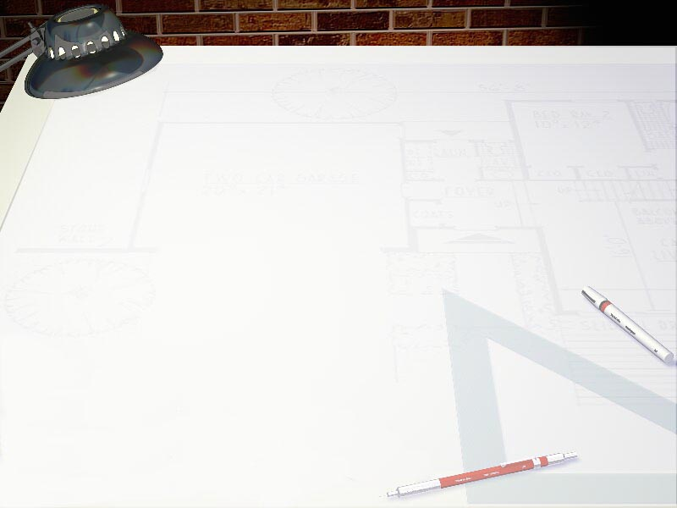
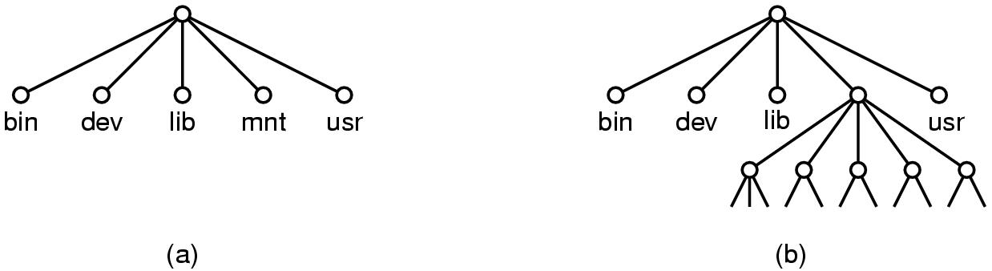
File System Mounting
Mount allows two FSes to be merged into one
  For example you insert your floppy into the root FS
mount(“/dev/fd0”, “/mnt”, 0)

Slide 32
Remote file system mounting
Same idea, but file system is actually on some other machine
Implementation uses remote procedure call
  Package up the user’s file system operation
  Send it to the remote machine where it gets executed like a local request
  Send back the answer
Very common in modern systems

Slide 33
File Protection
File owner/creator should be able to control:
  what can be done
  by whom
Types of access
  Read
  Write
  Execute
  Append
  Delete
  List

Slide 34
File System Implementation
How exactly are file systems implemented?
  Comes down to: how do we represent
    Volumes/partitions
    Directories (link file names to file “structure”)
    The list of blocks containing the data
    Other information such as access control list or permissions, owner, time of access, etc?
  And, can we be smart about layout?

Slide 35
Implementing File Operations
Create a file:
  Find space in the file system, add directory entry.
Writing in a file:
  System call specifying name & information to be written. Given name, system searches directory structure to find file. System keeps write pointer to the location where next write occurs, updating as writes are performed
Reading a file:
  System call specifying name of file & where in memory to stick contents. Name is used to find file, and a read pointer is kept to point to next read position. (can combine write & read to current file position pointer)
Repositioning within a file:
  Directory searched for appropriate entry & current file position pointer is updated (also called a file seek)

Slide 36
Implementing File Operations
Deleting a file:
  Search directory entry for named file, release associated file space and erase directory entry
Truncating a file:
  Keep attributes the same, but reset file size to 0, and reclaim file space.

Slide 37
Other file operations
Most FS require an open() system call before using a file.
OS keeps an in-memory table of open files, so when reading a writing is requested, they refer to entries in this table.
On finishing with a file, a close() system call is necessary. (creating & deleting files typically works on closed files)
What happens when multiple files can open the file at the same time?

Slide 38
Multiple users of a file
OS typically keeps two levels of internal tables:
Per-process table
  Information about the use of the file by the user (e.g. current file position pointer)
System wide table
  Gets created by first process which opens the file
  Location of file on disk
  Access dates
  File size
  Count of how many processes have the file open (used for deletion)

Slide 39
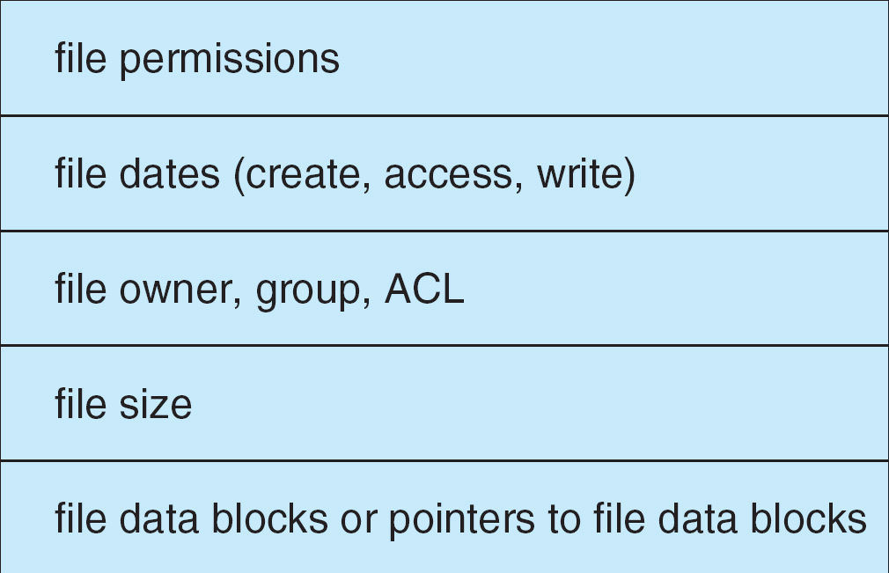
A Typical File Control Block

Slide 40

In-Memory FS Structures
Opening a file
Reading a file

Slide 41
Virtual File Systems
Virtual File Systems (VFS) provide an object-oriented way of implementing file systems.
VFS allows the same system call interface (the API) to be used for different types of file systems.
The API is to the VFS interface, rather than any specific type of file system.

Slide 42

Schematic View of Virtual File System

