Slide 1
Operating Systems
CMPSC 473
Recap of Some Basics
CPU Management (Processes)
September 3, 2015 – Lecture 4
Instructor: Diman Zad Tootaghaj
Adapted from slides by Dr. Bhuvan Urgaonkar
http://www.cse.psu.edu/~buu1/

Slide 2
Recap of Basics
Key to OS acting as a control program and a resource controller are following CPU/memory facilities
  #1: Multiple CPU modes and privileged instructions
  #2: The notion of traps (part of CPU design)
    Related concepts: Interrupts and signals
  #3: Memory address translation and protection facilities (hardware called memory controller)
    Related: Translation Lookaside Buffer (TLB)

Slide 3
Memory Protection and Translation
Key Idea #3: Virtual vs. Physical addresses
Multiple processes and the OS can generate the same virtual address
Need to translate to different physical addresses for protection
Done by a piece of hardware called the memory controller
Where are address translations kept?

Slide 4
Memory Protection and Translation
Address translations kept in memory in data structures called page tables
A subset of translations stored in a fast on-CPU cache called Translation Lookaside Buffer (TLB)
Memory Controller, TLB, and OS cooperate to keep correct translations

Slide 5
CPU Management

Slide 6
CPU Mgmt: What we will study
What is the OS’s role in sharing CPU among user programs?
What does a user program expect from the computer and how does the OS help provide this?

Slide 7
Process
Roughly, a running program
  Check out info offered by top, /proc, etc.
A closer look:
A process is different than a program
  Program: Static code and static data
  Process: Dynamic instance of code and data
  No one-to-one mapping between programs and processes
  Can have multiple processes of the same program Example: many users can run “ls” at the same time.
  One program can invoke multiple processes Example: “make” runs many processes to accomplish its work

Slide 8
Process
The canonical virtualized CPU created by the OS for a program
Roughly, a running program
Revise:
  fork(), wait(), exec(), kill()
    Chapter 5 of OS3
    http://pages.cs.wisc.edu/~remzi/OSTEP/
  Info on processes running on your computer
    Task manager, top, /proc, etc.

Slide 9
Process Address Space
0xffffffff
stack
addresses
heap
data
code
0x00000000

Slide 10
Address Space
Address Space (AS): all memory a process can address
  Really large memory to use
  Linear array of bytes: [0, N), N roughly 2^32, 2^64
Process -> address space: 1 : 1 mapping

Slide 11
Address Space
Address space = protection domain
  OS isolates address spaces
  One process can’t access another’s address space
  Same pointer address in different processes point to different memory

Slide 12




Slide 13
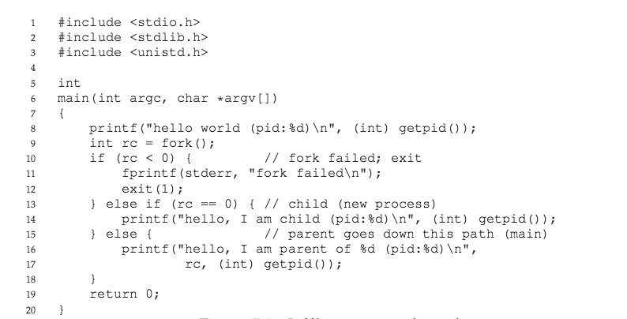
Fork System Call

Slide 14
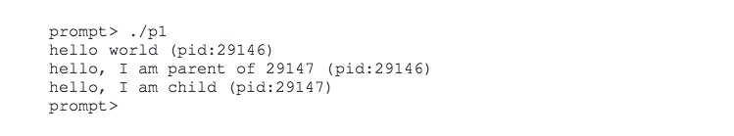
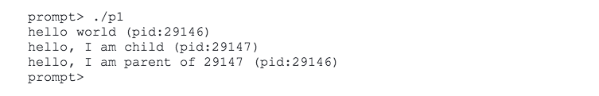
Fork System Call

Slide 15
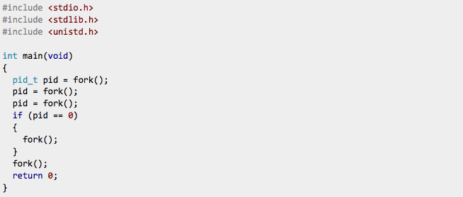
Question
How many processes are created with these fork statements?

Slide 16
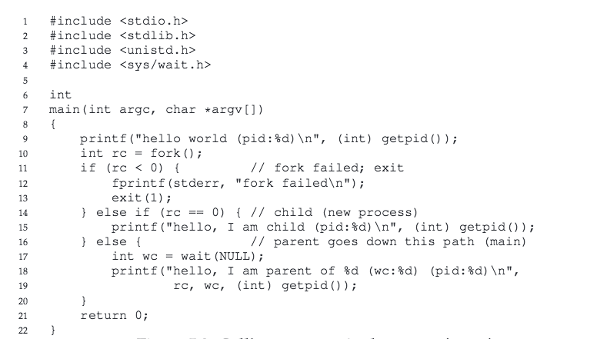
Wait System Call

Slide 17
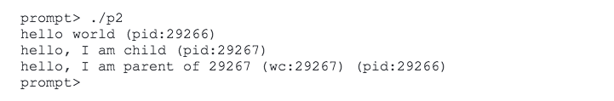
Wait System Call

Slide 18
Exec system Call
Fork is only useful if you want to keep running copies of the same program.
Exec: if you want to run a different program

Slide 19
Next: How Does the OS Help Multiple Processes Share the Same CPU?

