Slide 1
Operating Systems
CMPSC 473
Recap of Some Basics
CPU Management (Processes)
September 8, 2015 – Lecture 5
Instructor: Diman Zad Tootaghaj
Adapted from slides by Dr. Bhuvan Urgaonkar
http://www.cse.psu.edu/~buu1/

Slide 2
Recap of Basics
Key to OS acting as a control program and a resource controller are following CPU/memory facilities
  #1: Multiple CPU modes and privileged instructions
  #2: The notion of traps (part of CPU design)
    Related concepts: Interrupts and signals
  #3: Memory address translation and protection facilities (hardware called memory controller)
    Related: Translation Lookaside Buffer (TLB)

Slide 3
Memory Protection and Translation
Key Idea #3: Virtual vs. Physical addresses
Multiple processes and the OS can generate the same virtual address
Need to translate to different physical addresses for protection
Done by a piece of hardware called the memory controller
Where are address translations kept?

Slide 4
Memory Protection and Translation
Address translations kept in memory in data structures called page tables
A subset of translations stored in a fast on-CPU cache called Translation Lookaside Buffer (TLB)
Memory Controller, TLB, and OS cooperate to keep correct translations

Slide 5
CPU Management

Slide 6
CPU Mgmt: What we will study
What is the OS’s role in sharing CPU among user programs?
What does a user program expect from the computer and how does the OS help provide this?

Slide 7
Process
Roughly, a running program
  Check out info offered by top, /proc, etc.
A closer look:
A process is different than a program
  Program: Static code and static data
  Process: Dynamic instance of code and data
  No one-to-one mapping between programs and processes
  Can have multiple processes of the same program Example: many users can run “ls” at the same time.
  One program can invoke multiple processes Example: “make” runs many processes to accomplish its work

Slide 8
Process
The canonical virtualized CPU created by the OS for a program
Roughly, a running program
Revise:
  fork(), wait(), exec(), kill()
    Chapter 5 of OS3
    http://pages.cs.wisc.edu/~remzi/OSTEP/
  Info on processes running on your computer
    Task manager, top, /proc, etc.

Slide 9
Process Address Space
0xffffffff
stack
addresses
heap
data
code
0x00000000

Slide 10




Slide 11
Example
Int c[10];
Int *a;
Void foo(){}
Main{
  Int *b;
  b= c;
  a = malloc(10);
  free(a);
  foo();
  }

Slide 12
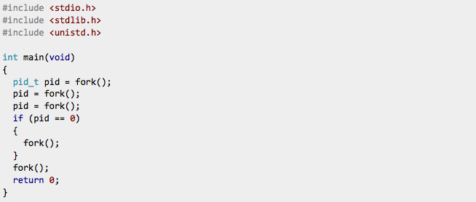
Question
How many processes are created with these fork statements?

Slide 13
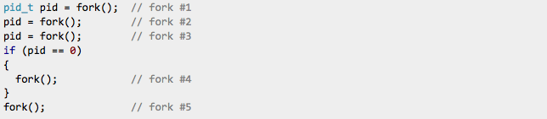
Question
Fork #1 -> two processes.
Fork #2 -> four processes.
Fork #3 -> eight processes.
  Half of those have pid==0 and half have pid != 0
Fork #4 -> 12 processes.
Fork #5 -> 24 processes.

Slide 14
Quiz
1- What is an operating system?
2- What are the three approaches for sharing related problems in a computer system? and make an example for each.
3- Suppose we have 3 programs (a web browser, a music player and an email client) which have n1, n2, and n3 instructions respectively. How many interleaving of these instructions is possible?
4- What is the 2 differences between an interrupt and a trap?

Slide 15
How Does the OS Help Multiple Processes Share the Same CPU?

Slide 16
Last class
Q1: how to ensure a process doesn’t do something “undesirable” when it is running on the CPU?
  Dual CPU mode and traps
  System calls also based on raising a trap
Q2: how to ensure the OS gets to run on the CPU every now and then?
  Interrupts
    E.g., a timer interrupt set by the OS at boot up lets the OS run periodically

Slide 17
Trap Handling: In More Detail
<board>
  Based on Table 6.2 of OS3
To try on your own:
  Work through a similar example for interrupt handling
  Finish the timeline with associated signal delivery by OS to process followed by process handling the signal
    More details on OS role in creating signals and helping process handle them coming up later

Slide 18
Next
Q3: how to ensure a process taken off the CPU executes correctly when it resumes execution on the CPU?
Q4: how does the OS decide which process should run when?
  CPU scheduler

Slide 19
E.g., Two processes on a CPU
Lets consider (only) two processes A and B that are running on the same CPU
Let us look closely at some illuminating events in such a system

Slide 20
T1
T2
Time
A
OS
B
OS
A
How does the OS get
to start running here?
Recall: user->privileged mode occurs only when a trap is raised or an interrupt occurs
Can’t rely on traps – why?

Slide 21
The Role of Interrupts
There must be an interrupt mechanism via which the OS gets a chance to run on the CPU every so often
  A timer interrupt that periodically lets the OS run, typically, once every few milliseconds

Slide 22
T1
T2
Time
A
OS
B
OS
A
How does the OS decide
which process to run next?
Done by the CPU scheduler within the OS
Will study later

Slide 23
T1
T2
Time
A
OS
B
OS
A
Q3: how do we ensure that
A resumes execution at T2
as if it had not been
taken off the CPU at T1?
By ensuring that we save the entire “state” of A at T1 and can resume it from this state at T2
state(A, T1) == state(A, T2)
What does the state of A at T1 consist of?

Slide 24
State of A at time T1 (1)
#1: Contents of A’s address space
  What the code, data, heap, and stack contained at T1

Slide 25
Contents of A’s Address Space
0xFFFFFFFF
00000111111……………………0000000000
stack
1111000………………………………………………..011000
virtual addresses
heap
001………..001
data
0110……………………………………….00
code
0x00000000

Slide 26
State of A at time T1 (1)
#1: Contents of A’s address space
  What the code, data, heap, and stack contained at T1
Q: Where do these contents reside at time T1?
  In a portion of main memory set aside for A
  We rely on memory manager to ensure they remain unchanged by other processes during [T1, T2]
    More details when we study virtual memory management

Slide 27
State of A at time T1 (2)
#2: Layout of A’s address space
  The address ranges the code, data, heap, stack span

Slide 28
Layout of Address Space
0xFFFFFFFF
stack
virtual addresses
heap
data
code
0x00000000

Slide 29
State of A at time T1 (2)
Layout of A’s address space
  The address ranges the code, data, heap, stack span
Q: Where are these address ranges stored?
  Somewhere in memory
  In whose address space? Again, A’s address space is a valid choice

Slide 30
State of A at time T1 (2)
Layout of A’s address space
  The address ranges the code, data, heap, stack span
Q: Where are these address ranges stored?
  Somewhere in memory
  In whose address space? Lets say A’s own address space for now (e.g., its heap or data segment)
  OS will need to maintain at least one address, say where A’s address space begins in main memory

Slide 31
State of A at time T1 (3)
#4: IO resources being used by the process
  E.g., open files, network sockets, etc.
Information held by the OS in its own address space

Slide 32
State of A at time T1 (4)
Anything else?
Hint: Suppose A’s instruction executed just before and after T1 are:
  Load R1, 100
  Add R1, R2, R3
T1
T2
Time
A
OS
B
OS
A

Slide 33
State of A at time T1 (4)
#3: All the register values at time T1 need to be saved in main memory and restored at time T2
Called the hardware context of process A
Typically, the hardware context also has information about address space layout
  E.g., Stack Pointer Register (SP)
  E.g., Program Counter (PC)

Slide 34
State of A at time T1 (4)
#3: All the register values at time T1 need to be saved in main memory and restored at time T2
Called the hardware context of process A
Typically, the hardware context also has information about address space layout
  E.g., Stack Pointer Register
  Why does the CPU provide this facility?
    Because registers are accessed much faster than memory

Slide 35
Process Control Block (PCB)
A data structure in the operating system’s address space where it maintains a variety of information about the process
  Example we learnt today: Values held in various registers when the process was context switched out

Slide 36
Context Switch
Involuntary/Voluntary
Process 0
Process 1
Context_switch() {
}
A1
B1
A2
B2
B3
B4

Slide 37
context_switch() {
push R0, R1, … // save regs on its stack
PCB[curr].SP = SP // save stack pointer
PCB[curr].PT = PT // save ptr(s) to address space
next = schedule() // find next process to run
PT = PCB[next].PT
SP = PCB[next].SP
pop Rn, … R0
return // NOTE: Ctrl returns to another process
}

Slide 38
Overheads of Process Switch
Direct
  “Wasted” instructions of outgoing process
  The time spent switching context
Indirect
  Cache pollution
  TLB flush

Slide 39
Thank you!

